Slide 1
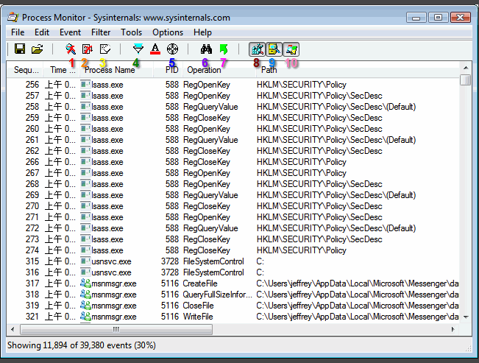
Process Monitor
A
B
C
D

