Slide 1
Lab 4
Savin Ghaderi
October 1, 2018

Slide 2
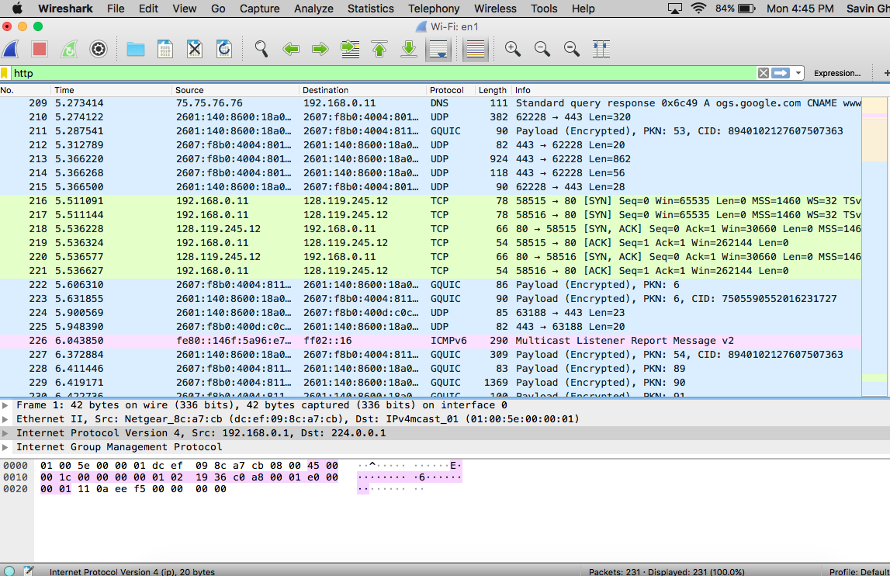
1

Slide 3
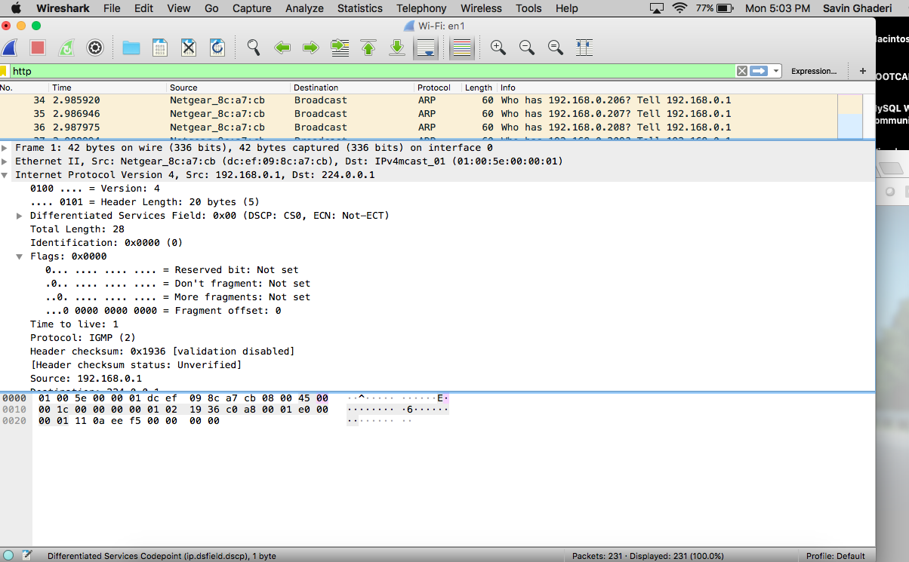
3

Slide 4
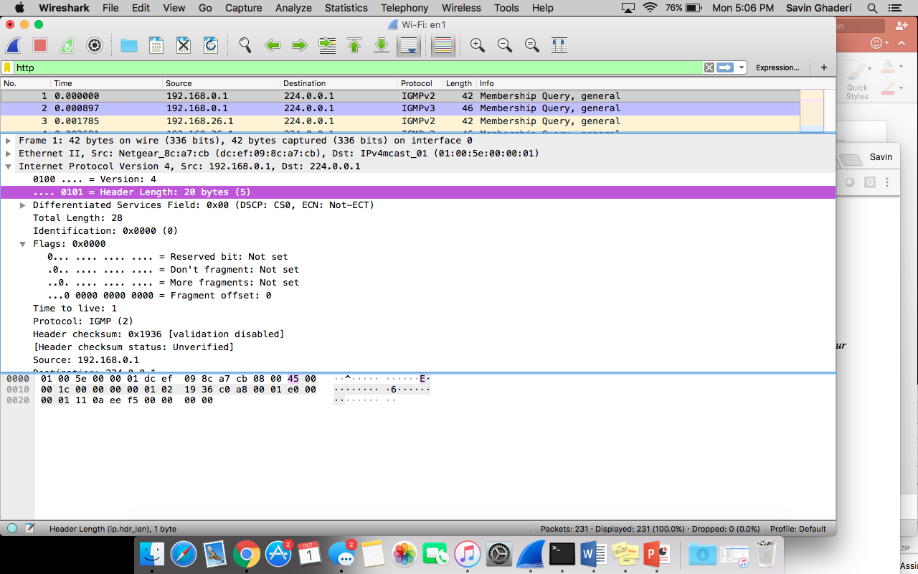
4

Slide 5
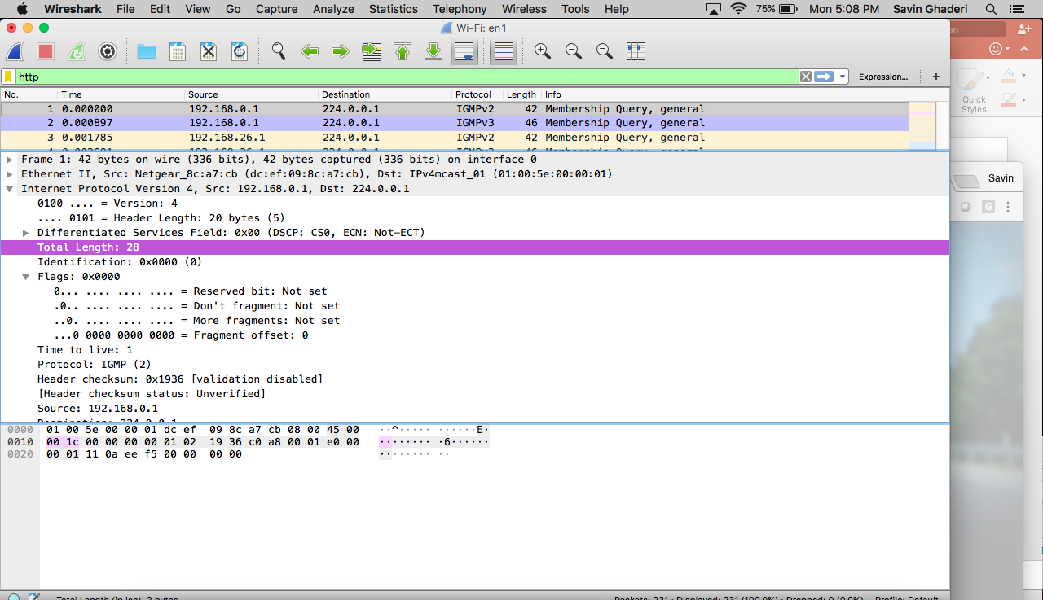
5
Deduct the header length from the total length to get the payload bytes. 28-20=8

