Slide 1
Savin Ghaderi Lab 8

Slide 2
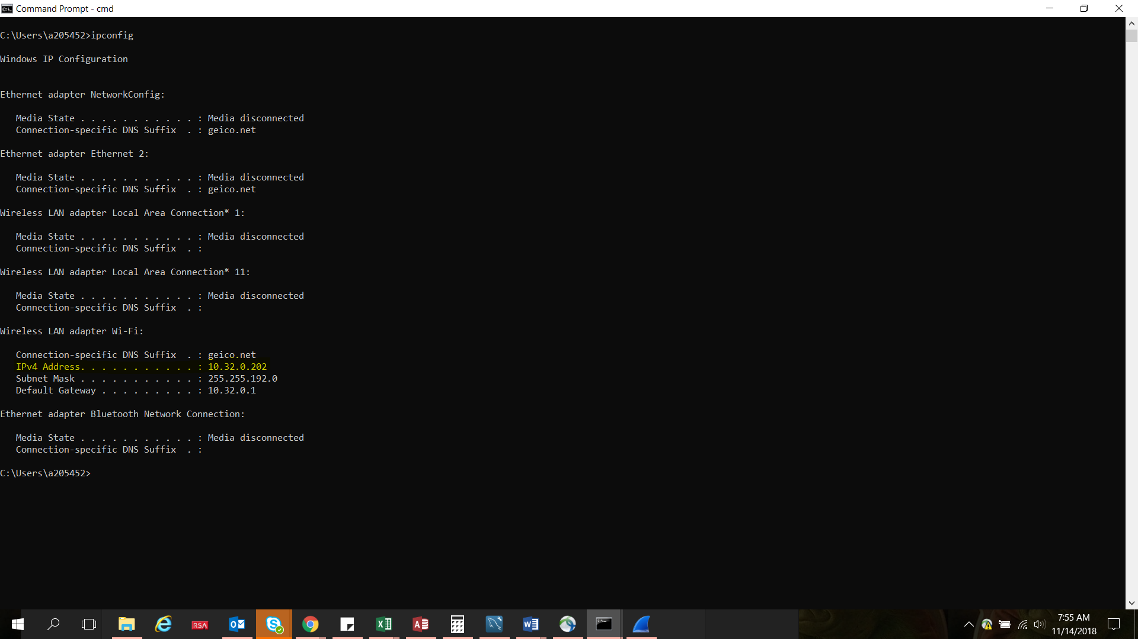
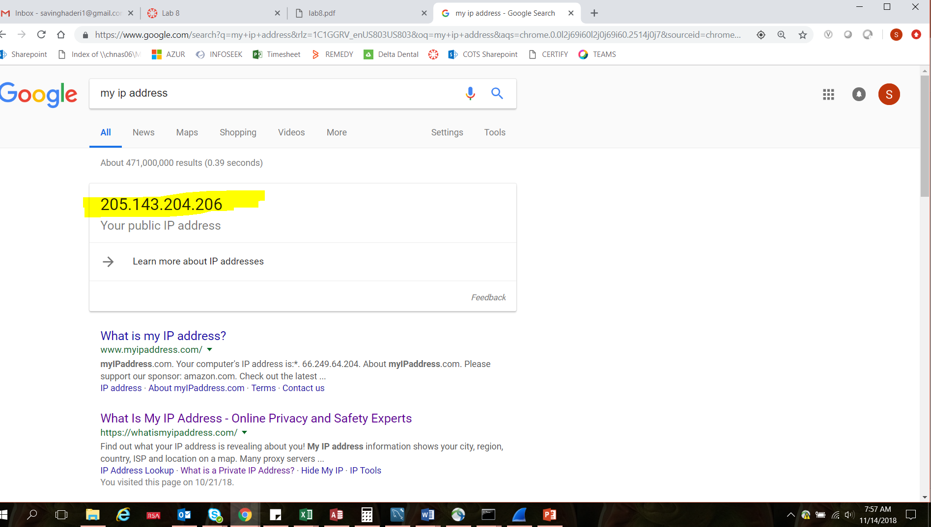
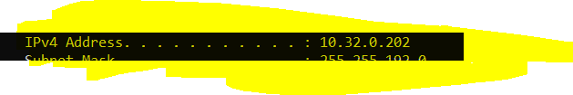
External IP address: 205.143.204.206
Internal IP address (IPv4)

Slide 3
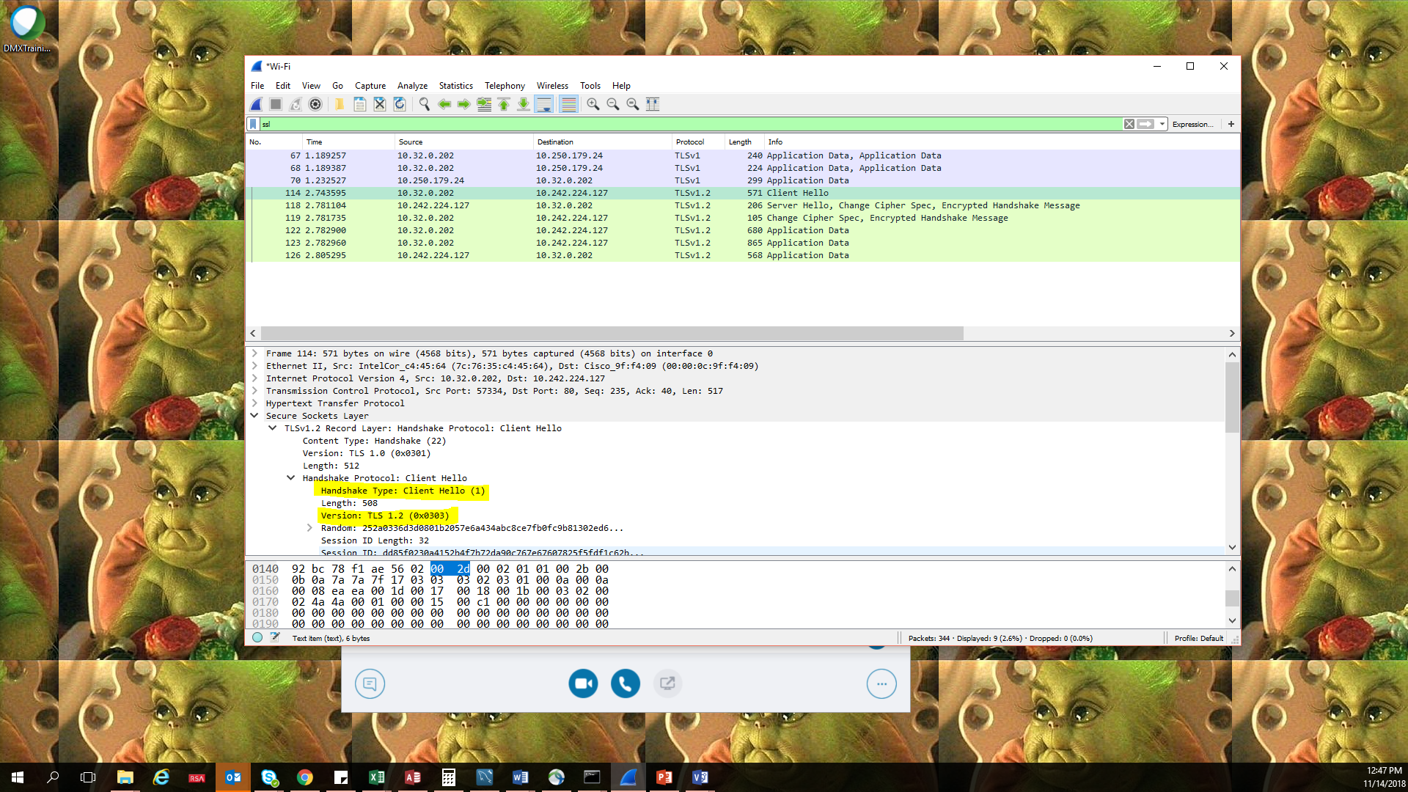
1. What is the SSL/TLS version of the of the Client Hello frame?

Slide 4
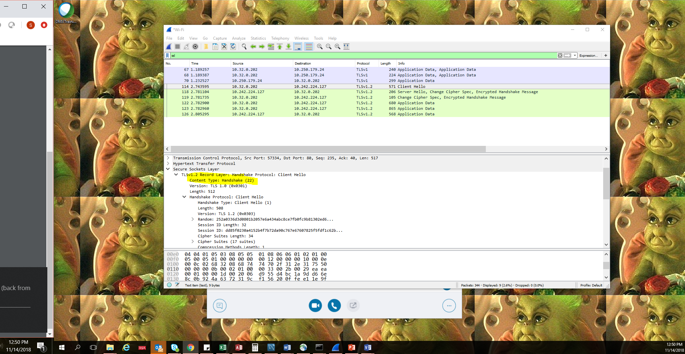
Expand the ClientHello record. (If your trace contains multiple ClientHello records, expand the frame that contains the first one.) What is the value of the content type?

Slide 5
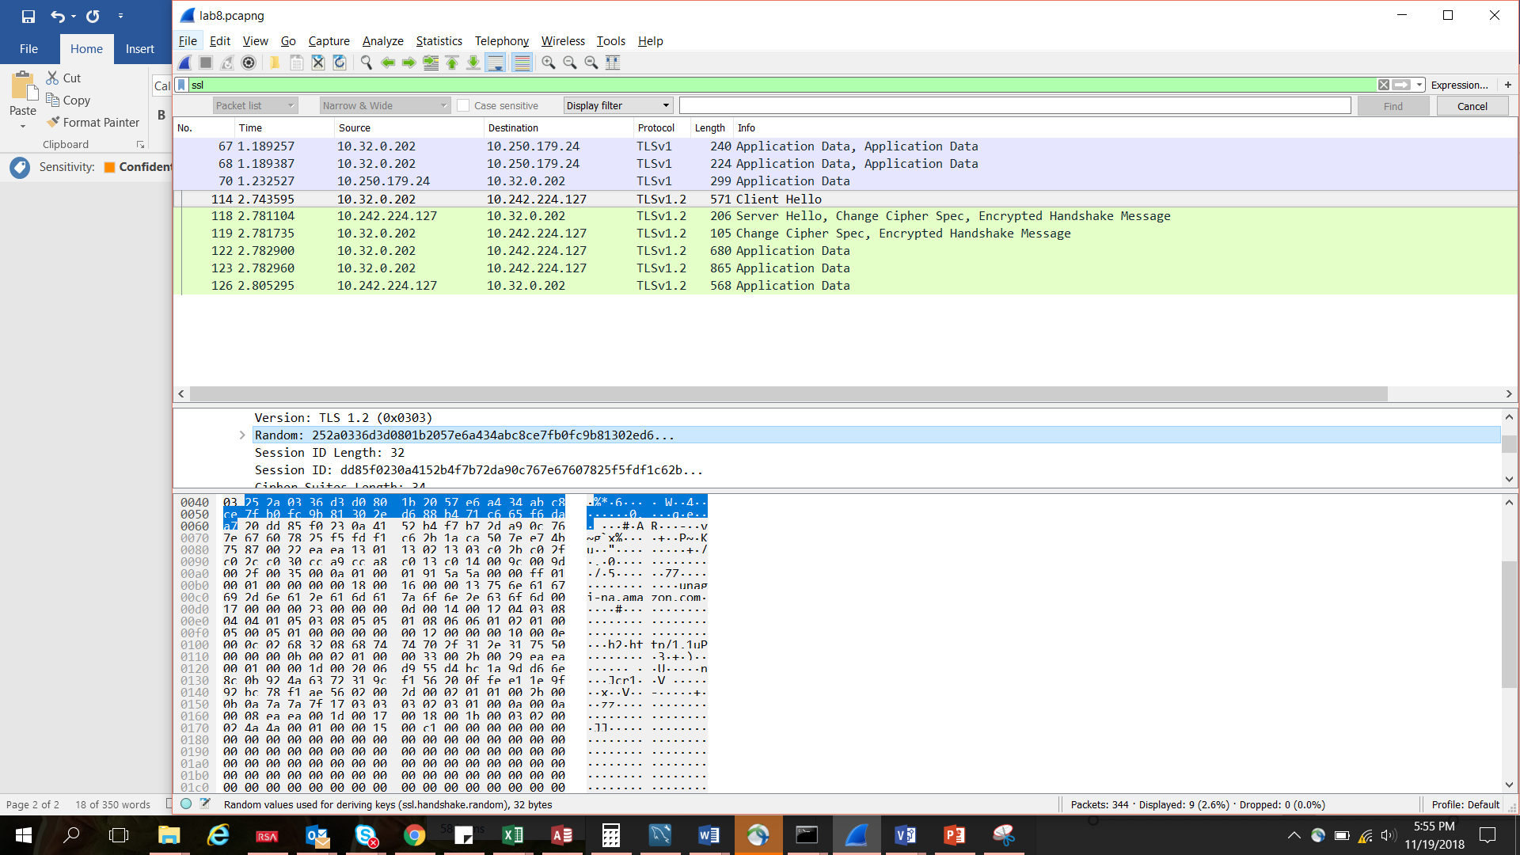
Does the ClientHello record contain a nonce (also known as a “challenge”)? If so, what is the value of the challenge in hexadecimal notation?
25:2a:03:36:d3:d0:80:1b:20:57:e6:a4:34:ab:c8:ce:7f:b0:fc:9b:81:30 2e:d6:88:b4:71:c6:65:f6:da:a7

Slide 6
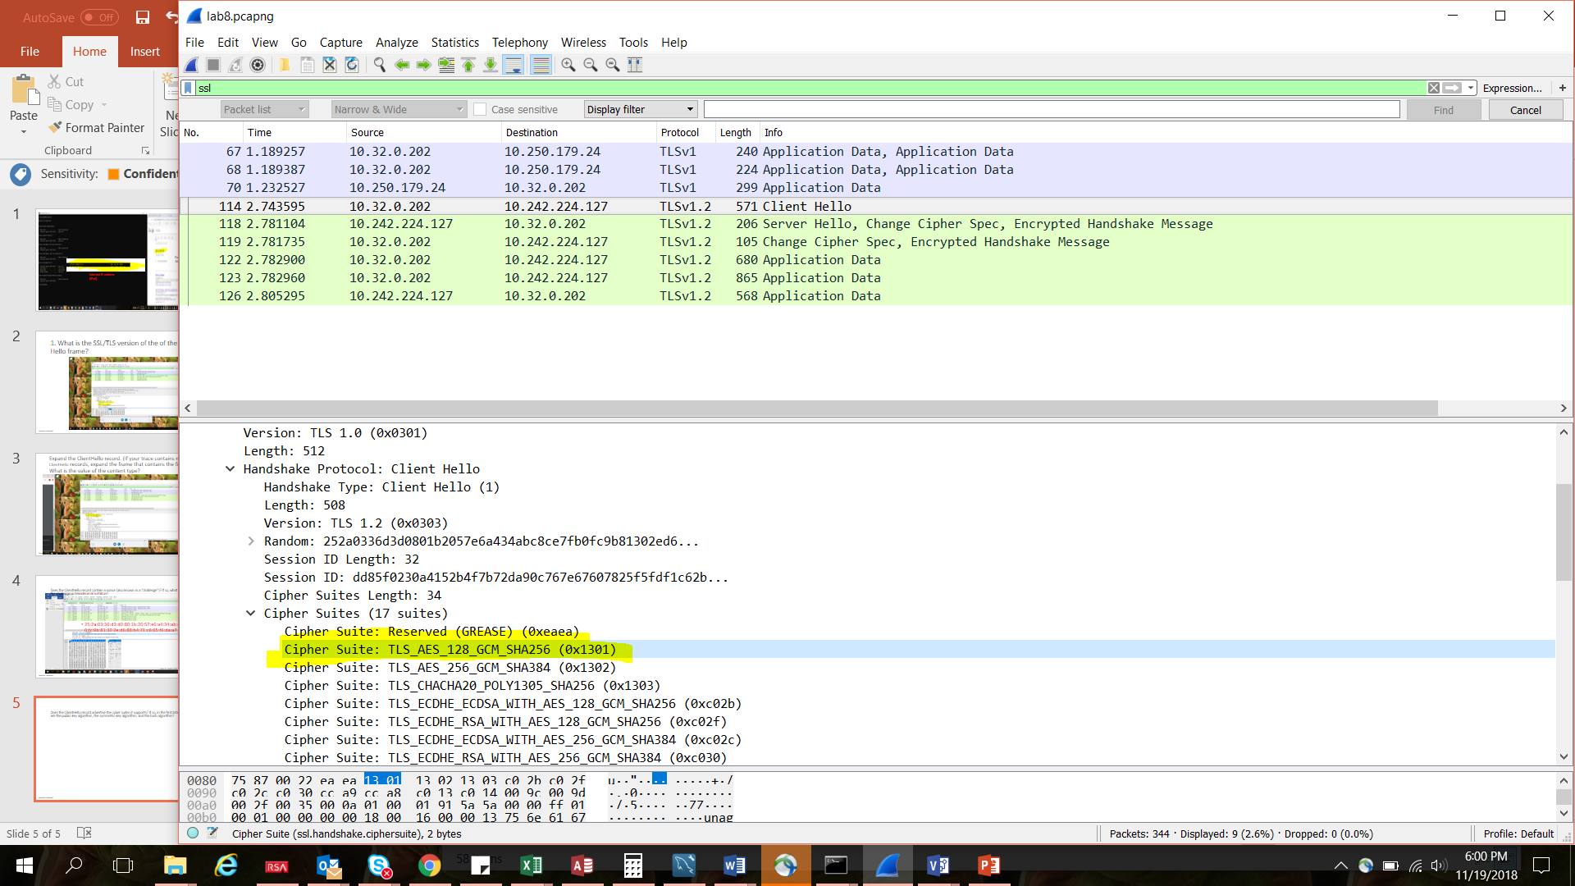
Does the ClientHello record advertise the cyber suites it supports? If so, in the first listed suite, what are the public-key algorithm, the symmetric-key algorithm, and the hash algorithm?
Public key: GCM
Symmetric Key: AES
Hash Algorithm: SHA256

Slide 7
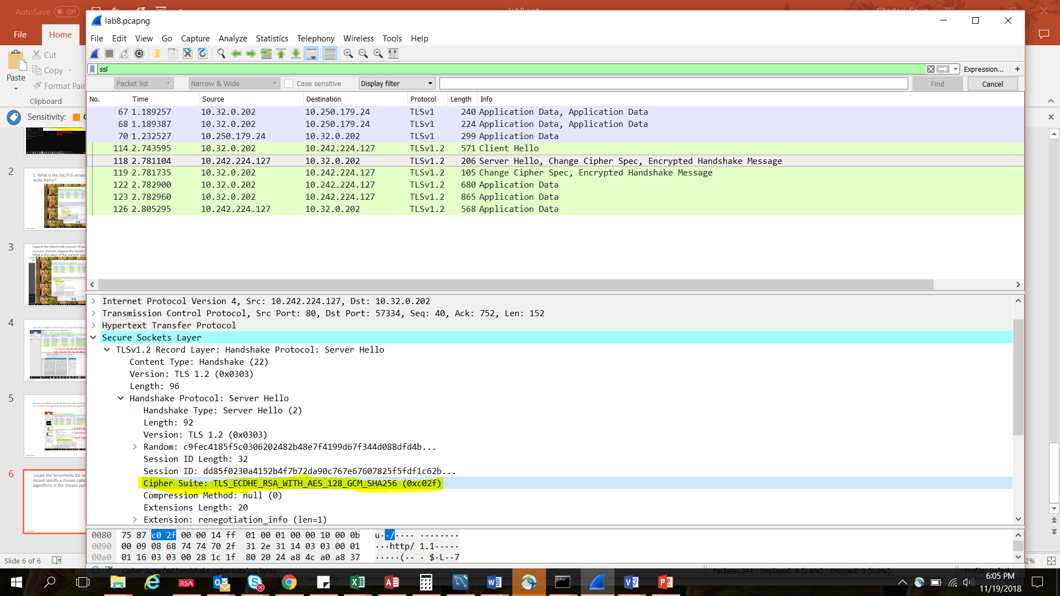
Locate the ServerHello SSL record. Does this record specify a chosen cipher suite? What are the algorithms in the chosen cipher suite?

