Slide 1

N.B.K.R. INSTITUTE OF SCIENCE AND TECHNOLOGY (AUTONOMOUS)
Affiliated to JNTUA, Ananthapuramu & Accredited by NAAC with ‘A’Grade
Courses Accredited by NBA Under Tier-I
Vidyanagar,Tirupathi Dist.A.P. India-524413
BYTEXL PROJECT
Title: GameMate
Team Members:
A. Sai Lokesh (24KB1A0501)
A. Sai Samslesh (24KB1A0517)
B. Vasu (25KB5A0505)
V. Sreenivasulu (25KB5A0508)
K. Sai Masthan (25KB5A0526)
Year: 3rd Year | Branch: CSE | Section: C

Slide 2
Index:
Introduction
Problem Statement
Objectives
Modules and requirements
Features and Screenshots
Conclusion
References
Year: 3rd Year | Branch: CSE | Section: C

Slide 3
Introduction
Gaming has become a popular way for people to connect and interact online.
Many gamers face difficulties finding teammates who share their interests, preferred games, and playing schedules.
GameMate is a web-based platform designed to connect gamers and help them find suitable teammates.
It provides features for gamer profiles, team formation, game discovery, and communication.
Year: 3rd Year | Branch: CSE | Section: C

Slide 4
Problem Statement
Gamers often struggle to find reliable teammates for multiplayer games.
Finding players with similar interests, skill levels, and availability can be difficult.
Communication and team coordination can become challenging when players use different platforms.
There is a need for a centralized platform that makes it easier to discover gamers and form teams.
Year: 3rd Year | Branch: CSE | Section: C

Slide 5
Objectives
To develop a user-friendly gaming community platform.
To help gamers find and connect with suitable teammates.
To allow users to create and join gaming teams.
To provide gamer profiles and game discovery features.
To support communication and coordination between players.
Year: 3rd Year | Branch: CSE | Section: C

Slide 6
Structure:
gamemate/
├── client/ # React and Vite frontend
│ └── src/
│ ├── components/
│ ├── context/
│ ├── pages/
│ └── services/
├── server/ # Express API and Socket.IO server
│ ├── config/
│ ├── controllers/
│ ├── middleware/
│ ├── models/
│ ├── routes/
│ ├── scripts/
│ └── socket/
├── package.json
└── README.md
Year: 3rd Year | Branch: CSE | Section: C

Slide 7
A. Modules of GameMate
Module | Description
User Authentication | Allows users to register and log in.
Gamer Profile | Displays gamer information and gaming interests.
Game Discovery | Helps users explore available games.
Find Gamers | Helps users discover potential teammates.
Team Management | Allows users to create teams and send team requests.
Chat and Notifications | Supports communication and updates.
Year: 3rd Year | Branch: CSE | Section: C

Slide 8
Requirements
Software requirements
Frontend: HTML, CSS, JavaScript, React and Vite
Backend: Node.js and Express.js
Database: MongoDB
Development tools: Visual Studio Code and Git
Hardware requirements
Computer or laptop
Internet connection
Modern web browser
Year: 3rd Year | Branch: CSE | Section: C

Slide 9
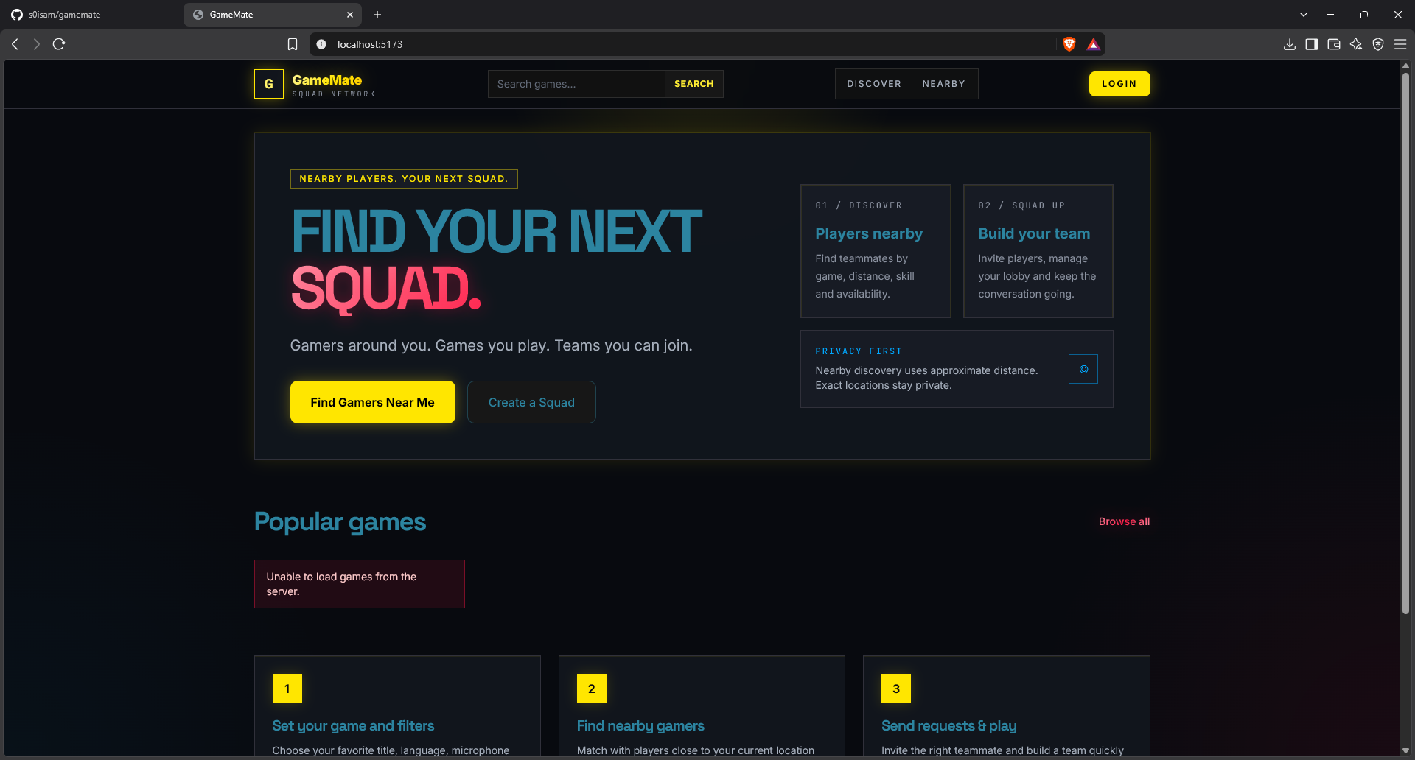
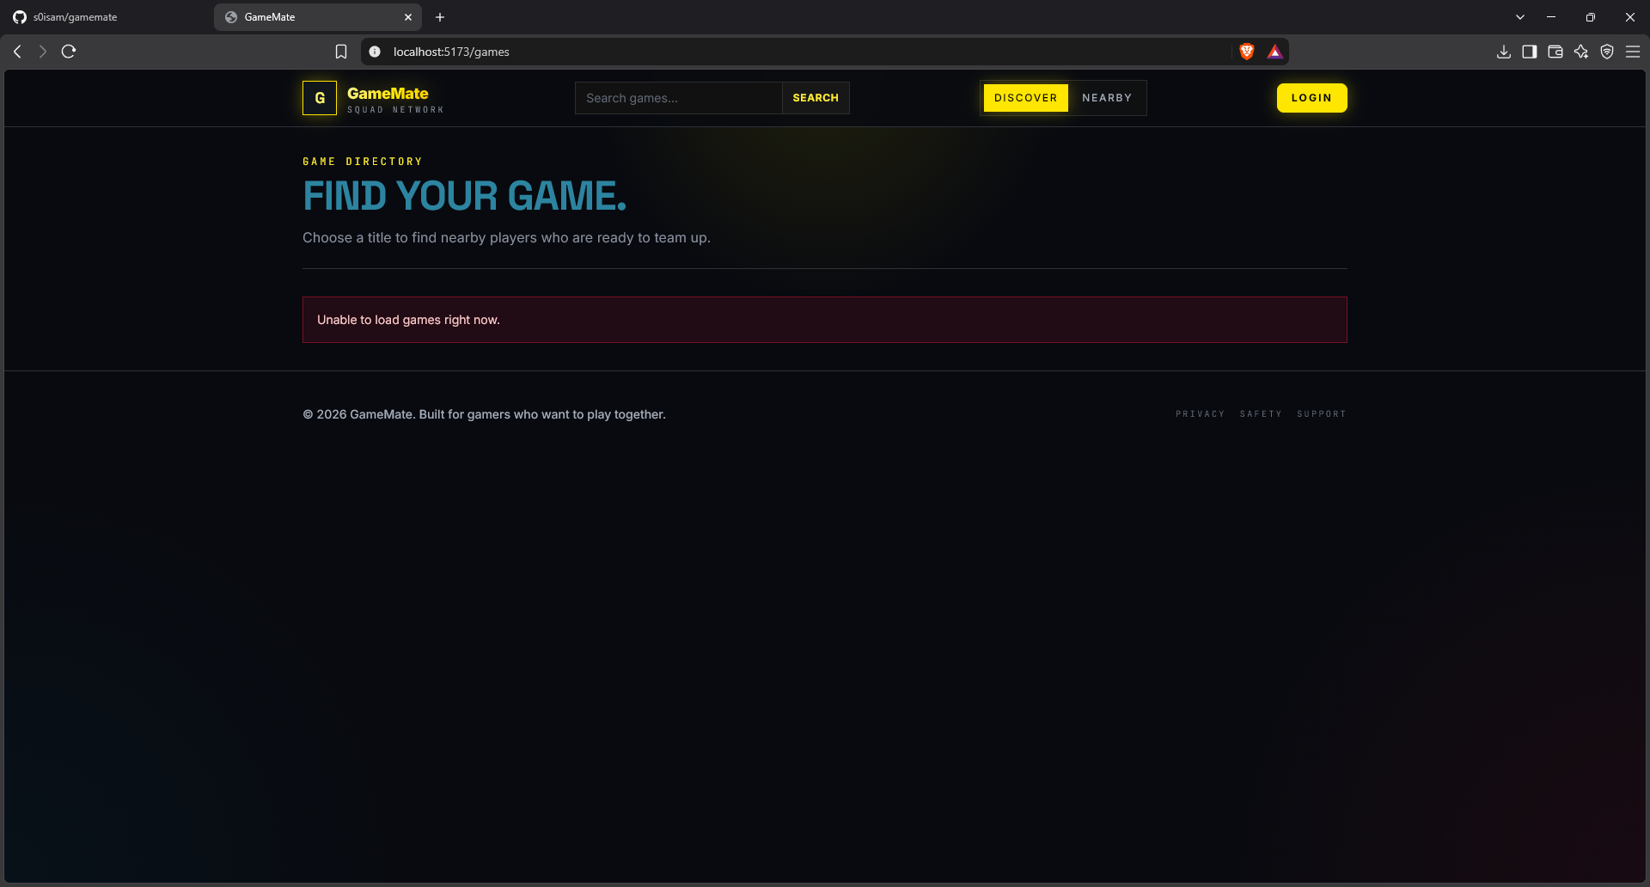
Screenshots:
Year: 3rd Year | Branch: CSE | Section: C

Slide 10
Key Features
User registration and login
Gamer profiles
Game browsing and discovery
Teammate search
Team creation and joining
Chat and notifications
Conclusion
GameMate aims to make multiplayer gaming more social and organized by helping gamers find teammates, form teams, and communicate through a single platform. It provides a foundation for building a connected gaming community.
Year: 3rd Year | Branch: CSE | Section: C

Slide 11
References
React Documentation — react.dev
Vite Documentation — vite.dev
Node.js Documentation — nodejs.org
Express.js Documentation — expressjs.com
MongoDB Documentation — mongodb.com/docs
Socket.IO Documentation — socket.io/docs
Year: 3rd Year | Branch: CSE | Section: C

Slide 12
Thank You
Questions and Suggestions?
We welcome your questions, feedback, and suggestions regarding GameMate.
Year: 3rd Year | Branch: CSE | Section: C

