Slide 1



Hackathon_Visuals
View in Power BI
Last data refresh:
19/07/2024 02:19:32 UTC
Downloaded at:
04/09/2024 10:36:46 UTC

Slide 2
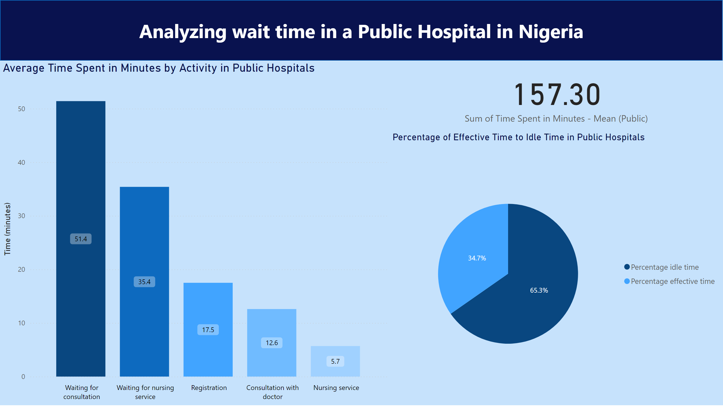
Page 1
Notes:
Average Time Spent in Minutes by Activity in Public Hospitals
No alt text provided
shape
No alt text provided
Percentage of Effective Time to Idle Time in Public Hospitals
No alt text provided
card
No alt text provided

Slide 3
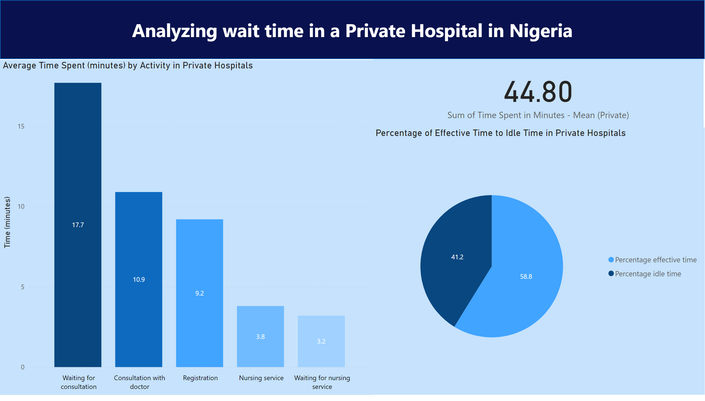
Page 2
Notes:
Average Time Spent (minutes) by Activity in Private Hospitals
No alt text provided
Percentage of Effective Time to Idle Time in Private Hospitals
No alt text provided
shape
No alt text provided
card
No alt text provided

Slide 4
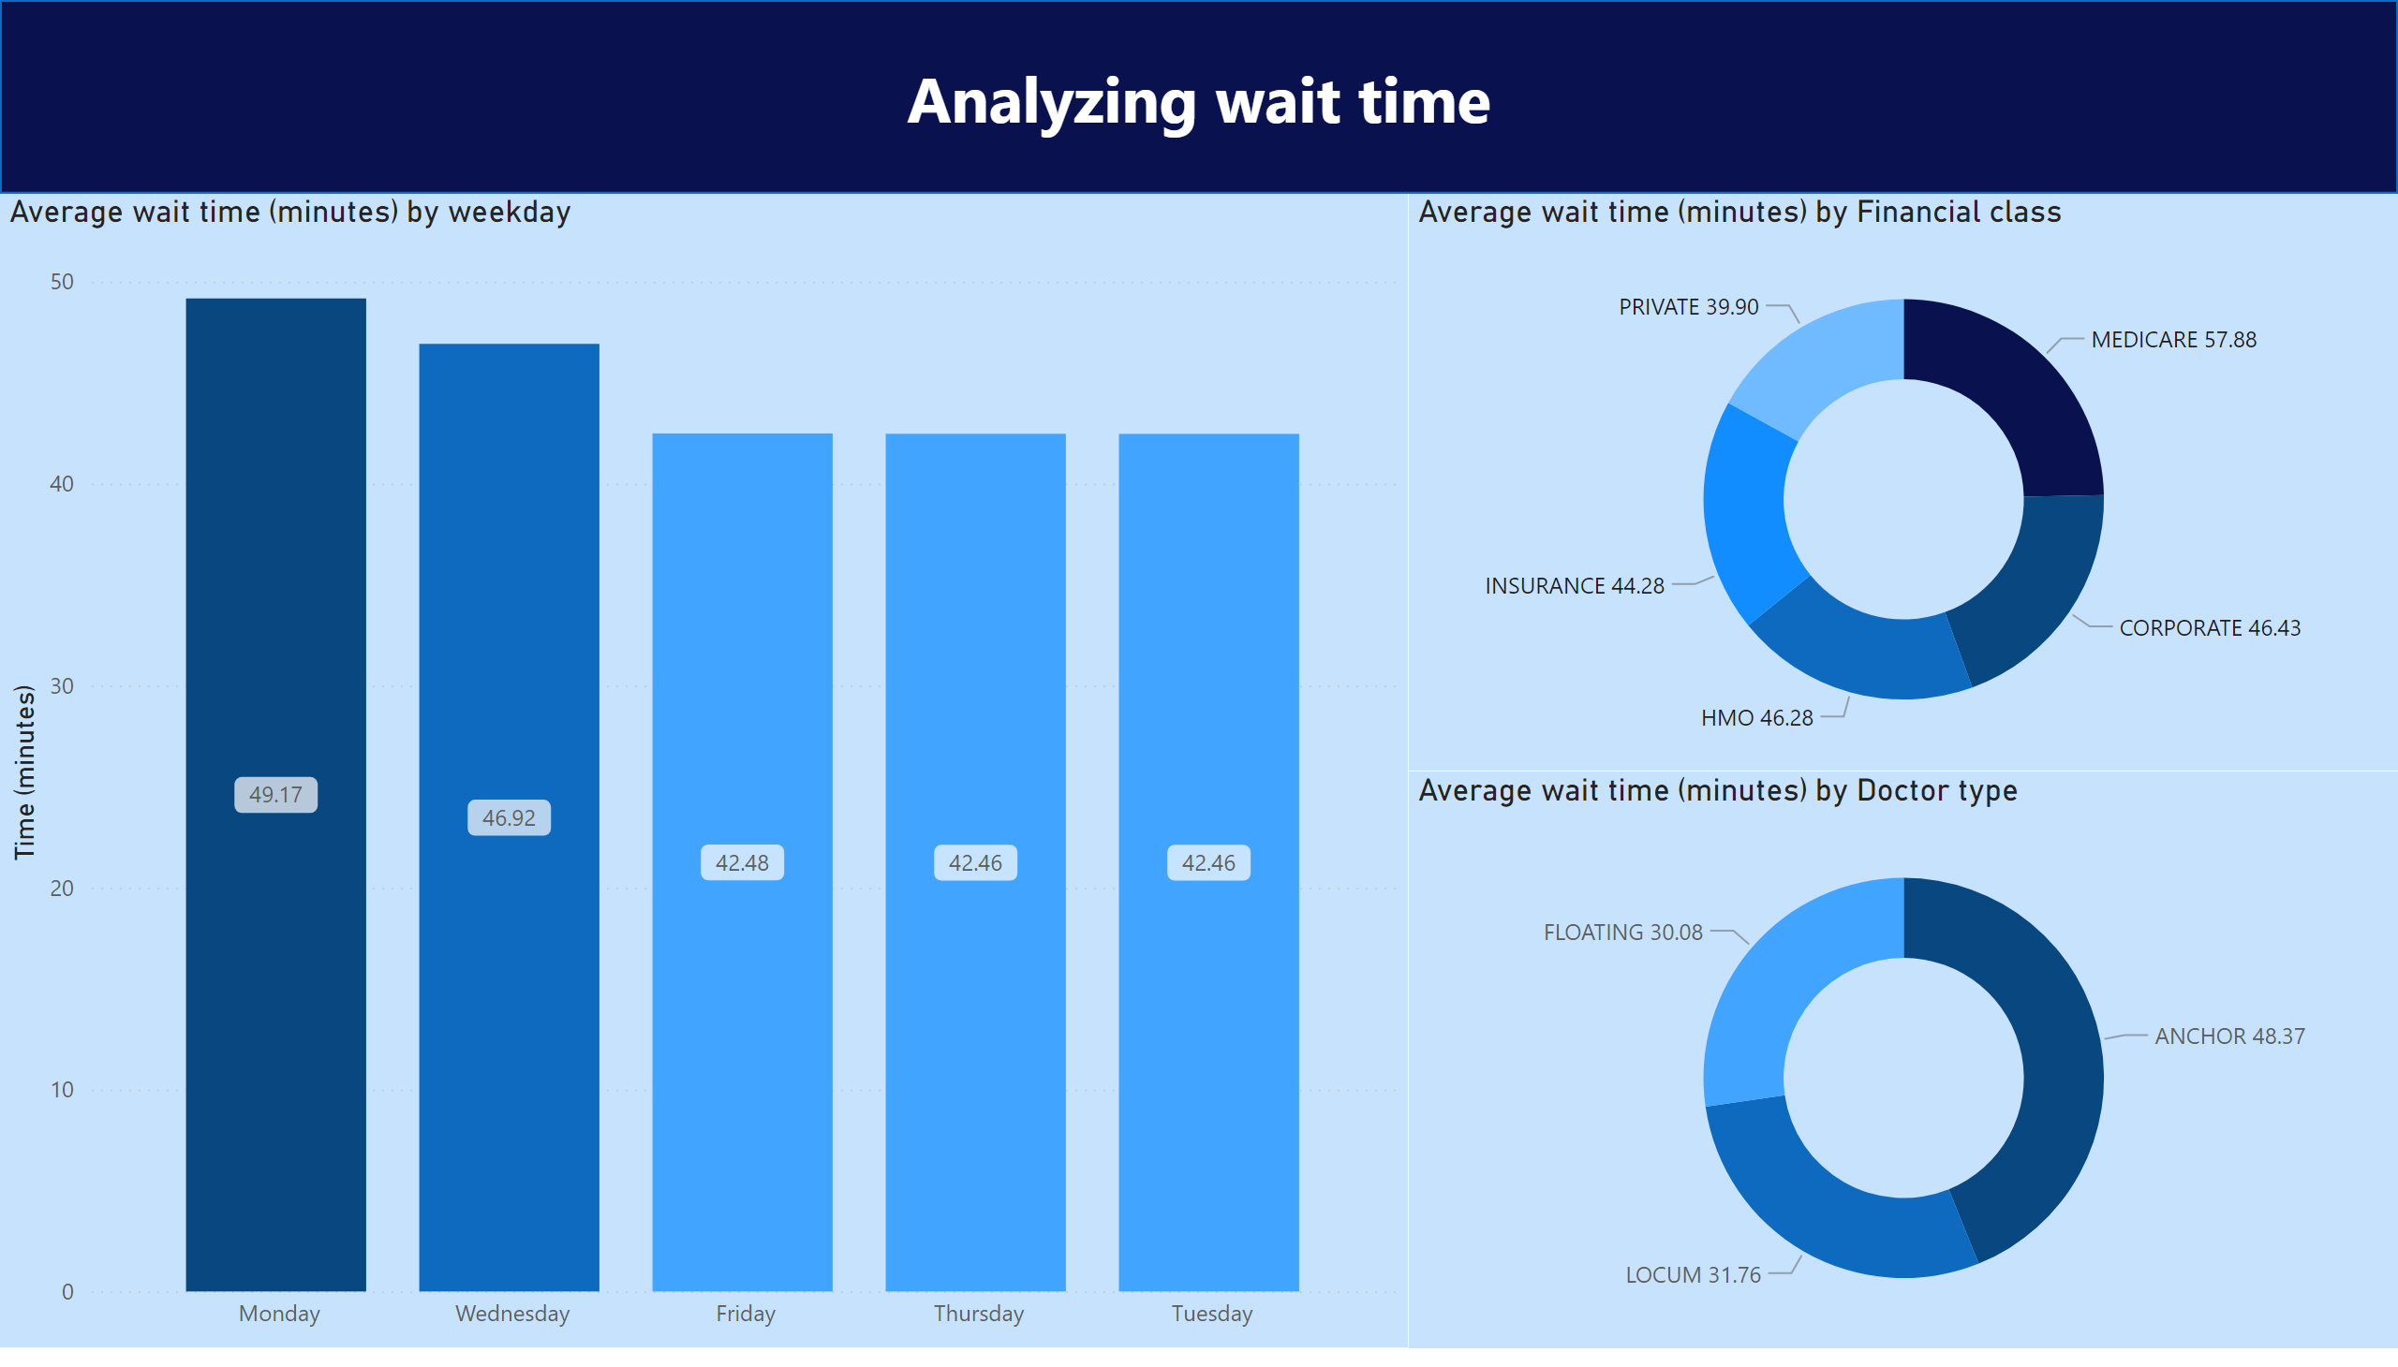
Page 3
Notes:
shape
No alt text provided
Average wait time (minutes) by Doctor type
No alt text provided
Average wait time (minutes) by Financial class
No alt text provided
Average wait time (minutes) by weekday
No alt text provided

Slide 5
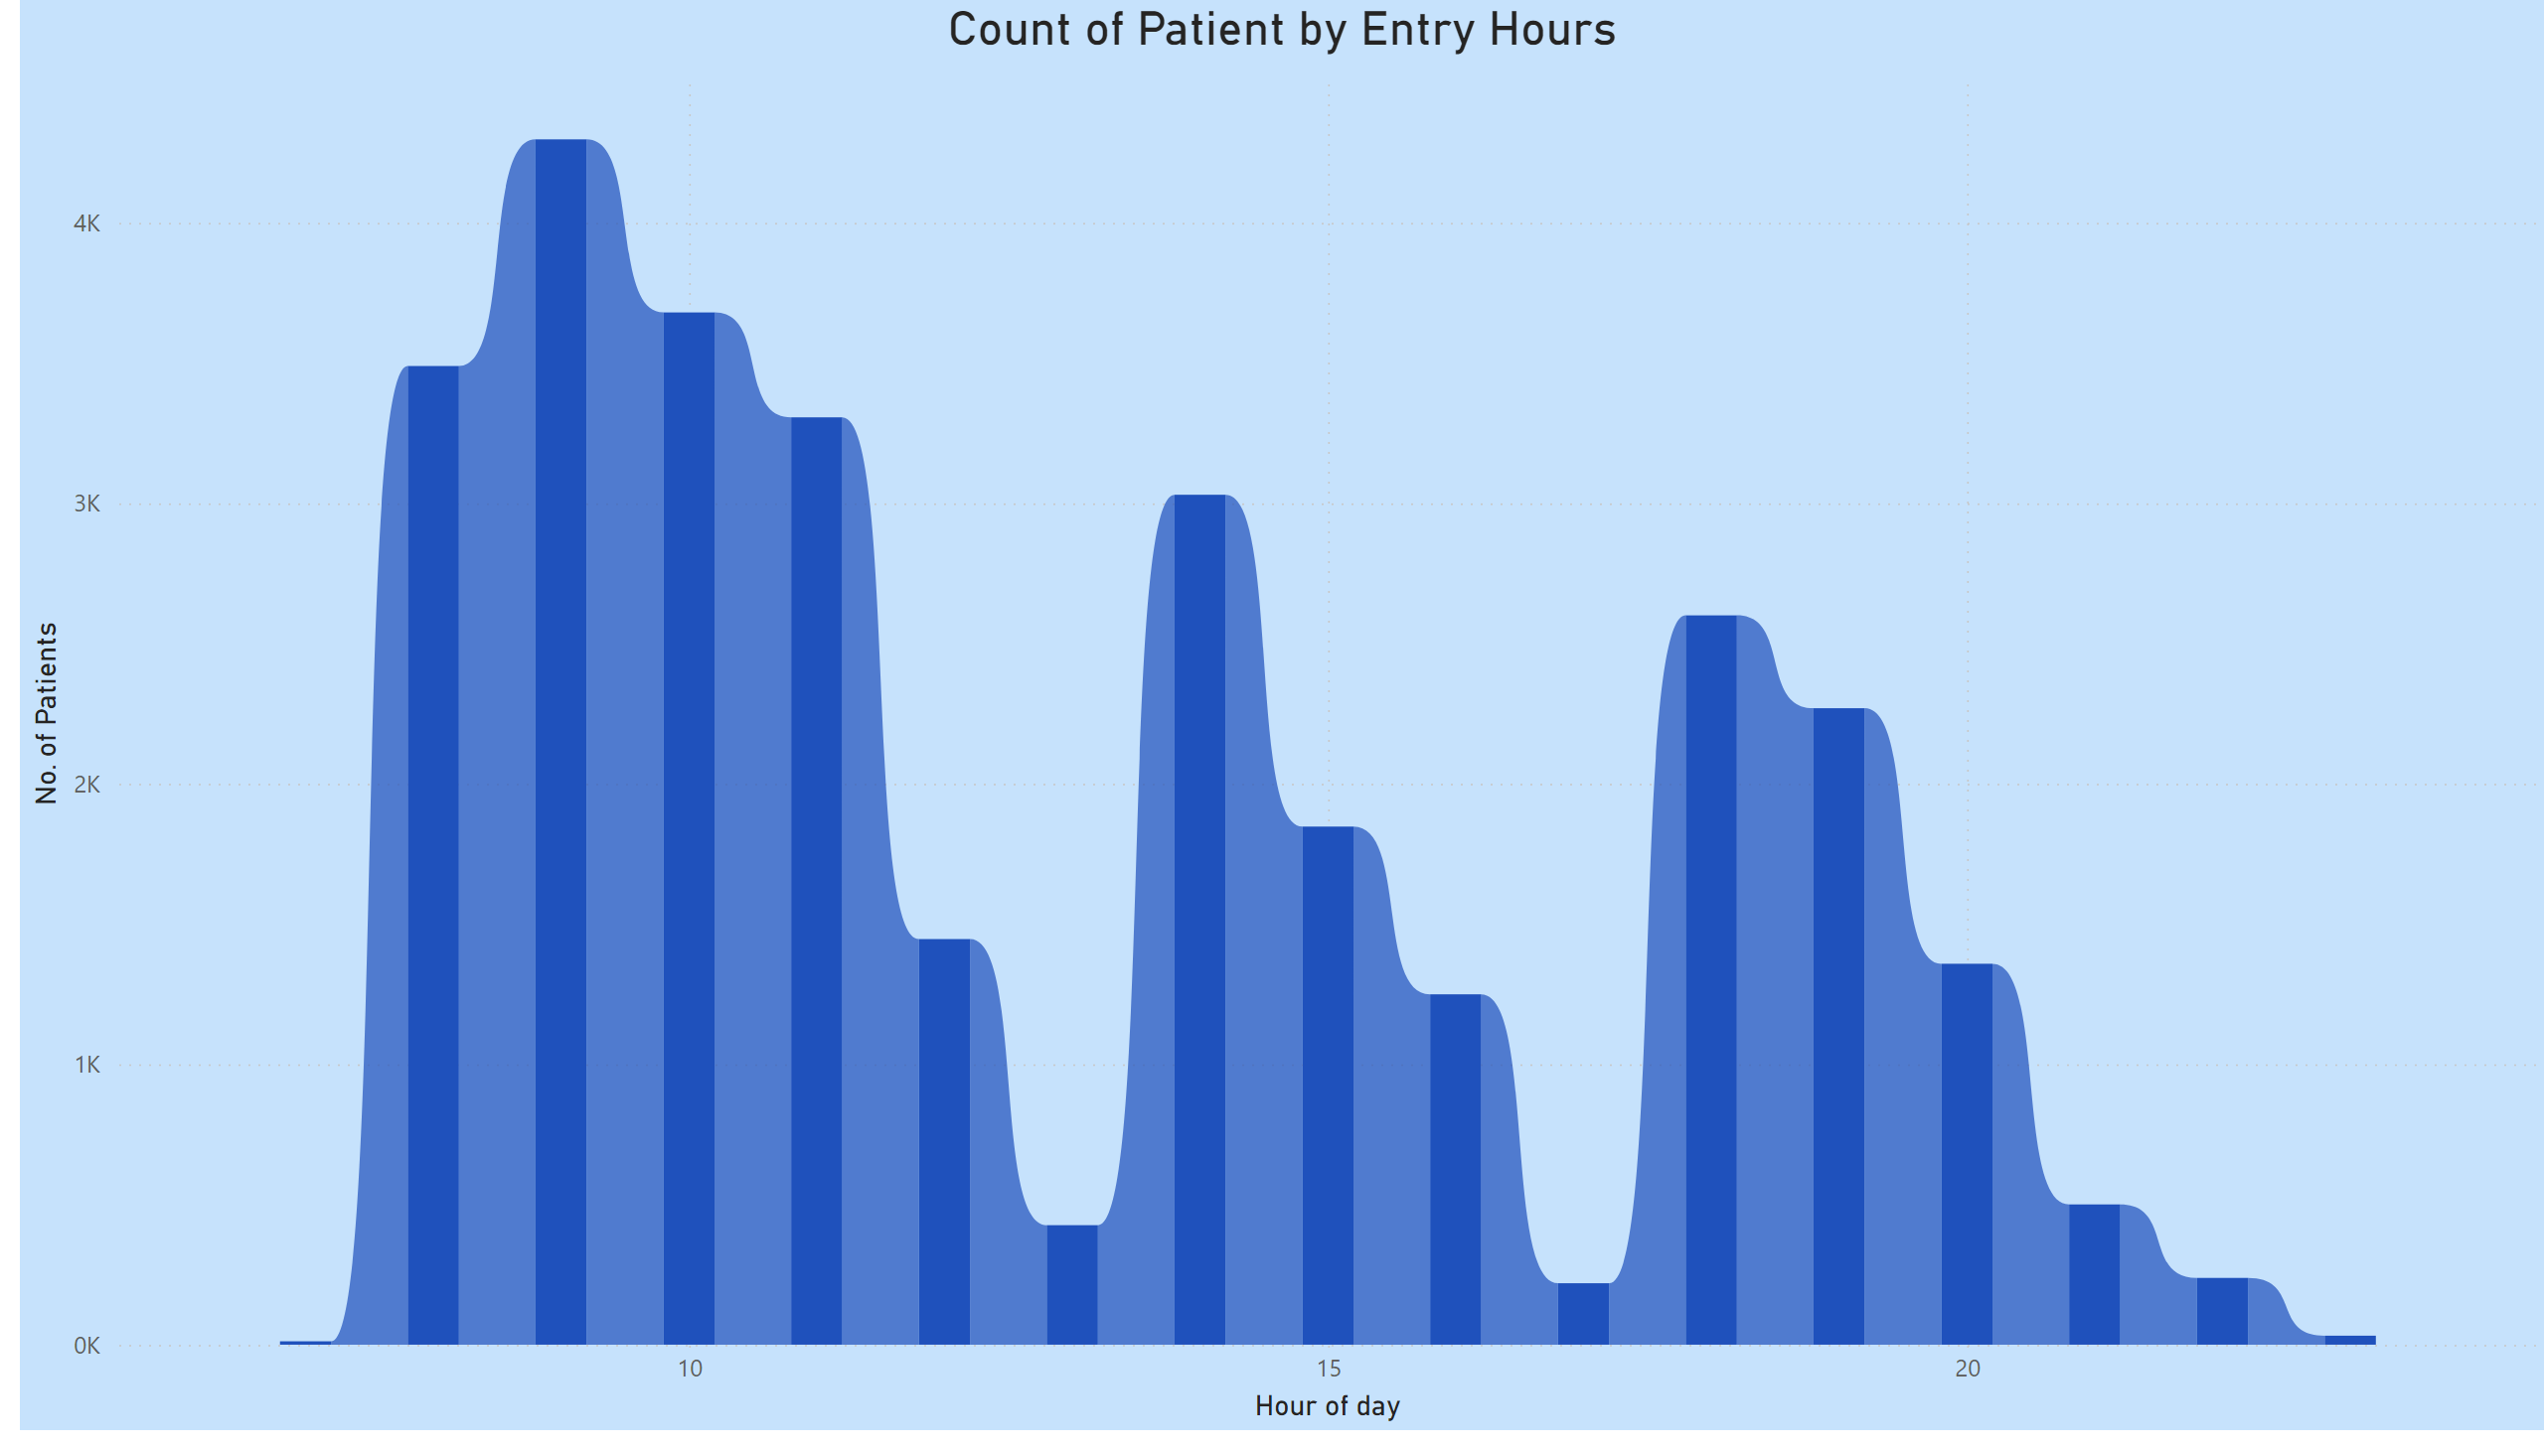
Page 4
Notes:
Count of Patient by Entry Hours
No alt text provided

