Slide 1



taxi_project
View in Power BI
Last data refresh:
11/6/2024 11:32:51 AM UTC
Downloaded at:
11/6/2024 11:34:15 AM UTC

Slide 2
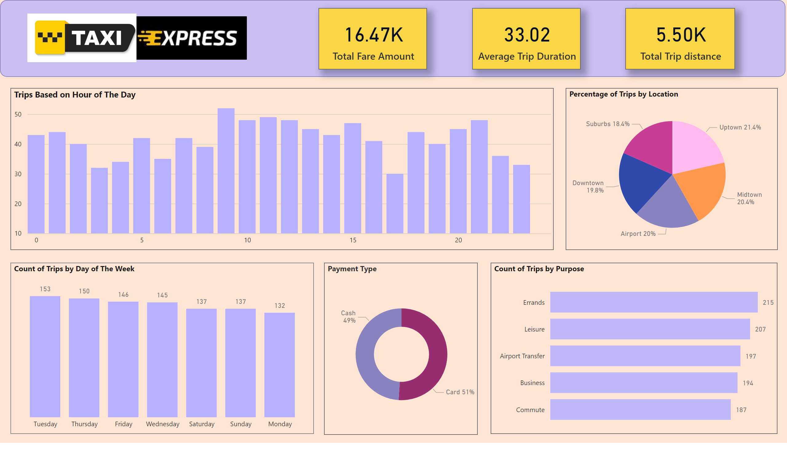
Customer Analysis
Notes:
Count of Trips by Purpose
No alt text provided
Count of Trips by Day of The Week
No alt text provided
Trips Based on Hour of The Day
No alt text provided
card
No alt text provided
card
No alt text provided
image
No alt text provided
image
No alt text provided
shape
No alt text provided
card
No alt text provided
Percentage of Trips by Location
No alt text provided
Payment Type
No alt text provided

Slide 3
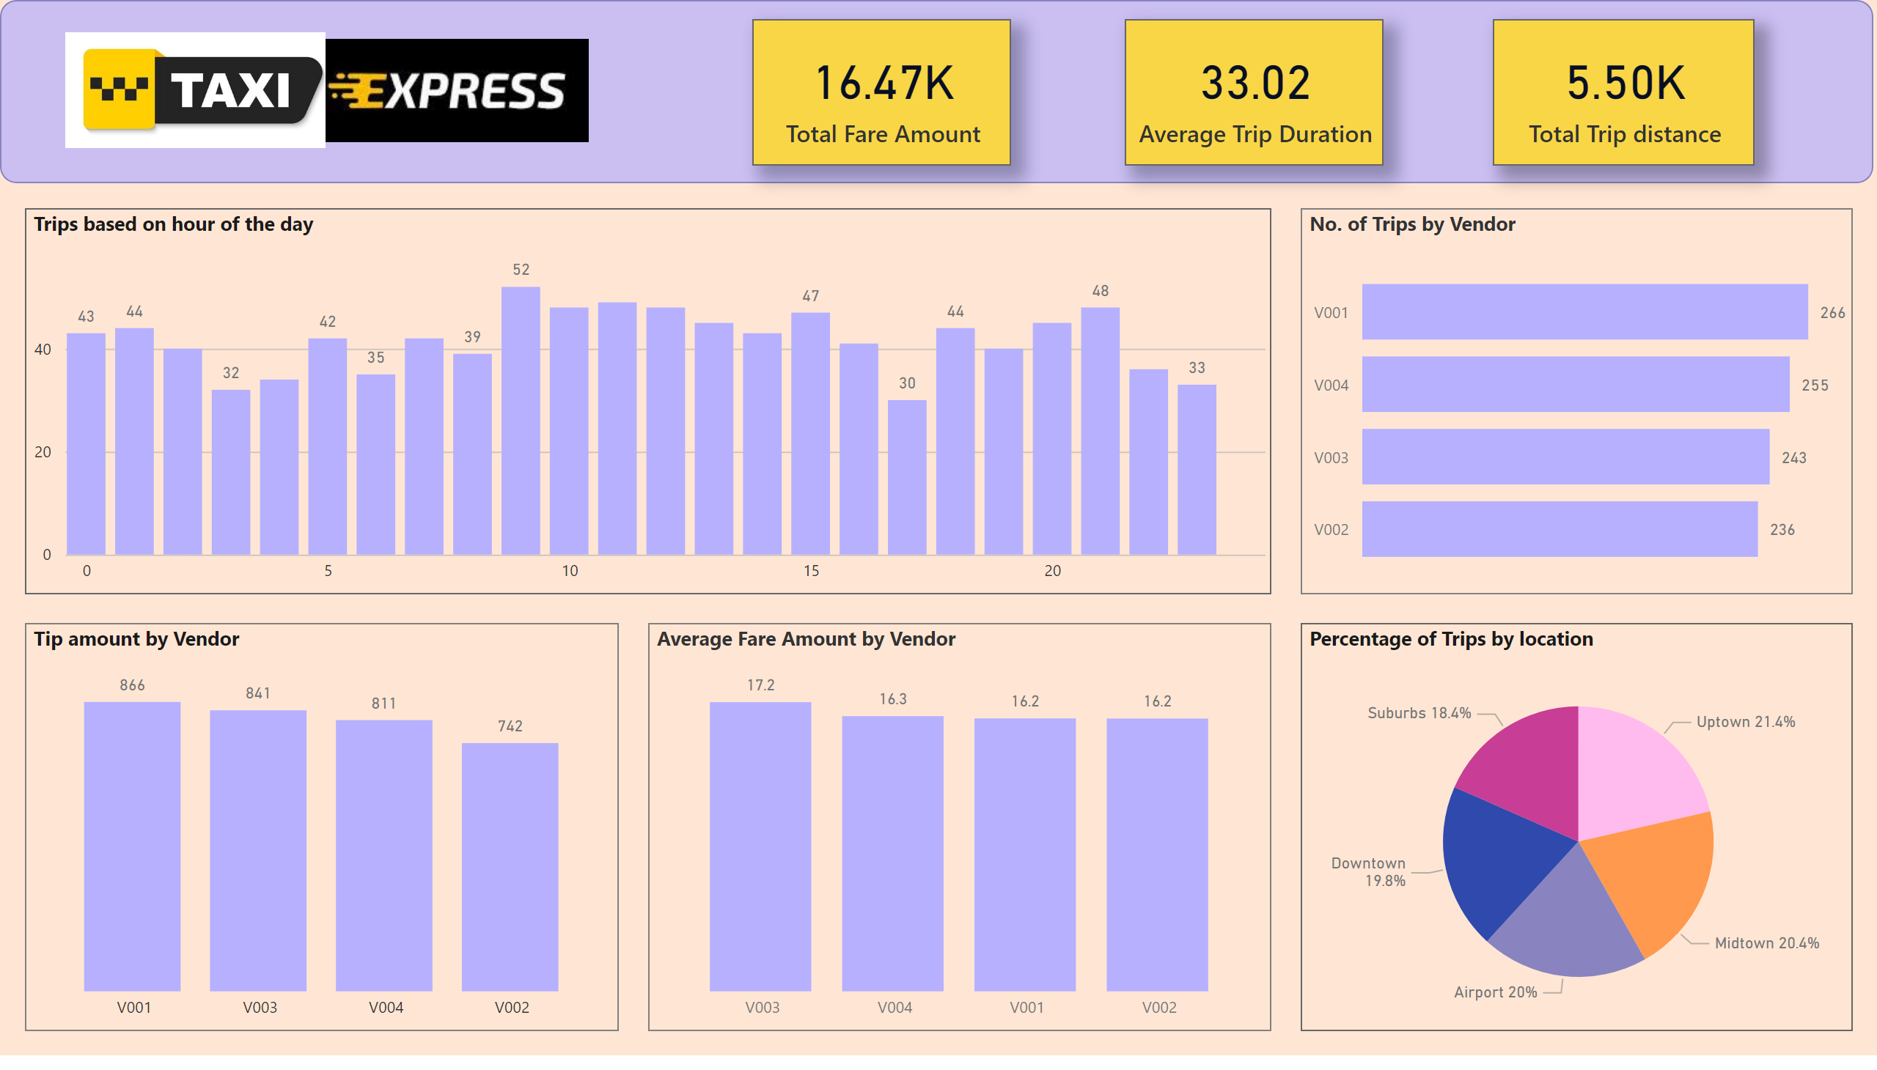
Vendor Analysis
Notes:
Tip amount by Vendor
No alt text provided
No. of Trips by Vendor
No alt text provided
Percentage of Trips by location
No alt text provided
card
No alt text provided
card
No alt text provided
card
No alt text provided
shape
No alt text provided
image
No alt text provided
image
No alt text provided
Trips based on hour of the day
No alt text provided
Average Fare Amount by Vendor
No alt text provided

Slide 4
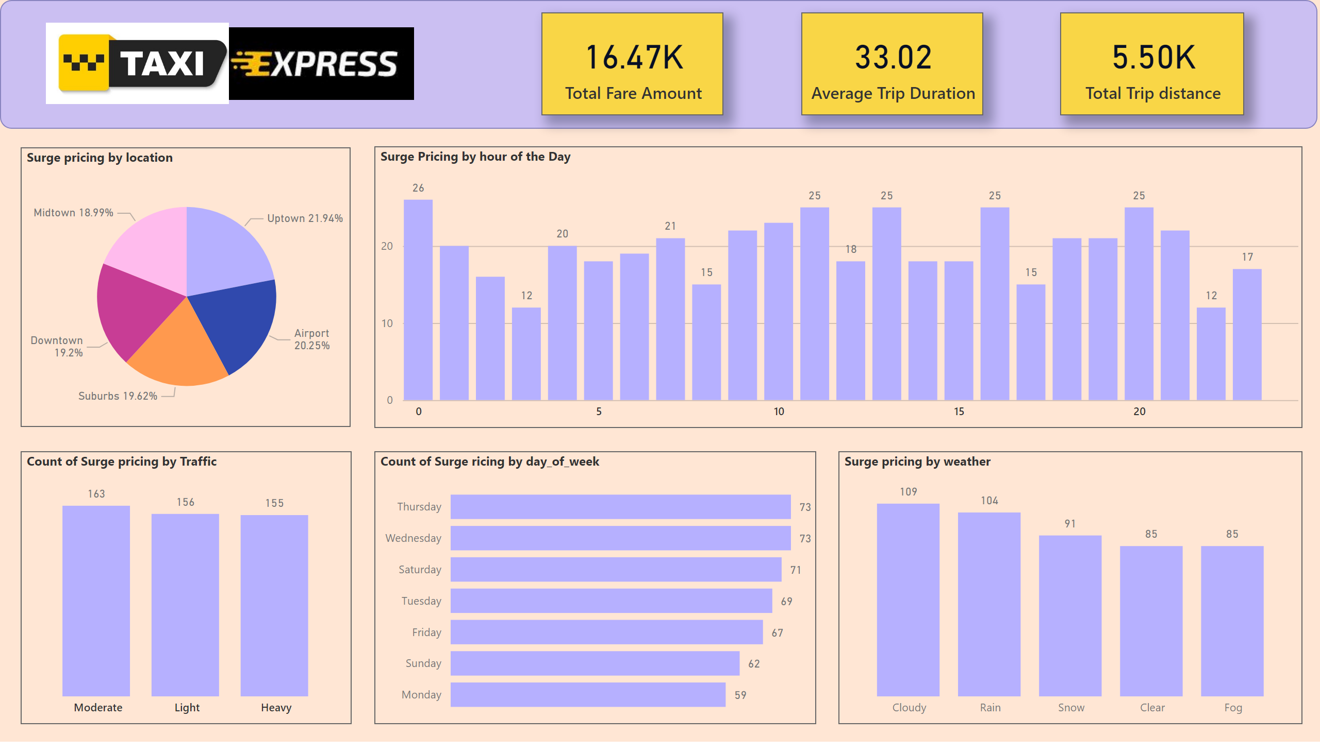
Surge Analysis
Notes:
Surge pricing by location
No alt text provided
Count of Surge pricing by Traffic
No alt text provided
Surge Pricing by hour of the Day
No alt text provided
card
No alt text provided
card
No alt text provided
card
No alt text provided
shape
No alt text provided
image
No alt text provided
image
No alt text provided
Count of Surge ricing by day_of_week
No alt text provided
Surge pricing by weather
No alt text provided

Slide 5
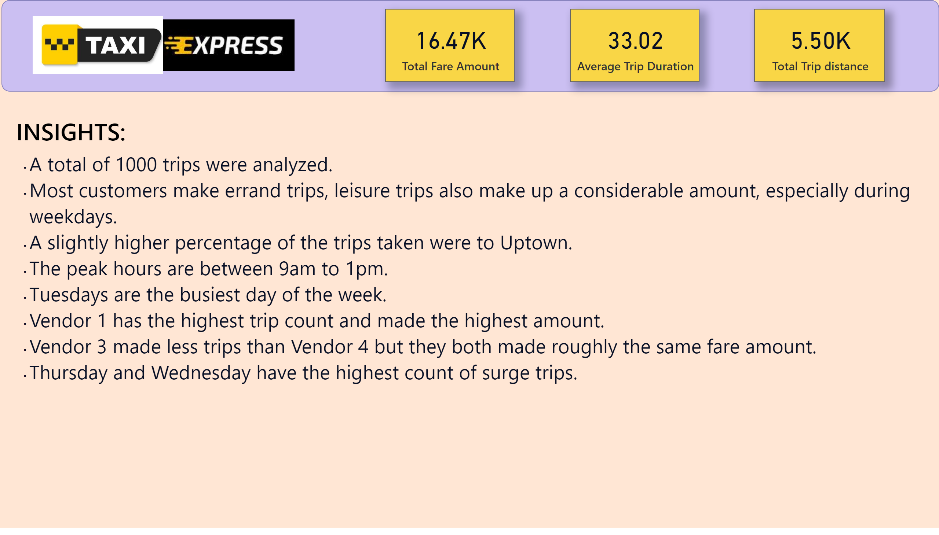
Key Insights
Notes:
shape
No alt text provided
image
No alt text provided
image
No alt text provided
textbox
No alt text provided
INSIGHTS:
No alt text provided
card
No alt text provided
card
No alt text provided
card
No alt text provided

