Slide 1
Smart usage of context information for the analysis, design, and generation of power-aware policies for mobile sensing apps
Presented by Rafael Pérez Torres
Supervisors: César Torres Huitzil PhD, Hiram Galeana Zapién PhD
Doctoral Seminar, 2014

Slide 2
Agenda
Introduction
State of Art
Methodology
Future work
Conclusions
Notes:
Mention that the purpose of the presentation is the description of advances performed in the state of art research.

Slide 3
Introduction
Notes:
Do not forget to emphasize when changing from sections.

Slide 4
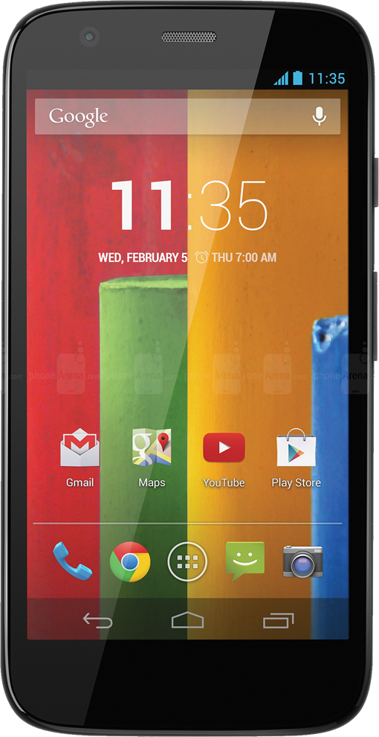
Introduction
Mobile devices are used massively around the world (1,900 millions in 2013*).
Their high acceptance is due to their Internet-enabled features and increasing storage and computing capabilities.
Mobile devices are shipped with sensors that enhance the interaction with user.
Sensors allow mobile devices to become omni-sensors of the environment.
Figure: The Motorola Moto G smartphone
* Ericsson Mobility Report, Rima Qureshi, June 2014
Notes:
Focus on the sensor information, this slide should be fast.

Slide 5
Introduction
By analyzing data from environment, smart devices become context aware.
Context refers to the set of environmental states and settings that either determines an application’s behavior or in which an application event occurs and is interesting to the user *.
A context aware mobile app detect changes in any context source of information and adapts its behavior accordingly
Context and location aware mobile apps can be categorized as mobile sensing apps (MSA).
MSA core activities are sensing data from environment, analyzing these data and generating high level information that has a special meaning for final user.
* A Survey of Context-Aware Mobile Computing Research, Guanling Chen and David Kotz, 2010
Notes:
Emphasize that such apps are known (nowadays) as MSA

Slide 6
Motivation
Advances in battery research are not at the same pace than those related to other components of smart devices.
Battery performance increments only 5 % annually¹.
The battery is a limited source of energy that is impacted by sensors and other embedded electronics usage.
Feature | Average power consumption (watts)
Processor (1%) | 0.06
Processor (100%) | 0.41
Accelerometer | 0.05
Bluetooth | 0.28
Microphone | 0.26
Screen | 0.23
Wi-Fi scan | 1.37
GPS | 0.32
3G radio (idle) | 0.47
3G radio (sending) | 1.11
Table: Average energy consumption of a Nokia N95 Smartphone²
¹ Energy Efficiency on Location Based Applications in Mobile Cloud Computing: A Survey, Xiao Ma et. al., 2012
² Location-Based Services on Mobile Phones: Minimizing Power Consumption, Mikkel Baun Kjærgaard, 2012
Notes:
Remark that battery is a problema in any mobile platform since it is not possible to attach an unlimited source of energy.
Remember that battery is a compited resource in the mobile platform.

Slide 7
Motivation
Despite the benefits of MSA the issue of energy reduces the time and diversity of tasks a smart device can be used for.
This issue becomes critical when performing continuous sensor access.
It is mandatory for any mobile application development to consider the energy constraint and implement mechanisms to optimize battery duration.
Notes:
Remember that the energy issue is a trending problema in software development.
Few years ago was optional, today is MANDATORY.

Slide 8
Problem Description
MSA access sensors in a continuous way over long periods of time.
Sensors usage impacts directly on battery.
Current smart devices' processors are designed to manage the heavy interaction with the user and the execution of mobile apps.
A continuous sensor reading is out of their current objectives *.
High level information about user's context remains ignored.
* LittleRock: Enabling energy-efficient continuous sensing on mobile phones, Bodhi Priyantha et. al., 2011
Notes:
The high level information is discarded, it can be used for creating better ways for using sensors.

Slide 9
Problem description
A special framework to generate smart policies for continuous sensor access is needed.
Such framework would be also useful to ease the development of MSA.
A policy is a high level concept that defines the usage sensors should observe to keep low energy consumption and fulfill mobile app requirements.
The smartness of policies is achieved by leveraging the user’s context obtained from data delivered by sensors:
Sensor data
Behavior pattern
User’s context
Smart policy generation
Notes:
Remark how the high level information can be obtained.

Slide 10
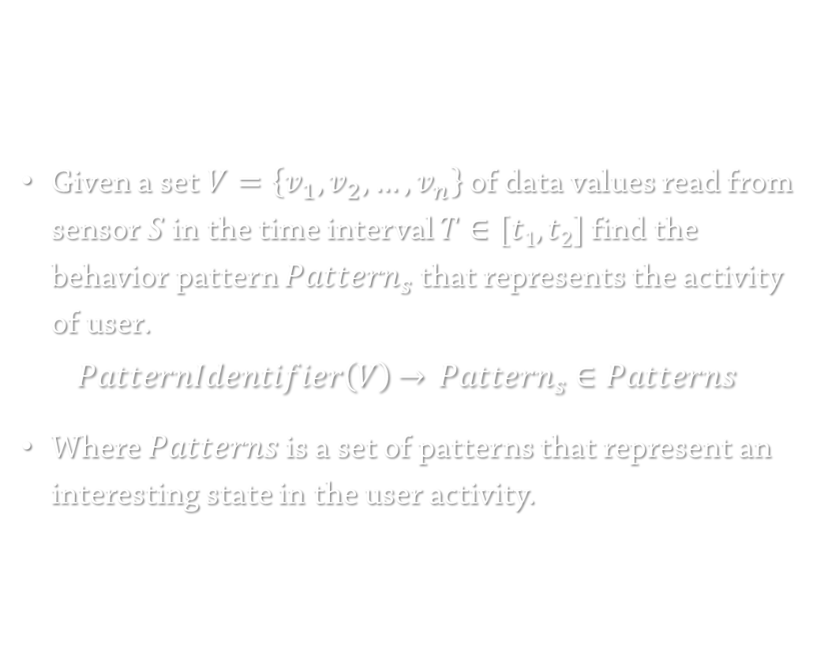
Problem statement
Given a set $V=\left\{v_{1},v_{2}, …,v_{n}\right\}$ of data values read from sensor $S$ in the time interval $T∈[t1, t2]$ find the behavior pattern ${Pattern}_{s}$ that represents the activity of user.
$$PatternIdentifier\left(V\right)\overset{→}{} {Pattern}_{s}∈Patterns$$
Where $Patterns$is a set of patterns that represent an interesting state in the user activity.
Pattern Identification
Notes:
Give the examples of elements inside the set Patterns:
“In the user motion scenario, the elements can be stationary, walking, running, vehicle and so on.”

Slide 11
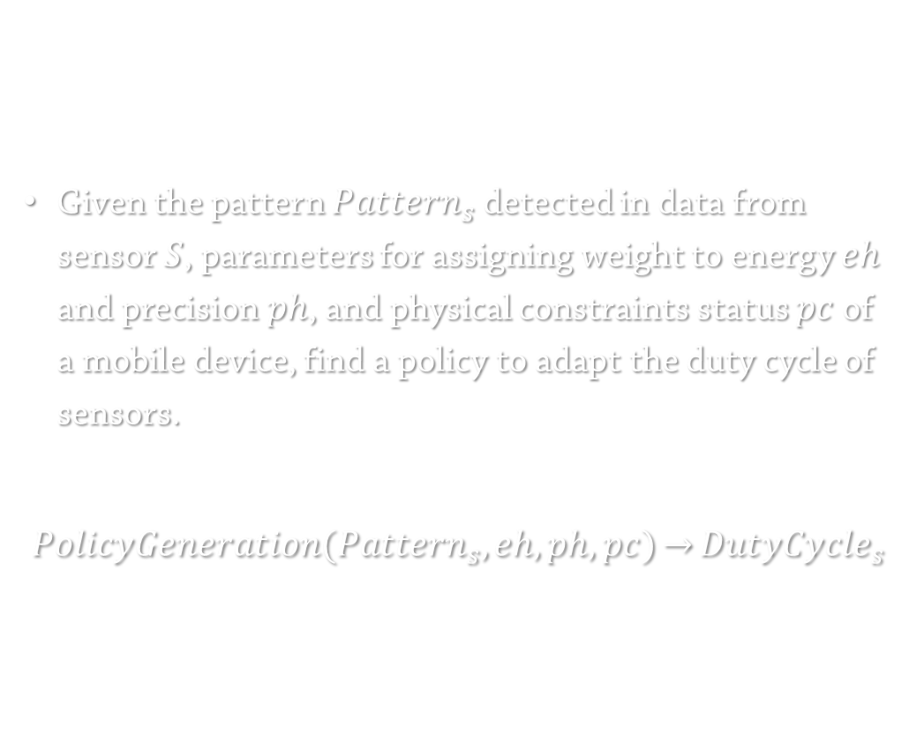
Problem statement
Given the pattern ${Pattern}_{s}$ detected in data from sensor $S$, parameters for assigning weight to energy $eh$ and precision $ph$, and physical constraints status $pc$of a mobile device, find a policy to adapt the duty cycle of sensors.
$$PolicyGeneration({Pattern}_{s},eh,ph,pc)\overset{→}{}{DutyCycle}_{s}$$
Policy Generator
Notes:
Mention that the policy can adapt the duty cycling of the sensor and eventually of other sensors.

Slide 12
Hypothesis
Smart policies generated through contextual information can be employed to reduce the energy consumption in a mobile device when performing continuous sensor readings.
Notes:
Enrich this hypothesis including comments of Dr. César:
The contextual information refers todata coming from the environment through sensors.
The smartness refers that the policy reacts according to the changes in environment-sensor data.

Slide 13
Main Objective
Reduce the energy consumption when performing continuous sensor readings in mobile devices by making use of context information.

Slide 14
Particular objectives
Identify behavior patterns which can provide meaningful context information from raw data collected by sensors.
Generate smart policies for sensor usage from context information, mobile app requirements and mobile device constraints.

Slide 15
State of Art
Notes:
Remark that is divided in two parts:
General background and
Related work

Slide 16
General Background
Notes:
Terminology useful for a better understanding of the problem

Slide 17
Stages of MSA *
Sensor reading
Filtering (optional)
Feature extraction
Classification
Post-processing
* Improving Energy Efficiency of Personal Sensing Applications with Heterogeneous Multi-processors, Moo-Ryong Ra, et. al., 2012
Notes:
If needed, mention that we are wrapping the sensor reading stage.

Slide 18
MSA Features
Sensing Scale *
Sensing paradigm *
Individual
Community
Participatory
Opportunistic
* A Survey of Mobile Phone Sensing, Nicholas D. Lane, et. al., sep 2010

Slide 19
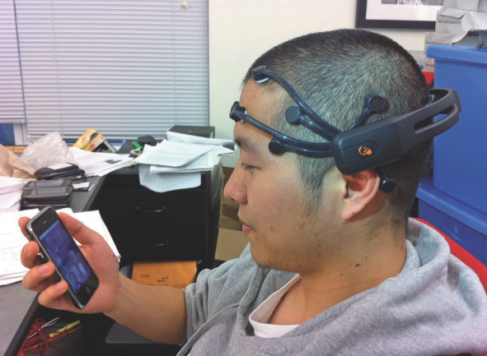
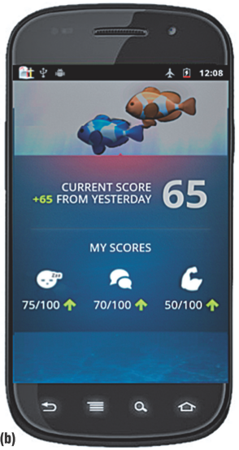
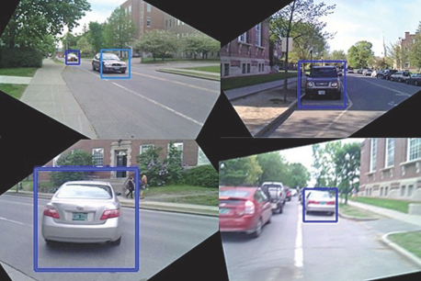
MSA Examples
NeuroPhone¹
BeWell²
WalkSafe³
A brain-controlled address book dialing app that employs neural signals obtained from an EEG headset.
An opportunistic sensing app that continuously tracks user behavior along three health dimensions (sleep duration, physical activity, social interaction).
An app that aids people that walk and talk, improving the safety of pedestrian phone users.
¹ NeuroPhone: Brain-mobile Phone Interface Using a Wireless EEG Headset, Andrew Campbell, et. al., 2010
² BeWell: A Smartphone Application to Monitor, Model and Promote Wellbeing, Nicholas D. Lane, et. al., 2010
³ WalkSafe: A Pedestrian Safety App for Mobile Phone Users Who Walk and Talk While Crossing Roads, Tianyu Wang, et. al., 2012
Notes:
Briefly, just announce that it is posible to do this kind of job with MSA

Slide 20
Related work

Slide 21
The Energy Issue
The usage of components of smart devices implies energy consumption.
Several efforts have been done in the field to address the issue.
The work can be categorized as:
General guidelines for using hardware components
Screen
Processor
Wireless communication interfaces
Focused on sensors' usage.
Notes:
First clarify, the work is related to the problema of the energy!

Slide 22
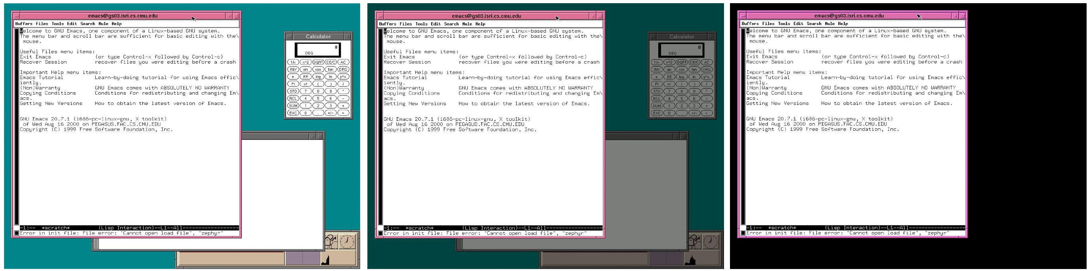
General guidelines
Mayo and Ranganathan* introduced the idea of the requirements-aware energy scale-down approach.
It states that energy consumption should be reduced as possible and still achieving mobile app requirements.
* Energy Consumption in Mobile Devices: Why Future Systems Need Requirements-Aware Energy Scale-down, Robert N. Mayo and Parthasarathy Ranganathan, 2004

Slide 23
Proposed Taxonomy
Approaches for solving the energy issue
Pure hardware
Autonomous
Not Autonomous
Hardware-Software
Hardware Access Layer
Pure software
Sensor usage adaptation based on user behavior
Duty cycling
Next value inference
Recycling existing data
Sensor replacement
Directly related
Context related
Notes:
Mention just in a higher level.

Slide 24
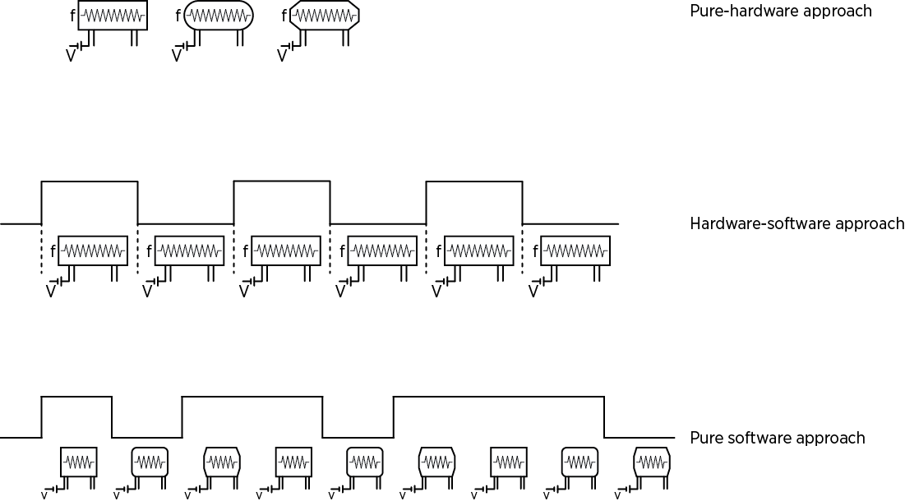
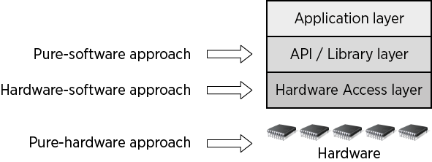
Approaches focused in sensors usage
Figure: The energy issue as a cross-layer problem
Figure: The approaches and their relation with the hardware mobile platform
Notes:
Get help of these images to explain how it is:
A cross layer ítem.
Materialized in hardware.

Slide 25
Pure Hardware Approach
It is focused in adapting physical features of hardware in order to reduce the energy consumption.
The most used physical features are the frequency and voltage introduced to circuits.
Hardware elements may be rearranged in order to exploit such features.

Slide 26
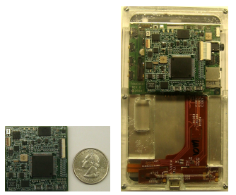
Pure Hardware: Not Autonomous
The hardware platform can not adapt its behavior by itself.
Instead, it needs a software element that dictates how access to sensors is performed.
LittleRock isolates sensors within a special hardware unit with a low power processor.
Its access is solely specified by the mobile app.
Figure: LittleRock hardware implementation
* LittleRock: Enabling energy-efficient continuous sensing on mobile phones, Bodhi Priyantha et. al., 2011

Slide 27
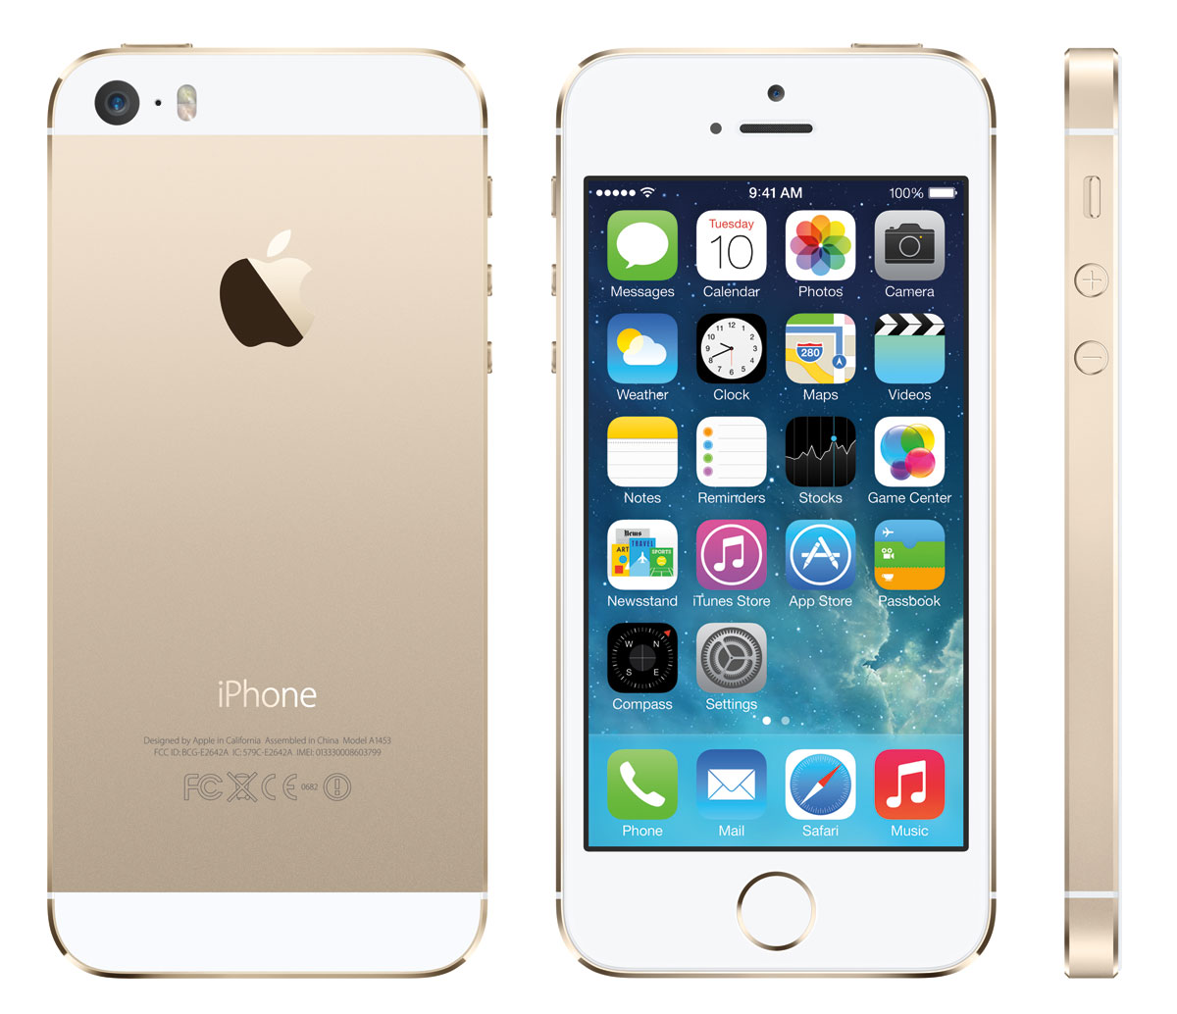
Pure hardware: Autonomous
The hardware platform is also able to deliver contextual information without intervention of a mobile app.
Apple iPhone 5s and newer models include an additional hardware unit with a low power coprocessor for accessing sensors.
Through the CoreMotion framework *, developers can access to fitness data such as distance covered, steps performed, and identify user activity (walking, running, etc.).
Figure: Apple iPhone 5s
* Core Motion Framework Reference, Apple Inc., 2013

Slide 28
Hardware-Software
This approach introduces the basic notion of rules and special cases in order to decide the best moment for turning sensors on and off.
Typically, it means that the control points for accessing sensors offered by the pure hardware approach are isolated and grouped into new control points accessible trough hardware drivers or the lowest layers of the mobile OS.
Notes:
Don’t forget that it can be summarized as drivers-OS!

Slide 29
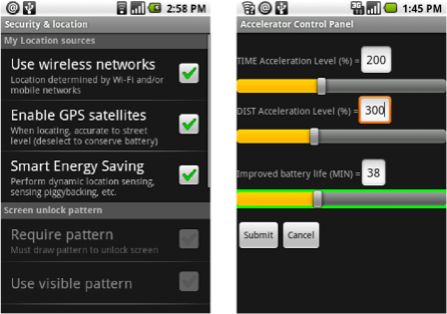
Hardware-Software
Zhuang, et. al.*, proposed a framework for reducing energy consumption by location based services. Its core elements:
Sensor substitution.
Sensor suppression.
Sensor piggybacking.
Sensor adaptation.
It is immersed in the Android mobile operating system.
* Improving Energy Efficiency of Location Sensing on Smartphones, Zhenyun Zhuang, et. al., 2010
Notes:
Substitution: Possibility to change the sensor employed.
Suppression: Possibility to use a ‘cheaper’ sensor.
Piggybacking: Possibility to coordinate several requests for sensor data coming from different mobile apps.
Adaptation: Modify the frequency of sensors access.

Slide 30
Pure software
The main idea is to improve the smartness of the mobile platform, making it aware of the user activities and behavior.
The context awareness is then used to adapt the sensor usage in order to obtain energy savings.
By implementing such cognitive processes in the higher software layers, they can be configured, tuned, packed and distributed for their usage in mobile apps running in millions of mobile devices.

Slide 31
Pure Software: Sensor usage adaptation
Tries to analyze historical data delivered by sensors for detecting patterns in the user behavior.
Three decisions can be made based on the information discovered:
Sensor usage adaptation
Duty cycling
Recycling existing data
Next value inference

Slide 32
Pure Software: Sensor usage adaptation
Duty cycling
Next value inference
Recycling existing data
It adapts the sensor access frequency to reduce energy consumption.
It May introduce energy-precision tradeoffs.
Perez-Torres and Torres-Huitzil¹ implemented GPS duty cycle manipulation using a basic notion of policy.
It analyzes the historical data in order to infer the next value.
An actual access to sensor is avoided.
It might be useful in high energy consuming sensors (pluggable) or in distributed systems as shown by Musolesi, et. al.².
It identifies common or frequent circumstances and deliver the same data each time.
An actual access to sensor is avoided.
Chon et. al. ³, implemented a framework that recycles existing location data based on the detection of certain events.
¹ A power-aware middleware for location & context aware mobile apps with cloud computing interaction, R. Perez-Torres and C. Torres Huitzil, et. al., 2012
² Supporting Energy-efficient Uploading Strategies for Continuous Sensing Applications on Mobile Phones, Mirco Musolesi, et. al., 2010
³ Adaptive Duty Cycling for Place-Centric Mobility Monitoring using Zero-Cost Information in Smartphone, Yohan Chon, et. al., 2014

Slide 33
Pure Software: Sensor Replacement
It considers the semantic of data in order to find another source of information.
Typically, the sensor replacement will carry an energy – precision tradeoff.
Directly related
Context related
The selected sensor delivers the same type of information.
For example, Ben Abdesslem, et. al.¹, propose to obtain user location from GPS or Wireless Networks depending on GPS coverage.
The selected sensor does not deliver the same type of data, but it can be translated (mapped) to be semantically meaningful.
For example, Yohan Chon, et. al.², employ the battery status, that might suggest whether user is at home or work.
¹ Less is More: Energy-efficient Mobile Sensing with Senseless, Ben Abdesslem, et. al., 2009
² Adaptive Duty Cycling for Place-Centric Mobility Monitoring using Zero-Cost Information in Smartphone, Yohan Chon, et. al., 2014
Notes:
Finishing mentioning that all approaches are not mutually excludent.
There can be mix of approaches.

Slide 34
Scope of research
The solution pursued by this research will be materialized in a software element following:
The pure-software approach.
The individual sensing scale.
The opportunistic paradigm.
Additionally, the sensors to be employed are the ones describing motion (inertial sensors) like GPS and accelerometer.
Notes:
If you did not say it:
Finishing mentioning that all approaches are not mutually excludent.
There can be mix of approaches.

Slide 35
Methodology

Slide 36
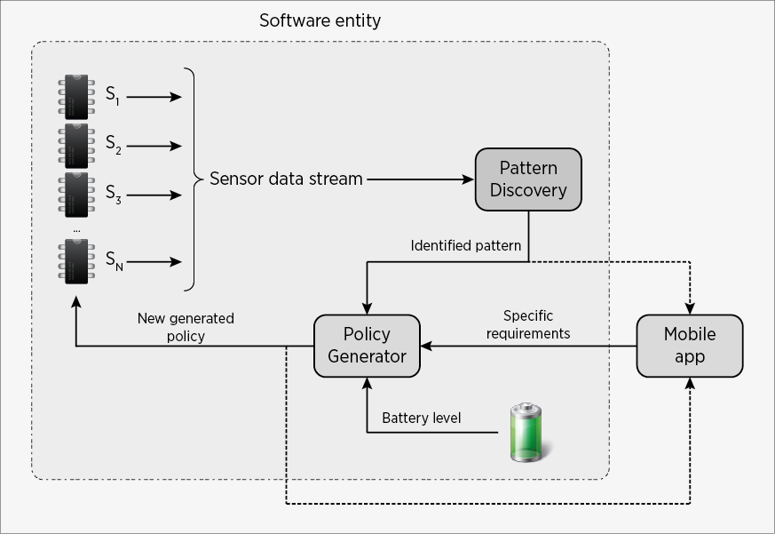
Methodology
Figure: Proposed methodology for addressing the energy issue from a pure software perspective.
Notes:
Implicitly describe that there are steps and then talk at detail in the next slides

Slide 37
Data acquisition
Data acquisition is the starting point and the ending point of the process.
It gathers streams of data used later to discover a pattern in user behavior.
It is influenced by feedback information created by the Policy generator.

Slide 38
Pattern Identifier
It receives data from sensors.
It has the implicit requirement of a memory for storing data.
It should implement pattern recognition techniques for identifying relevant events from sensor data.

Slide 39
Policy generator
It creates policies based on the pattern identified from sensor data, precision and energy hints provided by mobile app, and current status of physical constraints (battery level) of mobile platform.
It is the supplier element of smartness in the platform.
The policy created can be implemented by modifying the duty cycling of sensors.

Slide 40
Ongoing Work

Slide 41
Ongoing work
Verify the completeness of the presented taxonomy of approaches for solving the energy issue.
Creation of a mobile app for collecting location data from user.
These data is useful for identifying the mobility patterns to be considered in the research and for running future experimentation.
Writing a survey about state of art techniques for reducing the energy consumption of mobile sensing apps.

Slide 42
Schedule
 |  | SEP 14 – AUG 15 |  |  | SEP 15 – AUG 16 |  |  | SEP 16 – AUG 17 |  |  | SEP 17 – AUG 18
 | Activity | 1st | 2nd | 3rd | 1st | 2nd | 3rd | 1st | 2nd | 3rd | 1st | 2nd | 3rd
1 | Research on the characteristics of data delivered by sensors (GPS receiver).
2 | Definition and selection of mobility patterns to be identified.
3 | Research and adaptation of algorithms to detect mobility patterns of user based on data delivered by GPS
4 | Creation of the pattern identifier element (PIE)
5 | Creation of the policy generator element (PGE)
6 | Development of a software element (SE) that integrates both PIE and PGE
7 | Experimentation
8 | Publication of results
9 | Thesis writing
10 | Related subject courses

Slide 43
Conclusions

Slide 44
Conclusions
The advances performed during the first period of the research has been presented.
A detailed introduction of the energy issue in MSA has been described.
A taxonomy of approaches for solving the energy issue in MSA has been presented.
The taxonomy shows that the issue is a cross-layer problem.
A method for solving such problem from the pure software perspective has also been introduced.
The pure software approach offers the opportunity for increasing the smartness level of the mobile platform, becoming aware of the environment for making informed decisions.

