Slide 1
John the Ripper

Slide 2
John the Ripper
is a password cracking software used by penetration testers and cyber security experts
it is completely free
first released in 1996 by “OpenWall”
it’s latest version is 1.9.0 which was released in 2019
it has the ability to crack passwords and also it automatically detects the hash type if passwords are saved in a hash rather than plain text, it combines a number of strategies to crack passwords

Slide 3
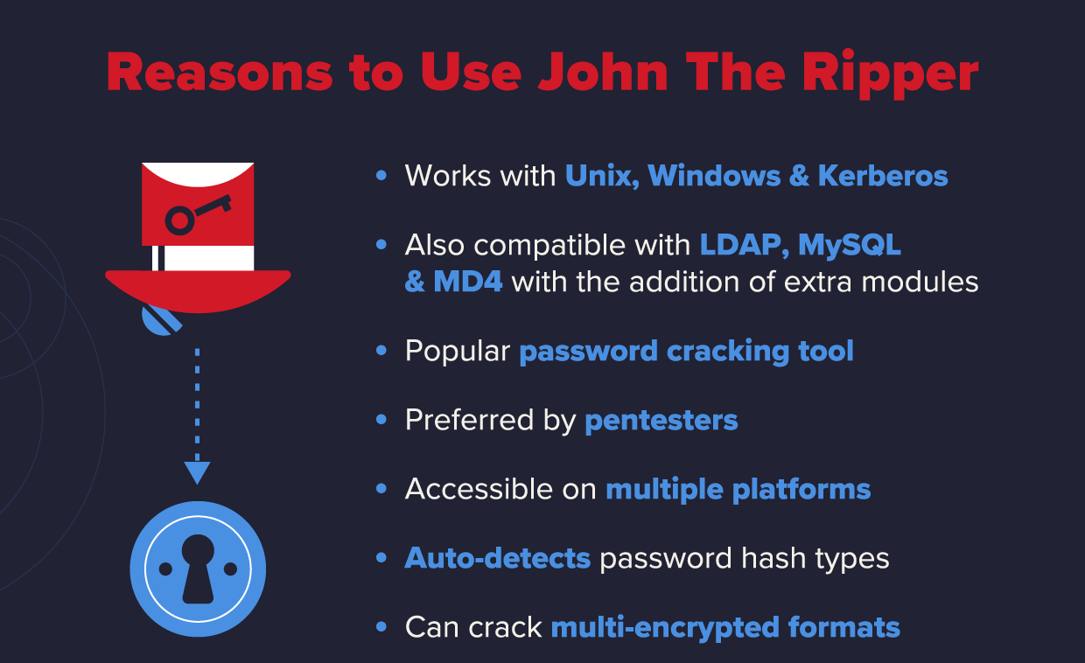

Slide 4

Cracking passwords

Slide 5
SINGLE CRACK MODE
- is the fastest and best mode if you have a full password file to crack
WORDLIST MODE
- compares the hash to a known list of potential password matches
INCREMENTAL MODE
- is the most powerful and possibly won’t complete
- this is your classic brute force mode that tries every possible character combination until you have a possible result

Slide 6
How to Install John the Ripper on Windows?

Slide 7
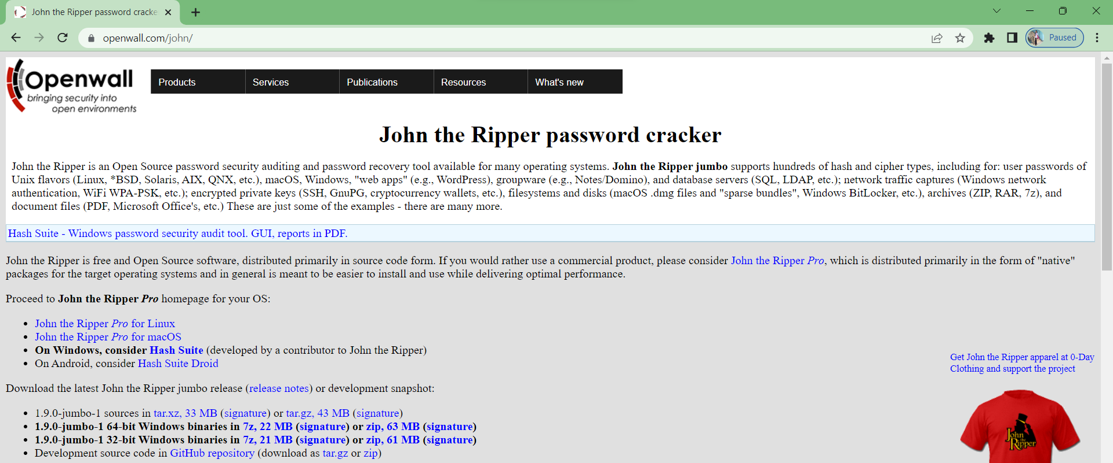
Step 1: Visit the official website (https://www.openwall.com/john/) of John the ripper using any web browser.

Slide 8
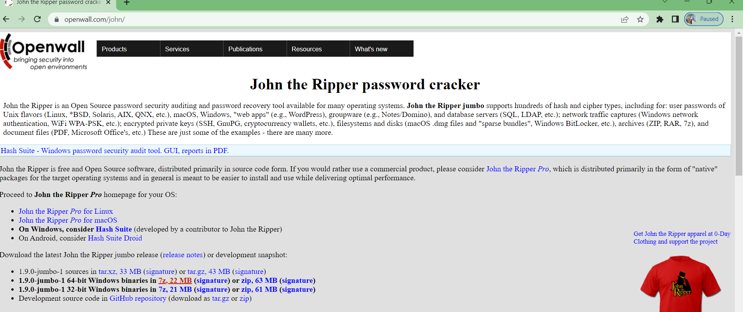
Step 2: There are two options available for windows one is 1.9.0-jumbo-1 64-bit Windows and the other is 1.9.0-jumbo-1 32-bit Windows. Click on the one as per your system configuration. Let’s take the one for the 64-bit operating system. Downloading of the executable file will start shortly. It is a small 21.1 MB file that will hardly take a minute.

Slide 9
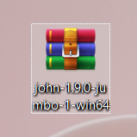
Step 3: Now check for the zip file in downloads in your system and extract it.

Slide 10
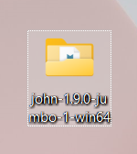
Step 4: After extraction, a new folder will be seen on the desktop, open it.

Slide 11
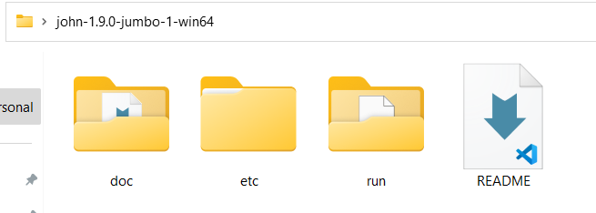
Step 5: Below folders are inside the extracted folder.

Slide 12
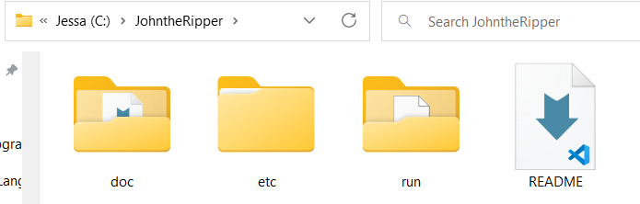
Step 6: Cut/Copy these folders and go to C drive, make a new folder named JohnTheRipper and paste these folders into this new folder named John the Ripper.

Slide 13
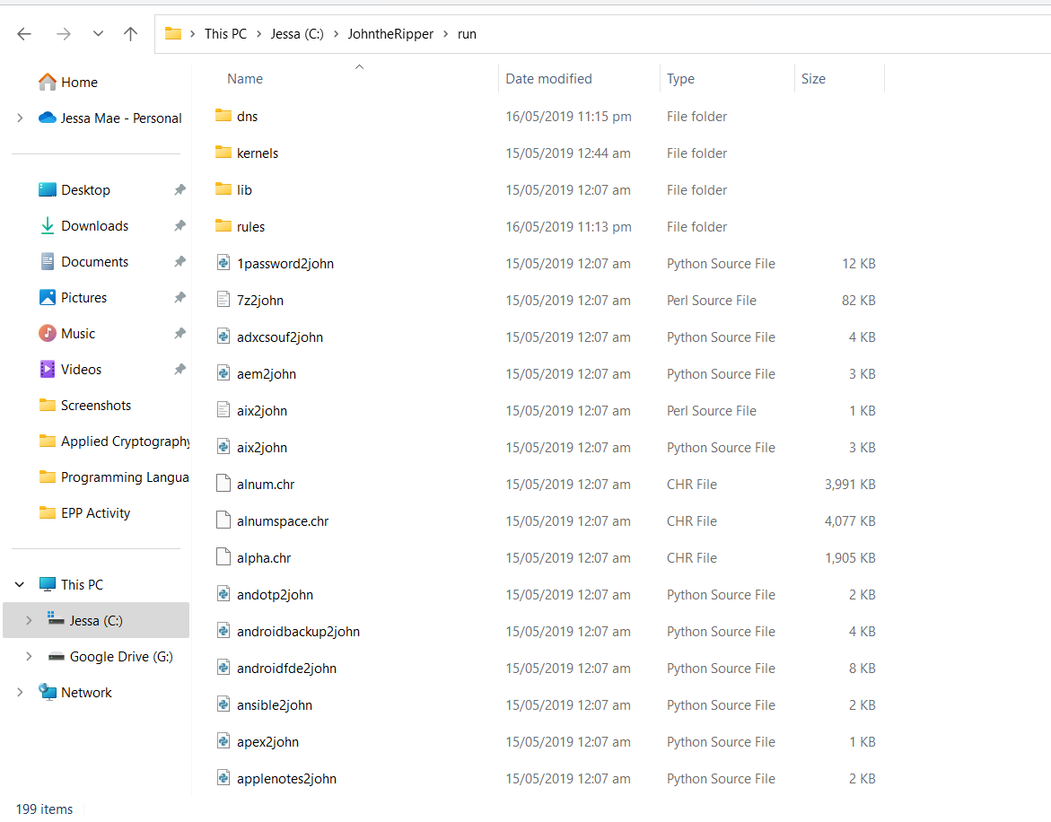
Step 7: Now go inside the run folder.

Slide 14
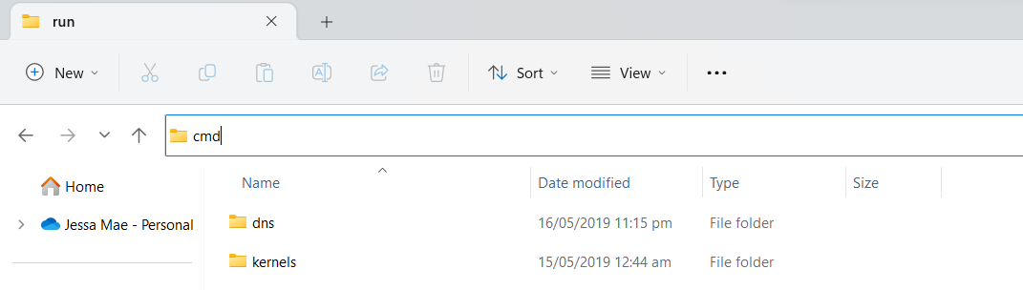
Step 8: Type cmd on as shown in the below image and press enter.

Slide 15
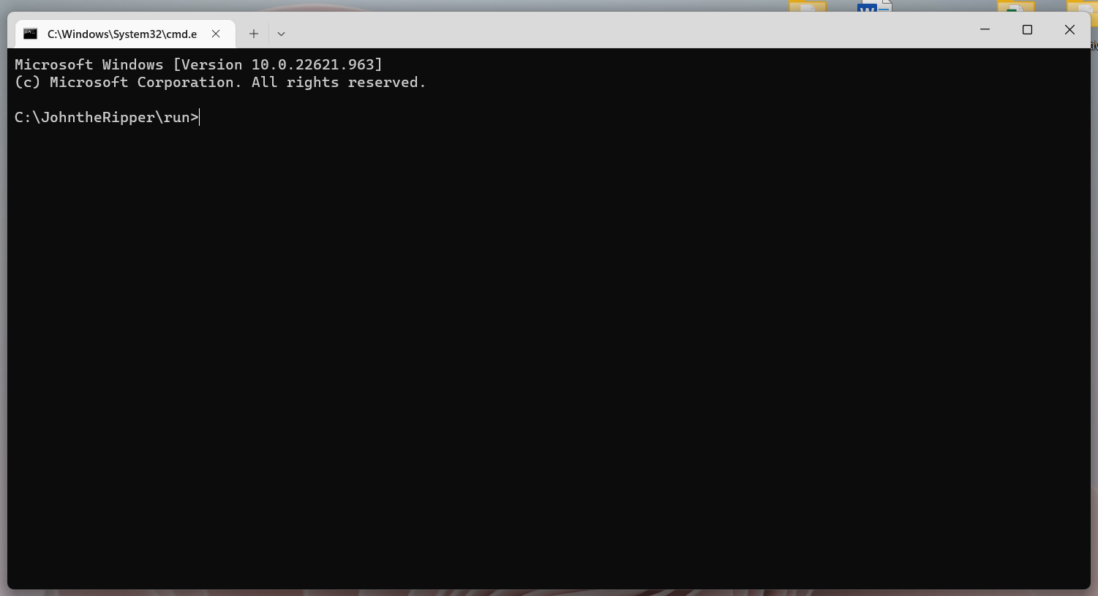
Step 9: The command prompt will open with the current folder.

Slide 16
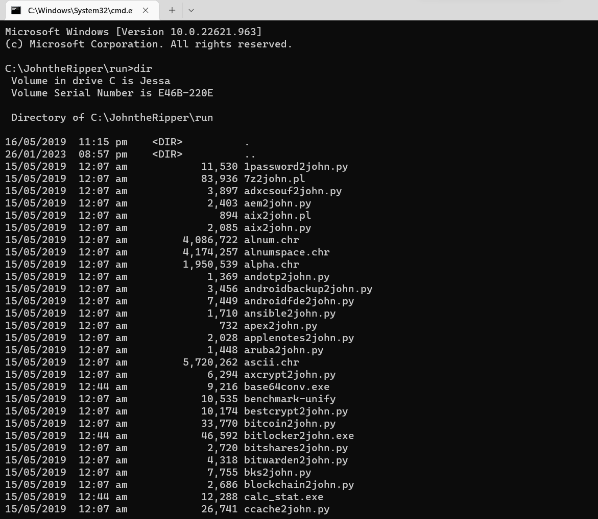
Step 10: Type dir for listing all files and folders.

Slide 17
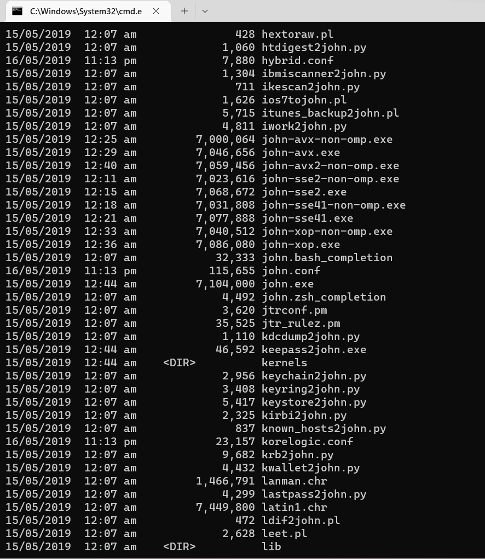
Step 11: Now look for john.exe.

Slide 18
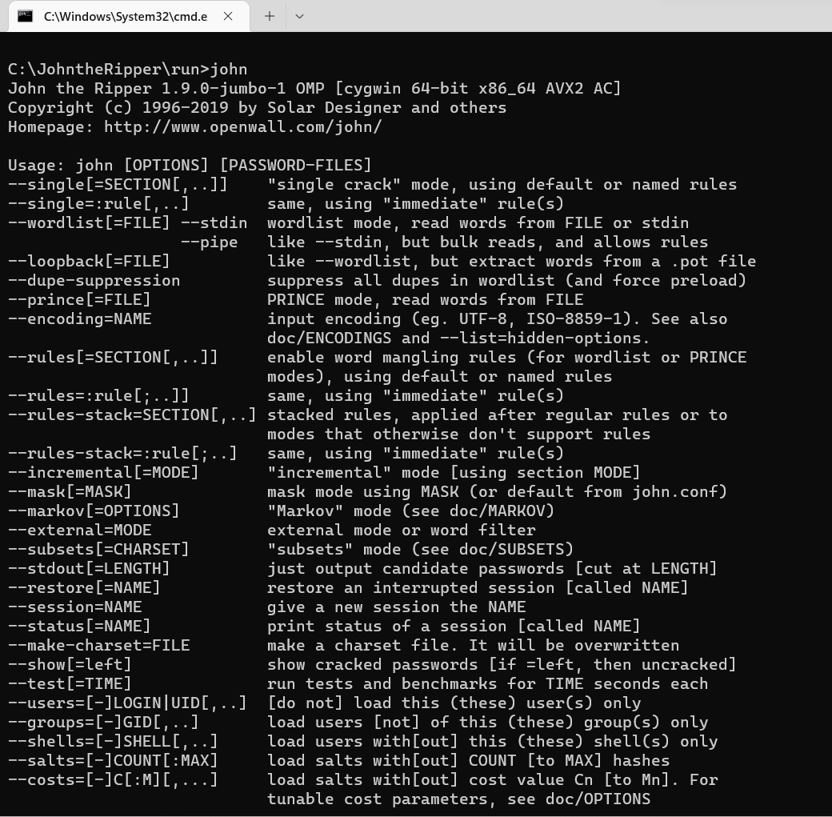
Step 12: Type john and press enter, it will show the version of john the ripper so it is working correctly.

Slide 19
How to generate a hash?

Slide 20


Slide 21
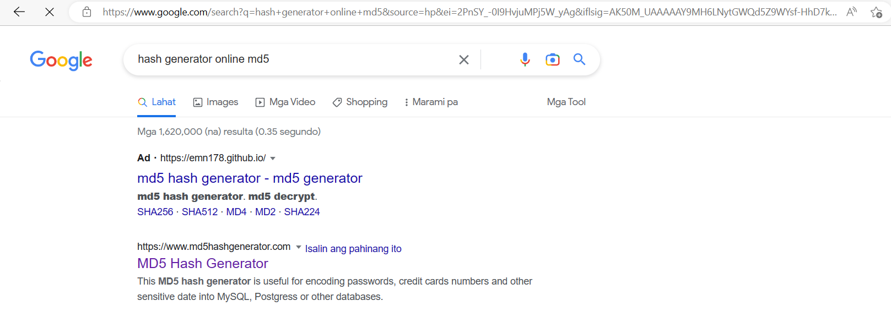

Slide 22
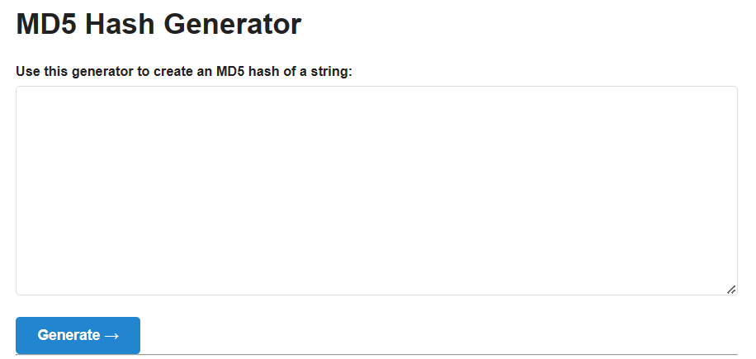

Slide 23
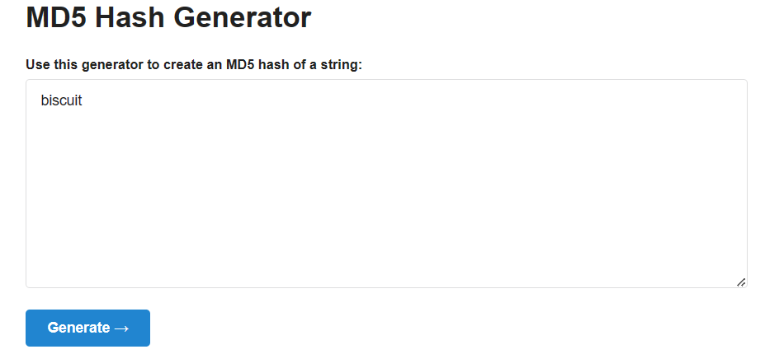

Slide 24
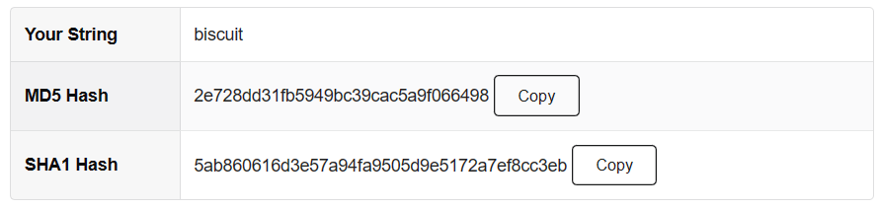
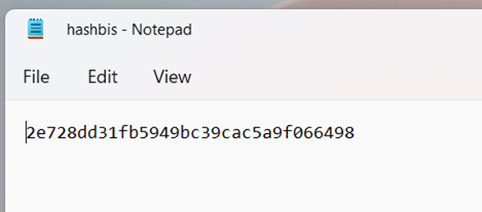

Slide 25
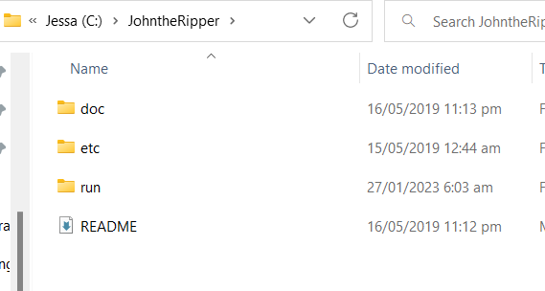
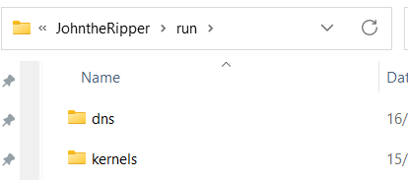
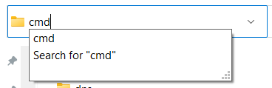

Slide 26
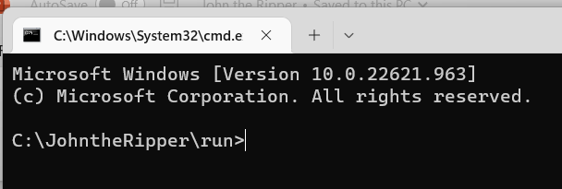
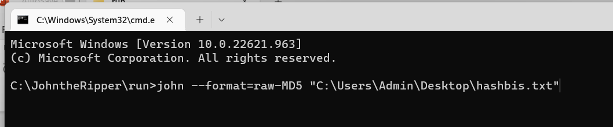


Slide 27
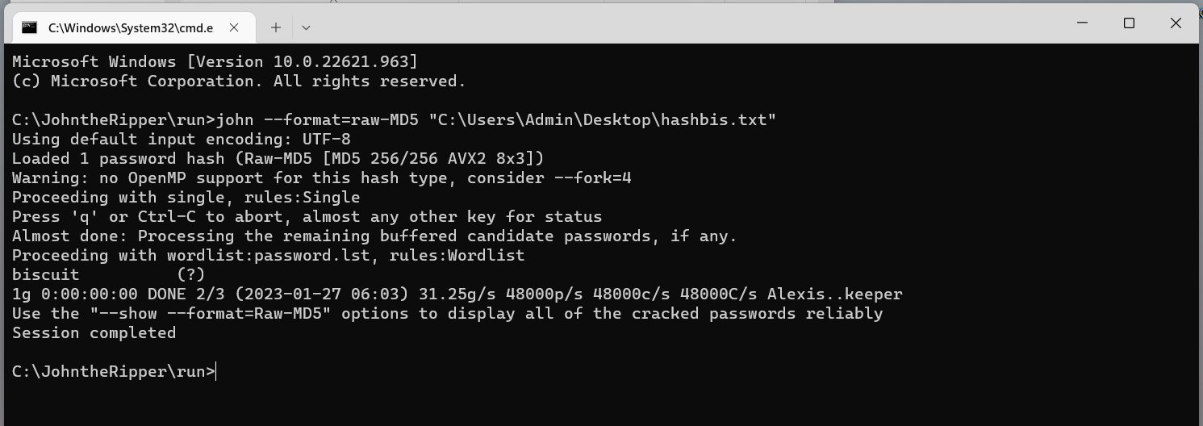


Slide 28
References:
https://www.geeksforgeeks.org/how-to-install-john-the-ripper-on-windows/
https://www.hackingarticles.in/beginner-guide-john-the-ripper-part-1/
https://www.youtube.com/watch?v=_4-kwklhxho

