Slide 1
Word embedding with word2vec
<Team 어쩌다>
20161466 강소정
20172584 양소연
20163332 권영선
20161916 황채원

Slide 2
Our Project is …
Keyword Detection System based on Naver News Data

Slide 3

Project Description
news_crawler.ipynb Collect data
word2vec.ipynb Preprocess data
word2vec
Model application
NEWS.csv
stopwords-ko.txt
exceptionwords.txt
: Collected news data
: List of Korean stop words
: List of words that should not be split

Slide 4

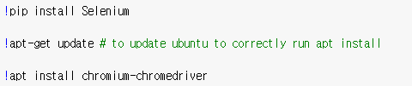
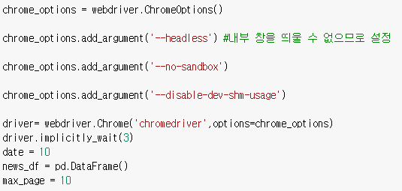
Data Crawling
Selenium can automate browser behavior as a tool for website testing.
Programming controls browser behavior so you can request web pages and get responses as if they were human.
We use Selenium to make web crawler.
These options prevent the chrome driver from displaying a chrome window or being denied access.
new_df: Dataframe for storing news data

Slide 5
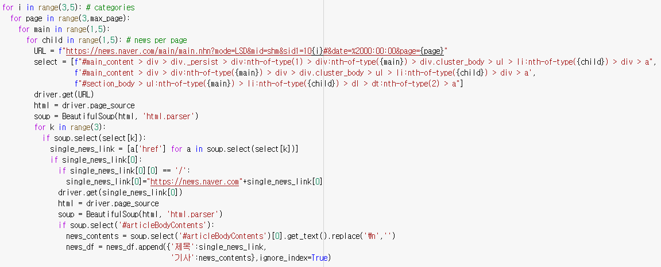
Data Crawling
- Go to the news list page of Naver News.
- Enter categories i and page to complete url to obtain links for each article from the driver and parse html source code from pages moved to links in each article with beautyifulsoup.
- Save each body text in the Newslink article column in the title column and save it as a data frame.

Slide 6

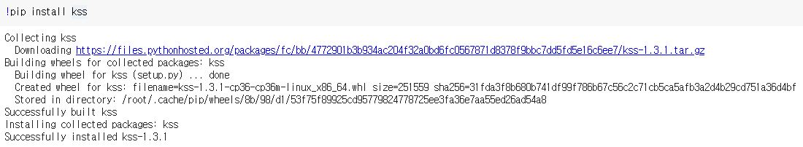
Data Preprocessing
1. Library
Install kss, one of the best tokenizer in Korean sentence separation libraries.

Slide 7
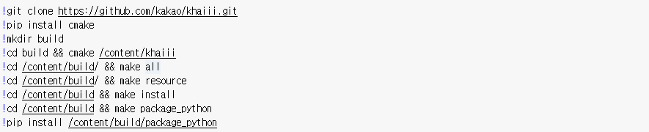
Data Preprocessing
1. Library
khaiii is a morphological analyzer developed by Kakao, which means "Kakao Hangul Analyzer III," and is a software that separates words into morphemes using data (or machine learning)-based algorithms.
We use Khaii, one of the best performing ones among the Python-based morphology analyzer.

Slide 8
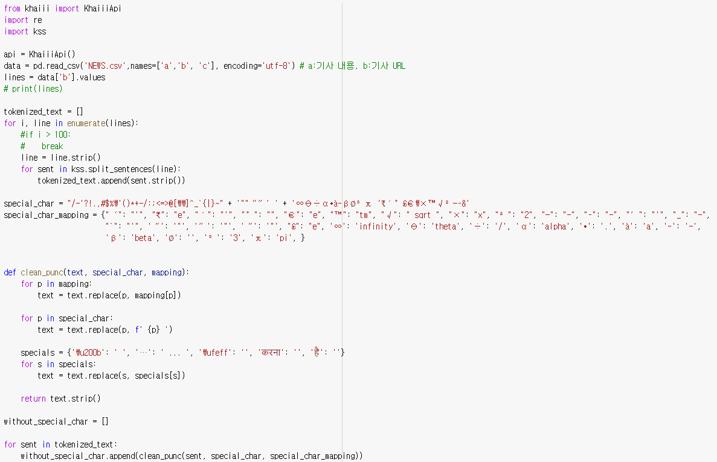
Data Preprocessing
<Basic preprocessing>
Remove html tag
Remove numeric characters
Remove special characters like “@%*+()?+”

Slide 9
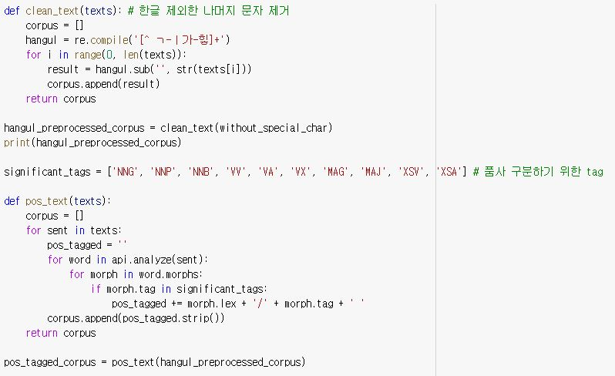
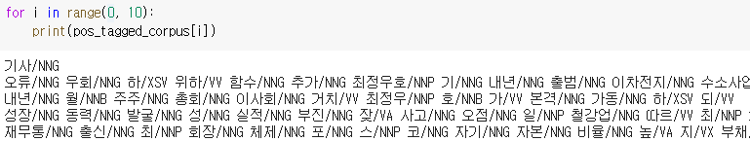
Data Preprocessing
<Morphological analysis>
Remove any characters without Korean.
Put a tag on the back to distinguish the parts of the words.

Slide 10
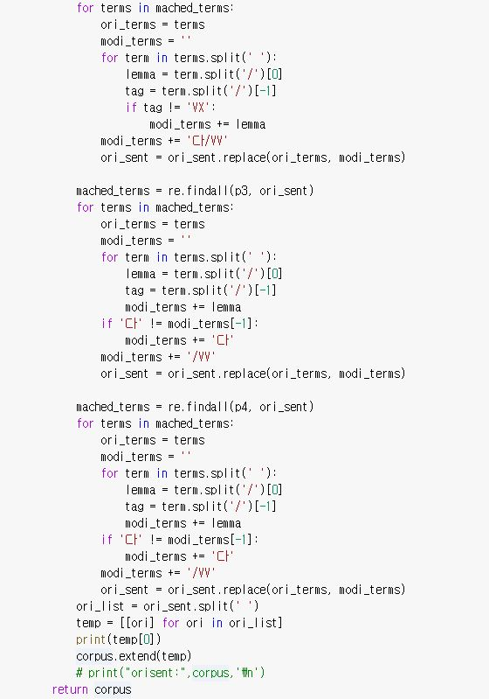
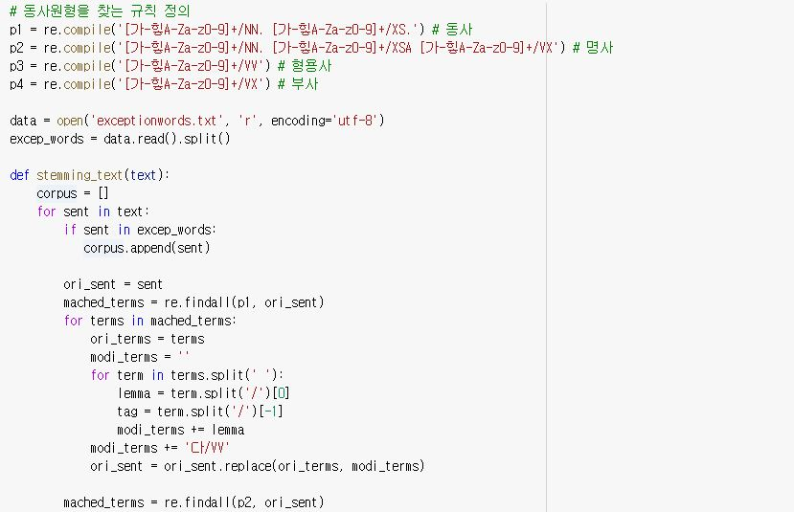
Data Preprocessing

Slide 11
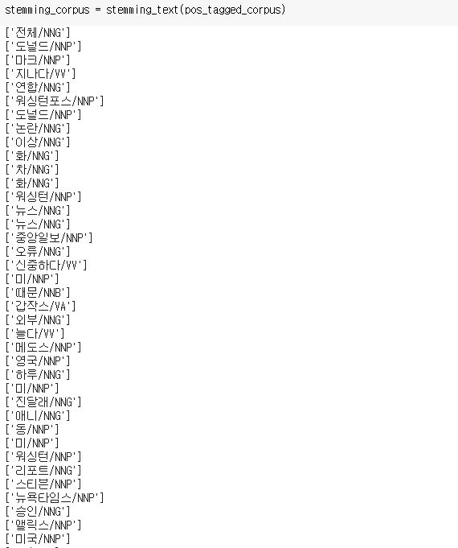
Data Preprocessing
<Stemming>
: Restore the verb to its original word. The rules are as below.
1. NNG|NNP|NNB + XSV|XSA --> NNG|NNP|NNB + XSV|XSA + 다
2. NNG|NNP|NNB + XSA + VX --> NNG|NNP + XSA + 다
3. VV --> VV + 다
4. VX --> VX + 다
: The result is as right image.

Slide 12
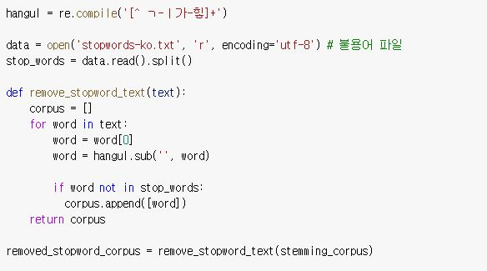
Data Preprocessing
<Stopwords>
: Remove Korean stop words using “stopwords-ko.txt” file.

Slide 13

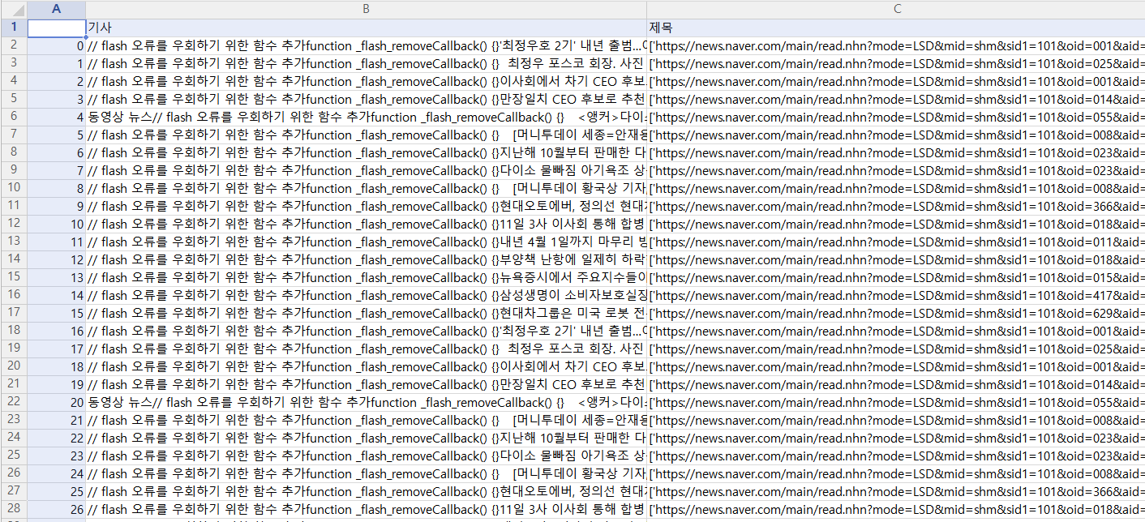
Data Model
Data structure
<NEWS.csv example>
- Number of document : about 3,880
- Size : 14502KB
- Type : Naver news text
- Period: 2018.12.10 ~ 2019.12.18
Collection method
: python Selenium package
- We saved news to a .csv file

Slide 14
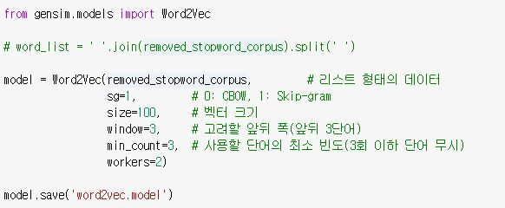
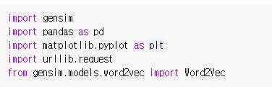
Data Model
<Model>
: Python's gensim package supports Word2Vec, so we used the gensim package to implement Word2Vec based on the preprocessed data.
sentences: Sentences to learn size: Dimension of word vector(embedding size) window: Size of window sg: Usage status of skip-gram (1: Use, 0: CBOW) min_count: Minimum frequency of words (words appearing less than this size are not used as learning words)
iter: Number of learning

Slide 15

Result
키워드 입력해서
나오는 유사도 캡쳐해서 넣어주세요!!!

Slide 16

Measurement

Slide 17

Visualization

Slide 18

GitHub information
https://github.com/s0ye0nyang/News-Recomendation-System

Slide 19

Complementary point
We didn't collect enough data because we crawled the data ourselves. As a result, the accuracy came out low.
더 채워주세요!!!!

Slide 20
THANKYOU

