Slide 1
LuckyPig Calculator
Author: 張勝韋
Student number: 102502549

Slide 2
功能
加,減,乘,除運算
數字範圍 -1e100 to 1e100
一個記憶空間

Slide 3
問題與解決
eval()
%
00.1
Number.prototype.toPrecision()
0.0033333 -> 0.003333300
Number.prototype.toExponential()
0.0033333 -> 3.33330e-3

Slide 4
問題與解決
eval()
replace(/(\d+\.?\d*(?:e\+\d+)?(?:e\-\d+)?|\d*\.?\d+(?:e\+\d+)?(?:e\-\d+)?)(?=%)/g, "($1").replace(/%(?=%)/g, "*1/100").replace(/%/g, "*1/100)")
replace(/0+\./g, ".").replace(/0+(?=\d+\.)/g, "")
Number.prototype.toPrecision()
replace(/(\.[0-9]*[1-9])0*|(\.0*)/, "$1")
Number.prototype.toExponential()
replace(/(\.[0-9]*[1-9])0*|(\.0*)/, "$1")

Slide 5
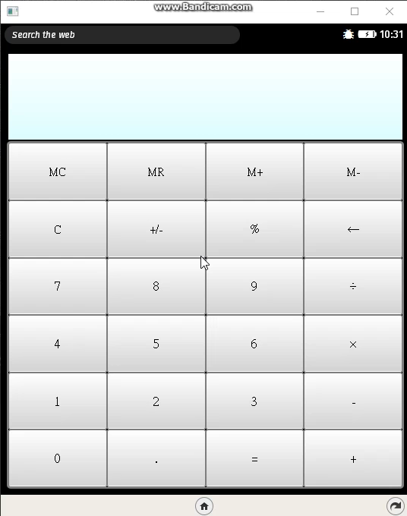
Demo

