Slide 1
A Survey of Artiﬁcial Intelligence for Cognitive Radios
IEEE TRANSACTIONS ON VEHICULAR TECHNOLOGY, VOL. 59, NO. 4, MAY2010
Author: An He, Kyung Kyoon Bae, Timothy R. Newman, Joseph Gaeddert, Kyouwoong Kim, Rekha Menon
Rekha Menon, James Jody Neel, Youping Zhao, Jeffrey H. Reed, William H. Tranter
Presenter: Chi-Yuan, Huang

Slide 2
Agenda
01
CR & CE
Cognitive Radio & Cognitive Engine
02
MLPN, GA, HMM, CBR
Brief introduction of some algorithm and model
03
Conclusion
Give a conclusion of this paper

Slide 3
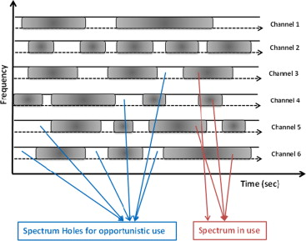
What is CR?
A cognitive radio (CR) is a radio that can be programmed and configured dynamically to use the best wireless channels in its vicinity to avoid user interference and congestion. Such a radio automatically detects available channels in wireless spectrum, then accordingly changes its transmission or reception parameters to allow more concurrent wireless communications in a given spectrum band at one location.
Observation: Collect information about the operating environment, capability, and characteristics of the radio.
Reconfiguration: Change the operation parameters of the radio.
Cognition: Understand the environment and capability of the radio (awareness), make informed decisions on actions (reasoning), and learn the impact of these actions on the performance of the radio.

Slide 4
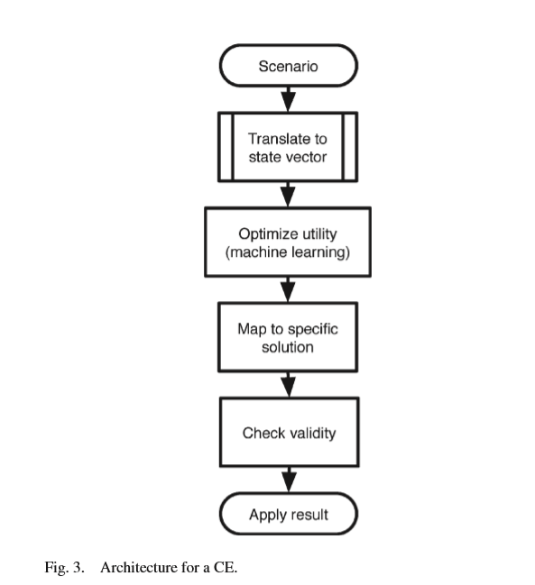
What is CE?
This paper deﬁnes a Cognitive Engine as an “intelligent” agent that manages the cognition tasks in a CR, where intelligence denotes behavior that is consistent with a speciﬁed goal.

Slide 5
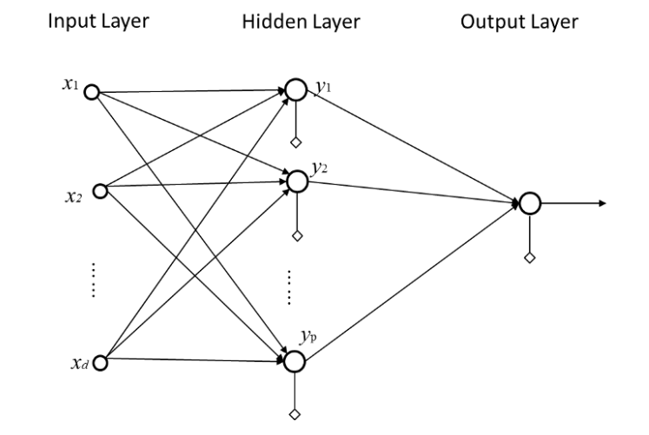
MLPN (Multi-layer perceptron Network)
Pros:
Classiﬁcation
High self-adaptability
Cons:
Overtraining initial data set

Slide 6
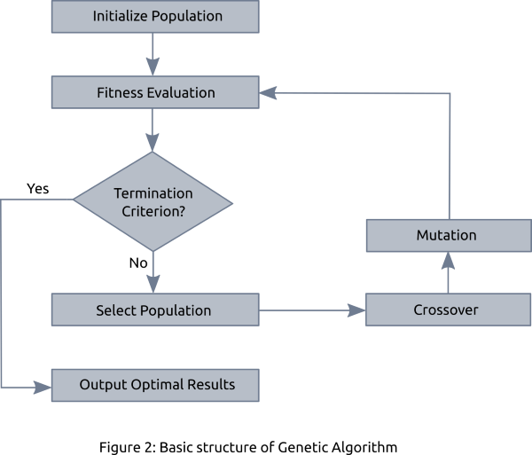
GA (Genetic Algorithm)

Slide 7

Pros:
Combinatorial optimization
Cons:
hypothesis space

Slide 8
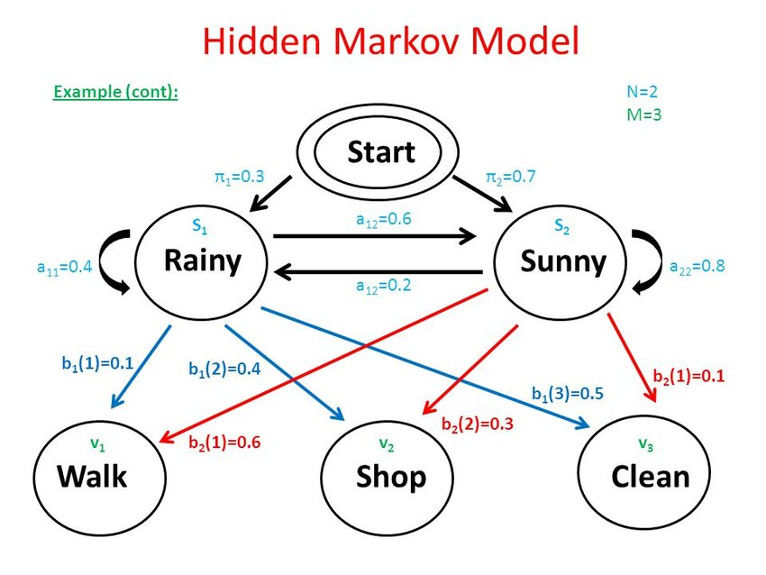
HMM (Hidden Markov Model)
Pros:
Classiﬁcation
Prediction
Cons:
require good training sequence

Slide 9
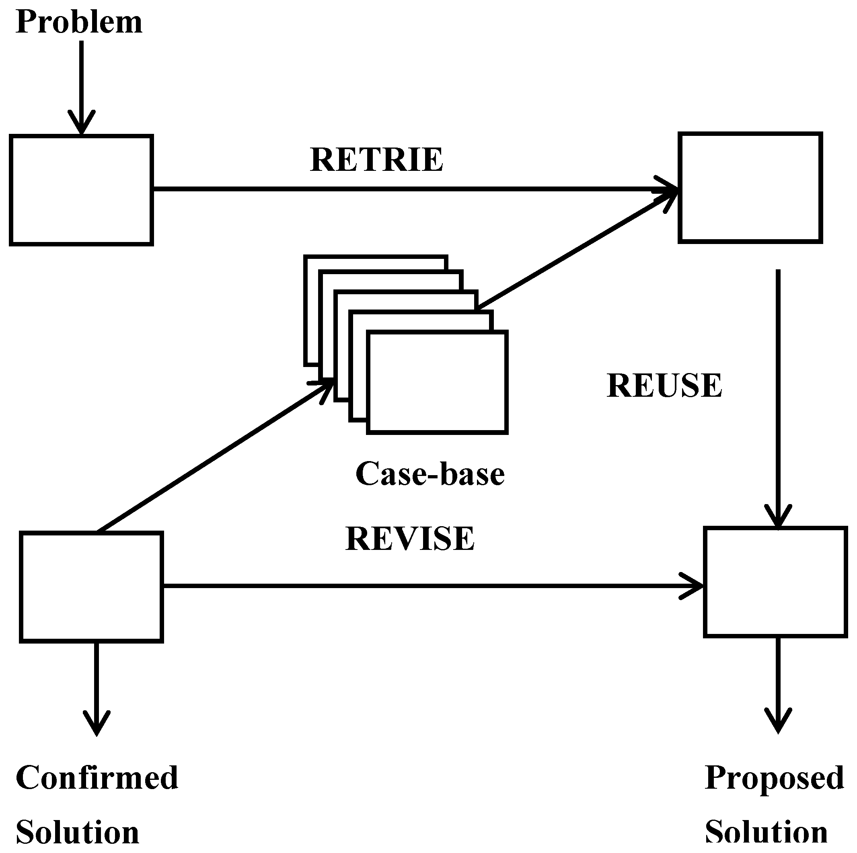
CBR (Case-Based Reasoning)

Slide 10
Conclusion
Response time, processing complexity, training sample availability, robustness are important. In addition to the choice of AI techniques, the CE training process is crucial to performance.
Training could be hastened by using cooperative training techniques, but to limit potential security vulnerabilities, these sources should be authenticated, and externally learned behaviors should be evaluated against self-generated field measurements.

