Slide 1
FP Growth: A Frequent Pattern-Growth Approach

Slide 2
FP Growth - Introduction
Bottlenecks of the Apriori approach
Scan DB once each iteration → need lots of I/O
Candidate generation could be very slow
Huge memory consumption
Advantage of the FP Growth approach
Scan DB only twice
Much faster than the Apriori approach
Store a compact version of DB in memory

Slide 3
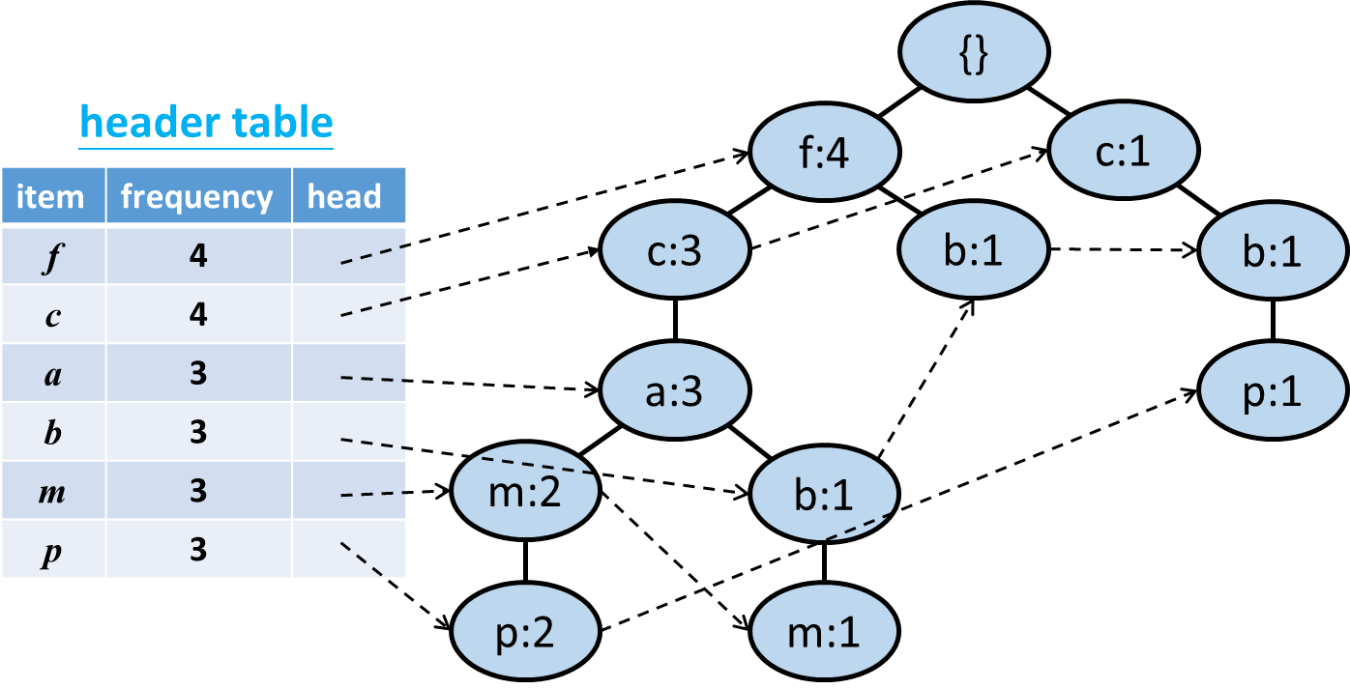
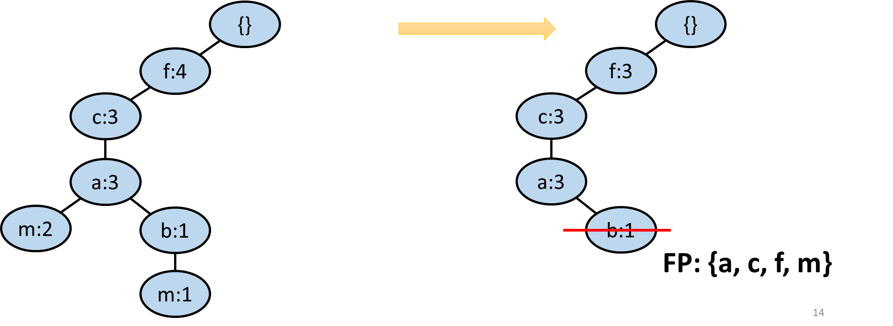
FP Growth - Introduction
Step 1. Construct a FP tree
Step 2. Select each frequent item to be suffix and use FP tree to find frequent patterns

Slide 4
FP Growth - Constructing FP tree
1. Scan DB once, find
frequent 1-item set
(support >= min_support)
2. Build a header table of
frequent items, which is sorted by their frequency in
descending order
FP tree is related to min_support. If min_support changes, a new tree needs to be re-built.
DB
header table
TID | items
100 | f, a, c, d, g, i, m, p
200 | a, b, c, f, l, m, o
300 | b, f, h, j, o, w
400 | b, c, k, s, p
500 | a, f, c, e, l, p, m, n
item | frequency | head
f | 4
c | 4
a | 3
b | 3
m | 3
p | 3
Build
min_support = 3

Slide 5
FP Growth - Constructing FP tree
3. Scan DB again. Exclude non-frequent items
and sort frequent items by their frequencies. Then construct FP tree (details given later)
header table
item | frequency | head
f | 4
c | 4
a | 3
b | 3
m | 3
p | 3
DB
TID | Items
100 | f, a, c, d, g, i, m, p
200 | a, b, c, f, l, m, o
300 | b, f, h, j, o, w
400 | b, c, k, s, p
500 | a, f, c, e, l, p, m, n
TID | Items
100 | f, c, a, m, p
200 | f, c, a, b, m
300 | f, b
400 | c, b, p
500 | f, c, a, m, p

Slide 6
FP Growth - Constructing FP tree
{}
1. Create the root of the tree.

Slide 7
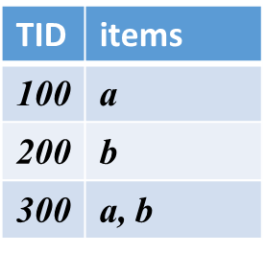
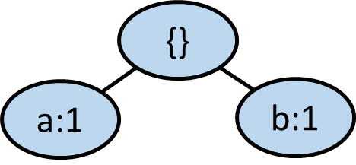
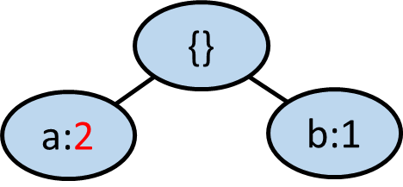
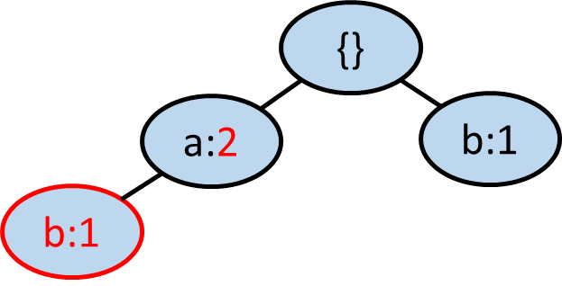

FP Growth - Constructing FP tree
2. Add itemsets into the FP tree
If the prefix of the itemset exists, add 1 to the value of the prefix. Otherwise, create a new node and set its value to 1.
Link from the previous same itemset node or from the header table.
An example is shown below.
b: not exist below a
a: exist
To insert: {a, b}
link from the previous same item

Slide 8
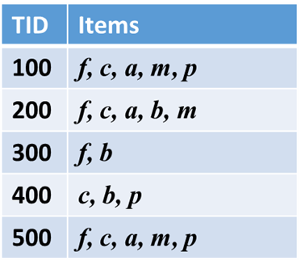
FP Growth - Constructing FP tree
{}
header table
f:1
item | frequency | head
f | 4
c | 4
a | 3
b | 3
m | 3
p | 3
c:1
a:1
m:1
p:1
Notes:
Frequency高放在前面的好處： frequency高的會比較靠近root，之後加transaction時容易沿著已有的path建（不會變成一棵root然後下面掛著一堆frequency為1的path

Slide 9
FP Growth - Constructing FP tree
{}
header table
f:2
item | frequency | head
f | 4
c | 4
a | 3
b | 3
m | 3
p | 3
c:2
a:2
m:1
b:1
p:1
m:1
Notes:
為什麼leaf要有link? 因為這棵tree是從下往上找，所以對同一個item，有link方便橫向移動

Slide 10
FP Growth - Constructing FP tree
{}
header table
f:3
item | frequency | head
f | 4
c | 4
a | 3
b | 3
m | 3
p | 3
c:2
b:1
a:2
m:1
b:1
p:1
m:1

Slide 11
FP Growth - Constructing FP tree
{}
header table
f:3
c:1
item | frequency | head
f | 4
c | 4
a | 3
b | 3
m | 3
p | 3
c:2
b:1
b:1
a:2
p:1
m:1
b:1
p:1
m:1

Slide 12
FP Growth - Constructing FP tree
{}
header table
f:4
c:1
item | frequency | head
f | 4
c | 4
a | 3
b | 3
m | 3
p | 3
c:3
b:1
b:1
a:3
p:1
m:2
b:1
p:2
m:1

Slide 13
FP Growth - Constructing FP tree
{}
header table
f:4
c:1
item | frequency | head
f | 4
c | 4
a | 3
b | 3
m | 3
p | 3
c:3
b:1
b:1
a:3
p:1
m:2
b:1
p:2
m:1

Slide 14
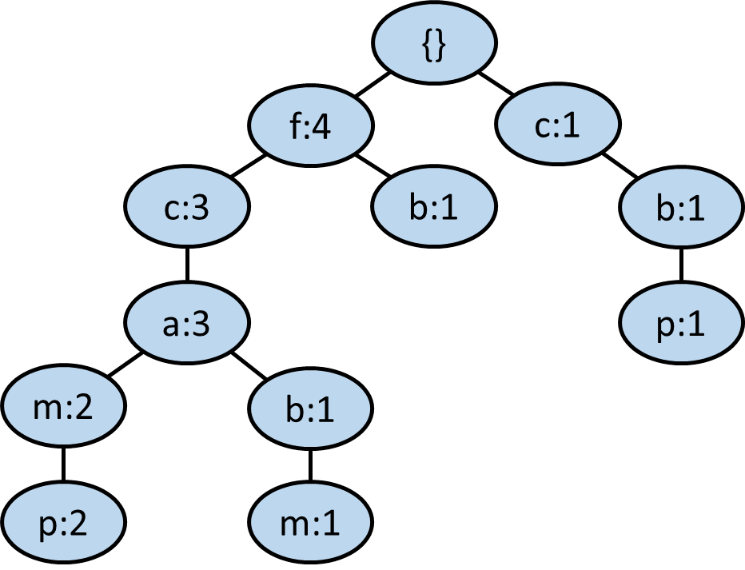
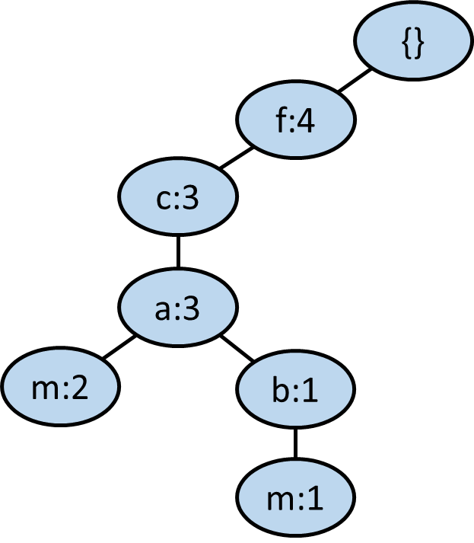
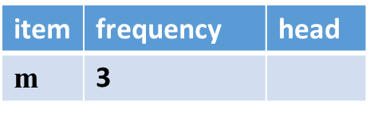
FP Growth - Mining FP tree
1. Select an item x in header table (low-frequency item first) to be the suffix. Obtain the subtree with all leaves as x (links in the header table can help).
We pick m as an example (assumed p is already processed).
Here, m is called Suffix.
min_support = 3
Notes:
因為越離leaf近的item frequency越少，所以從小的開始篩
注意的是，所有path上留下的frequency要是child nodes的frequency和

Slide 15
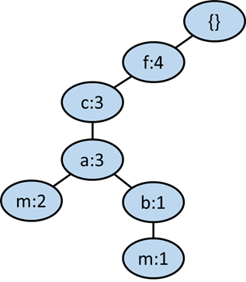
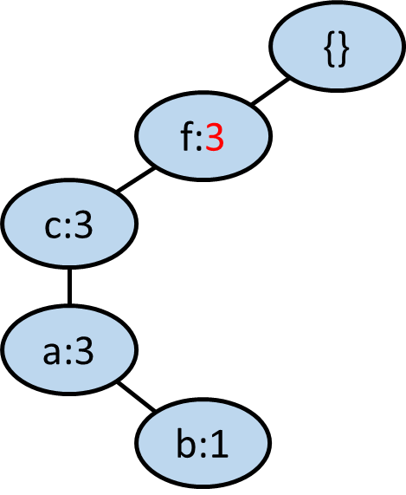
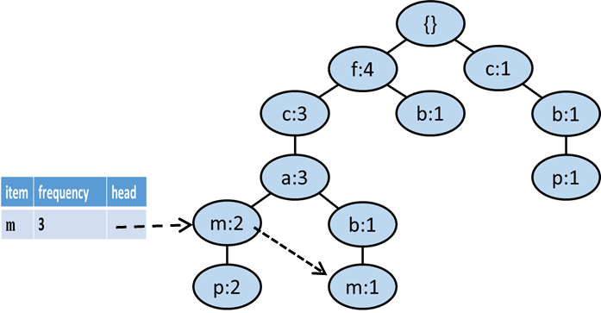

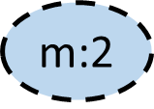
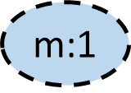
FP Growth - Mining FP tree
2. Except x (the item we are examining), set each node’s value as the sum of its child’s values (from leaves to root)
E.g., suffix m
除了suffix以外的node value改為他們child value之和，suffix可不放上去
min_support = 3

Slide 16
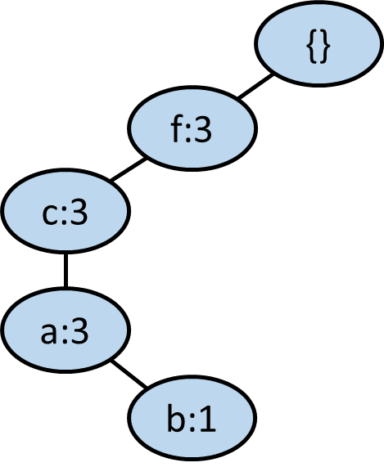
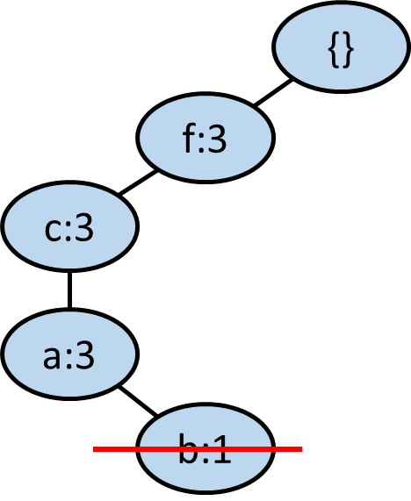
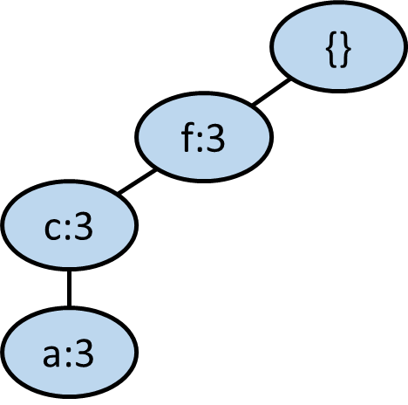



FP Growth - Mining FP tree
3. Delete the items which have sum of values < min_support. Use the remaining items to construct a conditional FP tree and mine the frequent patterns on it to obtain the frequent patterns with item x. E.g., suffix m
conditional FP tree
frequent pattern with suffix m: {a, c, f, m}、{a, c, m}、{a, f, m}、{c, f, m}、{a, m}、{c, m}、{f, m}、{m}

Slide 17
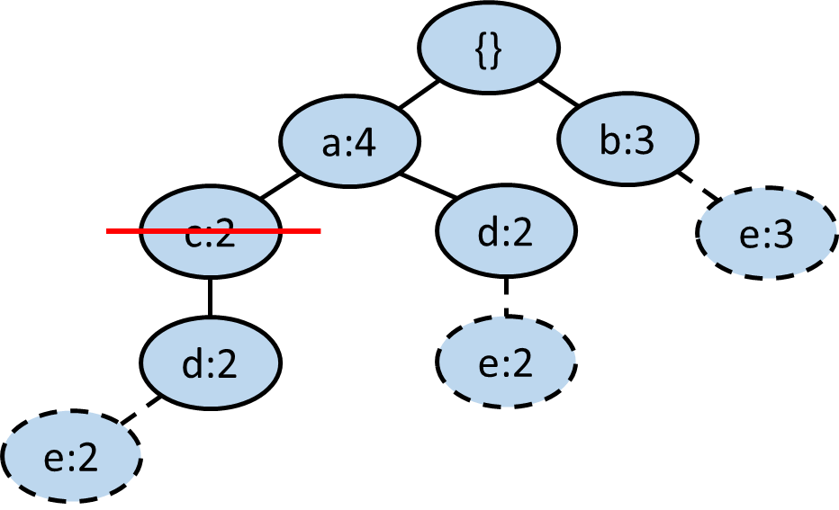
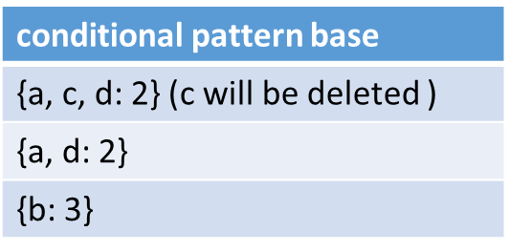
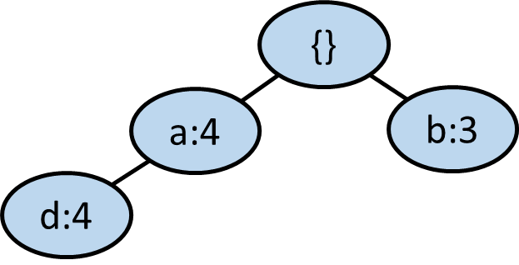
FP Growth - Mining FP tree
Another example of conditional FP tree (another dataset)
suffix e
conditional FP tree
Mining the conditional FP tree (suffix d, a, b), we can form it with e then acquire frequent patterns and their supports: {a, d, e: 4}, {a, e: 4}, {d, e: 4}, {b, e: 3}

Slide 18
FP Growth - Mining FP tree
4. Repeat steps 1, 2, and 3 above to select one new item to start with until only one item exists in the subtree.

Slide 19
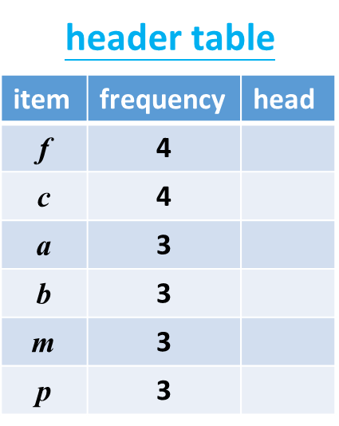
FP Growth - Mining FP tree
Suffix p
min_support = 3
{}
{}
f:4
c:1
f:2
c:1
c:3
b:1
c:2
b:1
a:3
p:1
a:2
省略建conditional FP Tree的步驟
p:1
m:2
m:2
FP: {c, p}、{p}
p:2
p:2

Slide 20
FP Growth - Mining FP tree
Suffix m
min_support = 3
{}
{}
f:4
f:3
省略建conditional FP Tree的步驟
c:3
c:3
FP: {a, c, f, m}、{a, c, m}、{a, f, m}、{c, f, m}、{a, m}、{c, m}、{f, m}、{m}
a:3
a:3
m:2
b:1
m:2
b:1
m:1
m:1

Slide 21
FP Growth - Mining FP tree
Suffix b
min_support = 3
{}
{}
f:4
c:1
f:2
c:1
c:3
b:1
b:1
c:1
b:1
b:1
a:3
a:1
省略建conditional FP Tree的步驟
b:1
b:1
FP: {b}

Slide 22
FP Growth - Mining FP tree
Suffix a
min_support = 3
{}
{}
f:4
f:3
c:3
c:3
省略建conditional FP Tree的步驟
a:3
a:3
FP: {a, c, f}、{a, c}、{a, f}、{a}

Slide 23
FP Growth - Mining FP tree
Suffix c
min_support = 3
{}
{}
f:4
c:1
f:3
c:1
c:3
c:3
省略建conditional FP Tree的步驟
FP: {c, f}、{c}

Slide 24
FP Growth - Mining FP tree
Suffix f
{}
f:4
FP: {f}
省略建conditional FP Tree的步驟
END

Slide 25
FP Growth - Mining FP tree
Frequent patterns:
1-itemset: {a}, {b}, {c}, {f}, {m}, {p}
2-itemset: {a, c}, {a, f}, {a, m}, {c, f}, {c, m}, {c, p}, {f, m}
3-itemset: {a, c, f}, {a, c, m}, {a, f, m}, {c, f, m}
4-itemset: {a, c, f, m}

Slide 26
FP Growth - Mining FP tree
Q: 若我們找frequent pattern的同時還要找它的support，當用一個suffix找到一組frequent pattern和它的子frequent pattern組合時，是否要計算全部組合的support呢?
A: 否，以suffix m為例，我們找到了frequent pattern {a, c, f, m}，也可以從中得到包含m的frequent patterns (eg: {a, c, f, m}、{a, c, m})之support。但我們無法確定不含m的frequent patterns如{a, c, f}是否所有transactions都在這個suffix被算到，然而也不需要在這時特別計算{a, c, f}的support，因為在suffix a時就能得到。因此在每個suffix只需要計算包含該suffix的frequent pattern之support就好。

Slide 27
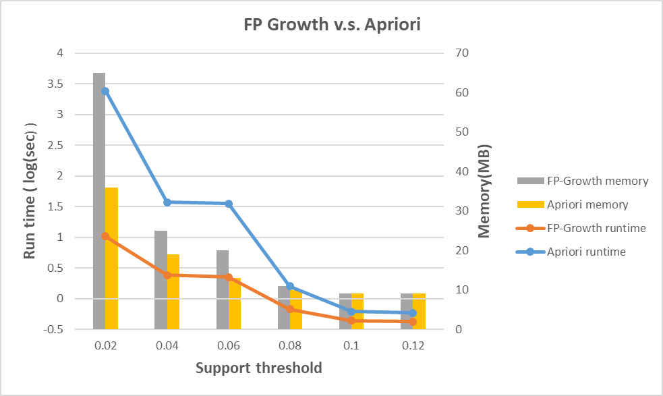
FP Growth v.s. Apriori
Dataset 1

Slide 28
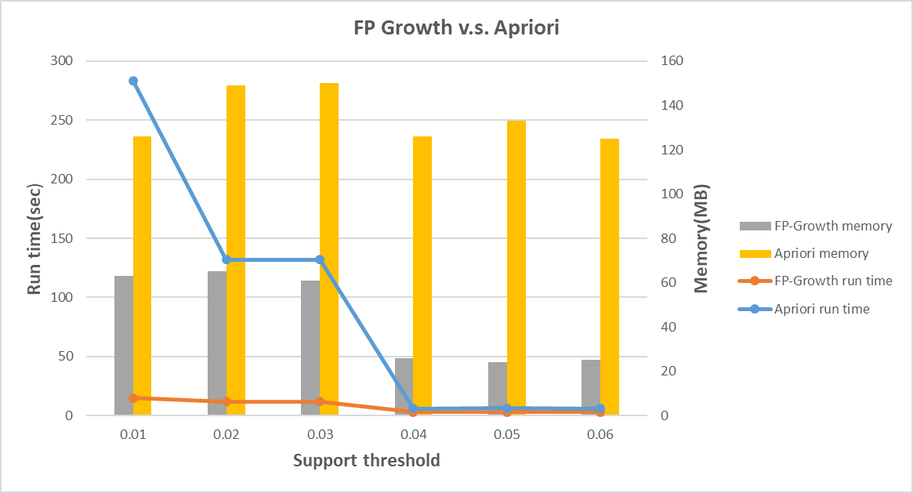
FP Growth v.s. Apriori
Dataset 2

Slide 29
FP Growth v.s. Apriori
Q: Why sometimes the memory consumption of the FP Growth approach is greater than the Apriori approach? (e.g., dataset 1)
A: In general case the FP Growth approach consumes less memory than Apriori. However, if the dataset is sparse, the FP tree might be very large and consumes lots of memory.

Slide 30
ECLAT: Frequent Pattern Mining with Vertical Data Format

Slide 31
ECLAT: Mining by Exploring Vertical Data Format
Vertical format: t(AB) = {T₁₁, T₂₅, …}
tid-list: list of trans.-ids containing an itemset
Deriving frequent patterns based on vertical intersections
t(X) = t(Y): X and Y always happen together
t(X) ⊂ t(Y): transaction having X always has Y

Slide 32
Assume min_sup = 2
Vertical data format
Original database (horizontal)
Intersect each frequent 1-itemsets, leading to 8 non-empty 2-itemsets
Join and intersect 2-item sets,
similar to Apriori

Slide 33
Strong Points of Mining with Vertical Data Format
Apriori property can be leveraged
No need to scan the DB to find support of (k+1)-itemsets
diffset can be used to reduce the storage overhead of vertical data format
Using diffset to accelerate mining
Only keep track of differences of tids
t(X) = {T₁, T₂, T₃}, t(XY) = {T₁, T₃}
Diffset (XY, X) = {T₂}

