Slide 1
Data Science HW3
Department of Computer Science
National Tsing Hua University (NTHU)
Hsinchu, Taiwan
Due Date: 2023/05/12 (FRI) 23:59
TA : 蔡珮瑜 資電館743
Email: lobsterlab.cs.nthu@gmail.com

Slide 2
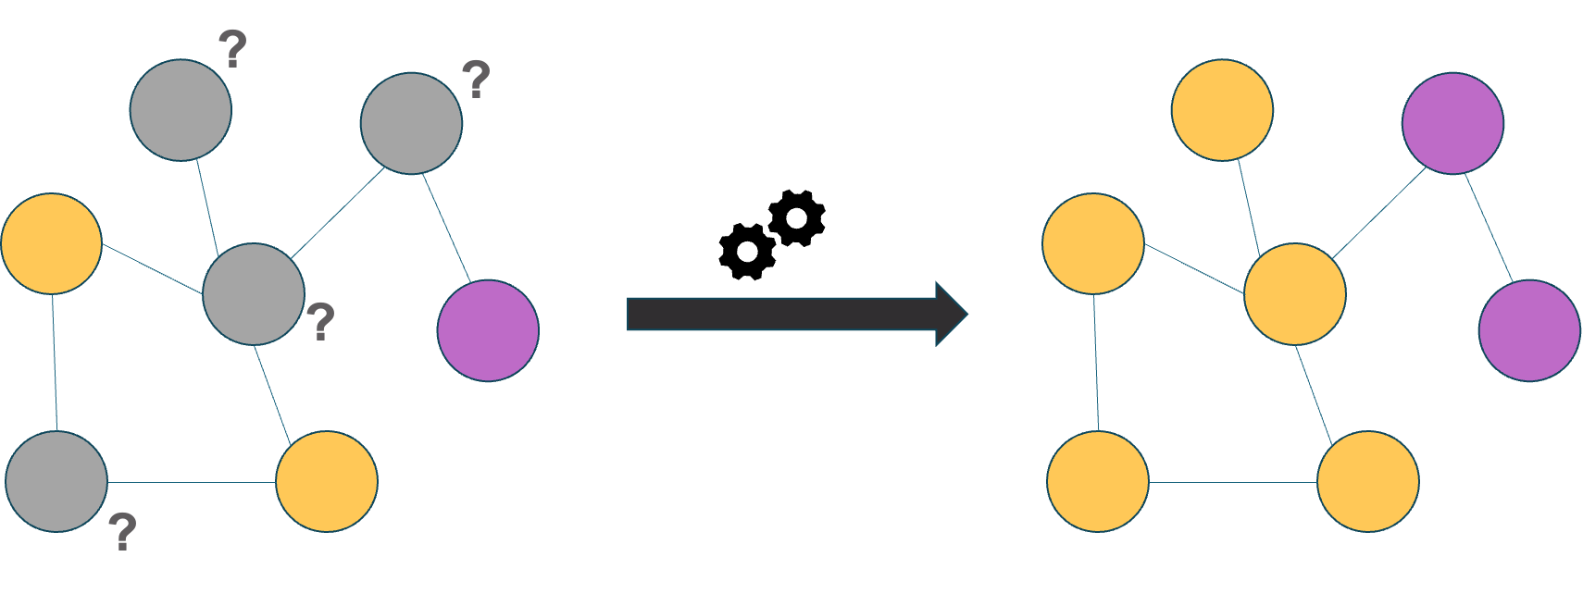
HW3 Node classification
Build a node classification model
Given an unknown graph dataset
Train your model using the training nodes
Predict the labels of the testing nodes.

Slide 3
HW3 is hosted on Kaggle
HW 3 Kaggle link
https://www.kaggle.com/t/d1097b49b16014572e81c3bafd7e3bb9
Deadline: 2023/05/12 (FRI) 23:59
Fill your Kaggle name in the google form
We will use the result on Kaggle to score this homework
You also need to hand in your code on eeclass.
The instructions for submitting files will be described in later pages.
Do not directly copy any source on the internet.

Slide 4
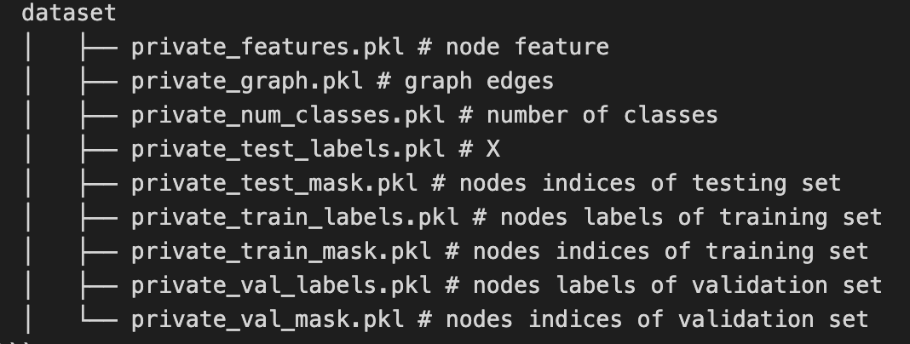
Dataset description (1/2)
A modified graph data
Each node has a predefined feature.
Dataset file name description

Slide 5
Dataset description (2/2)
Why training data size is far less than validation and testing data?
The purpose of splitting the data in this way is to test the learning ability of the graph neural network when there is a lack of labeled data.
In such a situation, it can be difficult to use other machine learning models that do not take structural information into account.
Please do not modify the training and validation data.
Why #training data + #validation data + #testing data != #total nodes(60+500+1000!=19717) ?
During the training of a graph neural network, the model constructs learned representations using features from neighboring nodes. As a result, even nodes that are not part of the training, validation, or test sets can still have an impact on the learned representation.
The setting is followed other frequently used public datasets.

Slide 6
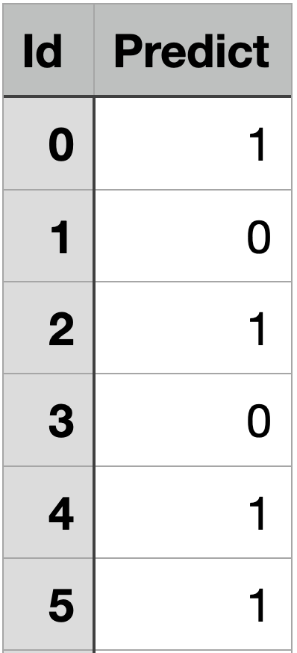
Output format
For each testing instance, there is a unique id
Output your prediction to csv file with the following format and submit to Kaggle
Remember to write the first line ‘Id,Predict’
Output csv file example:

Slide 7
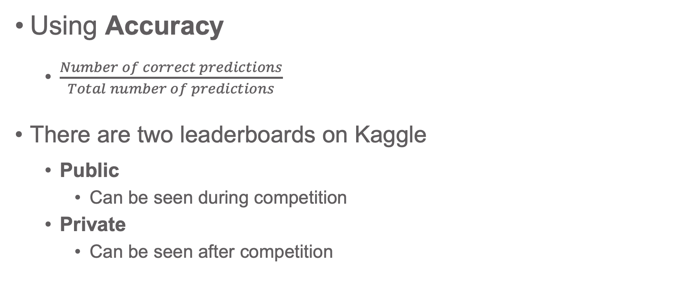
Evaluation
Using Accuracy
$\frac{Number of correct predictions}{Total number of predictions}$
There are two leaderboards on Kaggle
Public
Can be seen during competition
Private
Can be seen after competition

Slide 8
Public and Private leaderboard
Public (Can be seen during competition)
50% testing data
For reference
Private (Can be seen after competition)
the other 50%
Use this result for final scoring
50%
Public score
Testing
data
50%
Private score

Slide 9
Scoring
 | Public | Private* | Your HW3 Score
Baseline 0 | 0.750 | 0.740 | 0
Baseline 60 | 0.814 | 0.786 | 60
Baseline 70 | 0.834 | 0.806 | 70
Baseline 80 | 0.838 | 0.822 | 80
Baseline 88 | 0.850 | 0.840 | Top 20% : 100 20%~80%: 92 Others: 88
You will get 0, if your private score is between baseline 0 and baseline 60
You will get 60, if your private score is between baseline 60 and baseline 70
You will get 70, if your private score is between baseline 70 and baseline 80
And so on
* The private score of each baseline may be adjusted based on the results of classmates.

Slide 10
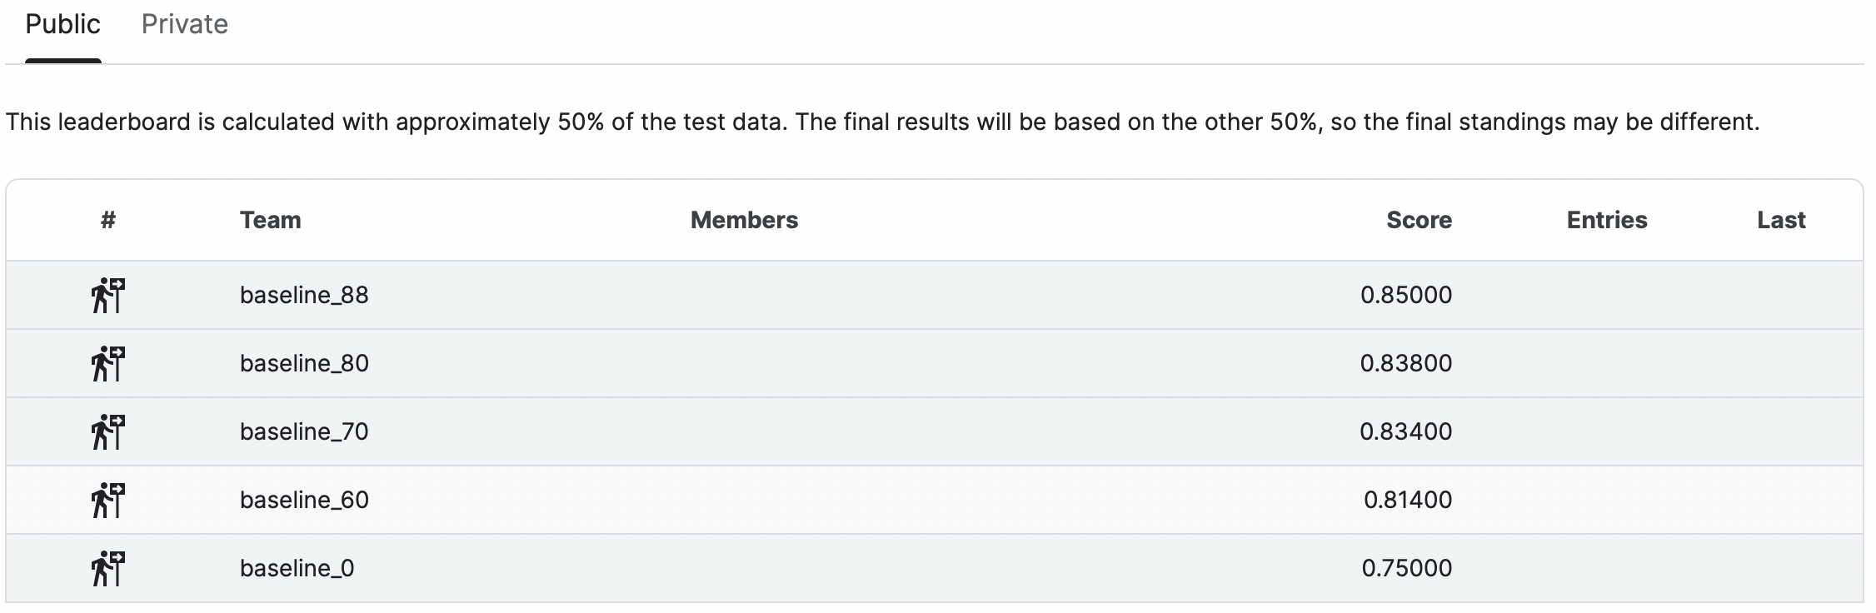
Scoring
Baseline scores
There are benchmarks on the leaderboard for reference

Slide 11
Other rules
You can submit 20 times per day
You can choose 5 predictions for final scoring
Kaggle will use the best one to be your result
We will publish private leaderboard one time on eeclass 3 days before the deadline of this homework.
This won’t affect your final score, just for you to check your status.

Slide 12
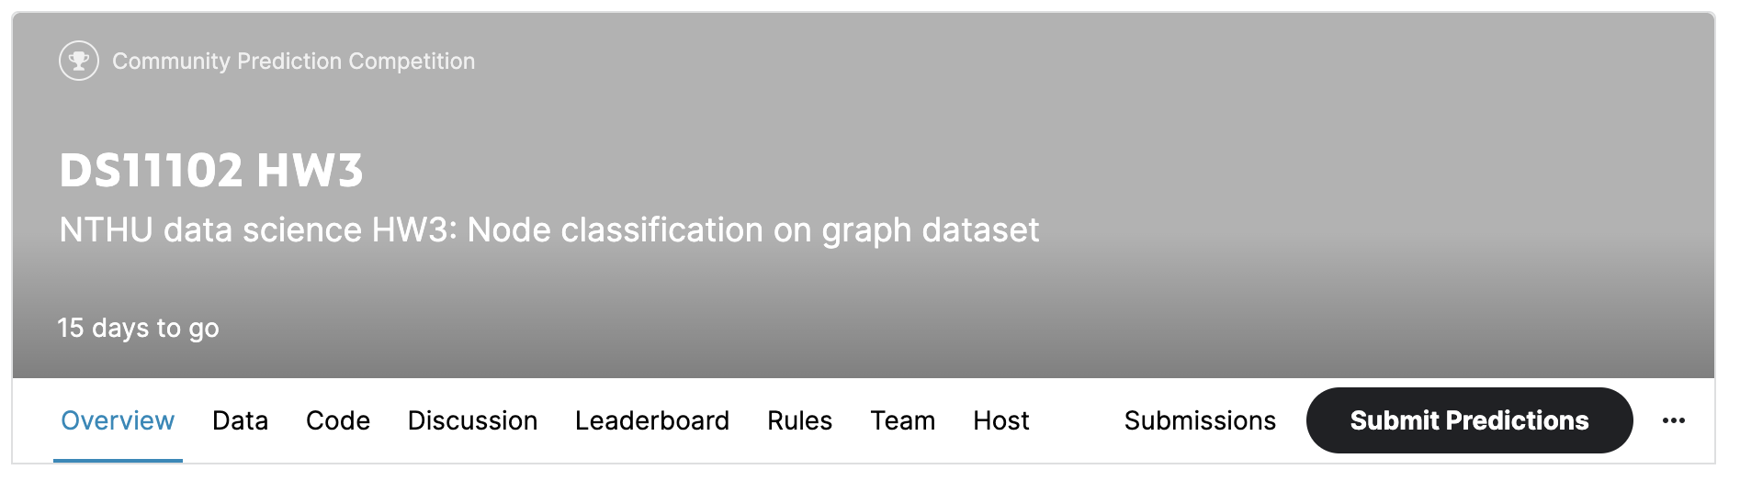
How to submit
Click ‘Submit Predictions’ button on the navigation bar

Slide 13
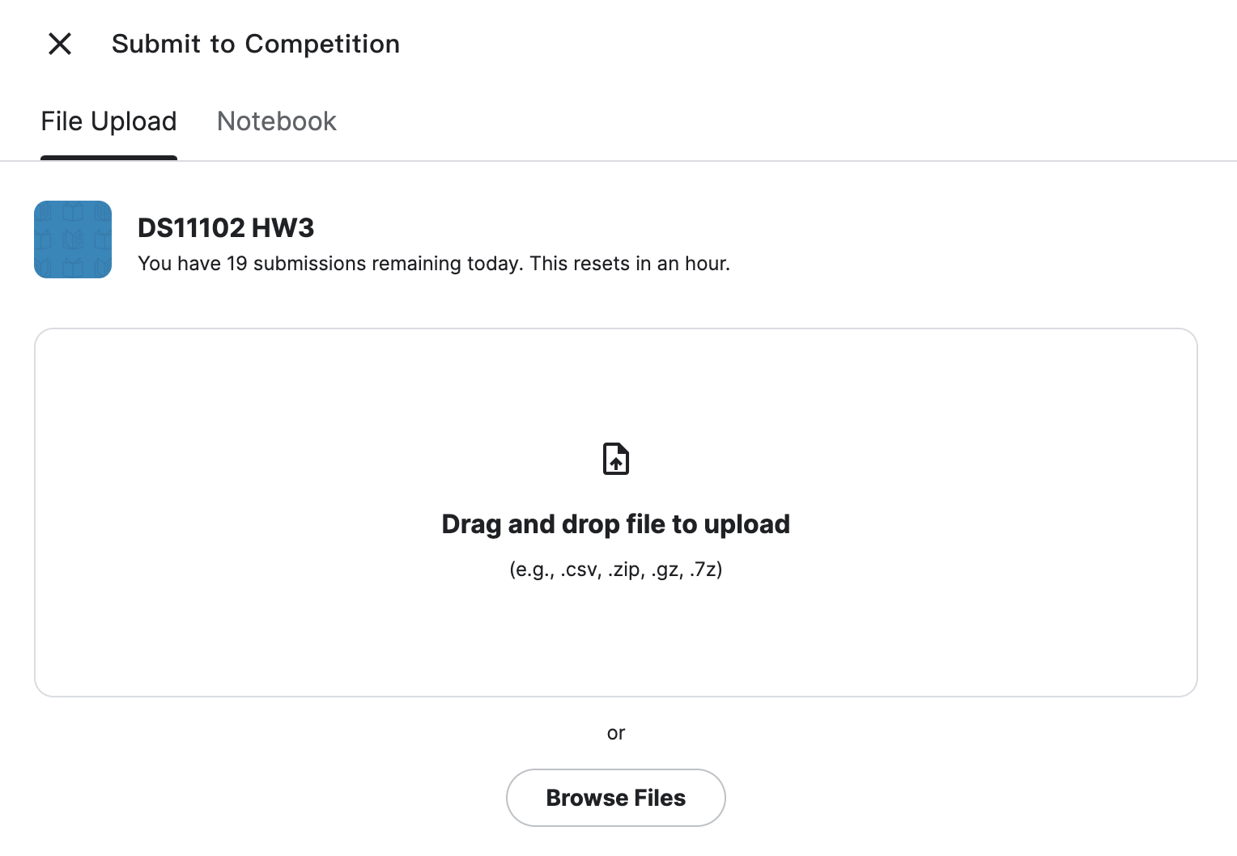
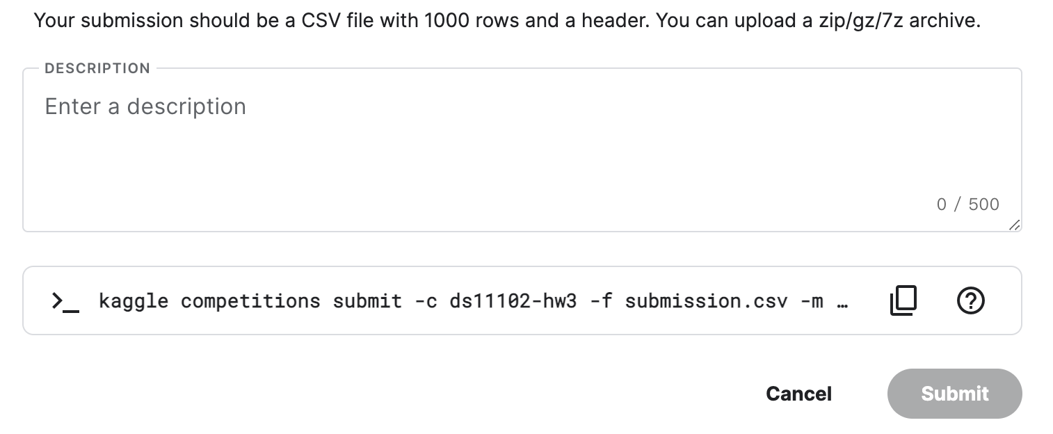
How to submit
You can write some description
about the answer csv file
Upload your answer csv file here
Click to submit

Slide 14
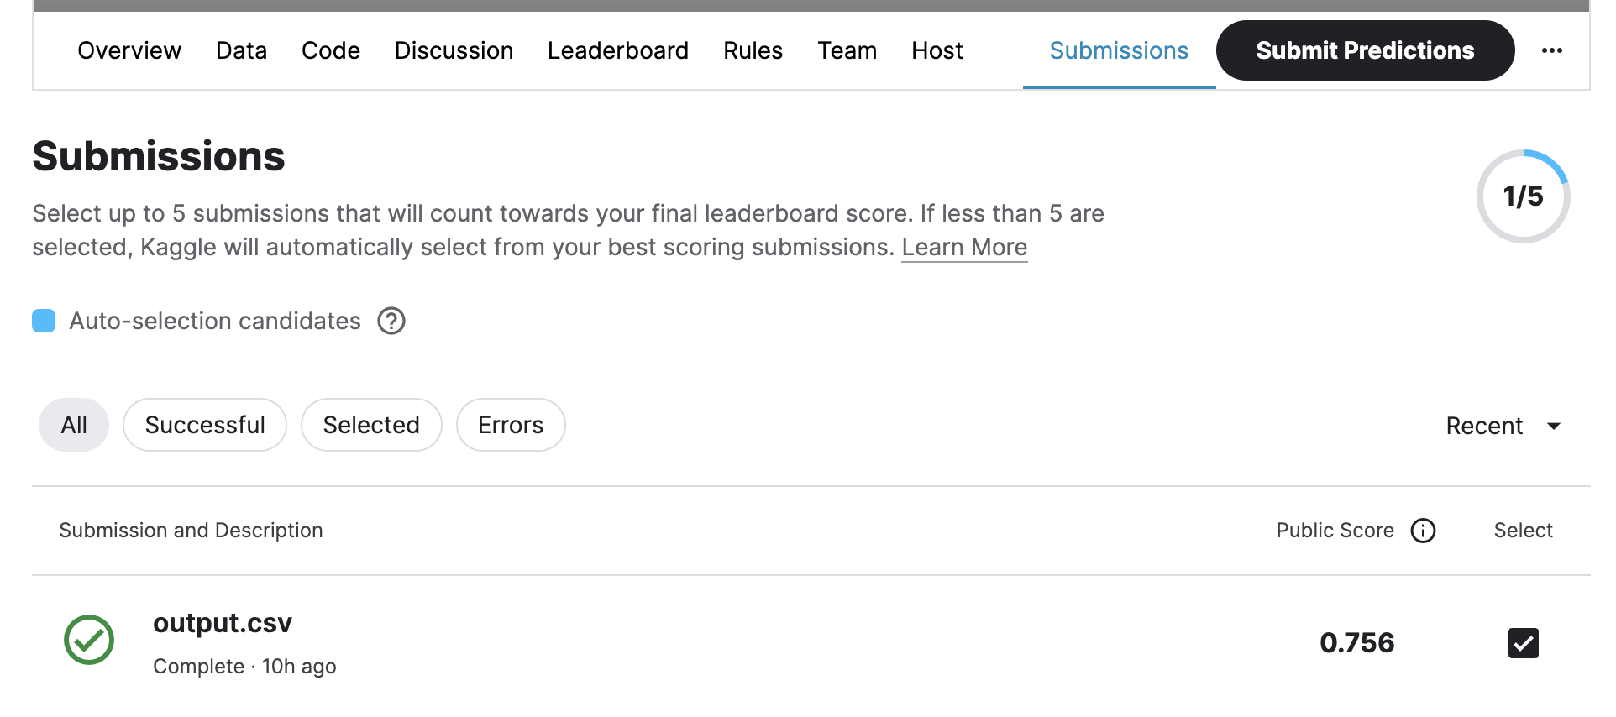
Choose predictions for final scoring
You can see all your submissions in ‘Submissions’
Remember to choose 5 predictions before the deadline

Slide 15
Sample code description
Baseline 0 method

Slide 16

Sample code
Load data based on provided dataset name.
No need to modify this file.
Define the details of model.
Train and evaluate the model.
Export the submission csv file.

Slide 17
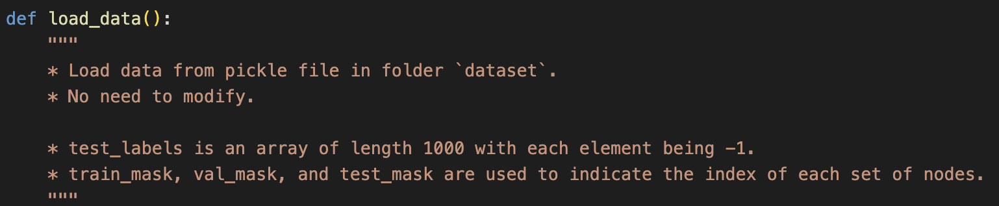
data_loader.py

Slide 18
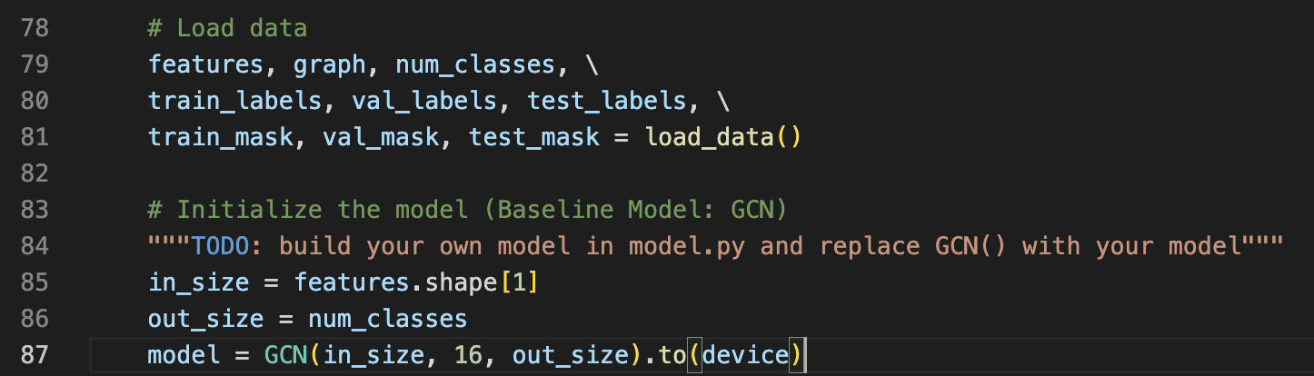
train.py

Slide 19
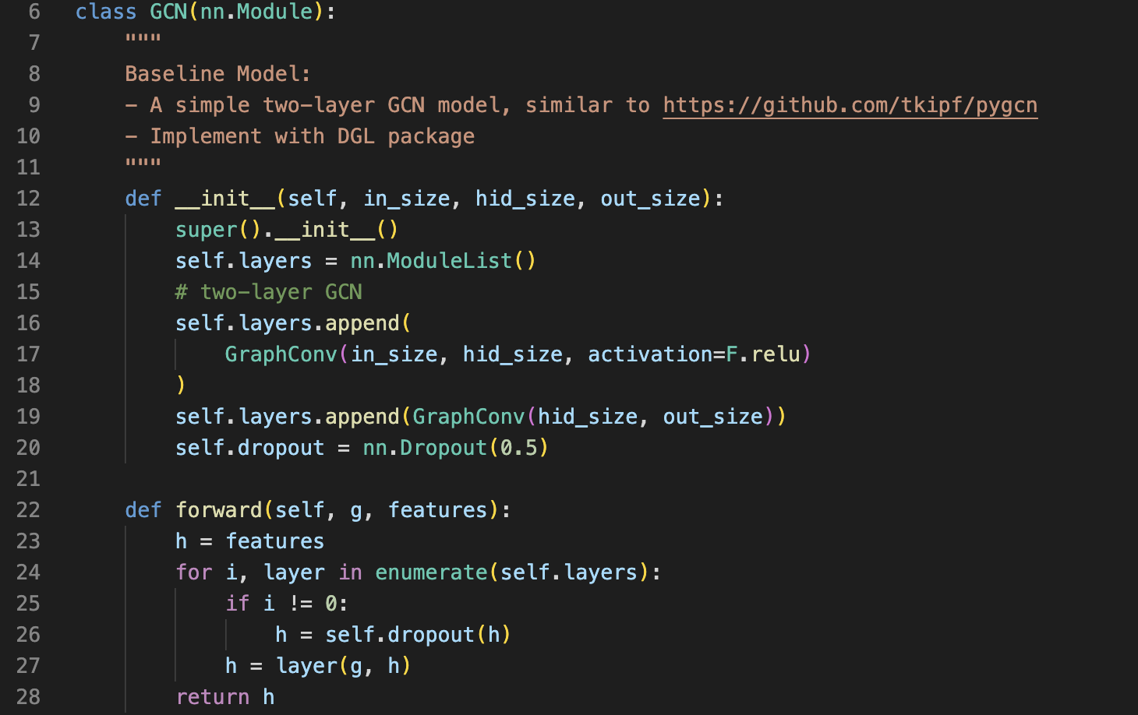
model.py

Slide 20
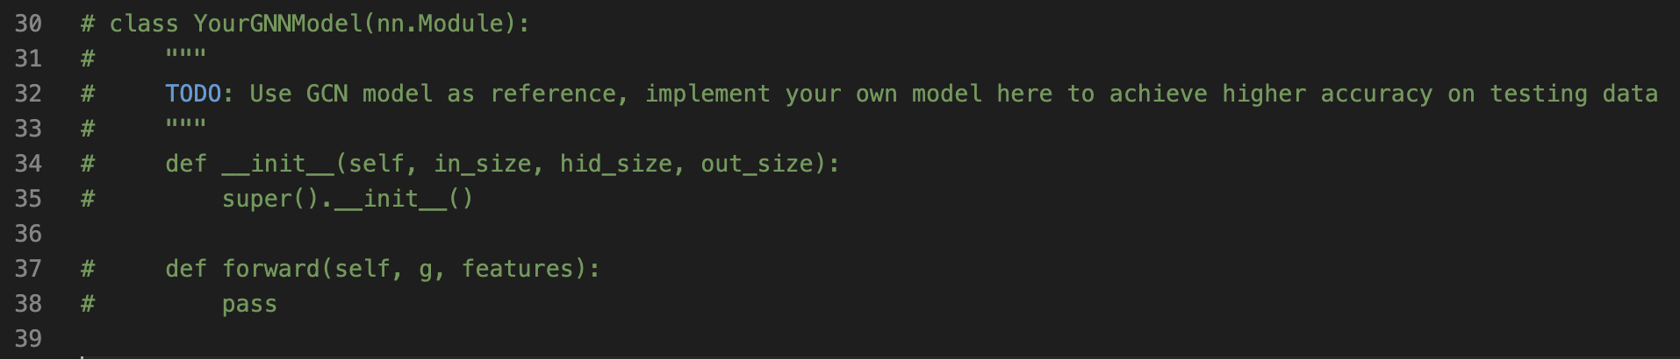
model.py

Slide 21
How to run
Run:
python3 train.py \
--epochs {num of epochs} \
--es_iters {num of iters to trigger early stopping}\
--use-gpu
Example:

Slide 22
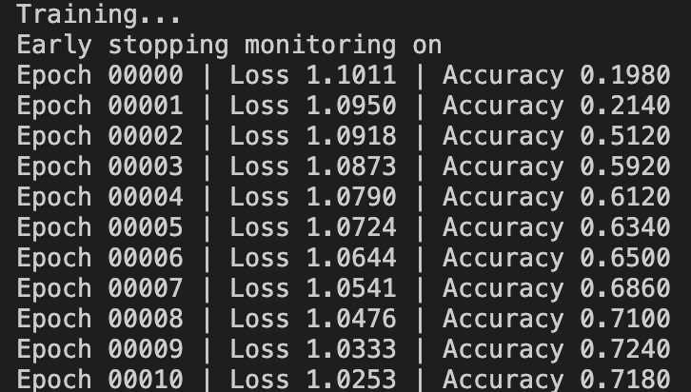
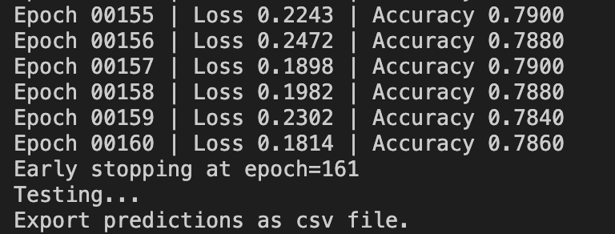
Once you successfully run the sample code…
……
* Please remember to upload your output csv file to Kaggle for scoring.

Slide 23
HW3 Conclusion
Submit your code to eeclass before deadline
All your python scripts file which is able to read dataset, train your model, export a prediction csv file
a README.md file
describe how to run your code
Your code must be able to show that the predictions are derived from a machine learning or deep learning model.
Evaluate your model performance on Kaggle.
Submit your model prediction file
We will use the result on Kaggle to score this homework.

Slide 24
For Your Reference
DGL: https://docs.dgl.ai/index.htm
State-of-the-Art
GAT: https://arxiv.org/pdf/1710.10903v3.pdf
SSP: https://arxiv.org/pdf/2008.09624v1.pdf
GRACE: https://arxiv.org/abs/2006.04131v2
State-of-the-art on Node Classification : https://paperswithcode.com/task/node-classification

