Slide 1
PowerShell
powershell 指令格式 === 動詞-名詞 Verb-Noun 常用動詞 ===> Get, Set, Update, Remove
PowerShell commands類型:
PowerShell commands come in a few flavors:
cmdlets,functions, aliases(別名), and sometimes external scripts.

Slide 2
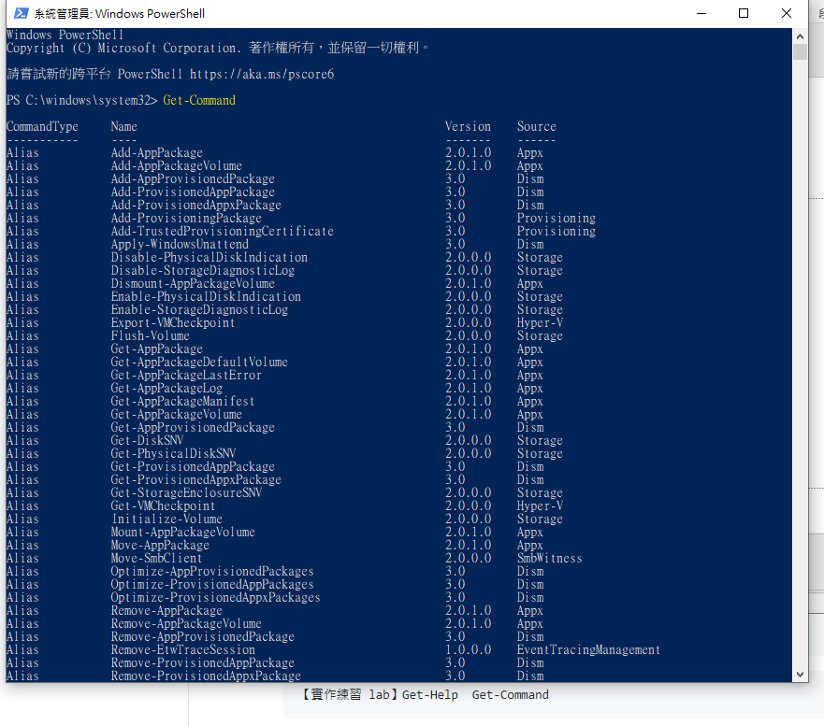
Get-Command ==> a list of every command PowerShell is aware of by default

Slide 3
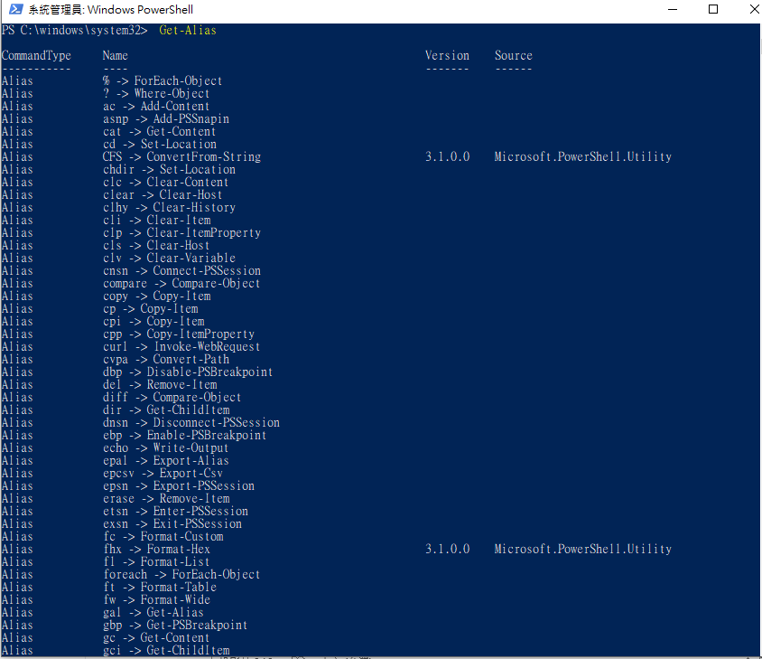
Get-Command -Name Get-Alias

Slide 4
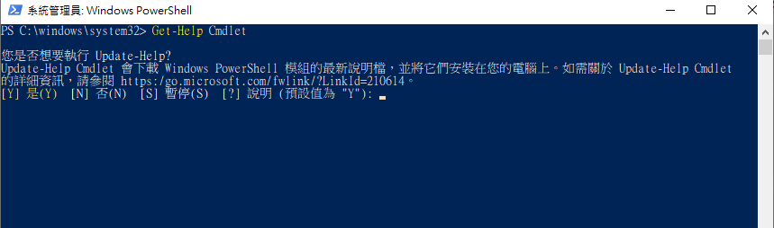
PowerShell 包含詳細的說明文章，解釋了 PowerShell 概念與命令語法。 可以在命令提示字元中使用 Get-Help Cmdlet 來顯示這些文章

Slide 5
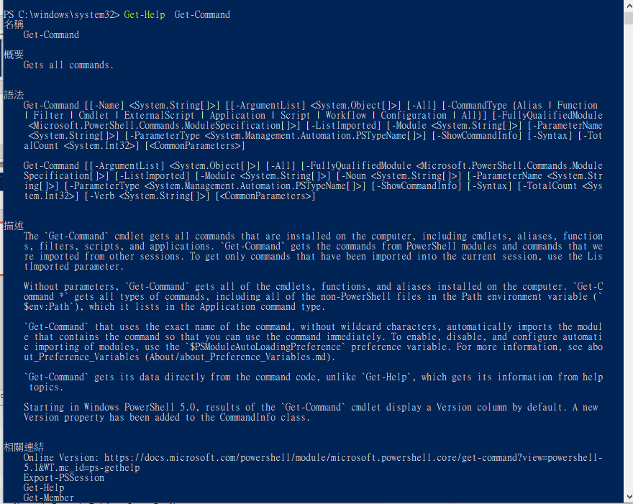
Get-Help Get-Command

Slide 6
相關連結
Online Version: https://docs.microsoft.com/powershell/module/microsoft.powershell.core/get-command?view=powershell-
5.1&WT.mc_id=ps-gethelp
Export-PSSession
Get-Help
Get-Member
Get-PSDrive
Import-PSSession
about_Command_Precedence
註解
若要查看範例，請輸入: "get-help Get-Command -examples".
如需詳細資訊，請輸入: "get-help Get-Command -detailed".
如需技術資訊，請輸入: "get-help Get-Command -full".
如需線上說明，請輸入: "get-help Get-Command -online"

Slide 7
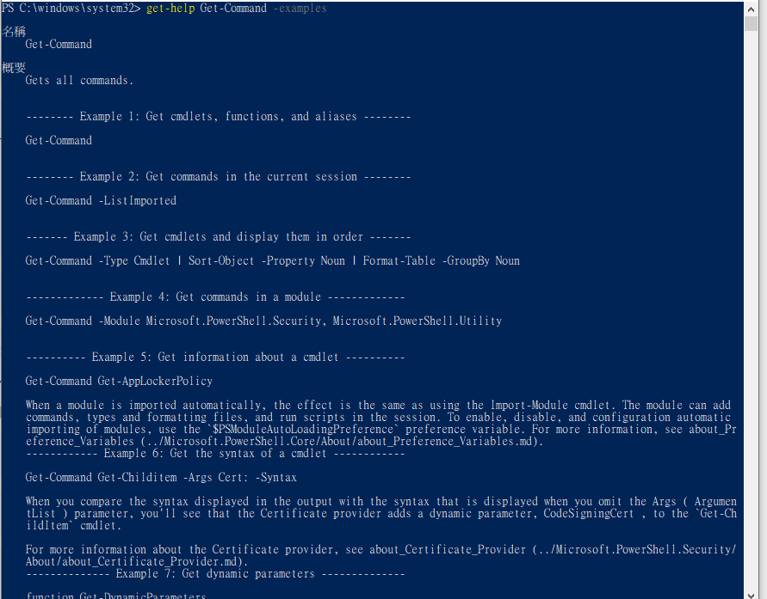
get-help Get-Command -examples

Slide 8
Get-Command -Type Cmdlet | Sort-Object -Property Noun | Format-Table -GroupBy Noun
This command gets all of the cmdlets,
sorts them alphabetically by the noun in the cmdlet name,
and then displays them in noun-based groups.
This display can help you find the cmdlets for a task.

Slide 9
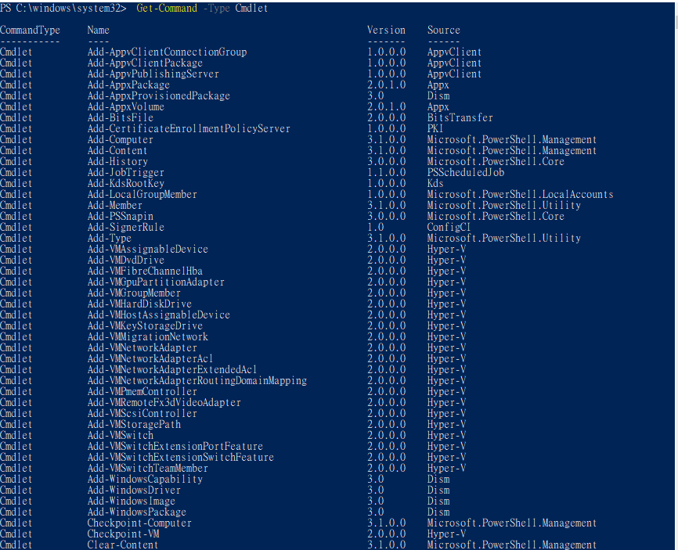
Get-Command -Type Cmdlet

Slide 10
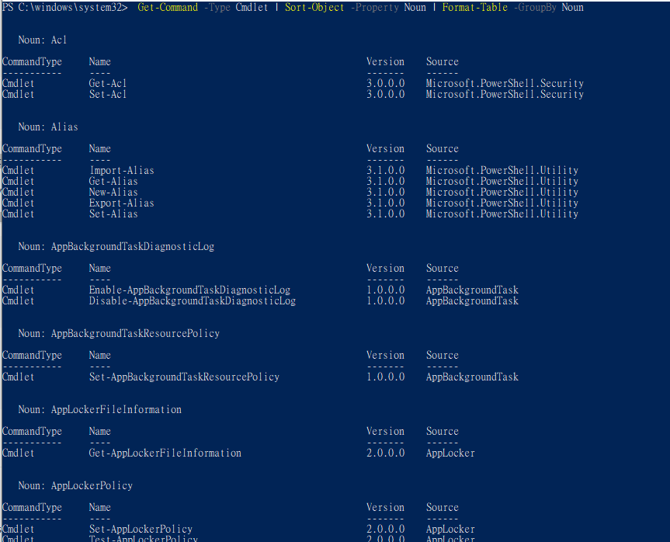

Slide 11
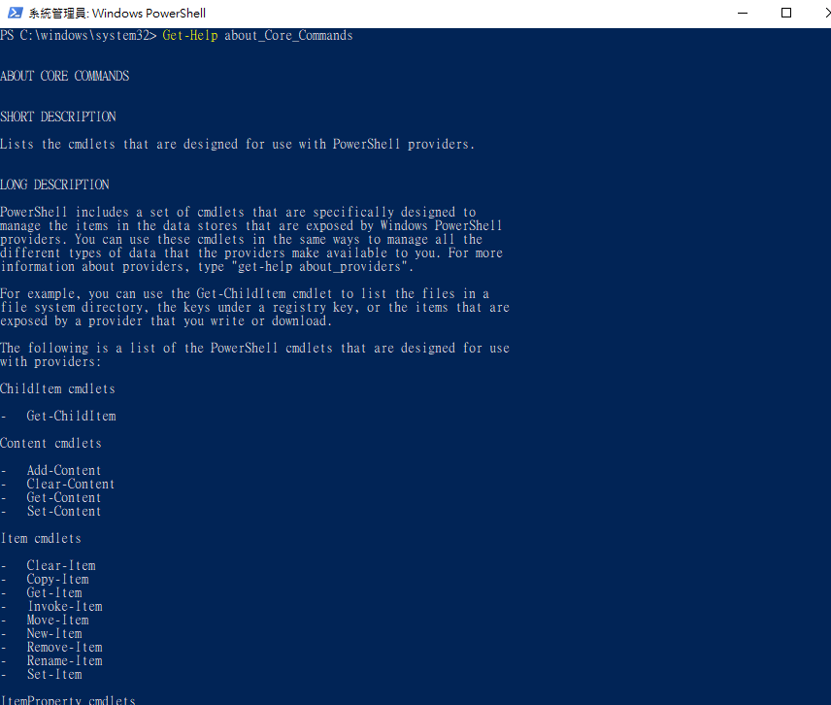
Get-Help about_Core_Commands

Slide 12
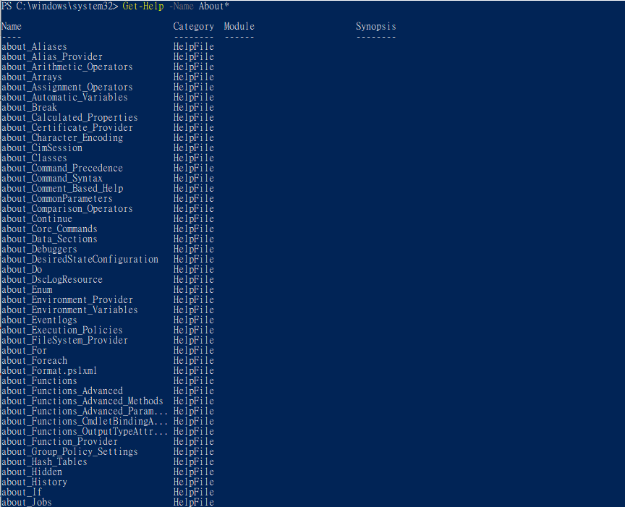
Get-Help -Name About*

Slide 13
PowerShell == scripting language 程式語言
編寫與執行指令碼 write a script and execute
開發工具 PowerShell Integrated Scripting Environment (ISE)
Microsoft’s Visual Studio Code editor
PS> powershell_ise.exe

Slide 14
Write-Host 'Hello, I am in a script!'

Slide 15
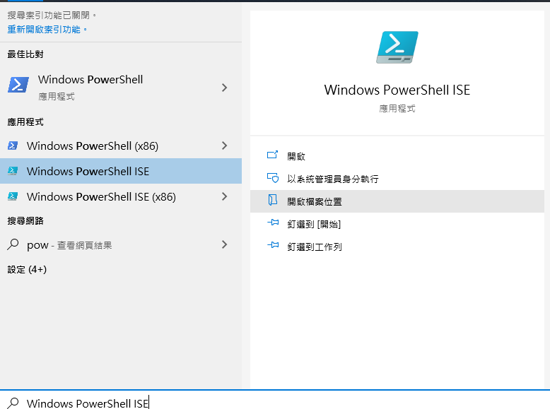

Slide 16
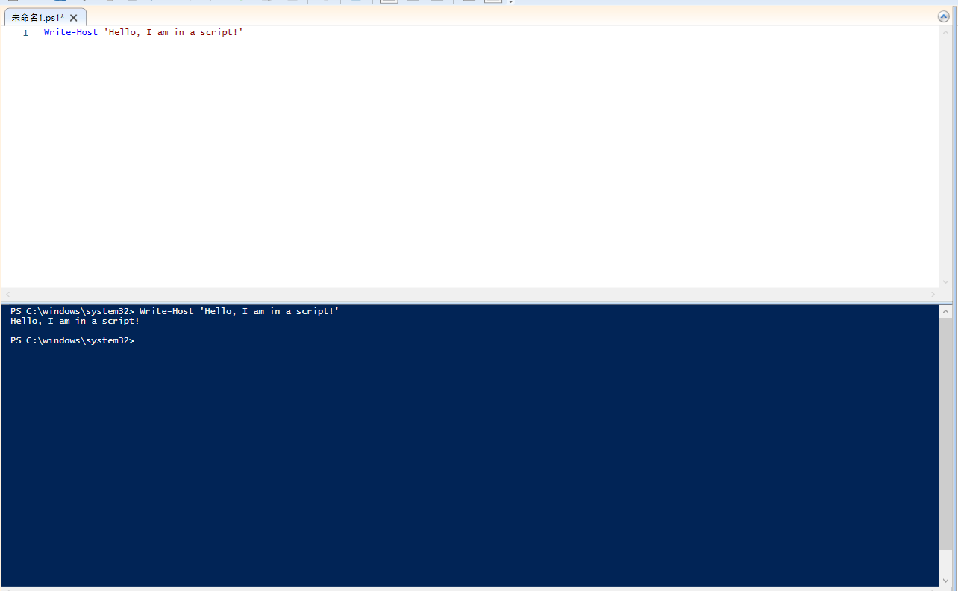

Slide 17
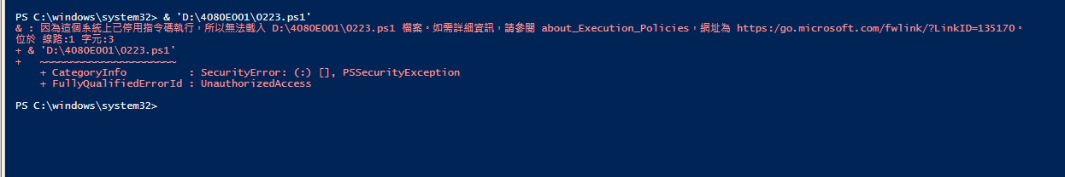

Slide 18
execution policy 執行策略
The execution policy has four main configurations:
[1]Restricted(限制) ==> default, doesn’t allow you to run scripts.
[2]AllSigned This configuration allows you to run only scripts that have been cryptographically signed by a trusted party (more on this later).
[3]RemoteSigned This configuration allows you to run any script you write,
and any script you download as long as it’s been cryptographically signed by a trusted party.
[4]Unrestricted(無任何限制) ==> This configuration allows you to run any scripts.

Slide 19
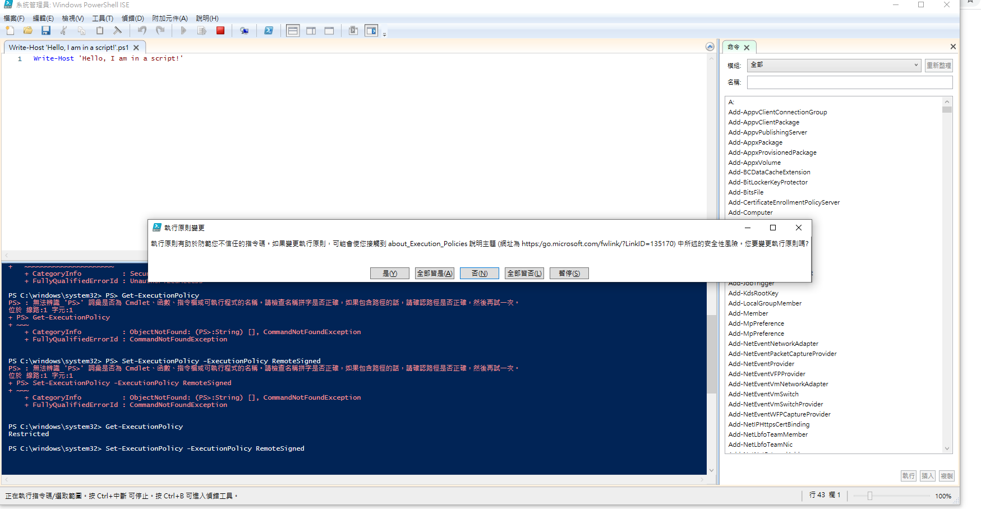
Get-ExecutionPolicy
Set-ExecutionPolicy -ExecutionPolicy RemoteSigned

Slide 20
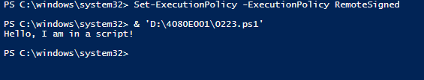
變成誰都能執行

