Slide 1


Project: Online Trading website dAtabase management system lab
Created by:
- Jayansh goyal(2017kucp1042)
- Shashwat singh(2017kucp1054)
Submitted To:
- Ms Megha Sharma
- Ms Anubha Jain

Slide 2
Introduction
This is a website based online trading system . This is designed to perform actions like buying ,selling of real stocks . This is designed by keeping in view the faults in other similar websites .
Its simple and easy to use interface makes the work of users supereasy.

Slide 3
Technology used
Frontend :- HTML5, CSS3, JINJA2
Backend :- Python, Flask(Framework)
Database:- Sqlite3

Slide 4
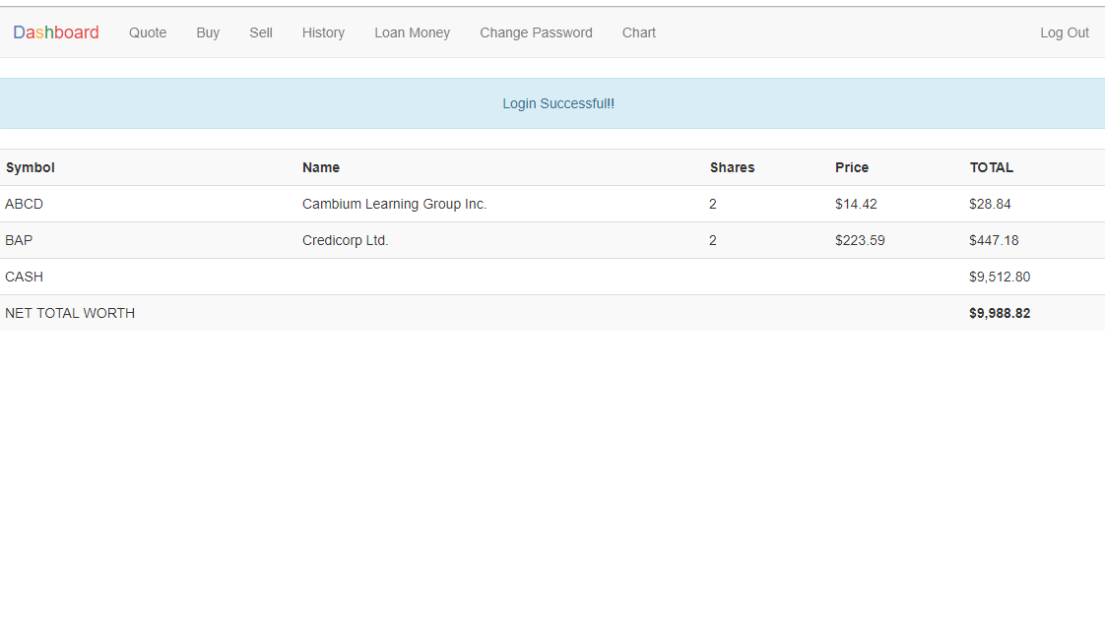
Login & Logout
New users can register and old users can login

Slide 5
Logged in users can logout to protect their privacy

Slide 6
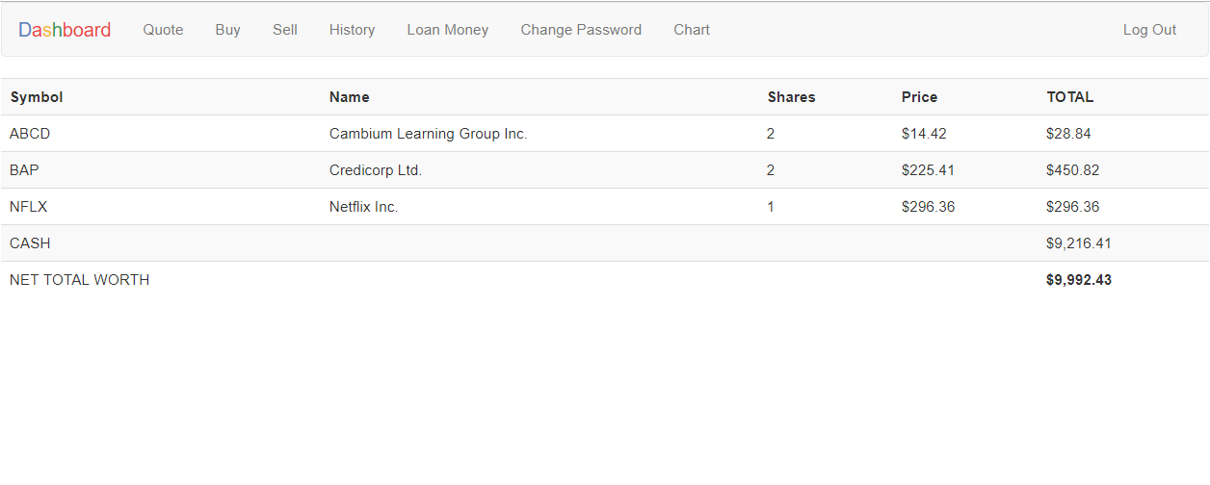
HOME
It has index() function which displays the current state or stock of user.

Slide 7
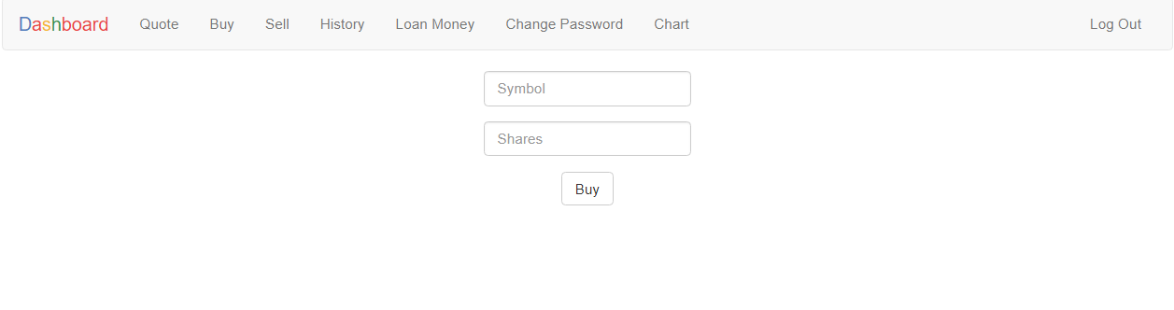
BUY STOCKS
Users can buy real stocks at real price .

Slide 8
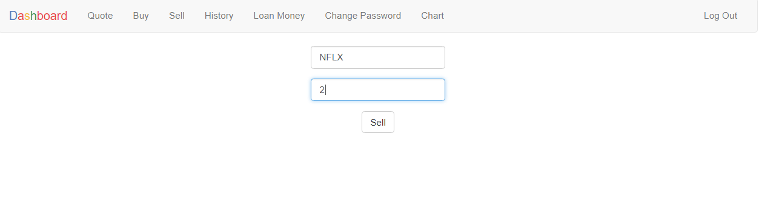
SELL STOCKS
Users can sell their stocks after sometime when their price is increased to earn money .

Slide 9
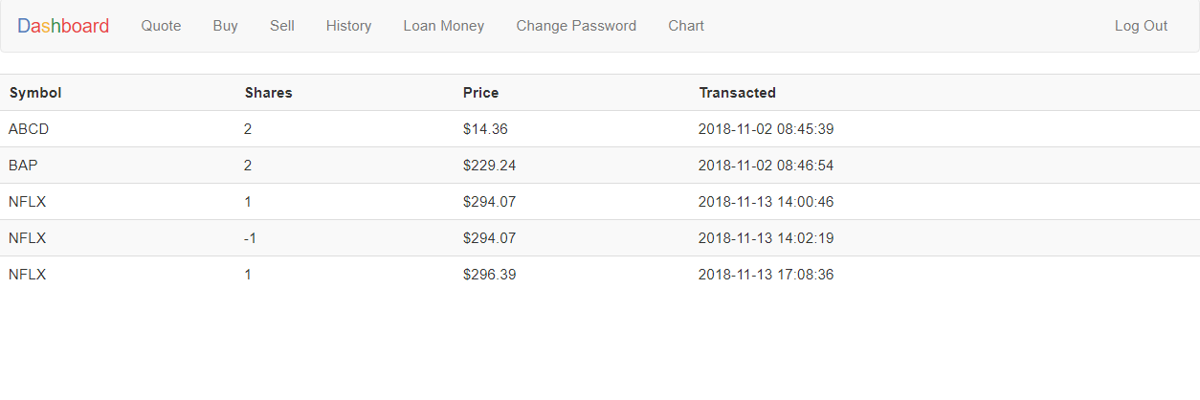
HISTORY
User can keep track of his past activities . With this he can calculate that he is in profit or loss

Slide 10
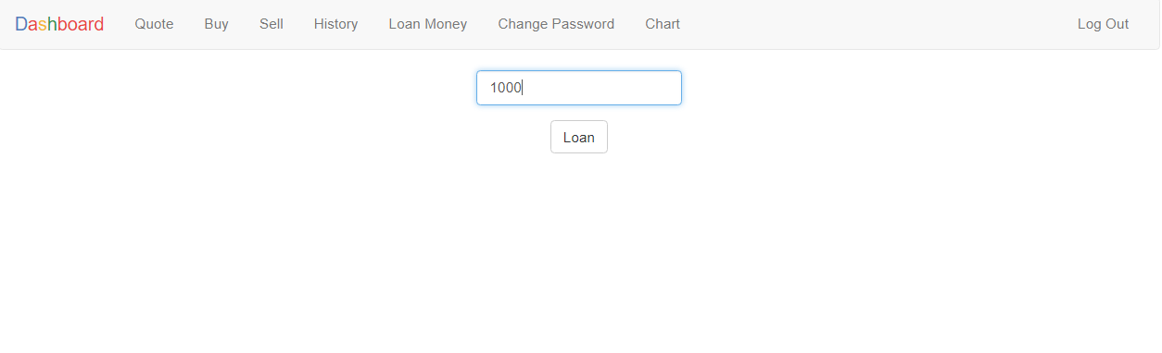
LOAN FACILITY
If user didn’t have sufficient balance to buy loan , he can loan money upto $1000.

Slide 11
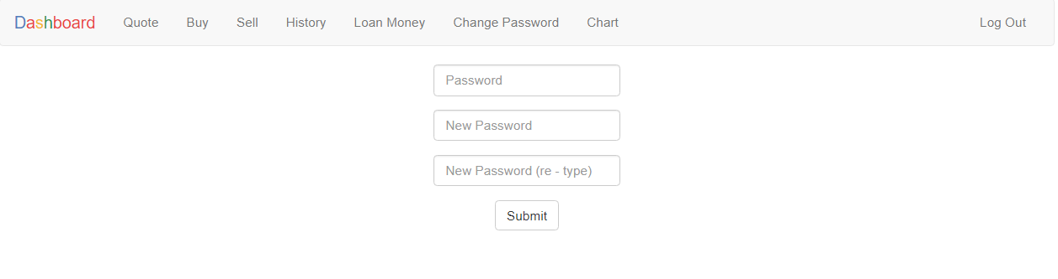
PASSWORD UPDATION
User can modify his/her password for security purposes.

Slide 12
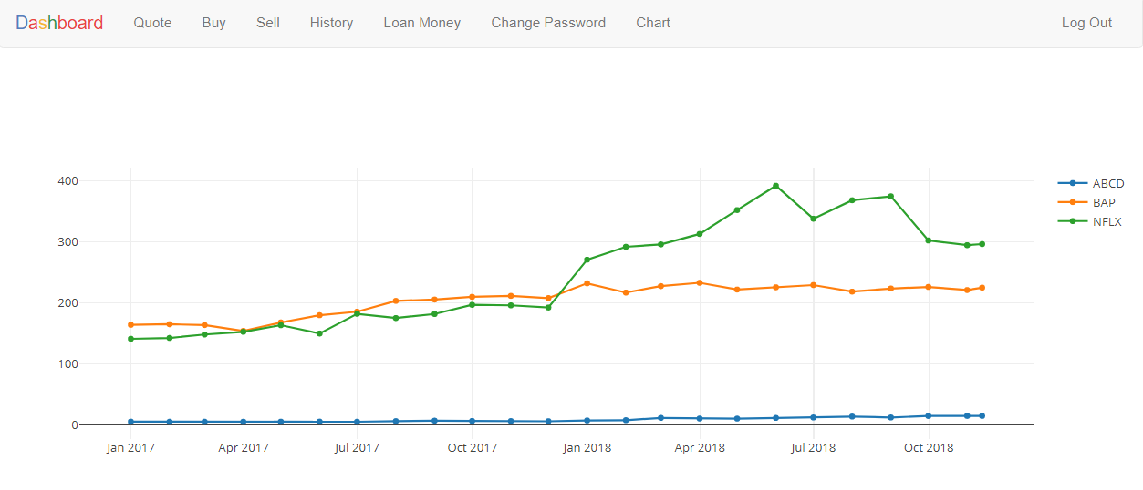
CHARTS
To make visualization easy, user can see the chart for the price variation of his stocks.

Slide 13
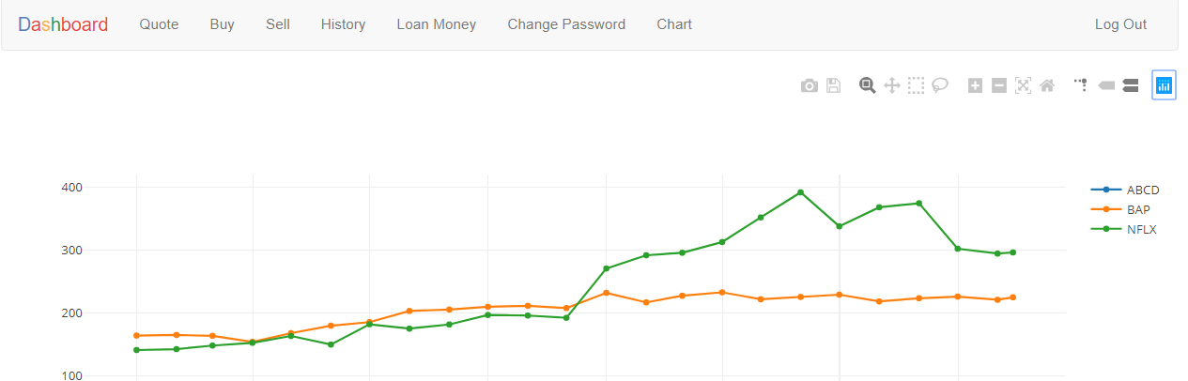
TOOLS
It gives user powerful tools to do much more with the graphs.

Slide 14

Hope You Like it!
THANK YOU

