Slide 1
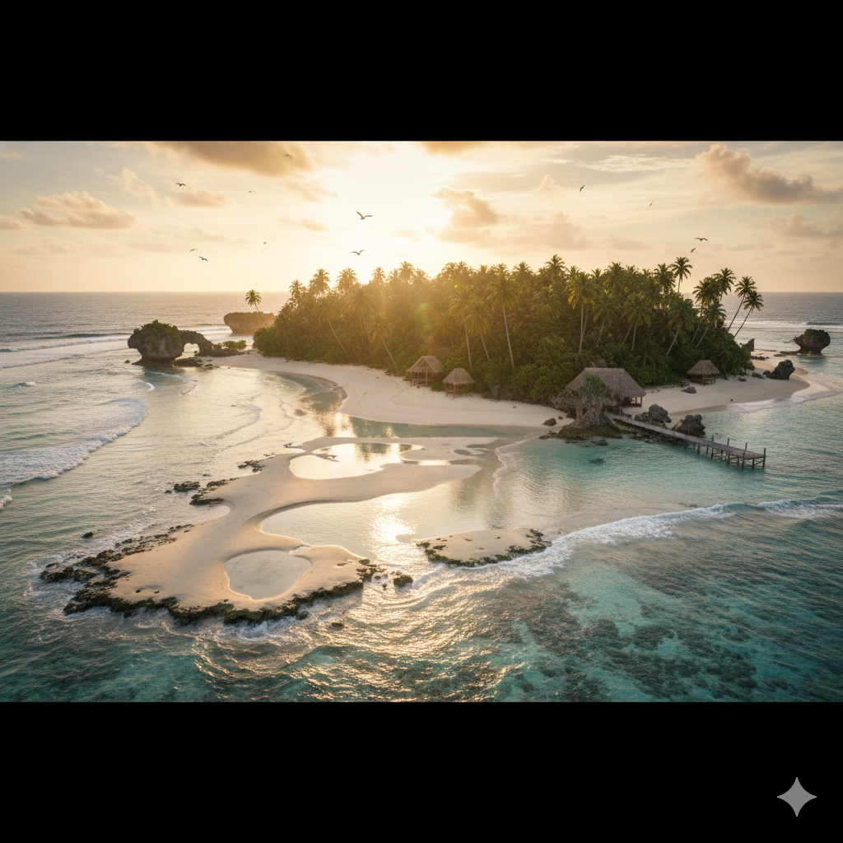
圖片一
Prompt:
A photorealistic, ultra-detailed wide-angle panoramic view of a remote coral reef island at golden hour. The island is surrounded by turquoise crystal-clear ocean and soft white sandy beaches. Waves gently hit the shore, with tide pools reflecting the sky. Dense tropical jungle covers the island interior, filled with tall coconut trees, giant ferns, and lush green vegetation. Strange rock formations rise like natural sculptures along the coastline. A small wooden pier and a few traditional thatched-roof huts blend naturally into the landscape. Seabirds circle above, while the sunlight breaks through scattered clouds, casting cinematic golden rays across the ocean. Shot in 8K resolution, HDR, cinematic lighting, Sony A7R IV, 24mm lens, f/8, ISO 100, realistic textures, natural color grading.
我想展現出一個擁有乾淨沙灘、清澈海水，還有特別的礁石和滿滿的椰子樹，看起來很有生氣地島。茅草屋和木棧道看起來不會破壞景色，反而讓人覺得更貼近自然。和我原本想像的比起來，這張圖的夕陽、潮池的倒影和天空的鳥群，讓整個畫面變得既夢幻、又真實。

Slide 2
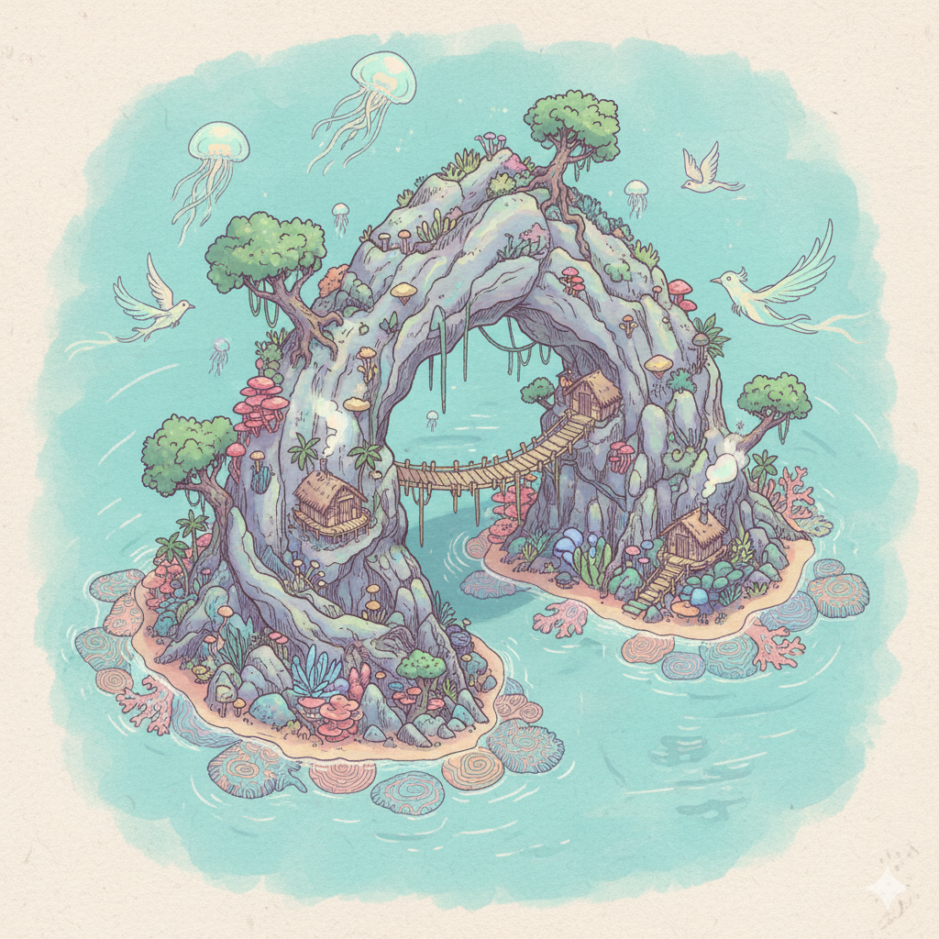
圖片二
Prompt:
Fantasy illustration of a coral island in isometric view, focusing on a massive rock formation shaped like a natural arch rising from the ocean. Around it, glowing tropical plants and bioluminescent mushrooms grow among the jungle trees. Colorful coral patterns spread along the coastline, with small wooden huts and bamboo bridges hidden between the rocks. A few mythical creatures, such as glowing jellyfish floating in the air and spirit-like birds, add a magical atmosphere. Style: vibrant fantasy illustration, hand-drawn effect, pastel colors, highly detailed, isometric perspective, whimsical and dreamlike.
我想生成出一個看起來像夢幻的秘境的島嶼。拱門形狀的巨石就像入口一樣，帶點神祕感；島上有樹木、發光的菇類和繽紛的珊瑚，加上小木屋和吊橋，讓人感覺真的可以在那裡生活。最後生成的畫面，比我想像的更柔和可愛，顏色偏向粉彩，看起來像童話世界，而不是我原本以為會比較濃烈的奇幻風格，整體多了一份輕盈夢幻感。

