Slide 1
Windows PowerShell Trojan Horse
Kim Kraemer & Alex Sheriff

Slide 2
About PowerShell Malware
PowerShell Scripts are convenient in malware because they can run in memory only and never save to disc
Able to run more discretely and do damage to system without alerting the user
They are also powerful because PowerShell can run many system commands and this type of malware is almost never detected by antivirus software
Becoming a more common malware tool
Recent study shows 38% of attacks seen by one security vendor involve PowerShell [1].
Another report from SentinelOne claims "In June 2018, there were a record 5.2 PowerShell attacks per 1,000 PCs, up from 2.5 attacks in May" [2].
Can be used in Fileless malware
Malware that infects a computer without writing anything to the HardDrive [2].
*Note* Our trojan is NOT fileless malware, as we will be writing the .cmd file that uses PowerShell to the user's StartUp folder

Slide 3
Dimnie Attacks
2017, hackers sent emails targeted to developers on GitHub
Appeared to be requests for work that would result in payment
Emails contained .gz attachment w/ corrupted word doc
Once downloaded, the malware inside the word doc ran PowerShell commands that quietly installed Dimnie from an external server
Once installed, Dimnie downloaded even more malware into memory of other processes & modules that stole data, keylogged, and screen grabbed [3]

Slide 4
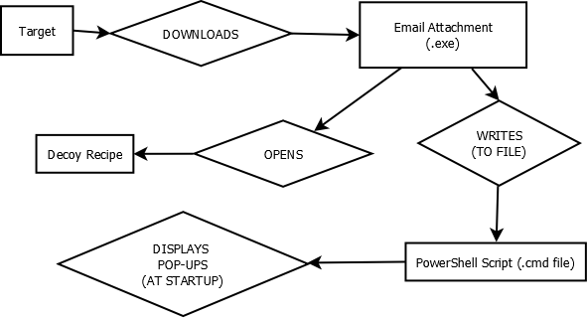
Project Plan
1. Create PowerShell program with C++.
2. Disguise file as link to innocent cookie recipe.
3a. Upon download, victim will be redirected to recipe webpage.
3b. The malware will be saved in C:/Users/..../AppData/.../Startup
4. The victim can continue to use their computer without any interference from the malware.
5. Upon system startup, pop-up shall be displayed.

Slide 5
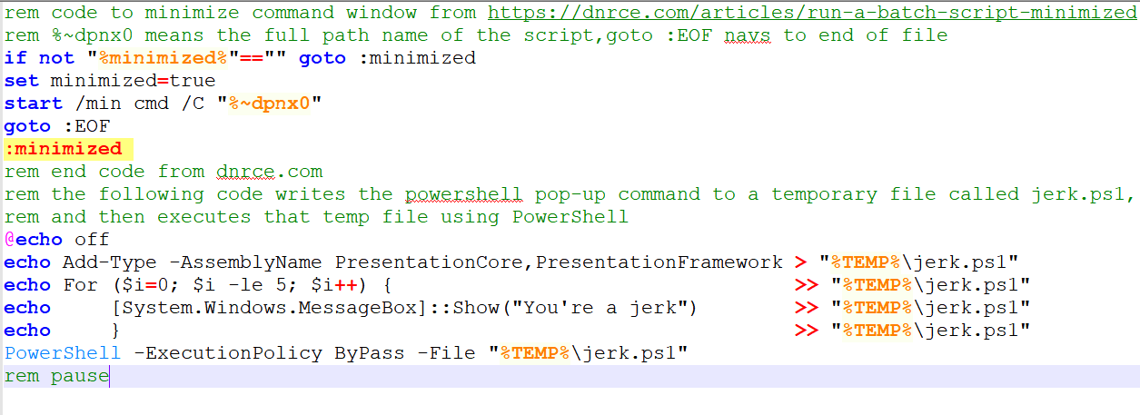
The .cmd file
Minimizes the command window
Writes temporary PowerShell program that displays a pop-up 6 times
Uses PowerShell to execute temp program
(Will be written to the victim's startup folder by the executable)

Slide 6
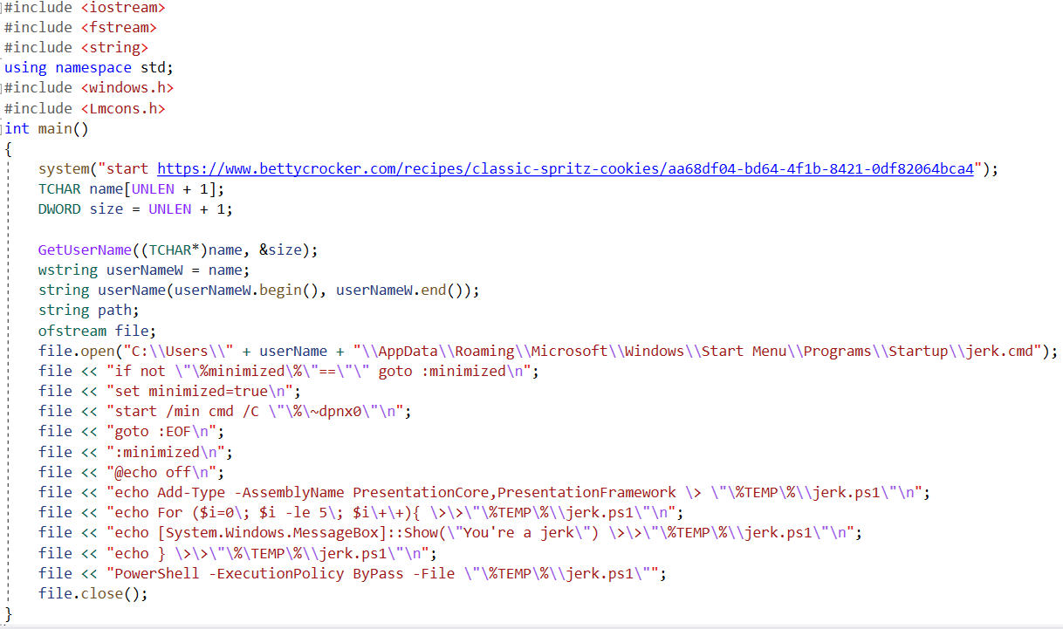
The C++ code (.exe)
Uses windows.h and Lmcons.h libraries to gain access to victim's Username
used in file.open() command to write the .cmd file to the StartUp Directory
GetUserName returns TCHAR, must be converted to string
"file <<"s write the .cmd file
This code got built as the executable file that gets sent via email

Slide 7
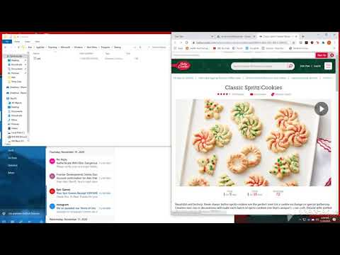
Finished Product

Slide 8
Encountered Issues
C++ cannot directly write a file to a generic path directory stored in AppData (e.g. ~\AppData\Roaming\...\Startup)
We had to write a function that obtains the users username, and inserts it into a path to save (e.g. C:\Users\*username*\AppData\Roaming\...Startup)
Obtaining the username brought other problems, because the function used stores the data as a TCHAR. Converting a TCHAR to a string turned out to be more complicated than anticipated.
To send via email, we had to upload the .exe file to Google Drive because GMail does not allow sending of .exe files any other way
This could be potentially be avoided by using/running some sort of external email program and sending email with attachment that way (ie. Python program)
Initially, the executable caused issues when downloaded via email to a computer that didn't have certain packages downloaded
Had to rebuild as a release instead of debug & change runtime library in properties to multi-threaded(MT) instead of Multi threaded DLL

Slide 9
Conclusion
Though this Trojan is annoying, yet harmless, it shows that with more time and malicious intent, a much more invasive and harmful piece of malware could be installed on your computer.
Using our program as a template, minor changes alone could make innocent victims subject to scams.
For example, make two pop-ups appear, one being the "jerk" pop-up, which could be increased to appear hundreds or thousands of times, and another being a fake virus detection pop-up informing users to call "Windows Support" (Your phone number). You can then charge any amount of money for seemingly one minute of work, since you know exactly where the problem is and how to fix it.

Slide 10
References
[1] T. Greene, "Power Shell is a powerful malware tool," Network World(Online), 2016.
Available: https://ezproxy.monmouth.edu/login?url=https://www-proquest-
com.ezproxy.monmouth.edu/docview/1780625743?accountid=12532.
[2] D. Crookes, "Fileless malware," Web User, pp. 38-39, 2018. Available:
https://ezproxy.monmouth.edu/login?url=https://www-proquest-
com.ezproxy.monmouth.edu/docview/2132197114?accountid=12532.
[3] L. Constantin, "Open-source developers targeted in sophisticated malware attack,"
JavaWorld, 2017. Available: https://ezproxy.monmouth.edu/login?url=https://www-
proquest-com.ezproxy.monmouth.edu/docview/1884289704?accountid=12532.

