Slide 1
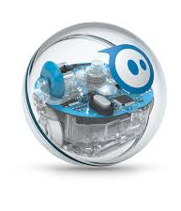
Robotics Triathlon
Group 1
CS 104 02
Prof. Eckert
9 December 2020
Christian Dimitry, Michael Auletto, Haemah Akhtar, Jamir Barnes

Slide 2
Role of Each Team Member…
•Michael Auletto: Michael was the owner of the robot. His role was to develop and test the code.
•Christian Dimitry: Christian's role was to work on the first part of the Design Document. He also helped develop the second part of the document as well.
•Jamir Barnes: Jamir worked on the second part of the Design Document.
•Haemah Akhtar: Haemah was the project manager. Created a Gantt chart, the algorithm, and the flowchart. Helped out with the coding as well.

Slide 3
Challenges that were being faced
COVID-19 limited our opportunities to meet in person
Some members of the group work full time/part time jobs, busy time schedule
Not all members had access to the robot
Programming was new to some of the people in our group

Slide 4
What we would do differently…
Time management: The group did finish the project on time, but we should have taken more time out to review it than we did.
Meet in person: If we met in person, it would have been a bit easier to communicate and work with the robot itself since only one person was working with it. We were able to have group discussions virtually it was just a little complicated.
More Knowledge: Although our group had an understanding of the sprints, learning more about the sprint would benefit us even more. For example, gaining more knowledge about the Sphero and its abilities would save time.

Slide 5
What we learned about Software Engineering
Teamwork and Collaboration
Block Coding
Managing time
Determination

Slide 6
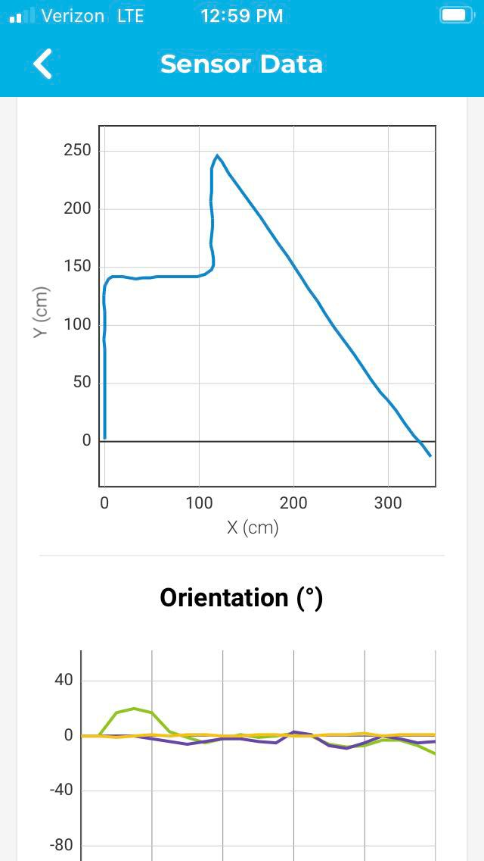
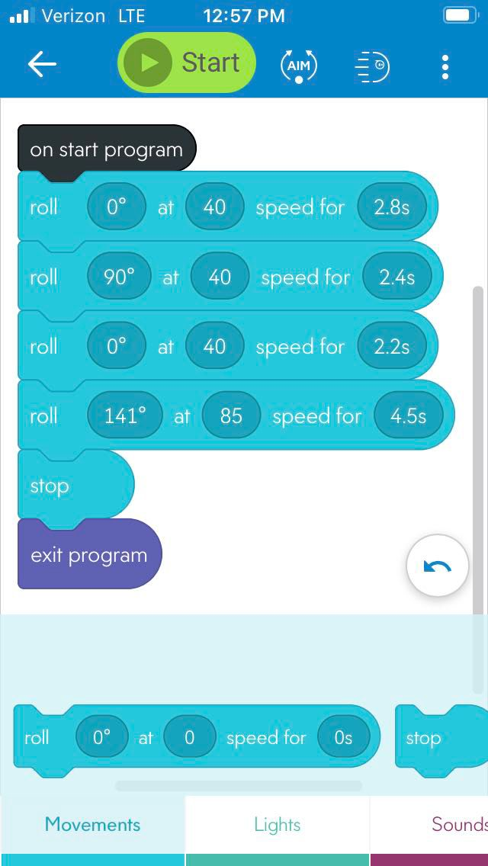
Block Code for Sprint 3
This is the code for sprint 3
Took about an hour or so to finish
It was quite simple to maneuver around the obstacles, so I didn't need that many blocks of code to finish the course

Slide 7
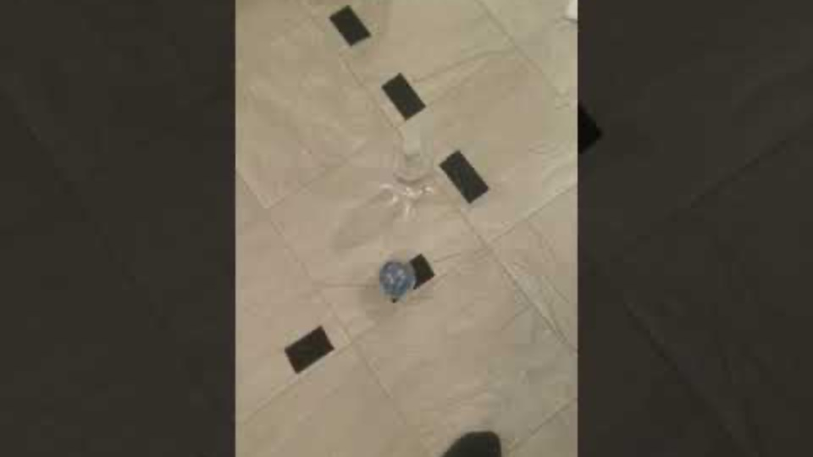
Sprint 3 Video
https://youtu.be/ZTwP64PnhH4
Notes:
https://youtu.be/ZTwP64PnhH4

