Slide 1
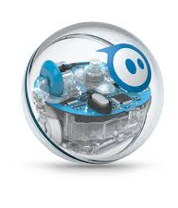
Robotics Triathlon
Group 1
CS 104 02
Prof. Eckert
9 December 2020
Christian Dimitry, Michael Auletto, Haemah Akhtar, Jamir Barnes

Slide 2
Role of Each Team Member…
•Michael Auletto: Michael was the owner of the robot. His role was to develop and test the code.
•Christian Dimitry: Christian's role was to work on the first part of the Design Document. He also helped develop the second part of the document as well.
•Jamir Barnes: Jamir worked on the second part of the Design Document.
•Haemah Akhtar: Haemah was the project manager. Created a Gantt chart, the algorithm, and the flowchart. Helped out with the coding as well.

Slide 3
Challenges that were being faced
COVID-19 limited our opportunities to meet in person
Some members of the group work full time/part time jobs, busy time schedule
Not all members had access to the robot
Programming was new to some of the people in our group

Slide 4
What we would do differently…
Time management
Meet in person
More Knowledge
More Communication

Slide 5
What we learned about Software Engineering
Teamwork and Collaboration
Block Coding
Managing time
Determination

Slide 6
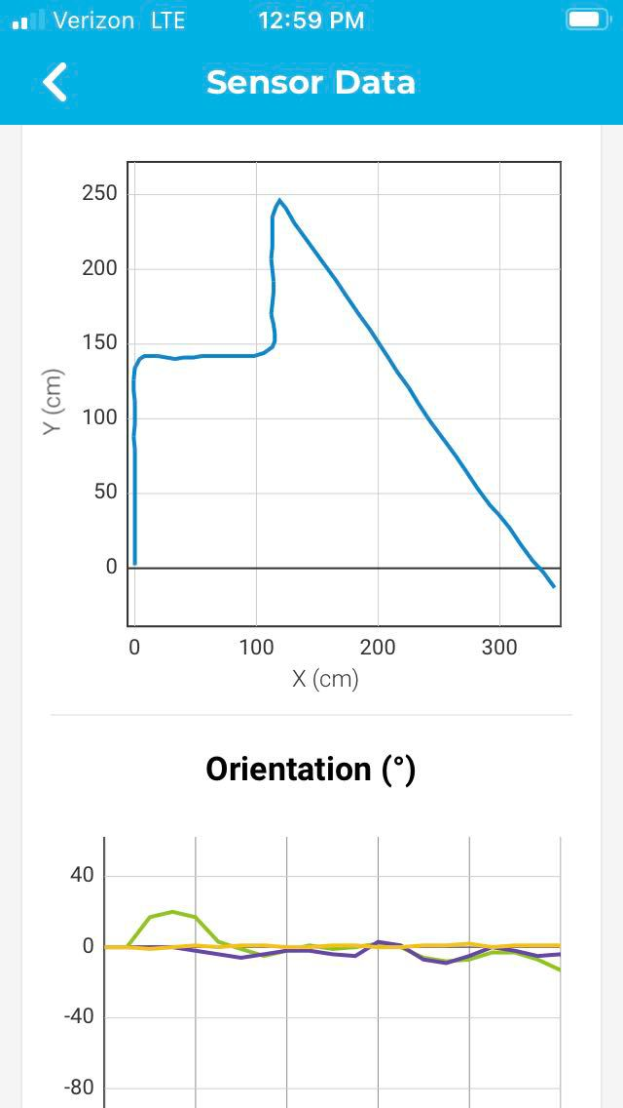
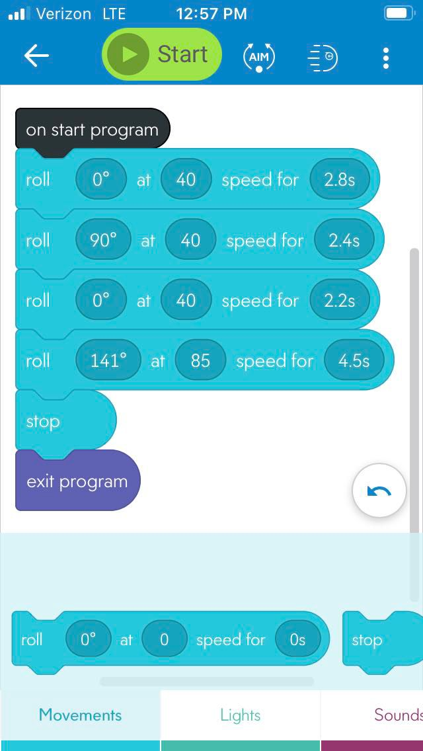
Block Code for Sprint 3
This is the code for sprint 3
Took about an hour or so to finish
It was quite simple to maneuver around the obstacles, so I didn't need that many blocks of code to finish the course

Slide 7
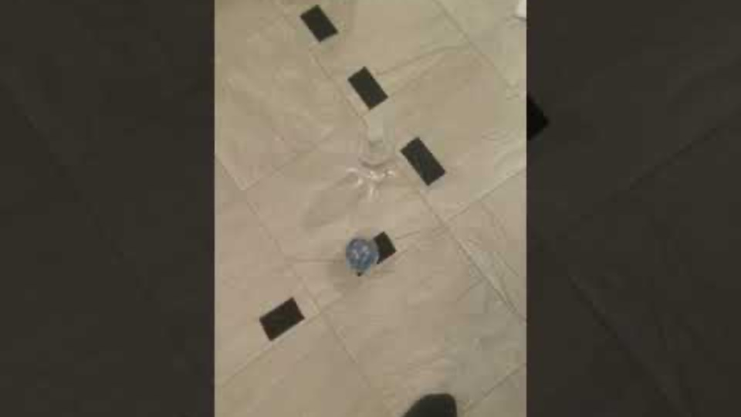
Sprint 3 Video
https://youtu.be/ZTwP64PnhH4
Notes:
https://youtu.be/ZTwP64PnhH4

