Slide 1
Deep Reinforcement Learning in Forex Trading Using Metrics
Supervisor: Prof. LI Xiang
m5231142 HARUGUCHI Takuma
Notes:
Good afternoon everyone, I’m HARUGUCHI Takuma. My supervisor is Professor LI Xiang. Today I'd like to talk about “Deep Reinforcement Learning in Forex Trading Using Metrics”.

Slide 2
Outline
Introduction
Forex Trading
Reinforcement Learning (RL)
Moving Average (MA) as Metrics
Method and Algorithm
Overview of RL
State
Action
Profit and Loss (P/L) and Reward
Deep Q Network (DQN)
Experiment
Overview of Experiment
Dataset
Evaluation method
Result
Accumulated Reward
Waiting Ratio
Conclusion
Notes:
My talk is divided into five parts. First is introduction, second is method and algorithm, third is experiment, fourth is result, the last is conclusion.

Slide 3
1. Introduction
Notes:
Let us start from introduction.

Slide 4


1.1. Forex Trading
The retail foreign exchange trading (Forex trading, A.K.A. FX) is an exchange trading that allows individuals to speculate.
Forex
Companies
Take Long/short Position
Liquidate
Traders
Notes:
Firstly, I explain about Forex Trading. スライド本文をそのまま読む。
カッコ内は which is called Forex trading, and also known as FX
図にポインターを当てて：
Traders take long or short position, and then they liquidate his position to get a profit or suffer a loss.

Slide 5
Forex Trading (Cont.)
Within the scope of this thesis, all you have to do is to learn two rules:
A) Position State Transition
B) Position and floating P/L (profit and loss)
Notes:
そのままスライド本文を読む。

Slide 6
A) Position State Transition
Square
Liquidate
Liquidate
Wait
Take Short Pos.
Take Long Pos.
Short Pos.
Long Pos.
Wait
Wait
Notes:
Firstly, A) Position State Transition.
図にポインターを当てて：
From the beginning, the trader is in square which means no position. The trader can wait, take a short position or take a long position.
When the trader takes the long position, his position changes to the long. He waits there for a while. After that, he liquidates his long position, his position returns to square again.
The same is true for taking the short position.
So, how does the trader take a profit?

Slide 7
B) Position and floating Profit and Loss (P/L)
Long Pos.: $1=100->$1=120 => +\20 as floating P/L
Long Pos.: $1=100->$1=90 => -\10 as floating P/L
Short Pos.: $1=100->$1=120 => -\20 as floating P/L
Short Pos.: $1=100->$1=90 => +\10 as floating P/L
The P/L is finally realized after liquidating the position.
Liquidate: floating P/L ⇒ (realized) P/L
Notes:
The rule (B) explains it. Position and floating Profit and Loss
Simply stated, the long position means the buying position and the short position means the selling position. For example,
第1パターンにポインターを当てて：
If the trader is in the long position, when one hundred yen to the U.S. dollar changes to one hundred twenty yen, he get a profit as plus twenty yen.
第２パターンにポインターを当てて：
When one hundred yen to the U.S. dollar changes to ninety yen, he suffer a loss as minus ten yen.
第３，第４パターンにポインターを当てて：
If taking short position, the rules reverse.
最後のセンテンスにポインターを当てて：
The “floating” means changeable. In fact, the floating P/L fluctuates from moment to moment depending on the exchange rate. Therefore, the P/L is finally realized after liquidating the position.

Slide 8

1.2. Reinforcement Learning (RL)
Agent
Environment
Action
Reward
State
Notes:
And next, Reinforcement Learning.
図にポインターを当てて：
Reinforcement learning is one of machine learning which learns mapping the pairs of situations-to-actions so as to maximize a reward. In general, the reinforcement learning is modeled as Markov decision process like this figure.

Slide 9
Why using RL?
Before employing RL for finance in earnest, the papers that applied machine learning tended to focus on predicting the future.
The weakness in the predictive approach is to ignore the option to wait.
For example, when a trader cannot be sure the direction of the exchange rate, the best strategy should be to wait without bringing any profit and any loss.
RL allows the agent to consider waiting as part of actions.
Notes:
スライドをそのまま読む。

Slide 10
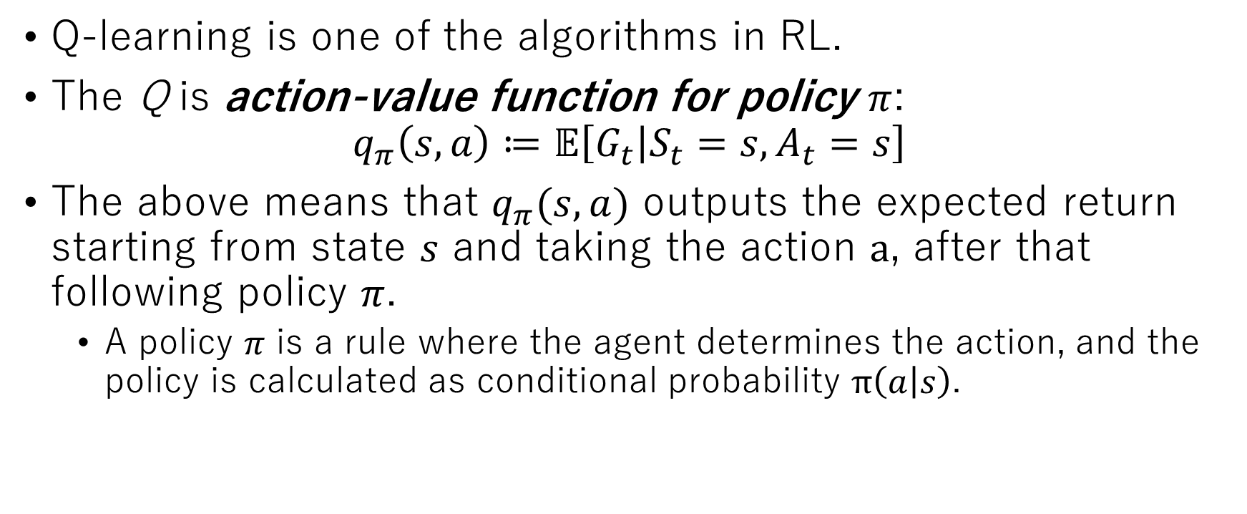
Q-learning: What is Q?
Q-learning is one of the algorithms in RL.
The Q is action-value function for policy $π$:
$$q_{π}\left(s,a\right)≔𝔼\left[G_{t} | S_{t}=s,A_{t}=s\right]$$
The above means that $q_{π}(s,a)$ outputs the expected return starting from state $s$ and taking the action $a$, after that following policy $π$.
A policy $π$ is a rule where the agent determines the action, and the policy is calculated as conditional probability $π\left(a | s\right)$.
Notes:
Next, let us introduce Q-learning. スライド本文をそのまま読む。
$q_{π}\left(s,a\right)≔𝔼\left[G_{t} | S_{t}=s,A_{t}=s\right]$: like this。
$q_{π}(s,a)$: Q Pi S A
$π\left(a | s\right)$: (conditional probability) Pi of A given S

Slide 11

What is Goal of Q-learning?
The goal of Q-learning is to obtain Optimal action-value function :
$$q_{∗}\left(s,a\right)≔max q_{π}\left(s,a\right)$$
for all $s∈𝒮$ and $a∈𝒜\left(s\right)$ where $\text{S}$ is set of all nonterminal states and the $𝒜\left(s\right)$ is set of all actions available in state $s$ [1].
Notes:
So, what is Goal of Q-learning? スライド本文をそのまま読む。
$q_{∗}\left(s,a\right)≔max q_{π}\left(s,a\right)$: Q star S A is defined as max Q Pi S A
$s∈𝒮$ : S belonging to S
$a∈𝒜\left(s\right)$: A belonging to A S

Slide 12
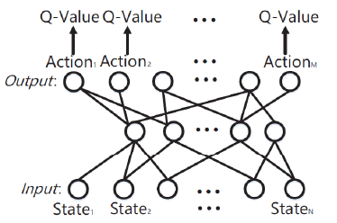
Deep Q-learning (DQL) with Deep Q Network (DQN)
DQL regards each state element as each DQN input node.
To reduce the size of calculating Q-value
DQN outputs only each Q-value for each action.
Input: continuous
Output: discrete
Notes:
So, how should we conduct Q-learning? It is Deep Q-learning with Deep Q Network.
スライド本文をそのまま読む。
右図にポインターを当てながら：
And then, the DQN learns as deep neural network in order to maximize Q-Value.

Slide 13
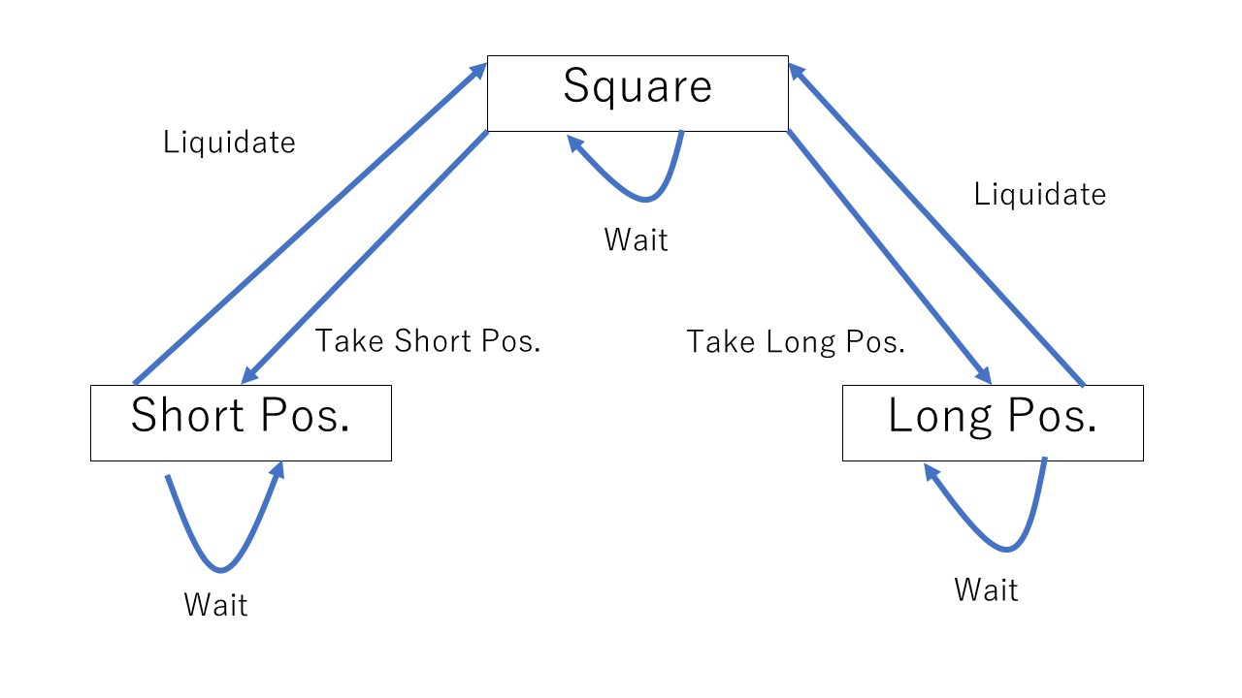
Why using DQN?
Forex trading can be characterized by the continuous of the state while the action is discrete.
Notes:
Why using DQN?
最後のセンテンスにポインターを当てながら：
In terms of RL modeling, Forex trading can be characterized by the continuous of the state while the action is discrete. This is because the state definition includes the exchange rate history which is continuous.
右図にポインターを当てながら：
On the other hand, the action can be defined as discrete like the position state transition.
Therefore, DQN is suitable for Forex trading modeling.

Slide 14
1.3. Moving Average as Metrics
MA (moving average) is one of the most basic metrics in many Forex technical analyses.
Therefore, the experiment will verify whether MA as state element of RL improves the performance of the agent.
This is contribution in my thesis.
Notes:
Next, Moving Average as Metrics
スライド本文をそのまま読む。

Slide 15
2. Method and Algorithm
Notes:
Next, Method and Algorithm

Slide 16
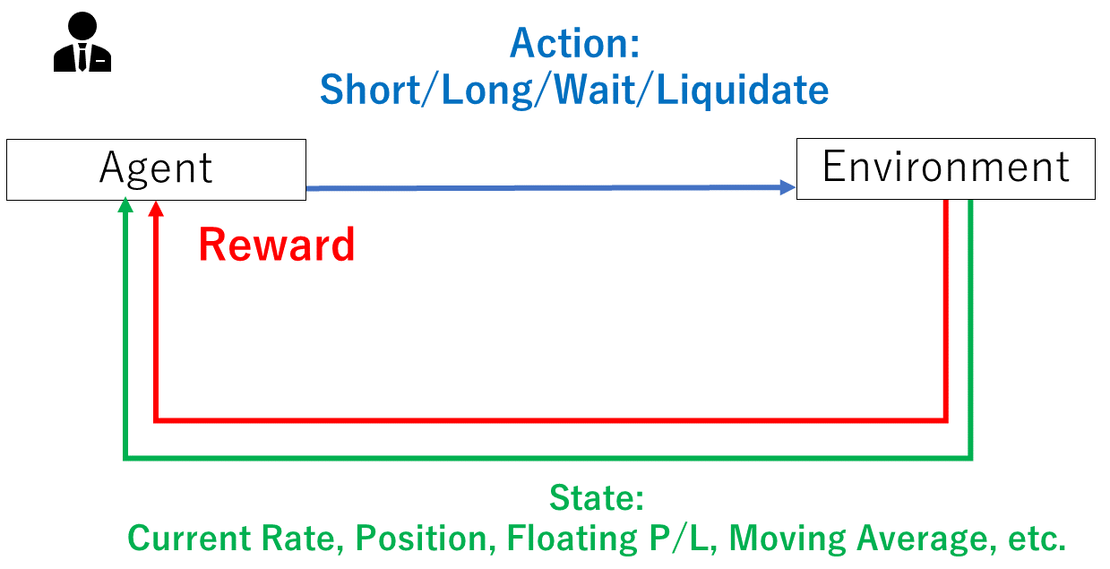
2.1. Overview of RL
Notes:
This paper employs RL as this figure.

Slide 17

2.2. State
The state element is defined as:
$S_{t}=\left(cu_{t},pos,ma1_{t},ma2_{t},ma3_{t},ma4_{t},ma5_{t},fpl_{t},pos_rate\right)$
$cu_{t}$: current exchange rate
$pos$: current position, $pos ∈\{ SQUARE, SHORT, LONG \}$
Notes:
Let us mention about details. スライド本文をそのまま読む。
数式： like this
$pos ∈\{ SQUARE, SHORT, LONG \}$: POS belongs to the set of the elements square, short and long.
最後に：
The subscript T means time step.

Slide 18

MA (Moving Average)
Each MA has a different window to calculate the average:
$ma1_{t}=\frac{1}{120}\sum_{i=t−120}^{t}{p_{i}}$, $ma2_{t}=\frac{1}{80}\sum_{i=t−80}^{t}{p_{i}}$
$ma3_{t}=\frac{1}{50}\sum_{i=t−50}^{t}{p_{i}}$, $ma4_{t}=\frac{1}{30}\sum_{i=t−30}^{t}{p_{i}}$
$ma5_{t}=\frac{1}{20}\sum_{i=t−20}^{t}{p_{i}}$
Notes:
Next, moving average. スライド本文をそのまま読む。
数式: Each definitions are like these

Slide 19
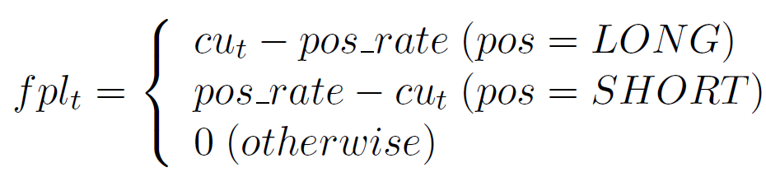

Floating P/L (Profit and Loss)
$fpl_{t}$: Floating P/L
Notes:
Next, floating P/L.
数式にポインターを当てながら：
The definition is like this.

Slide 20
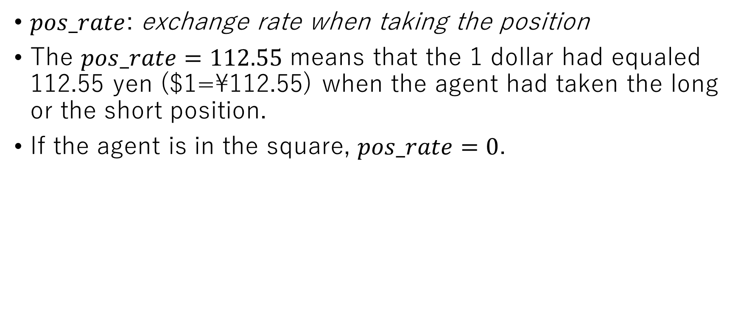
Exchange Rate When Taking the Position
$pos_rate$: exchange rate when taking the position
The $pos_rate=112.55$ means that the 1 dollar had equaled 112.55 yen ($1=\112.55) when the agent had taken the long or the short position.
If the agent is in the square, $pos_rate=0$.
Notes:
Next, スライド本文をそのまま読む。
$pos_rate=112.55$ : Pos rate equals one hundred twelve point five five
$pos_rate=0$: Pos rate equals zero.

Slide 21

2.3. Action
Square
Liquidate
Wait
Liquidate
Take Short Pos.
Take Long Pos.
Short Pos.
Long Pos.
Wait
Wait
Notes:
Next, action.
数式にポインターを当てながら：
Action definition is like this. These correspond to the position state transition.

Slide 22
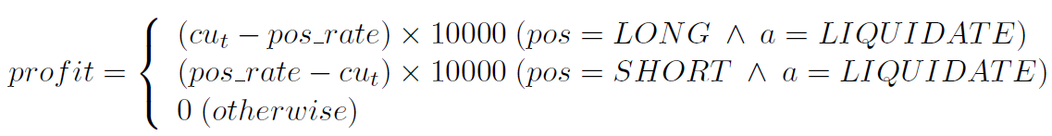
2.4. P/L and Reward
The X 10000 is leverage to amplify P/L.
In fact, the exchange rates in the implementation are normalized to reduce computational complexity. The leverage compensates it.
Note that the reward is defined as same as the profit.
Notes:
Next, P/L and Reward.
数式にポインターを当てながら：
P/L definition is like this.
X 10000: times ten thousand

Slide 23
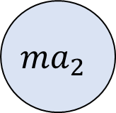
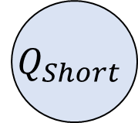
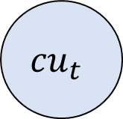
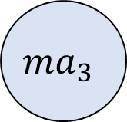
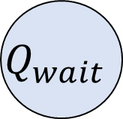
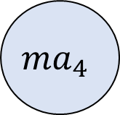
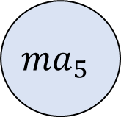

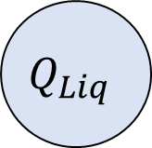
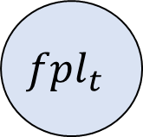
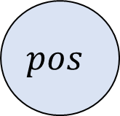
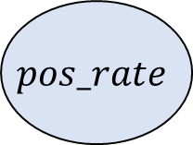
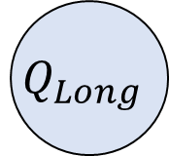
2.5. DQN
$$Q_{wait}$$
$$Q_{Short}$$
$$Q_{Long}$$
$$Q_{Liq}$$
・・・・・・・・・・・・
・・・・・・・・・・・・・
$${cu}_{t}$$
$$pos$$
$${ma}_{1}$$
$${ma}_{2}$$
$${ma}_{3}$$
$${ma}_{4}$$
$${ma}_{5}$$
$${fpl}_{t}$$
$$pos_rate$$
Notes:
Next, DQN.
図にポインターを当てながら：
Input nodes correspond to state elements. Output nodes are in charge of calculating the Q-value for each action.

Slide 24
3. Experiment
Notes:
Next, Experiment.

Slide 25
3.1. Overview of Experiment
Training consists of 50,000 steps trading with 47 episodes.
Testing consists of nine types of period.
The training and nine testing vary the number of MA.
MA1, MA2, MA3, MA4, MA5
To confirm the effect of MA as metrics
Notes:
Let us overview the experiment. スライド本文を読む。
50,000: fifty thousand
47: forty-seven

Slide 26
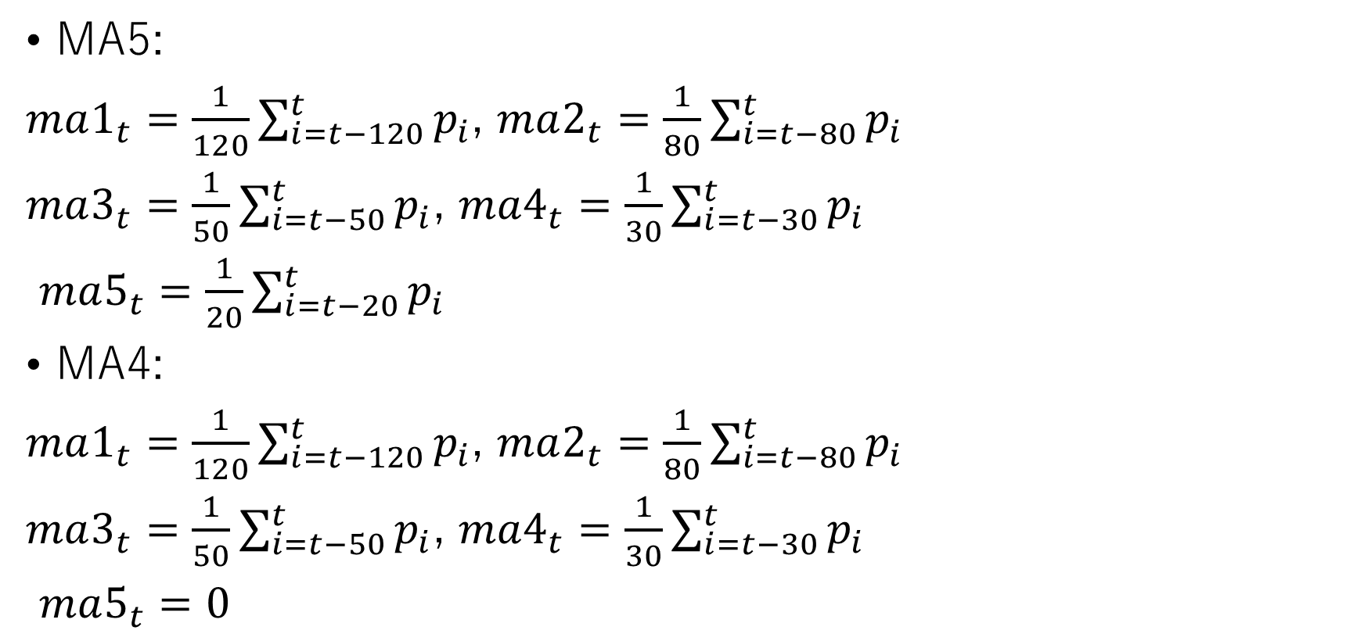
Number of MA
MA5:
$ma1_{t}=\frac{1}{120}\sum_{i=t−120}^{t}{p_{i}}$, $ma2_{t}=\frac{1}{80}\sum_{i=t−80}^{t}{p_{i}}$
$ma3_{t}=\frac{1}{50}\sum_{i=t−50}^{t}{p_{i}}$, $ma4_{t}=\frac{1}{30}\sum_{i=t−30}^{t}{p_{i}}$
$ma5_{t}=\frac{1}{20}\sum_{i=t−20}^{t}{p_{i}}$
MA4:
$ma1_{t}=\frac{1}{120}\sum_{i=t−120}^{t}{p_{i}}$, $ma2_{t}=\frac{1}{80}\sum_{i=t−80}^{t}{p_{i}}$
$ma3_{t}=\frac{1}{50}\sum_{i=t−50}^{t}{p_{i}}$, $ma4_{t}=\frac{1}{30}\sum_{i=t−30}^{t}{p_{i}}$
$ma5_{t}=0$
Notes:
Each number of MA is defined like this.
数式にポインターを当てながら：
MA-five is like this. MA-four is like this.

Slide 27
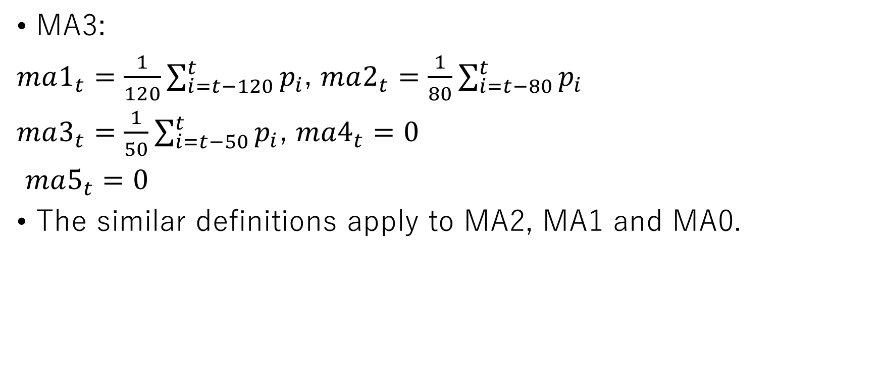
Number of MA (Cont.)
MA3:
$ma1_{t}=\frac{1}{120}\sum_{i=t−120}^{t}{p_{i}}$, $ma2_{t}=\frac{1}{80}\sum_{i=t−80}^{t}{p_{i}}$
$ma3_{t}=\frac{1}{50}\sum_{i=t−50}^{t}{p_{i}}$, $ma4_{t}=0$
$ma5_{t}=0$
The similar definitions apply to MA2, MA1 and MA0.
Notes:
数式にポインターを当てながら：
MA-three is like this. スライドの本分を読む。

Slide 28
3.2. Dataset
Dataset | Period (Day.Month.Year, GMT)
Train | 07.01.2004 - 07.01.2004
Test1 | 11.01.2004 - 16.01.2004
Test2 | 01.02.2004 - 06.02.2004
Test3 | 20.06.2004 - 25.06.2004
Test4 | 02.01.2005 - 07.01.2005
Test5 | 01.01.2007 - 05.01.2007
Test6 | 01.01.2009 - 07.01.2009
Test7 | 02.01.2011 - 07.01.2011
Test8 | 01.01.2014 - 08.01.2014
Test9 | 01.01.2019 - 08.01.2019
The more the testing ID increases, the further the period of testing dataset is from the training period.
Notes:
Next, dataset.
表の第1列にポインターを当てながら：
Dataset comprise one training set and nine testing set like this.
スライド本文を読む。
(2021/2/14追記）
TrainのPeriodが間違っていた。論文の方を直したのでそちらを参照。

Slide 29
3.3. Evaluation Method
Accumulated reward is defined as total rewards per one episode.
It means the performance of agent's Forex trading.
Note that the accumulated reward is equivalent to total P/L per one episode.
As mentioned in “Why using RL?” slide , when a trader cannot be sure the direction of the exchange rate, he should wait. The waiting ratio shows whether RL realizes this strategy.
Hypothesis: the further the period of testing dataset is from the training period, the more the waiting ratio should increase.
Notes:
Next, Evaluation Method.
Evaluation method consists of accumulated reward and waiting ratio.
スライド本文を読む。
数式： is defined like this
最後のセンテンスにポインターを当てながら：
I will verify the hypothesis:

Slide 30
4. Result
Notes:
Next, let us talk about result.

Slide 31
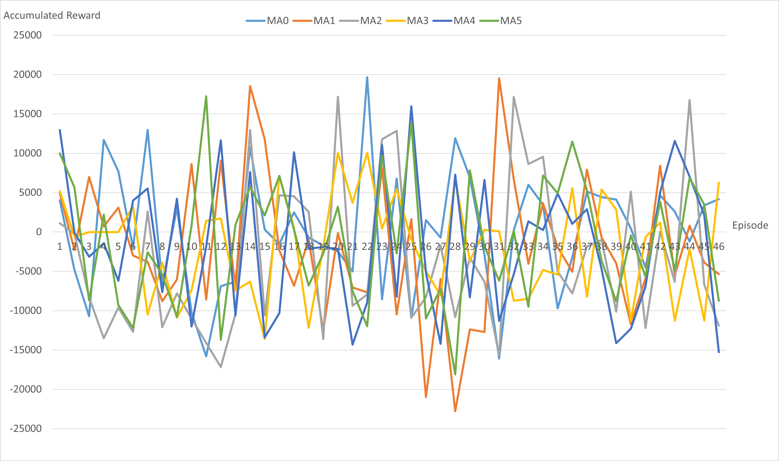
4.1. Accumulated Reward in Training
Notes:
図にポインターを当てながら：
This figure shows the accumulated reward of each MA for each training episode. It suggests that the agent cannot learn how to make a profit because even the second half of the episodes show mostly negative rewards. In addition, the number of MA seems to have little impact on the reward in the training.

Slide 32
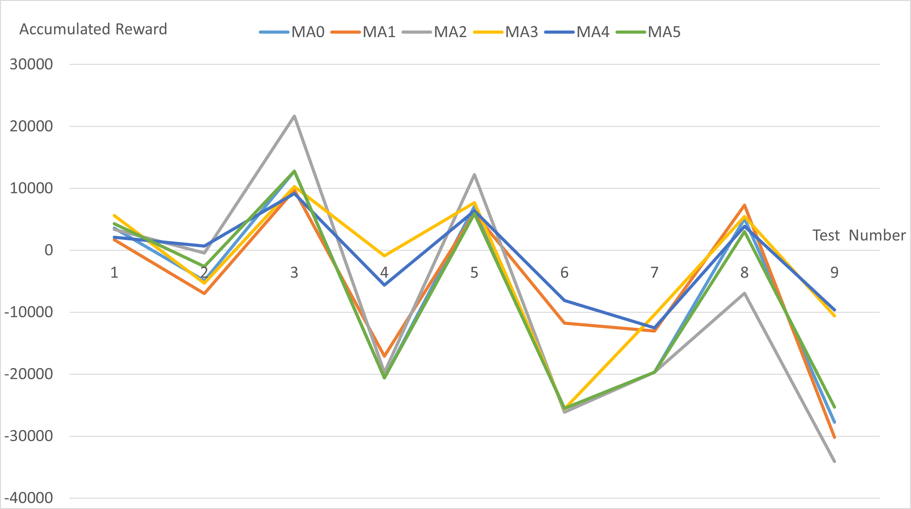
Accumulated Reward in Testing
Notes:
図にポインターを当てながら
The same is true for this figure for testing.
Most rewards of the tests are negative, and the figure suggests that the number of MA could not improve the trading performance since each MA shows similar accumulated rewards.
As a result, it is concluded that MA is invalid metrics for DQL of Forex trading.

Slide 33
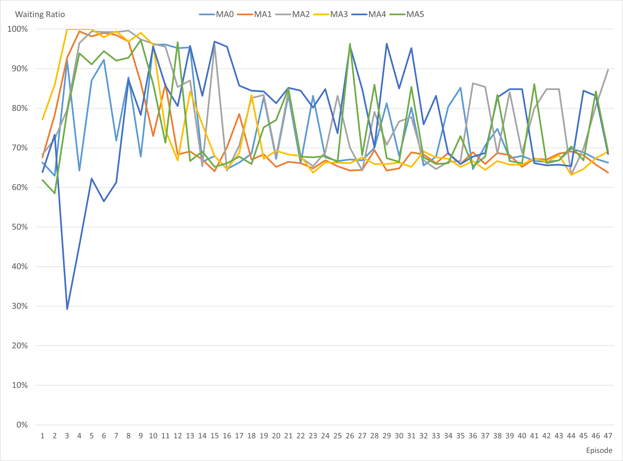
4.2. Waiting Ratio in Training
Notes:
Next, let us look at Waiting Ratio in Training.
チャートの右端をポインターで円形になぞりながら：
It suggests that the waiting ratios of any number of MA tend to converge to the range of seventy percent to seventy five percent.

Slide 34
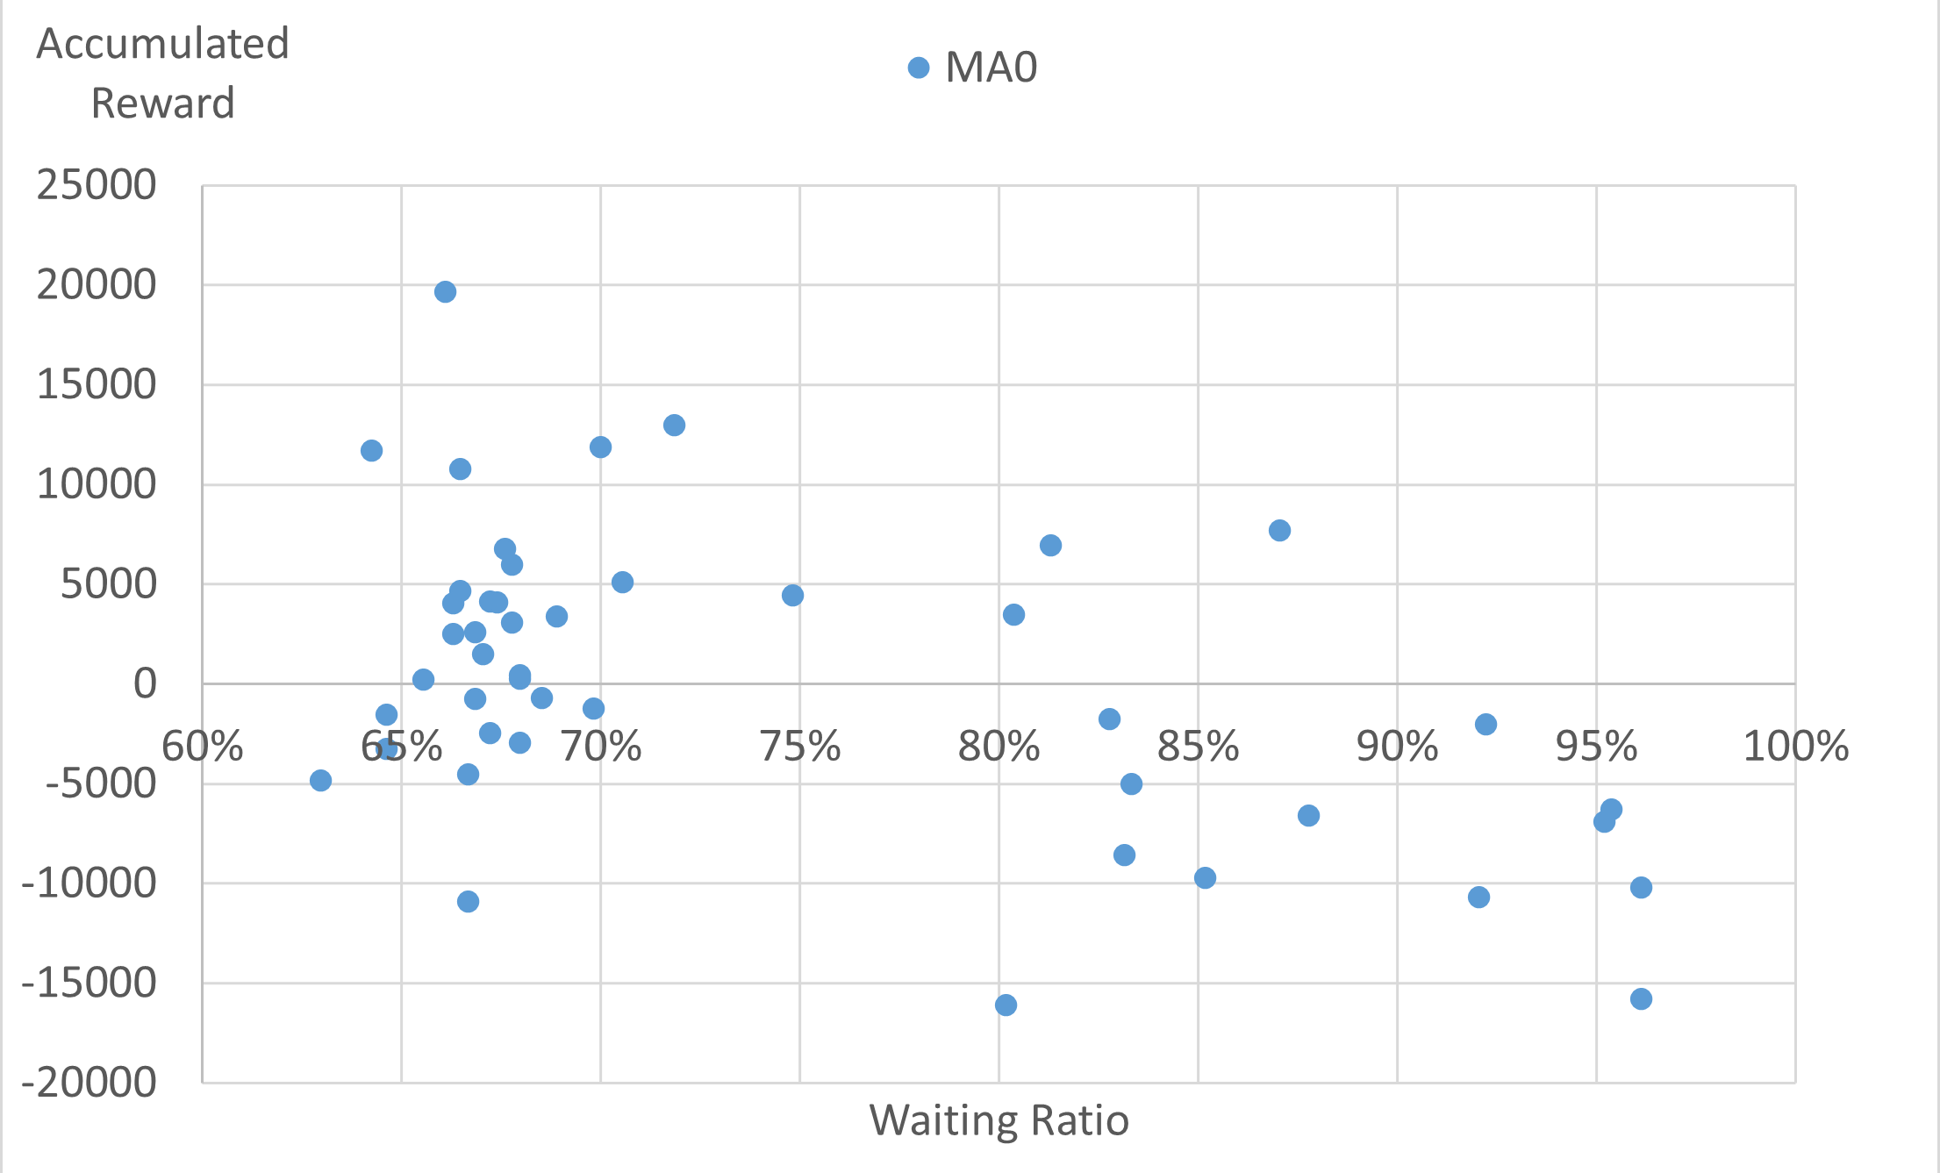
Scatter Plot between Waiting Ratio and Accumulated Reward in Training of MA0
Notes:
Look at Scatter Plot between Waiting Ratio and Accumulated Reward in Training of MA0
It indicates that the range of seventy percent to seventy five percent is the boundary whether the loss absolutely occurs or not
プロットをクリックし、右側をポインターで円を描く：
the right sides of the range in the figures show that most data points are negative accumulated rewards.
That is to say, RL is presumed to help to avoid losses in Forex trading.

Slide 35
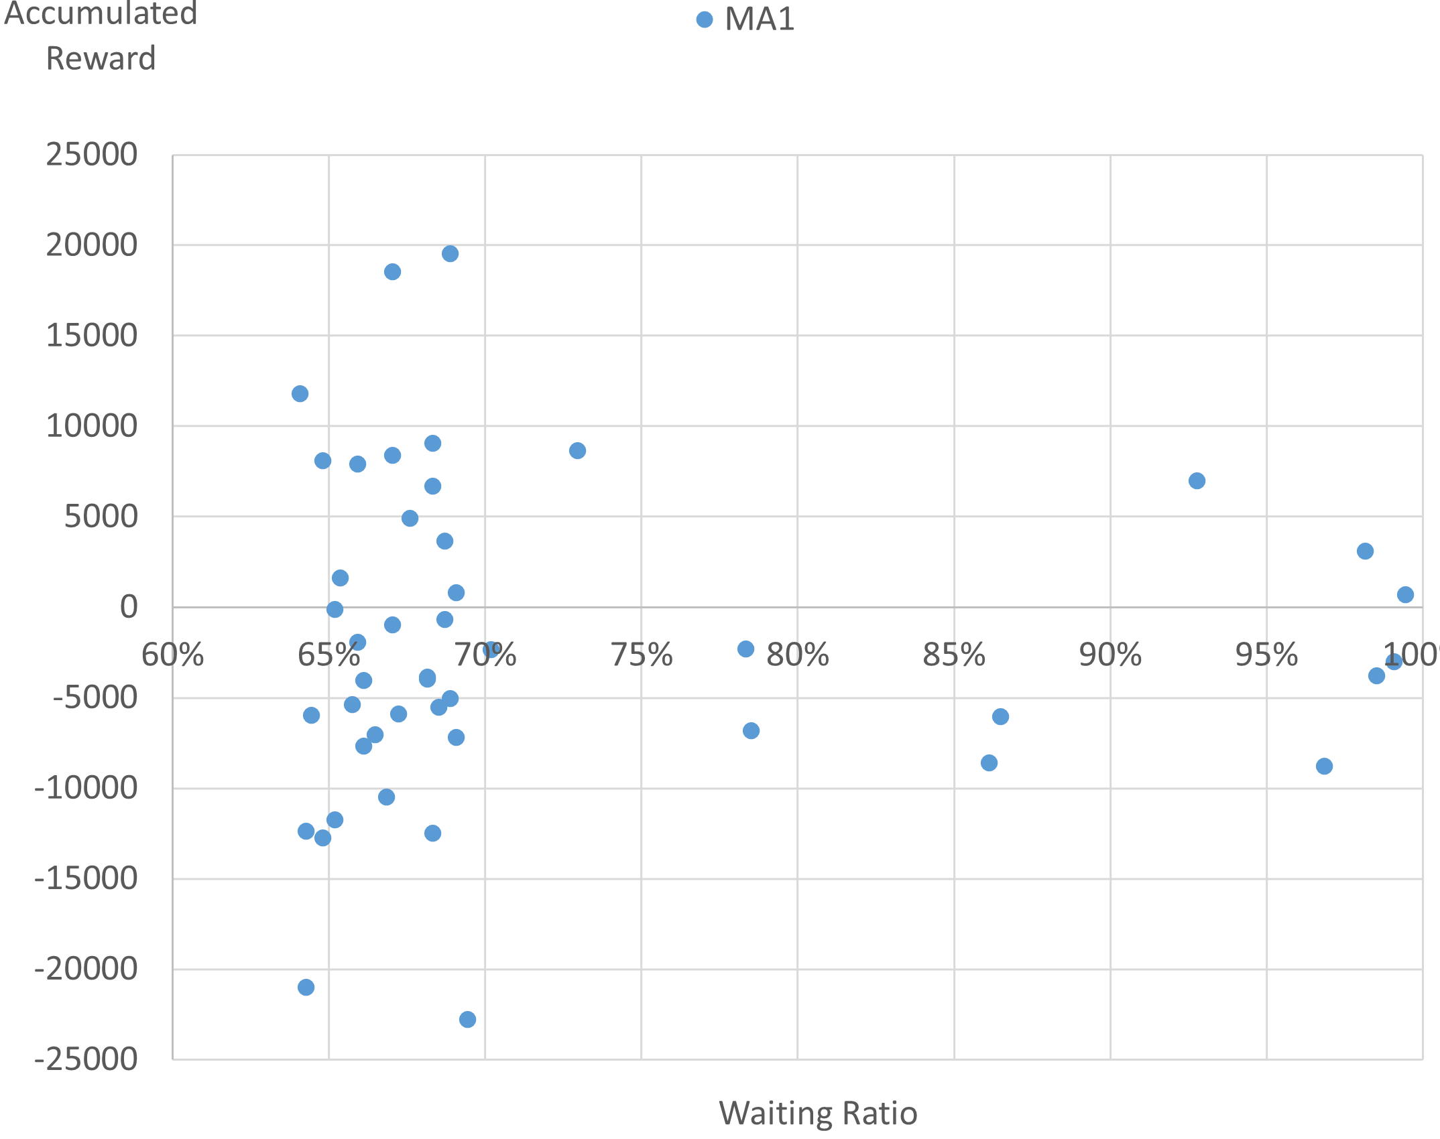
Scatter Plot between Waiting Ratio and Accumulated Reward in Training of MA1
Notes:
プロットをクリック：
MA1 also tends to the same.

Slide 36
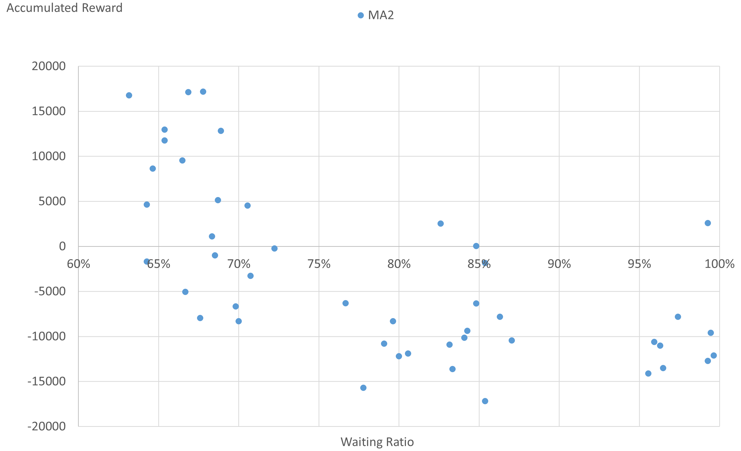
Scatter Plot between Waiting Ratio and Accumulated Reward in Training of MA2
Notes:
プロットをクリック：
MA2 too.

Slide 37
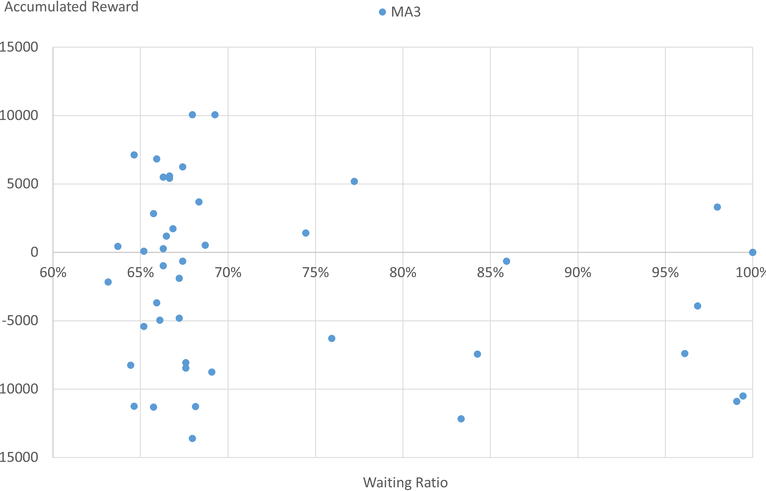
Scatter Plot between Waiting Ratio and Accumulated Reward in Training of MA3
Notes:
プロットをクリック：
MA3 too.

Slide 38
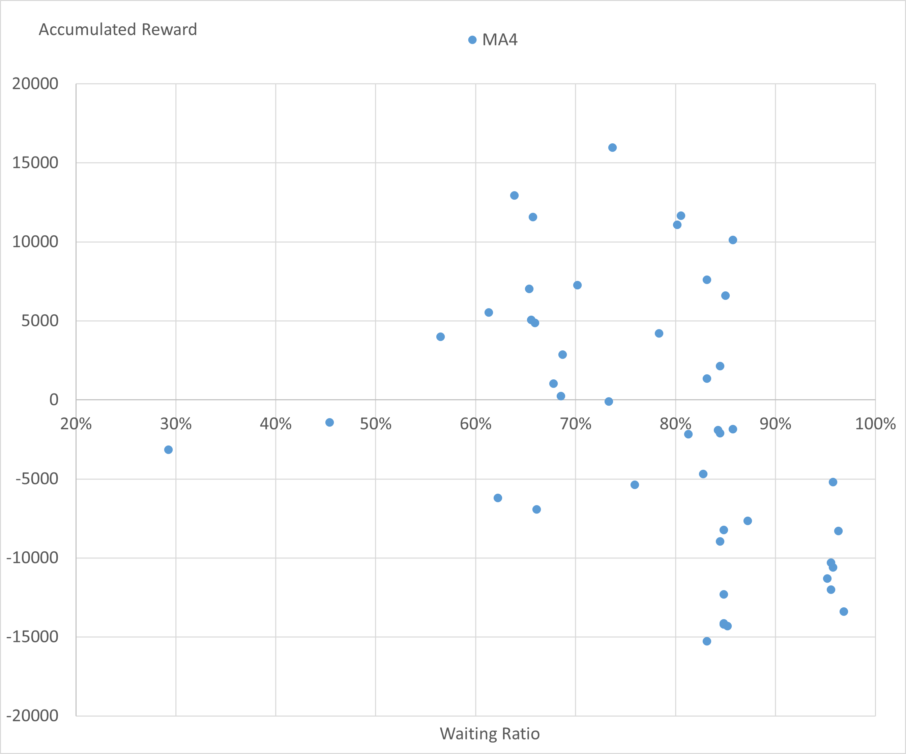
Scatter Plot between Waiting Ratio and Accumulated Reward in Training of MA4
Notes:
プロットをクリック：
It shows a bit different form other plots, but MA4 also nearly tends to the same.

Slide 39
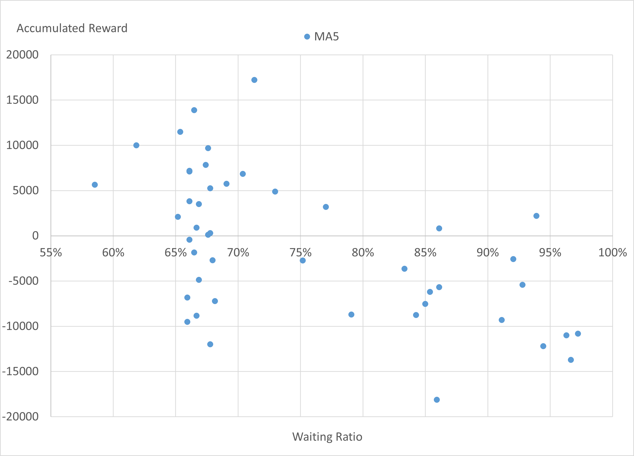
Scatter Plot between Waiting Ratio and Accumulated Reward in Training of MA5
Notes:
プロットをクリック：
MA5 tends to the same except MA4.

Slide 40
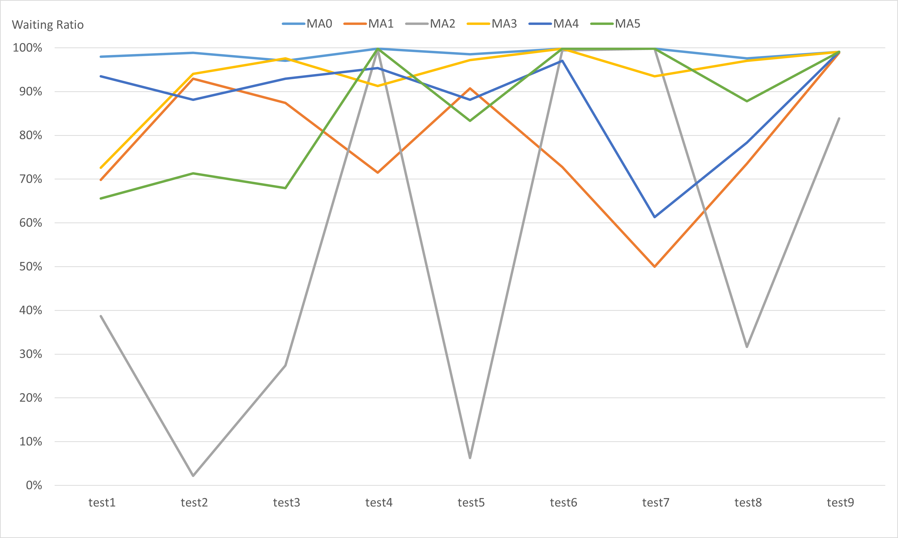
Waiting Ratio in Testing for the Number of MA
Notes:
This chart is the Waiting Ratio in Testing for the Number of MA. It is hard to see the implication as it is, so let us take the average for each test.

Slide 41
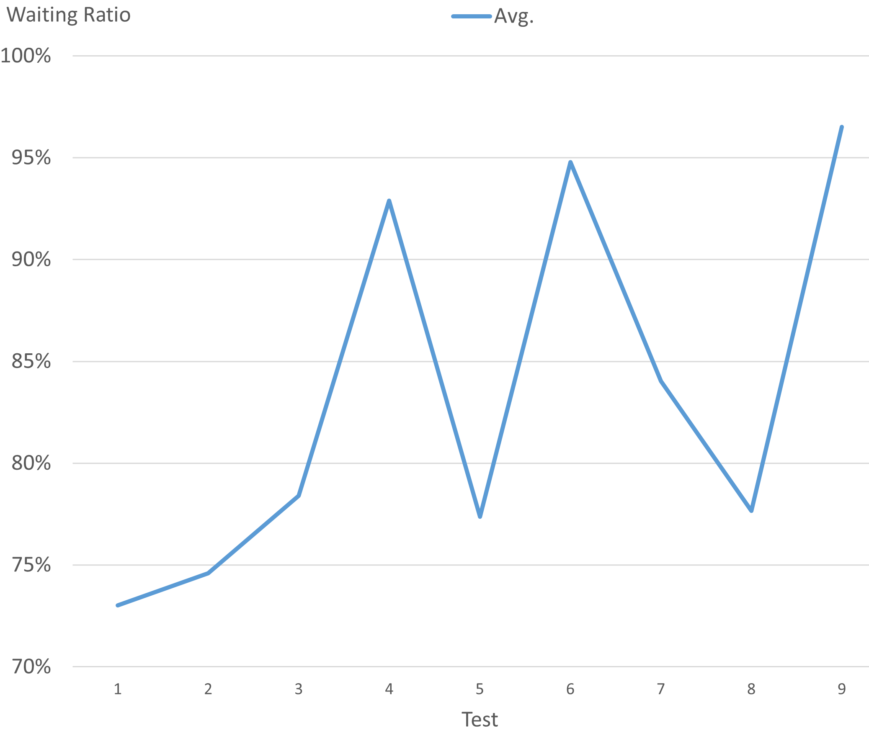
Average of Waiting Ratio in Testing
Notes:
And this is the average.
チャートをクリックする：
This figure suggests consistent with the hypothesis in the “Evaluation Method” slide: that is, the further the period of testing dataset is from the training period, the more the waiting ratio increases.

Slide 42
5. Conclusion
Notes:
So finally, Conclusion

Slide 43
5.1. Conclusion
The result of accumulated reward could not prove the importance of multiple MAs.
We concluded that MA was invalid metrics for DQL of Forex trading.
The result of the waiting ratio suggested that RL itself can be useful to avoid losses for the future the agent cannot be sure.
Waiting ratios for any MAs in training tended to converge between 70% and 75%.
The plots of training indicated that the range of 70% to 75% was the boundary whether the loss absolutely occurred or not
The confirmed hypothesis in the testing suggests the avoiding losses.
Notes:
スライドをそのまま読む
70%: seventy percent
75%: seventy five percent

Slide 44
Further Investigations Are Needed
We must consider other metrics as state element.
Oscillator, Fibonacci retracement, relative strength index (RSI), or Bollinger [3]
Consider combining DQL with the price prediction model such as using convolutional neural network (CNN) [4]
We must more strictly verify whether RL actually avoids losses in the trading.
It was not enough to prove the avoiding although the “Result” slides suggested it.
Notes:
Lastly, I have to say that further Investigations Are Needed
スライド本文をそのまま読む。

Slide 45
Thank You for Listening
Notes:
This is the end of my presentation. Thank you very much for kind attention. Any Question?
(Q&A)
「５個のMAのウェイト（重み付け）が全て同じなのは問題では？直近の方のMAのウェイトを大きくすべきだったのでは？」
I think it is good question. The reason is to implement the simplest code. I didn’t have its idea when coding. It will be improvement for further investigation.

Slide 46
Reference
[1] R. S. Sutton and A. G. Barto, Reinforcement learning: An introduction. MIT press, 2018.
[2] V. Mnih, K. Kavukcuoglu, D. Silver, A. Graves, I. Antonoglou, D. Wierstra, and M. Riedmiller, “Playing atari with deep reinforcement learning,” arXiv preprint arXiv:1312.5602, 2013.
[3] “6 Types of Technical Analysis Every Forex Trader Should Learn,” https://www.valutrades.com/en/blog/6-types-of-technical-analysis-every-forex-trader-should-learn, accessed: 2021-2-20.
[4] A. Suchaimanacharoen, T. Kasetkasem, S. Marukatat, I. Kumazawa, and P. Chavalit, “Empowered PG in Forex Trading,” 17th International Conference on Electrical Engineering/Electronics, Computer, Telecommunications and Information Technology, ECTI-CON 2020, pp. 316–319, 2020.

