Slide 1

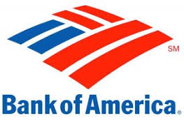



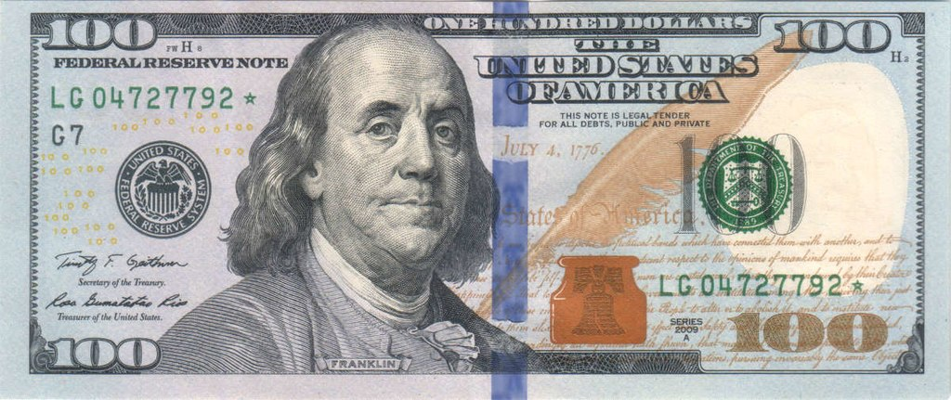
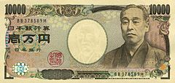



Interbank Market
Cover Deal
Forex
Companies
Take Long/short Pos.
Liquidate
Traders

