Slide 1
Classification of Hiragana with Plain CNN and ResNet
m5231142 春口 拓磨 (HARUGUCHI Takuma)

Slide 2
Introduction: What is ResNet?
Residual Network（ResNet）is the convolutional neural network to introduce the residual learning framework.
The framework prevents performance from getting worse when increasing the number of the layer.
Therefore, Resnet can have more layers than exiting CNNs.
Source: He, Kaiming, et al. "Deep residual learning for image recognition." Proceedings of the IEEE conference on computer vision and pattern recognition. 2016.

Slide 3
Problem Statement
This research topic is to compare the numbers of layers where the accuracy is best for each image datasets about CIFAR-10 and hiragana with the plain CNN and ResNet.

Slide 4
Technical Approach and Models
Datasets
CIFAR-10
Hiragana (73 classes) https://lab.ndl.go.jp/cms/hiragana73
Network Model
Plain CNN
ResNet
Framework: Pytorch
Clone and modify the existing implementation of ResNet
https://github.com/a-martyn/resnet

Slide 5
Modify For the Hiragana Dataset
Resize 48x48 size of hiragana to 32x32
Delete image transforming of random horizontal flipping and cropping
This is because hiragana is character, not objects such as car or bird.
Change the number of the output layer: 10->73
Add torch.nn.DataParallel() to speed up training

Slide 6
Experiments
Train the plain net and ResNet for CIFAR-10 and hiragana dataset
Compare the numbers of layers and test error for each network.
Testing Network Model
Plain Network (CNN): Layer = 20, 32, 44, 56
ResNet: Layer = 20, 32, 44, 56
Notes:
8/1 Prof. comment:
Layer -> Block

Slide 7
The Structure of Networks
ResNet
Plain Network
Source: He, Kaiming, et al. "Deep residual learning for image recognition." Proceedings of the IEEE conference on computer vision and pattern recognition. 2016.

Slide 8
Results: Test Error of CIFAR-10
Model | Test Error | Model | Test Error
PlainNet20 | 0.0942 | ResNet20 | 0.0842
PlainNet32 | 0.0924 | ResNet32 | 0.0790
PlainNet44 | 0.1152 | ResNet44 | 0.0716
PlainNet56 | 0.1367 | ResNet56 | 0.0770

Slide 9
Results: Test Error of Hiragana
Model | Test Error | Model | Test Error
PlainNet20 | 0.003125 | ResNet20 | 0.003563
PlainNet32 | 0.011250 | ResNet32 | 0.005687
PlainNet44 | 0.023688 | ResNet44 | 0.010625
PlainNet56 | 0.077938 | ResNet56 | 0.007000

Slide 10
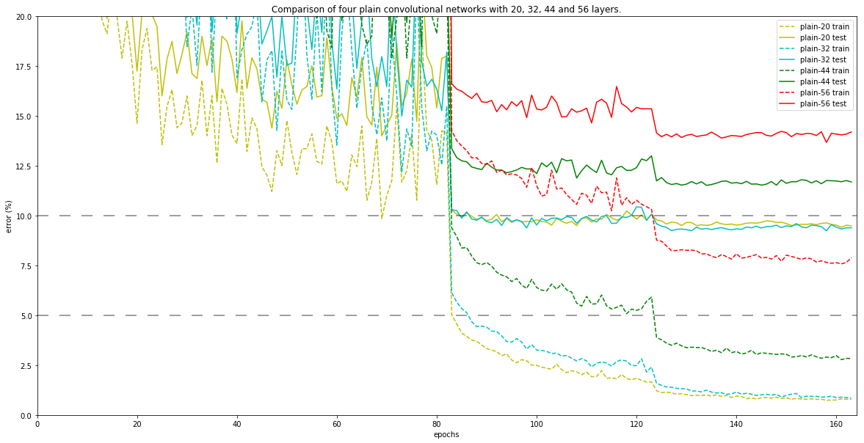
CIFAR-10 Plain Net

Slide 11
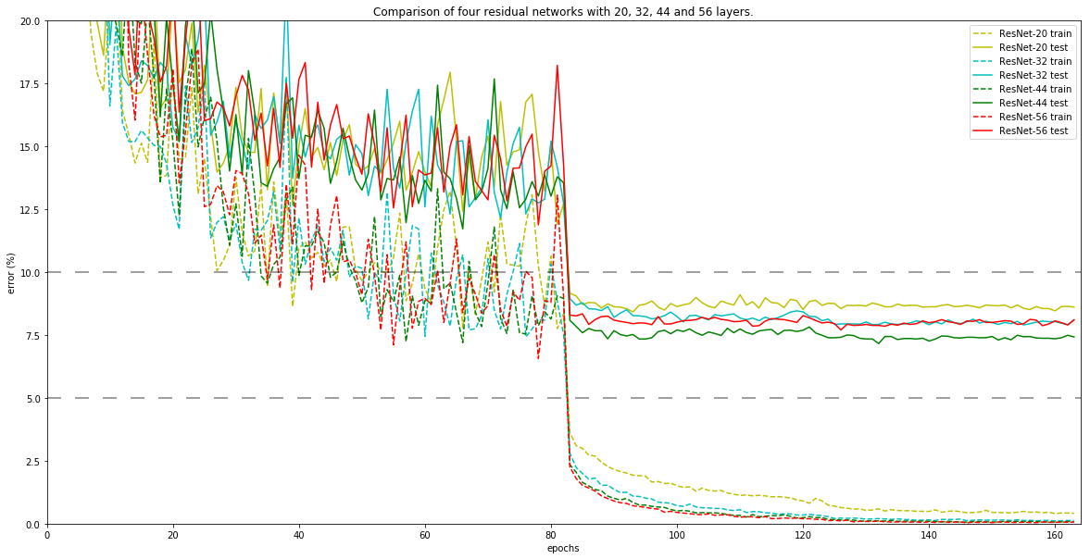
CIFAR-10 ResNet

Slide 12
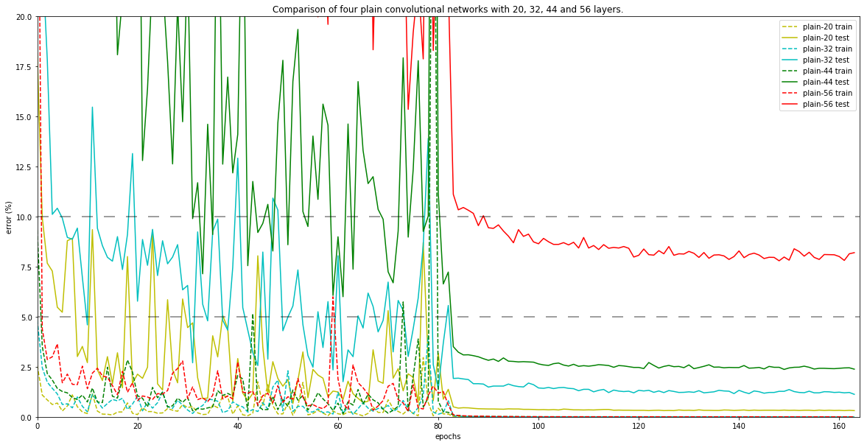
Hiragana Plain Net

Slide 13
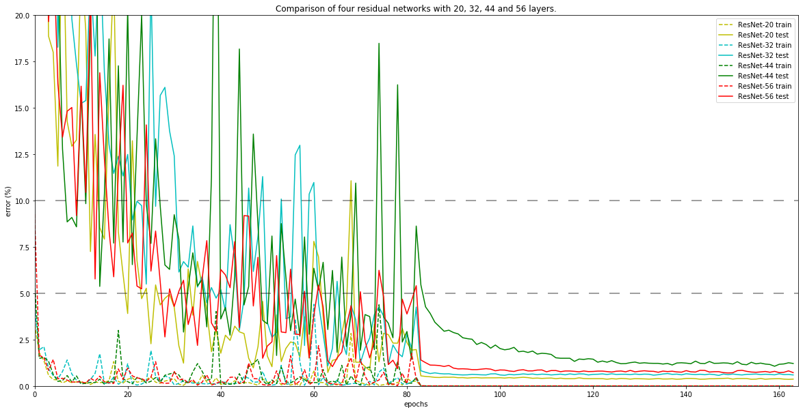
Hiragana ResNet

Slide 14
Discussion: The summary of Hiragana Result
Similar to CIFAR-10:
More the number of the layer in the plain net is, the worse the test error is.
In the ResNet, the increasing of layers does not strongly worsen the test error.
Different from CIFAR-10:
The best model of hiragana is PlainNet20 while the best of CIFAR-10 is ResNet44.
Note that the best model in CIFAR-10 of the original repository is ResNet56. The cause of the difference may be adding torch.nn.DataParallel.
In both the plain net and ResNet of the hiragana, the number of the layer in the best model is the smallest: PlainNet20 and ResNet20
The train errors of all models in the hiragana reached to zero while the errors of plain nets in CIFAR-10 do not.

Slide 15
Interpretation of the Result
Why “The best model in the hiragana is PlainNet20”?
It should mean hiragana as dataset is too simple image for CNN to classify it.
In fact, the best test error of the hiragana is 0.003125 while the best of the CIFAR-10 is 0.0770. The accuracy of hiragana classification is very high.
In addition, the train errors of all models in the hiragana reached to zero. It means that the networks cannot learn the features from the training dataset since the hiragana is more simpler than CIFAR-10.
Even if the number of the class is large, it seems not to worse the accuracy of CNN. The complexity of each image seems to affect the accuracy.
Hiragana: 73 classes, CIFAR-10: 10 classes

Slide 16
Reference
GitHub
https://github.com/a-martyn/resnet
https://github.com/s1230038/resnet
CIFAR-10 Test Commit: f87b5c49c1314fb0cbcd8012ccbfb15e491f8b92
Hiragana Test Commit: 4bbf87236909c505d241386995ddbc5083745e0c
He, Kaiming, et al. "Deep residual learning for image recognition." Proceedings of the IEEE conference on computer vision and pattern recognition. 2016.
Google Colab Jupiter notebook as example
https://colab.research.google.com/drive/1iyNXZ6LffoLycU8tj7U-1IeUh0GcdjMJ
https://colab.research.google.com/drive/144CmW5X3FMMHsycpon0XS4qTwjtdm9RV
For Your Information
https://sonaeru-blog.com/pytorch-dataset/
https://deepage.net/deep_learning/2016/11/30/resnet.html

Slide 17
Thank You for Listening

