Slide 1
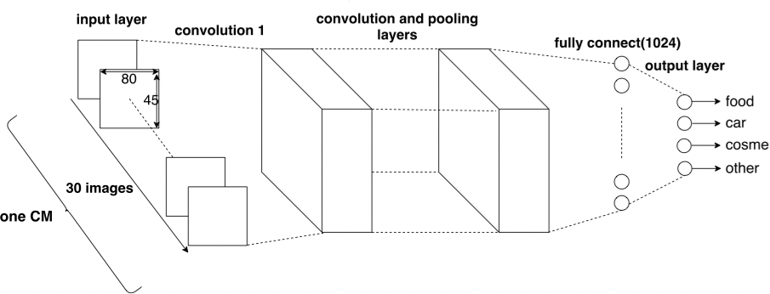
Classifying Television Commercials by Convolutional Neural Network with Evaluation of Error Functions s1250103 Ryota Moriya, Supervisor: Prof. Kazuyoshi Mori
Ｓｅａｌ
or Ｓｉｇｎａｔｕｒｅ
1. Motivation and Goal
3. Current Results and Status
Television commercials(TVCMs) provide information about products and services to viewers and TVCMs are watched by many people in a society. TVCMs reflects the social situation and trend.
We consider that investigating many TVCMs is useful for social analysis, especially business purposes. Therefore, we have decided to develop a semiautomatic system by convolutional neural network for classifying CMs.
In the neural network, a function called error function is used. There are many kinds of error functions and they often influence to significant results of the neural network. We consider that better error activation functions exercise a positive effect for making the system more effective.
In order to training CNN, we have so far collected 68 of various TVCMs. Each is classified with the three category labels, such as “food”, “car” , and “cosmetic”.
We have implemented a preliminary CNN (Figure 4) that can classify CM videos into three categories “food”, “car”, or “cosmetic”. It consists of 6 convolutional layers and one fully connected layers.
Figure1: Convolutional Neural Network
One CM should play a role of input, where a TVCM is a video. In the current system, we input 30 successive images from one TVCM.
2.Approach
4. Tasks and Schedule
As we have implemented a preliminary system, we are going to evaluate some error functions such as “Cross entropy error”, “Mean Squared Logarithmic Error” and “Mean squared error”.
As a future work, we intend to improve the accuracy by using additional data and discuss CNN by changing error functions.
We use convolutional neural network (CNN)[1] in order to classify a television commercials. CNN(Figure 1) is a kind of deep learning. It has several layers including convolution layers and pooling layers. It is often used for image recognition.
In many cases, images are inputs one by one to CNN. In this study, we implement CNN with video inputs by using several consecutive images for input. This will enable us to obtain a temporal feature of CMs.
We are going to use Open Source Computer Vision (OpenCV), TensorFlow and Keras[2].
References
[1]大関真之, “機械学習入門 ボルツマン機械学習から深層学習まで”, オーム社, 2019.
[2]青野雅樹, “Kerasによるディープラーニング”

