Slide 1
IE04 Weekly Progress Report
2020/10/21
Team: orange

Slide 2
Activities of Previous Week
Task | Member | Status | Work HoursRead
Read and discuss the RFP | Konno,Yanada,Katakura | 100% | 0:50
Think about the function that should be implemented at a minimum. | Konno,Yanada,Katakura | 100% | 1:20
Think about what we will make | Konno,Yanada,Katakura | 60% | 0:30
Create use cases | Konno,Yanada,Katakura | 80% | 1:00
Analyze requirements | Konno,Yanada,Katakura | 70% | 1:00
Create product backlog | Konno,Yanada,Katakura | 70% | 1:00
 |  | Total time: | 38:00

Slide 3
Plan for This Week
Task | Member | Work Hours
Think about what we will make | Konno,Yanada,Katakura | 1:00
Complete use cases | Konno,Yanada,Katakura | 1:00
Definite requirements | Konno,Yanada,Katakura | 1:00
 | Total time: | 29:00

Slide 4
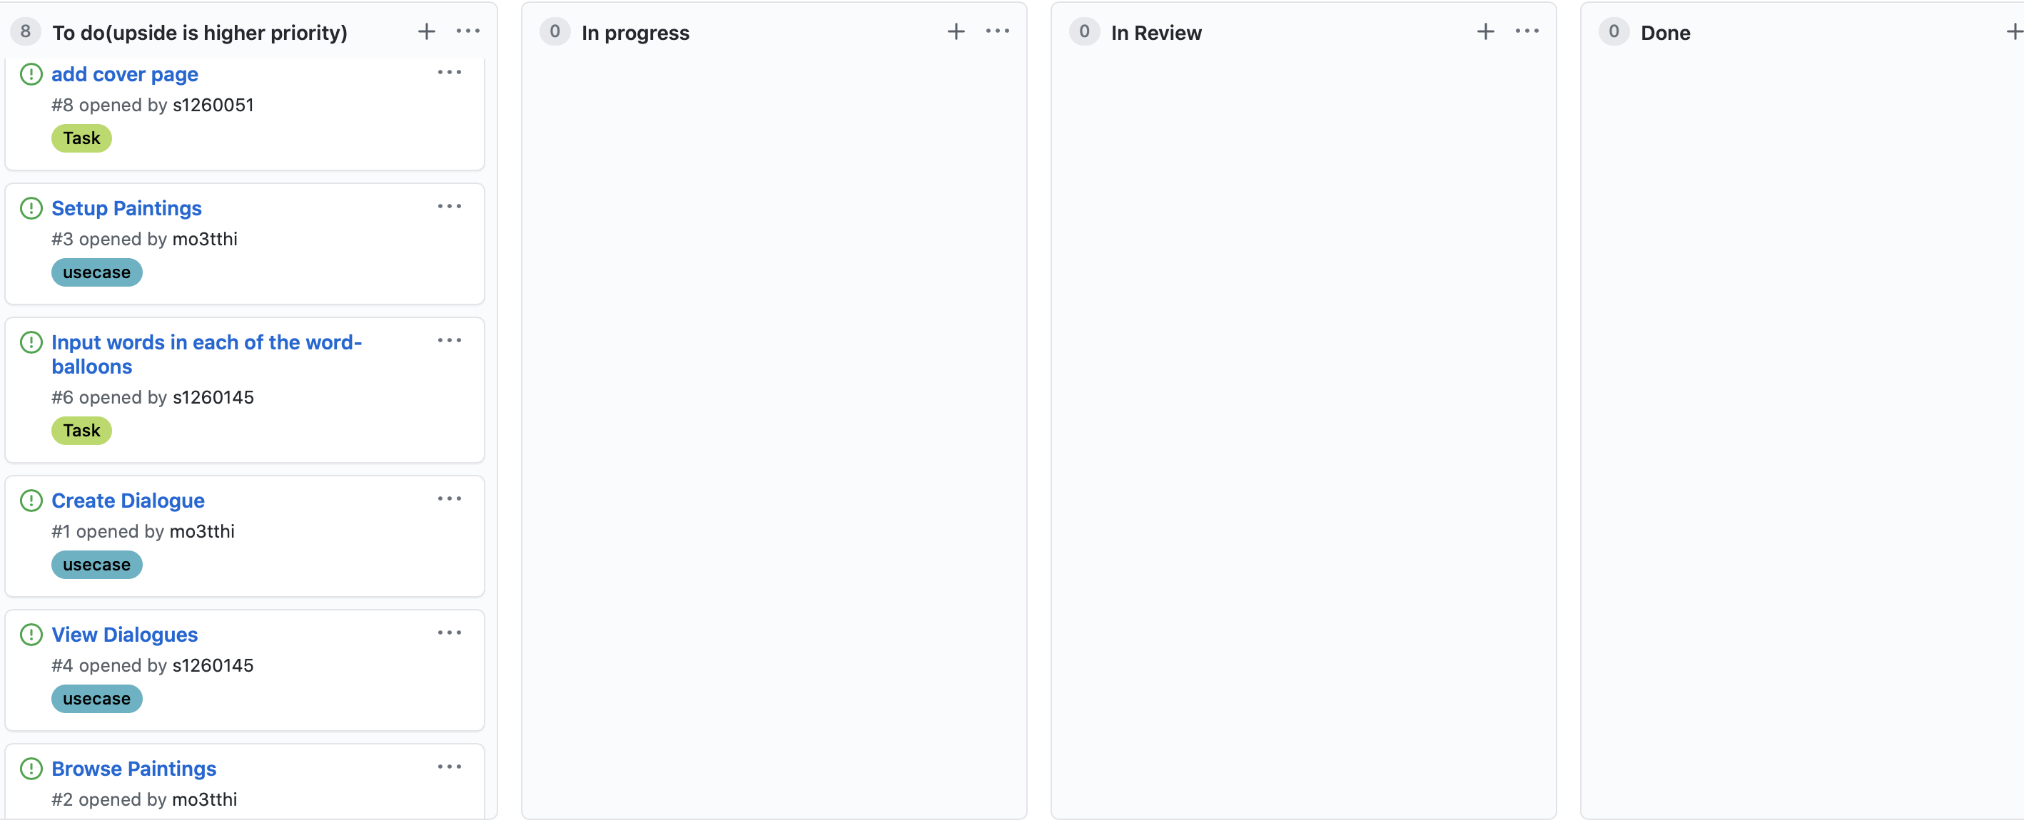
Phase Task Board

Slide 5
Issues & Risks (*if any)
Problem
Cause
Possible Solution
Deadline

