Slide 1
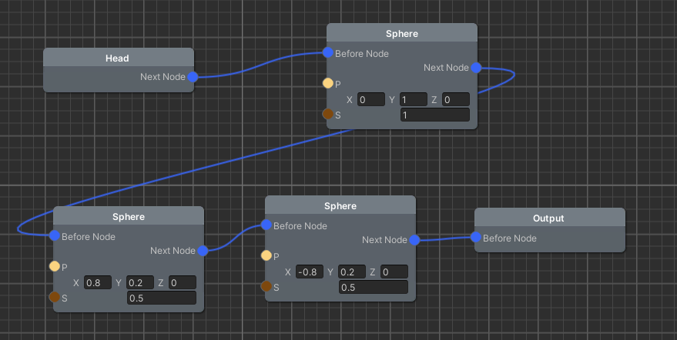
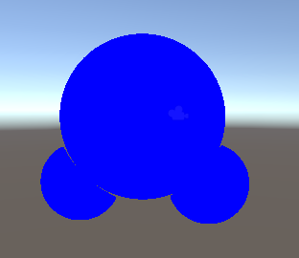
An SDF-based modeling system for Unity 距離関数モデリングシステム(仮) s1260201 Tomoki Chiba, Supervisor: Pierre-Alain Fayolle
1. Summary of the Research
3. Current Results and Status
Unity is a platform for developing games;
Lack 3D tools for designing 3D models
User Interface (UI) elements
Undo/Redo
Serialization
Etc.
Goal: Develop tools and a system based on Signed Distance Function (SDF) [1] for doing geometric modeling within Unity
Research objectives:
Investigate UI for geometry modeling
Design and evaluate a node graph based visual language for geometric modeling
Evaluate the suitability of SDF-based modeling for creating virtual assets for Unity
Figure 1: An example of a 3D object described by our visual language
We have implemented our visual language implemented in C# within Unity. We use for managing the graph nodes. An example of program is shown in Fig. 1.
Figure 2 shows the 3D object described by the scene graph shown in Fig. 1.
Figure 2: A rendering of the object described by the program shown in Fig. 1
2. Approach/Methodology
2.1 Approach
SDF based modeling system
Analytic and procedural primitives
Boolean and smooth Boolean operations
Offsets, extrusion, etc.
Interactive rendering by sphere tracing [2]
Node graph based visual language for end users
Automatic generation of C# and shader programs from the visual language for rendering [2, 3]
2.2 Development
Implementation done within Unity in C# and shader language
2.3 Evaluation
Experimental study of the developed system via a user study (questionnaire, A/B testing, statistical analysis, …)
4. Remaining Tasks and Tentative Schedule
April | May | June | July
Complete the implementation system (additional primitives, operations, code-generation, ..)
 | User study / evaluation of the system
 |  |  | Thesis writing
References
[1] S. Osher, R. Fedkiw, "Level Set Methods and Dynamic Implicit Surfaces", Springer, 2003.
[2] J. Hart, “Sphere tracing: A geometric method for the antialiased ray tracing of implicit surfaces”, Vis. Comput., vol. 12, no. 10, 1996.
[3] W. Lorensen, H. Cline, “Marching cubes: A high resolution 3D surface construction algorithm”, SIGGRAPH Comput. Graph., vol. 21, no. 4, 1987.

Slide 2
A SDF-based modeling system for Unity 距離関数モデリングシステム(仮) s1260201 Tomoki Chiba, Supervisor: Pierre-Alain Fayolle
Ｓｅａｌ
or Ｓｉｇｎａｔｕｒｅ
1. Summary of the Research
(Motivation/background and Goal)
3. Current Results and Status
In this section, please report on the result of your preliminary study or describe current progress.
Experimental/evaluation results
Preliminary results indicate that…
Progress of development/formulation
In this section, please describe your research objective(s).
The goal of this study is …
This study aims to…
Research objectives are…
Previous studies have shown…
What is NEW in your research?
Fig. 1. Example of a figure caption
[NOTE]
Font type: “Arial” or similar fonts
Font size: 16 pt or larger
Style: Double column & short summary style
Do not need to follow this template strictly, but all sections shown in this template must at least be included.
Do not need to use complete sentences, but make sure that your ideas written in this poster are clear enough to be understood without an oral presentation.
Your supervisor must place his/her seal or signature at the top-right corner.
Table 1. Example of a table caption
Condition | Algorithm 1 | Algorithm 2
1 | 1.23 | 0.65
2 | 2.25 | 1.02
4. Remaining Tasks and Tentative Schedule
2. Approach/Methodology
In this section, please describe specific techniques or experimental strategies used in your research.
How to solve the problem?
Development, Experiment(s), Analysis, Research Directions, etc.
For this study, XX was used to explore…
Include some sample sub-section titles;
2.1 Development
2.2 Requirements
2.3 Design (Specifications)
2.4 Evaluation, etc.
In this section, please provide the tentative schedule (milestones) of your research.
To-do list or Gantt Chart
Remaining issues
Milestones
Alternative plans in case some problems occur
Discussion (if any)
Figures and Tables
Schedule (Gantt Chart)
Include milestones
Figures and Tables
References
[1] Authors, “Paper title,” IEEE Trans. on Computer, vol. 11, no. 4, pp. nn–mm, April 2016.
[2] author a, and author b, “ ….,” ….

