Slide 1
Report of laminar shear case
MOUSE Project
Marcel Bock
06.07.2026

Slide 2
Update by S.ouchene
Samir: Regarding the large amplitude in the load center, I think it comes from your load center calculation rather than from the data.
My guess is that you computed the centroid per blade, meaning you might be calculating the load center for a single blade only instead of for all three blades. Could you please check your post-processing script?

Slide 3
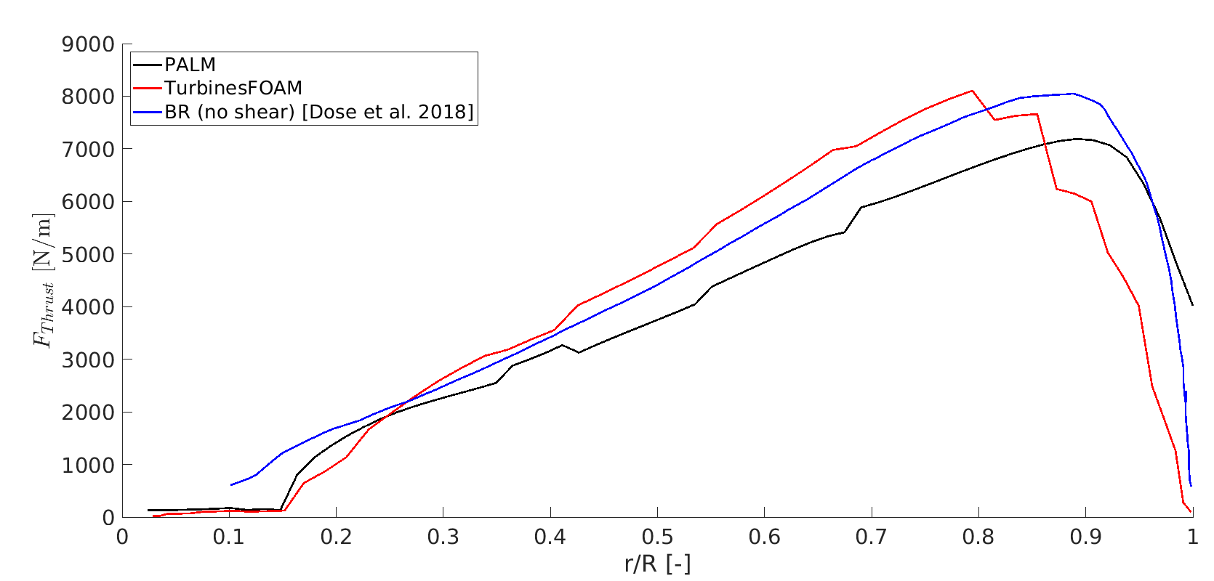
Blade load distribution

Slide 4
Blade load distribution
Comparison of the time average blade load distributions of the Actuator line simulations with PALM and OpenFOAM.
“Benchmark” comparison with Blade resolved (BR; from a laminar inflow, shear in present case)
Poor performance of OpenFOAM at the tip → Tip model
OpenFOAM generally closer to BR over the rest of the blade

Slide 5
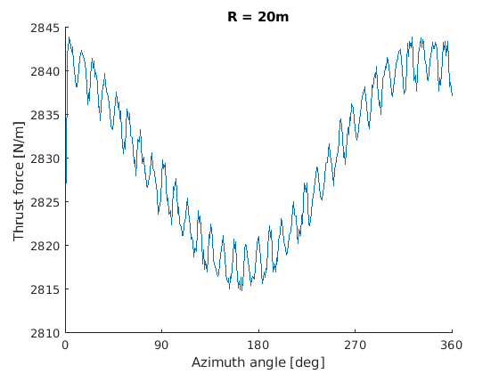
FYI: Normal variation (single blade element)
Variation of blade element thrust force over azimuth angle
Sinusoidal variation:
  Higher thrust force at the top → higher inflow velocity
“Higher harmonics” → probably grid interpolation errors
Change over revolution: 2842-2817 = 25 N ≈ 1%

Slide 6
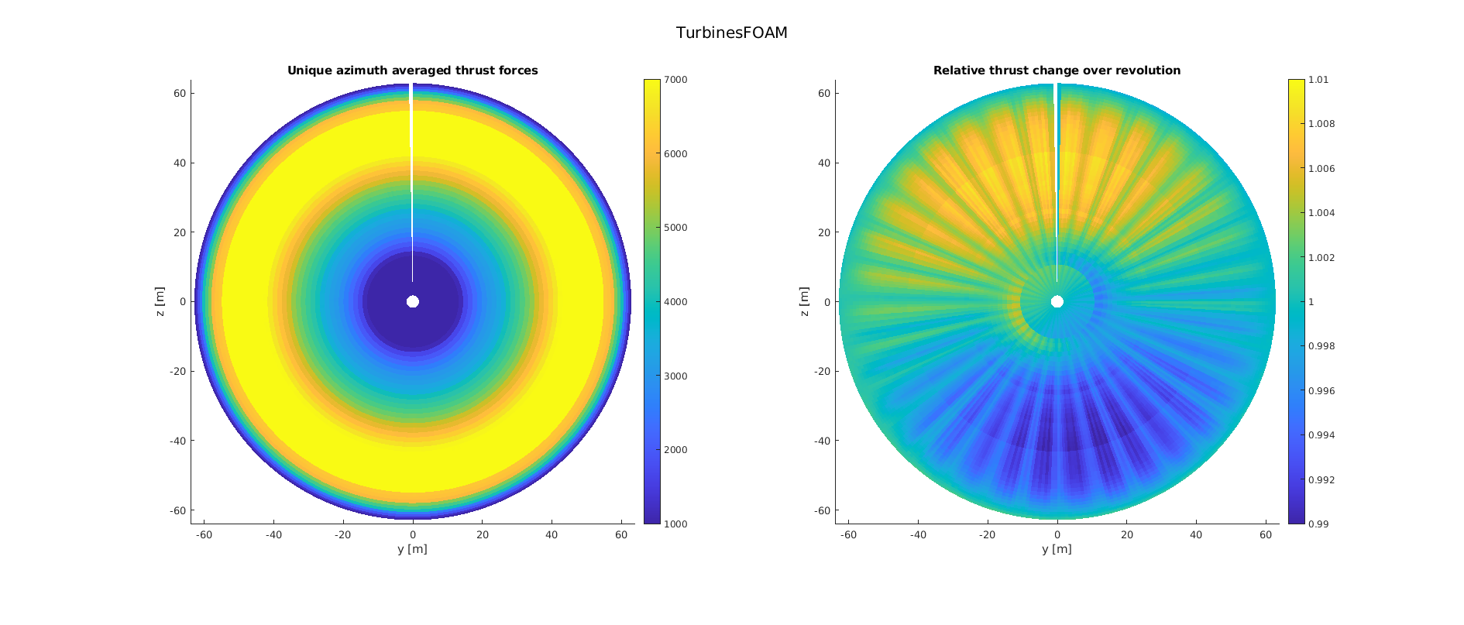
Thrust force variation over azimuth
Tip model issue

Slide 7
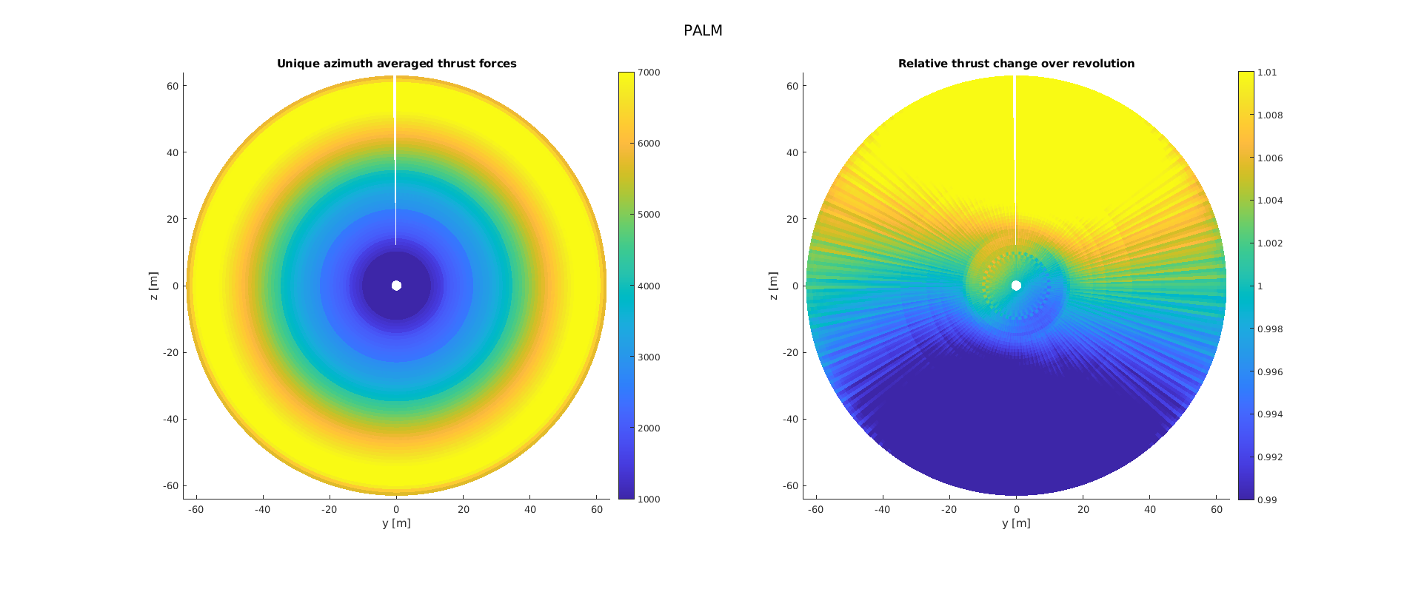
Thrust force variation over azimuth

Slide 8
Thrust force variation over azimuth
Higher change in relative thrust force over azimuth → Why?

Slide 9
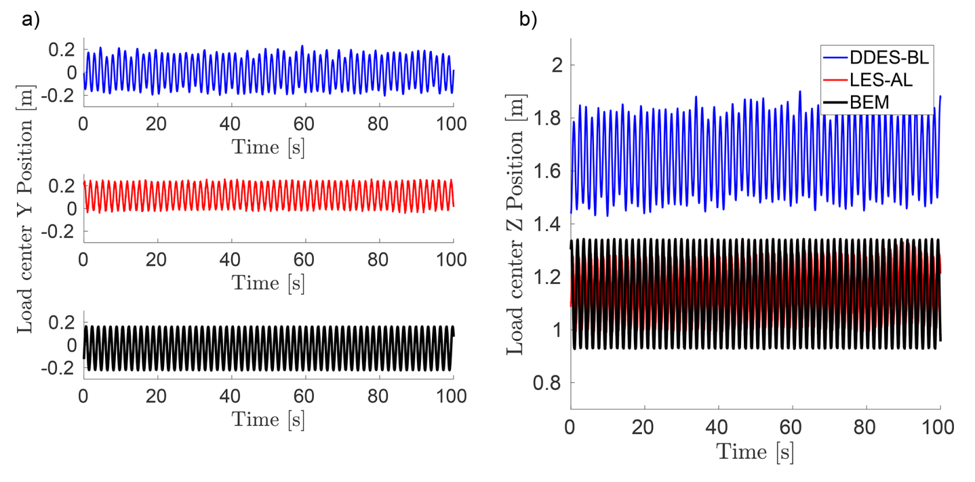
Load center in OpenFOAM
Figure from Paper
Z-Offset of ≈ 1m; Amplitude ≈ 0.4m

Slide 10
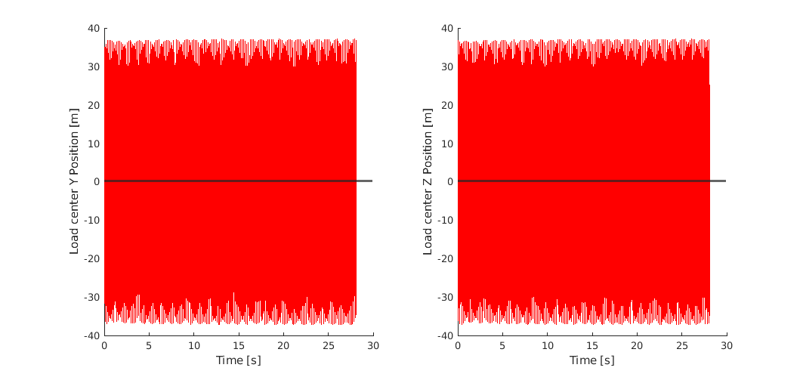
Load center in PALM (ε = 2)
Huge oscillations; Amplitude ≈ 80m
Mean = 0.1327m / 0.1362m

Slide 11
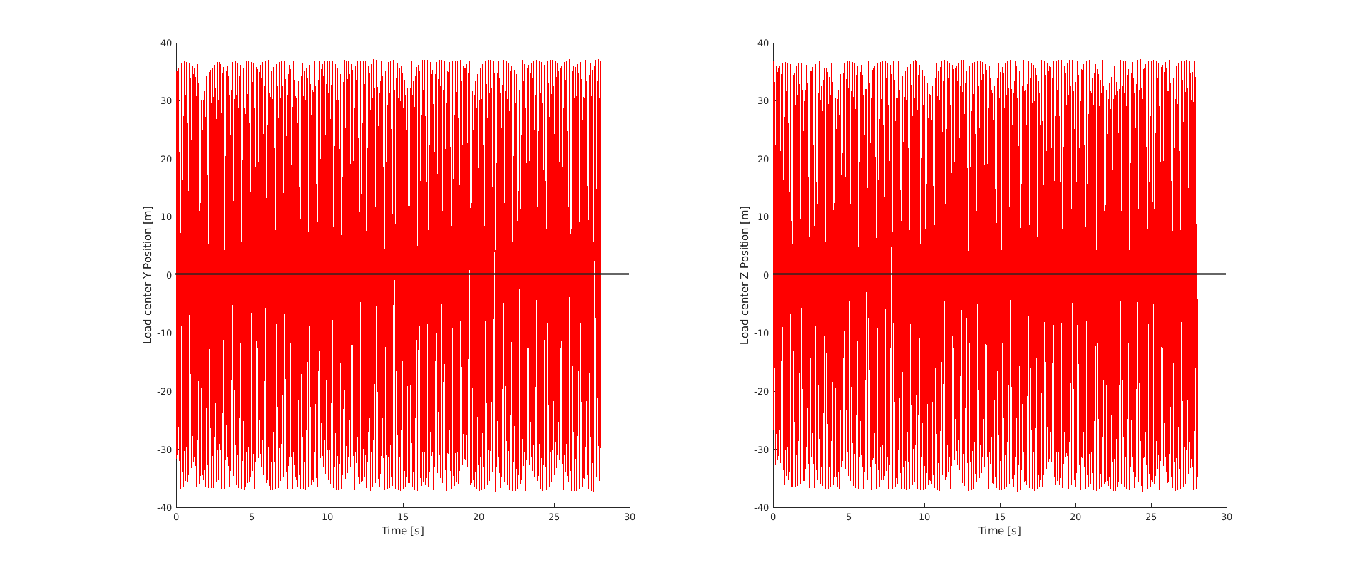
Load center in PALM (ε = 3)
Huge oscillations; Amplitude ≈ 80m
Mean = 0.1328m / 0.1363m

Slide 12
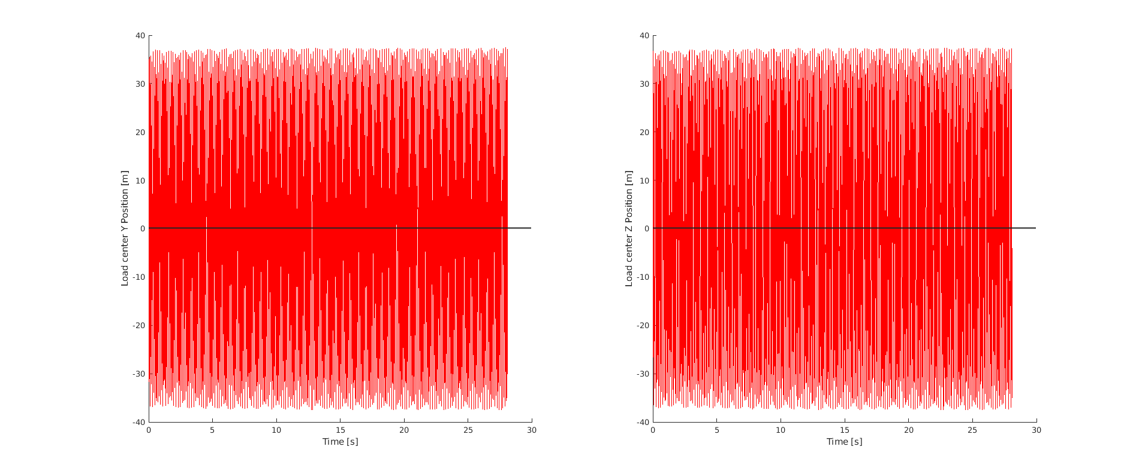
Load center in PALM (ε = 5)
Huge oscillations; Amplitude ≈ 80m
Mean = 0.1313m / 0.1348m

Slide 13
Conclusion and Outlook
Huge oscillation of the Load center in PALM:
Check the flow field upstream (needed for the turbulent case anyway)

