Slide 1
JAVA 2D/3D Project02
s1300030 Kohei Kuwana

Slide 2
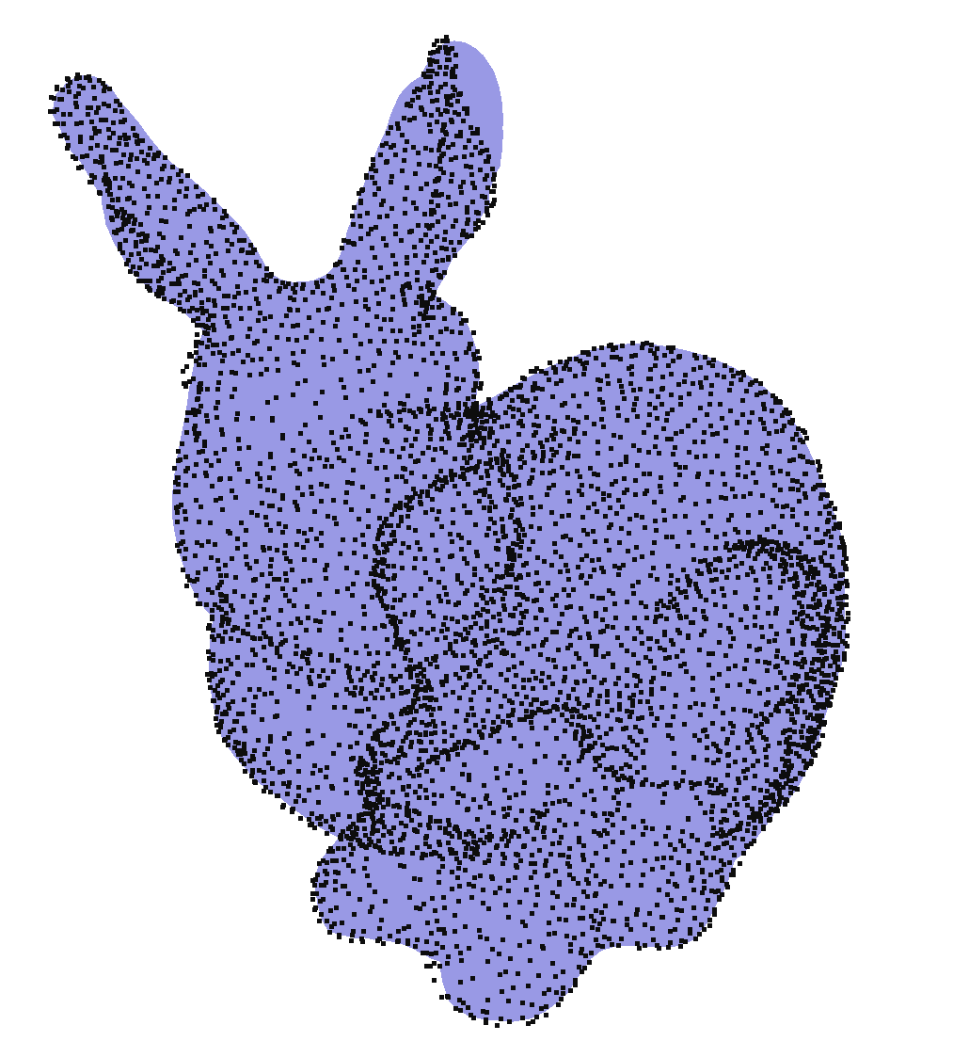
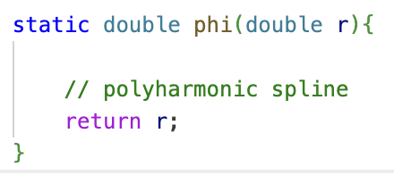
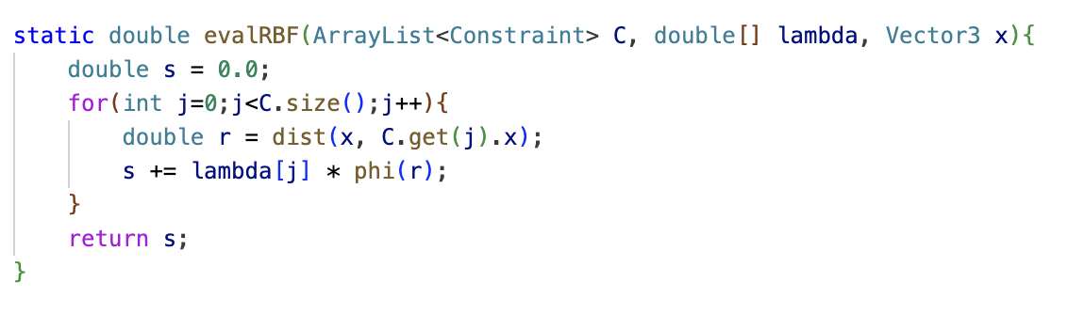
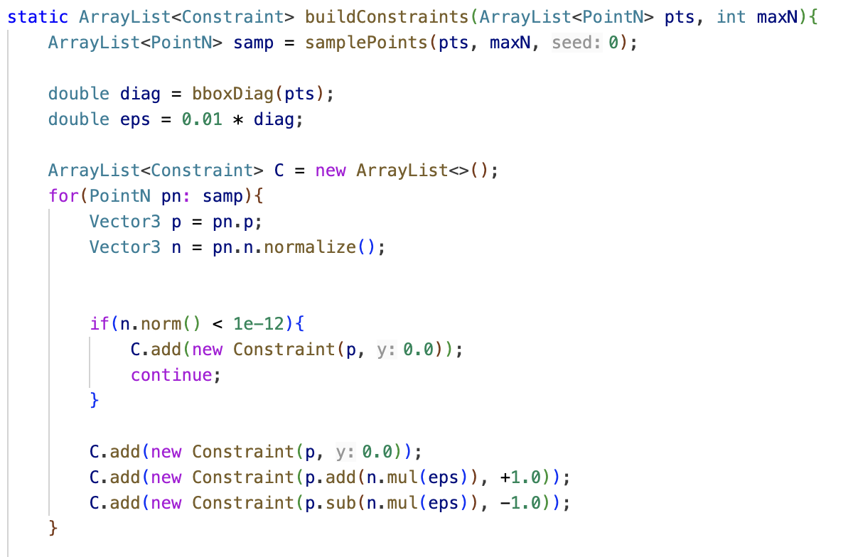
Result
Black points are input point-cloud samples
Blue area is the reconstructed surface
Implemented RBF (polyharmonic spline
φ(r)=r with off-surface constraints)
Using Marching Cube Table to make
triangle mesh
→https://pointclouds.org/documentation/surface_2include_2pcl_2surface_
2marching__cubes_8h_source.html?utm_source=chatgpt.com

