Slide 1
FPGA-based Neuromorphic Acceleration of Spiking Neural Networks for Event-Driven Humanoid Robotics
Author: Aruki Komatsuzaki , Atharv Sharma, Yuga Hanyu, Khanh N. Dang, Abderazek Ben Abdallah and Zhishang Wang
Notes:
My name is Aruki Komatsuzaki from The University of
Aizu. Today, I will present our research titled "FPGA-based Neuromorphic Acceleration of
Spiking Neural Networks for Event-Driven Humanoid Robotics."

Slide 2
Contents
Introduction
Proposed framework
Experimental Setup
Result
Conclusion
Reference

Slide 3
Introduction: Challenges in GANs
Generative Adversarial Networks (GANs) achieve strong performance in content generation, but demand high computational capability.
High computational cost significantly limits deployment on resource-constrained devices, such as embedded humanoid robotic systems.
Robotic systems require real-time, low-latency processing within strict power budgets.
Traditional Artificial Neural Networks (ANNs) are challenging to implement efficiently under these constraints.
Notes:
Generative Adversarial Networks, or GANs, achieve strong performance in content
generation. However, their high computational cost significantly limits deployment on
resource-constrained devices, such as embedded humanoid robotic systems. These systems
require real-time, low-latency processing within strict power budgets, making traditional
Artificial Neural Networks challenging to implement efficiently.

Slide 4
Introduction: Neuromorphic Computing
Neuromorphic computing offers a highly promising alternative for low-power intelligence.
Spiking Neural Networks (SNNs) provide simpler computation by using action potentials (spikes) as the primary elements for processing.
Event-driven and multiplication-free computation significantly reduces computational cost.
Mapping SNN operations onto programmable logic requires a dedicated architecture that exploits spike sparsity and memory efficiency.
Notes:
To address these challenges, neuromorphic computing offers a highly promising alternative.
Spiking Neural Networks provide simpler computation by using action potentials, or spikes.
By leveraging event-driven and multiplication-free computation, they reduce computational
costs. Deploying these on FPGAs requires a dedicated architecture that exploits spike
sparsity and memory efficiency.

Slide 5
Contents
Introduction
Proposed framework
Experimental Setup
Result
Conclusion
Reference

Slide 6
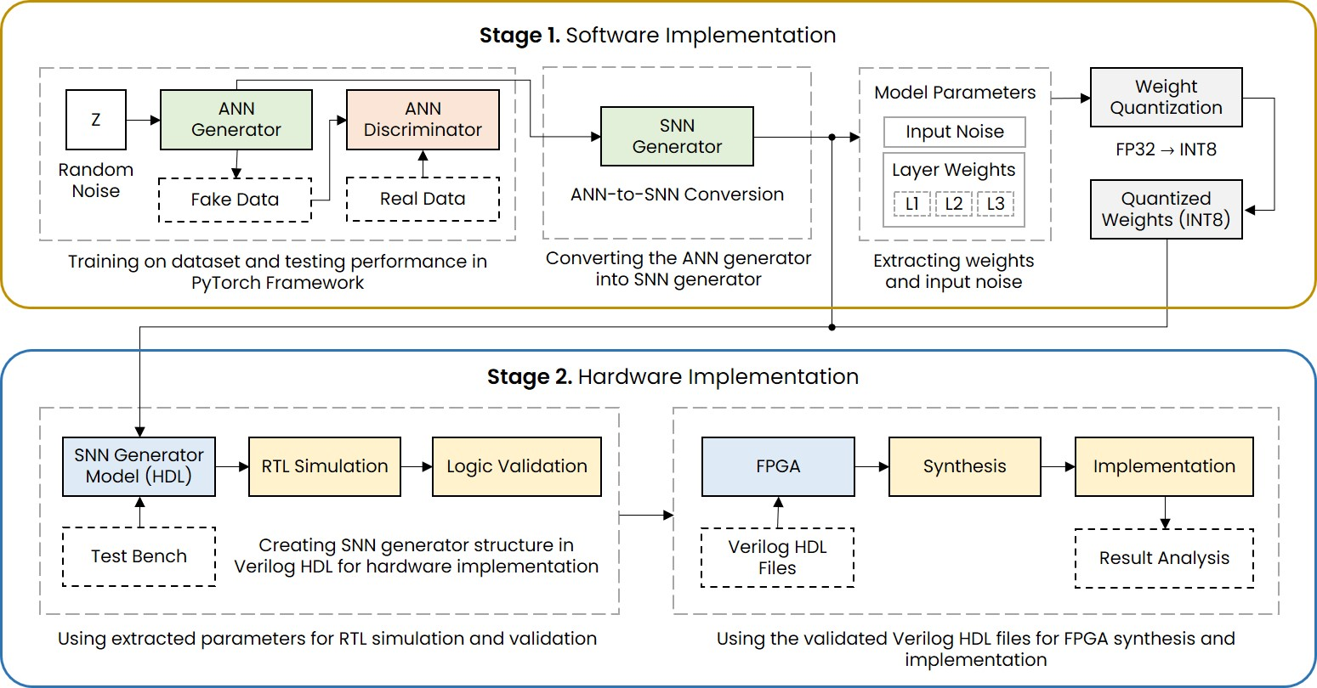
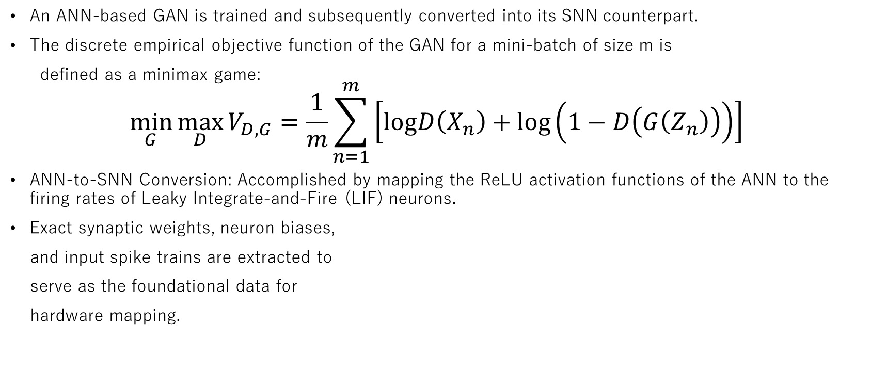
Proposed Framework: Software Implementation
An ANN-based GAN is trained and subsequently converted into its SNN counterpart.
The discrete empirical objective function of the GAN for a mini-batch of size m is
defined as a minimax game:
$$\min_{G} \max_{D} V_{D,G}=\frac{1}{m}\sum_{n=1}^{m}{\left[logD\left(X_{n}\right)+log\left(1−D\left(G\left(Z_{n}\right)\right)\right)\right]}$$
ANN-to-SNN Conversion: Accomplished by mapping the ReLU activation functions of the ANN to the firing rates of Leaky Integrate-and-Fire (LIF) neurons.
Exact synaptic weights, neuron biases,
and input spike trains are extracted to
serve as the foundational data for
hardware mapping.
Figure. Design flow of the implementation framework for GAN model.
Notes:
Our hardware-software co-design framework begins in the software domain. We train an
ANN-based GAN and convert it into its SNN counterpart. The discrete empirical objective
function of the GAN for a mini-batch of size m is defined as a minimax game between the
discriminator and the generator, as shown in Equation 1. The conversion is accomplished by
mapping the ReLU activation functions of the ANN to the firing rates of Leaky Integrate-
and-Fire neurons. Finally, exact synaptic weights, neuron biases, and input spike trains are
extracted for hardware mapping.

Slide 7
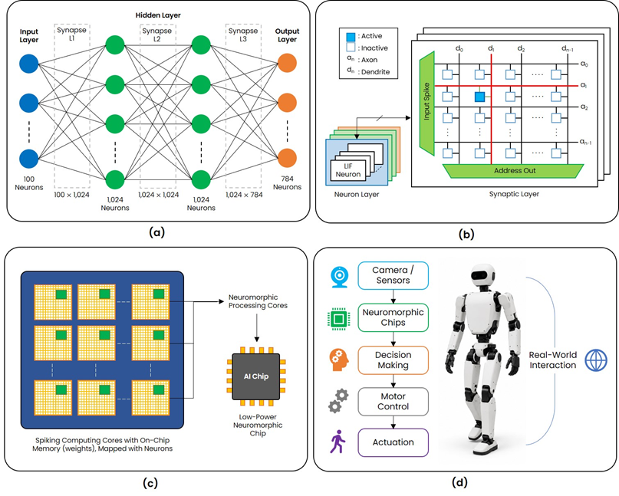
Proposed Framework: Hardware
Computing Core: Integrates a synapse crossbar for weighted accumulations and an LIF neuron array for spike generation.
OpenRAM-based SRAM macros (1024×8) are utilized to store the synaptic weights and biases.
Hardware operates in a timestep-driven manner, processing input spikes sequentially.
Neuron states are updated only upon the arrival of a spike.
Architecture effectively exploits spike sparsity to minimize unnecessary memory accesses and computational overhead.
(a) Structure of GAN Spiking Neural Network. (b) Computing core; consisting of synapse crossbar and neuron layer.
Notes:
In the hardware domain, the fundamental computational unit is the computing core, which
integrates a synapse crossbar and an LIF neuron array. Using OpenRAM-based SRAM
macros, the hardware operates in a timestep-driven manner. Because neuron states are
updated only upon the arrival of a spike, the architecture effectively exploits spike sparsity to
minimize unnecessary memory accesses and computational overhead.

Slide 8
Contents
Introduction
Proposed framework
Experimental Setup
Result
Conclusion
Reference

Slide 9
Experimental Setup (Model Architecture)
To evaluate the designed SNN-based GAN generator architecture, the software and hardware environments were configured with specific parameters. Table 1 details the datasets, network topology, and data formats used during both the software training and hardware execution phases.
Table 1. Model architecture and parameters
Parameter | Value
Training Data | MNIST Handwritten Digits
Training Numbers | 600 Images per Batch × 20 Epochs
Input Layer | 100 Neurons
Layer 1 | 1,024 Neurons
Layer 2 | 1,024 Neurons
Layer 3 (Output) | 784 Neurons
Software Model Parameter Format | Signed FP32
RTL Model Parameter Format | Signed INT8
Notes:
To evaluate the designed SNN-based GAN generator architecture, the software and hardware
environments were configured with specific parameters. As shown here, Table 1 details the
datasets, network topology, and data formats used during both the software training and
hardware execution phases.

Slide 10
Experimental Setup (Environment)
For hardware-level evaluation, the system was synthesized and deployed on the AMD VCK5000 Versal FPGA platform. This platform provides a representative environment for profiling hardware resource utilization and measuring power consumption. Table 2 summarizes the detailed specifications of the hardware and software environments.
Table 2. Hardware and software environment setup
Component | Specification
Software (Host PC)
OS | Windows 11
Framework | PyTorch (Python)
CPU | Intel Core i9-14900KF
RAM | 128GB (32GB × 4)
GPU | NVIDIA GeForce RTX 4060 8GB
Storage | 4TB SSD (NVMe Gen4)
Hardware (FPGA)
Platform | AMD VCK5000 Versal Development Card
Architecture | Versal 7nm ACAP
LUTs / FFs | ~ 899,840 / ~ 1,799,680
DSP Engines | 1,968
Notes:
For hardware-level evaluation, the system was synthesized and deployed on the AMD
VCK5000 Versal FPGA platform. Table 2 summarizes the detailed specifications of the
hardware and software environments. This platform provides a representative environment
for profiling hardware resource utilization and measuring power consumption under realistic
operating conditions.

Slide 11
Contents
Introduction
Proposed framework
Experimental Setup
Result
Conclusion
Reference

Slide 12
Computation Comparison
A comparative analysis evaluated computational efficiency. Table 3 summarizes the total number of linear layer function calls and the cumulative GPU execution time.
Table 3. Computational comparison between ANN and SNN generator
Images | Generator | Linear Function Calls | Total GPU Time (ms)
100 | ANN | 300 | 72.94
 | SNN | 10,500 | 18.90
200 | ANN | 600 | 74.71
 | SNN | 21,000 | 39.61
400 | ANN | 1,200 | 69.24
 | SNN | 42,000 | 22.71
600 | ANN | 1,800 | 69.55
 | SNN | 63,000 | 27.70
800 | ANN | 2,400 | 69.24
 | SNN | 84,000 | 33.50
1,000 | ANN | 3,000 | 73.60
 | SNN | 105,000 | 39.552
Notes:
A comparative analysis was performed to evaluate computational efficiency. Table 3
summarizes the total number of linear layer function calls and the cumulative GPU
execution time across a scaling range of 100 to 1,000 images. While the SNN operates over
multiple timesteps, its event-driven nature and multiplication-free accumulation operations
significantly reduce the overall computational overhead, achieving lower execution times
than the ANN baseline.

Slide 13
FPGA Resource Utilization
Table 4 summarizes the FPGA resource utilization, including Look-Up Tables (LUTs), Flip-Flops(FFs), and Block RAMs (BRAMs). Notably, the spike-driven nature of the computation aims to minimize or completely eliminate the use of Digital Signal Processing (DSP) slices, shifting the computational burden to event-driven logical operations.
Table 4. FPGA resource utilization
Resource | Used | Available | Utilization (%)
LUT | 307,977 | 899,840 | 34.22
LUTRAM | 10,528 | 449,920 | 2.34
FF | 81,093 | 1,799,680 | 4.40
BRAM | 580 | 967 | 59.98
DSP | 0 | 1,968 | 0.00
Notes:
Table 4 summarizes the FPGA resource utilization, including Look-Up Tables, Flip-Flops,
and Block RAMs. Notably, the spike-driven nature of the computation aims to minimize or
completely eliminate the use of Digital Signal Processing slices. As seen in the table, we
successfully achieved zero DSP utilization, effectively shifting the computational burden to
efficient logical operations.

Slide 14
FPGA On-Chip Power Breakdown
Table 5 provides the on-chip power consumption report, broken down by dynamic and static power components. The implementation exhibits superior energy efficiency, with dynamic power consumption representing only 19% of the total on-chip power.
Table 5. FPGA on-chip power breakdown
Category | Component | Power (W) | Share (%)
Dynamic Power | Clock | 0.475 | 15
 | Signals | 1.007 | 33
 | Logic | 1.150 | 37
 | BRAM | 0.461 | 15
 | Dynamic Total | 3.095 | 19
Static Power | Device Static | 13.496 | 81
Total On-Chip Power |  | 16.591 | 100
Notes:
Table 5 provides the on-chip power consumption report, broken down by dynamic and static
power components. Our implementation exhibits superior energy efficiency. Dynamic power
consumption was restricted to just 3.095 Watts, representing only 19% of the total on-chip
power.

Slide 15
Contents
Introduction
Proposed framework
Experimental Setup
Result
Conclusion
Reference

Slide 16
Conclusion
Successfully demonstrated the hardware acceleration of a large-scale generative SNN (SNN-GAN) on the AMD VCK5000 Versal platform.
Complete elimination of power-hungry DSP blocks via hardware-software co-design.
Energy-efficient logic-centric operations delivered a 1.86–3.86x execution speedup over conventional ANN baselines.
Results confirm that neuromorphic architectures provide the low-latency and low-power capabilities essential for embedded humanoid robotic systems.
Future work will focus on physical deployment into embedded robotic platforms.
Notes:
In conclusion, this work demonstrated the hardware acceleration of a generative SNN on the
AMD Versal platform. Our DSP-free approach utilizes logic-centric operations, delivering
significant execution speedups and low dynamic power consumption. These results confirm
its viability for the real-time cognitive demands of embedded humanoid robotic systems.
Future work will focus on physical deployment into these robotic systems.

Slide 17
Contents
Introduction
Proposed framework
Experimental Setup
Result
Conclusion
Reference

Slide 18
References
Goodfellow, Ian, et al. "Generative adversarial networks." Communications of the ACM 63.11 (2020): 139-144.
Aggarwal, Alankrita, Mamta Mittal, and Gopi Battineni. "Generative adversarial network: An overview of theory and applications." International Journal of Information Management Data Insights 1.1 (2021): 100004.
Wang, Kunfeng, et al. "Generative adversarial networks: introduction and outlook." IEEE/CAA Journal of Automatica Sinica 4.4 (2017): 588-598.
Tong, Yuchuang, Haotian Liu, and Zhengtao Zhang. "Advancements in humanoid robots: A comprehensive review and future prospects." IEEE/CAA Journal of Automatica Sinica 11.2 (2024): 301-328.
Liu, Dingbang, Hao Yu, and Yang Chai. "Low‐power computing with neuromorphic engineering." Advanced Intelligent Systems 3.2 (2021): 2000150.
Merolla, Paul A., et al. "A million spiking-neuron integrated circuit with a scalable communication network and interface." Science 345.6197 (2014): 668-673.
Bouvier, Maxence, et al. "Spiking neural networks hardware implementations and challenges: A survey." ACM Journal on Emerging Technologies in Computing Systems (JETC) 15.2 (2019): 1-35.
Mittal, Sparsh. "A survey of FPGA-based accelerators for convolutional neural networks." Neural computing and applications 32.4 (2020): 1109-1139.
Rathi, Nitin, et al. "Exploring neuromorphic computing based on spiking neural networks: Algorithms to hardware." ACM Computing Surveys 55.12 (2023): 1-49.
Diehl, Peter U., et al. "Fast-classifying, high-accuracy spiking deep networks through weight and threshold balancing." 2015 International joint conference on neural networks (IJCNN). ieee, 2015.
Guthaus, Matthew R., et al. "OpenRAM: An open-source memory compiler." Proceedings of the 35th International Conference on Computer-Aided Design. 2016.
Advanced Micro Devices, Inc. (AMD). AMD VCK5000 Versal Development Card Product Brief. Available online: https://japan.xilinx.com/content/dam/xilinx/publications/product-briefs/amd-xilinx-vck5000-product-brief.pdf.
Advanced Micro Devices, Inc. (AMD). VCK5000 Gen4x8 Vitis Platform User Guide. Available online: https://xilinx.github.io/Alveo-Versal-Platforms/alveoversalplatforms/build/html/docs/user-guide/ug_vck5000_gen4x8_qdma.html.

Slide 19
Thank you for your attention !

