Slide 1


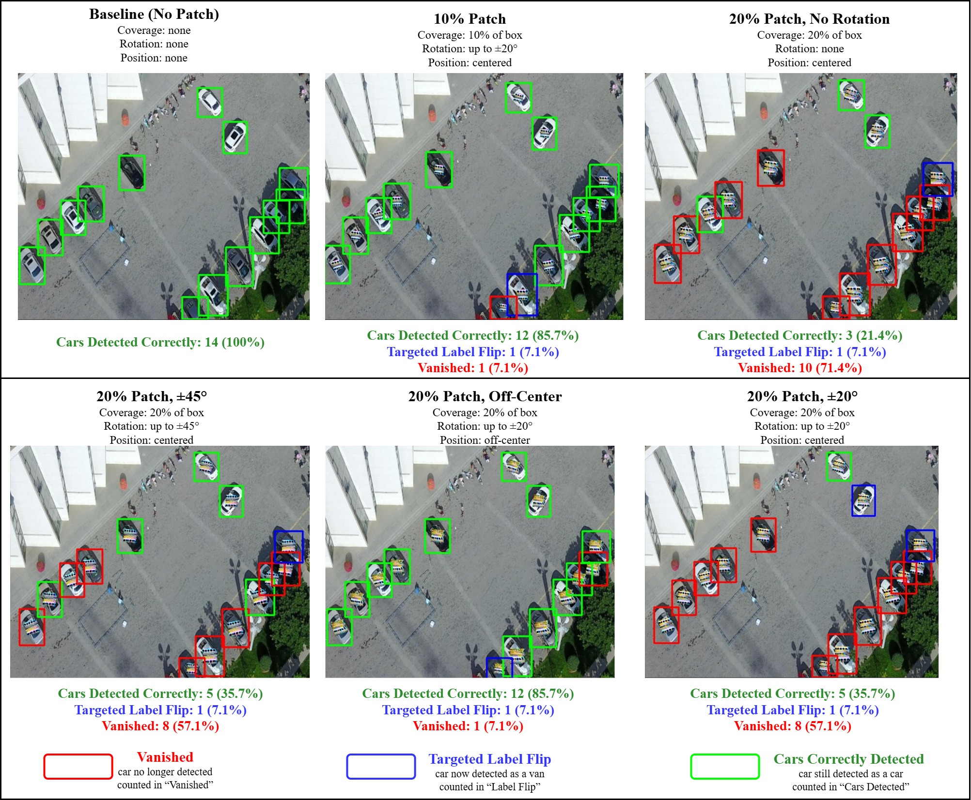
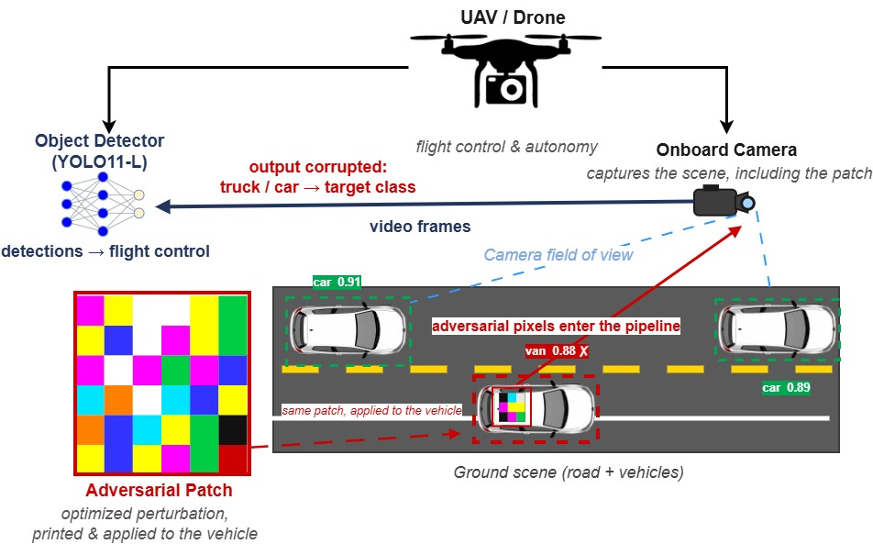



Adversarial Patch Attacks on UAV Vehicle Detection: Targeted Misclassification vs. Concealment on YOLO v11-L
Aarav Pulsani
Mentors: Dr. Alsharif, Muhammad Jahanzeb Khan
Introduction
Experiment
Results
Drone-borne object detectors are increasingly deployed for traffic monitoring, infrastructure inspection, and surveillance, where their outputs are frequently acted upon without human review.
An adversarial patch is a printed, physically realizable perturbation. Unlike pixel-wise noise, it persists through printing, illumination change, and camera capture, and therefore constitutes a physical rather than a purely digital threat.
Prior work (Pathak et al., IROS 2024) evaluates concealment, in which a vehicle is suppressed from detection. Targeted misclassification, inducing a confident but incorrect class assignment, remains comparatively unexamined despite posing a greater operational risk: an erroneous detection is acted upon, whereas an absent one is more readily noticed.
This work evaluates both objectives under a common model, dataset, and evaluation harness, permitting the disparity between them to be measured directly rather than inferred across publications.
Dataset Preparation
VisDrone2019-DET aerial imagery, 5 vehicle classes (car, van, truck, bus, motor).
Detector: YOLO11-L pretrained on COCO-2017 fine-tuned at 1280px using VisDrone2019. Clean baseline 0.639 car AP@0.5.
Generation of Results
One universal digital targeted adversarial patch optimized to flip car to van.
Patch projected onto each car's painted, off-glass surface (physically realizable).
One factor varied per run: size (10/20%), rotation (0/20/45°), placement (center/offset).
Performance Metrics
$ASR=\frac{N_{car→van}}{N}$
$VR=\frac{N_{undetected}}{N}$ $RAcc=\frac{N_{car→car}}{N}$
mAP@0.5 and car AP@0.5 measure the drop in detection accuracy from the clean baseline, overall and for cars specifically.
Per-Car Outcome by Patch Condition
Detection Accuracy Under Attack (AP@0.5)
Objective
To quantify the extent to which a physically plausible adversarial patch can induce a state-of-the-art UAV detector to reassign a car to the van class, and to characterize the cost of that objective relative to the comparatively tractable task of suppressing the detection entirely.
Experimental Runs
Threat Model
Conclusions & Future Work
A physically plausible patch reassigns approximately one in three cars to the van class on a strong, contemporary detector, a substantive threat, though well short of the near-total failure induced by concealment.
Because the patch is confined to the vehicle's flat, off-glass painted surface, its coverage is bounded by that region, which caps the achievable attack strength.
Attack success remained largely stable across patch rotation and placement, indicating the threat is robust to how the patch is positioned on the vehicle.
Future work will develop shape-conforming patches that follow the full contour of the car while still avoiding the windshield and other glass, increasing effective coverage while preserving physical realizability.
Fig. 1. An optimized patch is applied to the vehicle surface; the UAV camera acquires the scene and the object detector processes the resulting frame. In the white-box setting the loss is backpropagated through the detector to the patch pixels, leaving model weights unmodified. The detector then emits either an incorrect class (targeted) or no detection (concealment).
Fig. 2. The same aerial frame under each patch condition. Box color marks the per-car outcome (see key): green = still a car, blue = flipped to van, red = vanished. Frames were selected for a high flip count, so each is more favorable than its run-average ASR.
ACKNOWLEDGMENTS
This material is based on a study supported by the National Science Foundation under Grant No. 2244371. Any opinions, findings, and conclusions or recommendations expressed in this material are those of the author(s) and do not necessarily reflect the views of the National Science Foundation, and the U.S. Government assumes no liability for the contents or use thereof.

