Slide 1
PROJECT TITLE
CAPSTONE PROJECT
Presented By:
1.Shikha Mishra-Graphic Era Deemed To Be University-Computer Science & Engineering

Slide 2
OUTLINE
Problem Statement
Proposed System/Solution
System Development Approach
Result
Conclusion
Future Scope
References

Slide 3
PROBLEM STATEMENT
Travel planning is often time-consuming and complex, involving decisions about destinations, accommodations, transport, budget, and weather. So we need to create a Travel Planner Agent which is an AI-powered assistant that helps users plan trips efficiently and intelligently.It uses real-time data to suggest destinations, build itineraries, and recommend transport and accommodation options.By understanding user preferences, budgets, and constraints, it tailors personalized travel plans.This smart assistant transforms complex travel planning into a seamless, enjoyable process.

Slide 4
PROPOSED SOLUTION
The proposed system provides an AI-powered Travel Planner Agent built using IBM Watsonx.ai. It automates and simplifies the trip planning process through the following features:
User-Centered Interaction:
Understands user inputs such as travel destination, budget, duration, preferences (e.g., mountains, beaches, cultural).
2 Quick Start Options:
Suggest trendy destination
Plan based on your preferences
AI Foundation Model Integration:
Uses a pre-trained foundation model to generate intelligent, human-like responses and suggestions.

Slide 5
Simulated Real-Time Responses:
Generates context-aware and up-to-date recommendations (weather, activities, cost breakdown) .
Itinerary Generation:
Creates a full-day itinerary based on input constraints and destination, tailored for solo, couple, or group travelers.
Deployed on IBM Cloud:
Entire agent is built and deployed on Watsonx.ai within IBM Cloud Lite, using Cloud Object Storage and runtime services

Slide 6
SYSTEM APPROACH
System requirements
Laptop
Internet Connection
Cloud Requirements:
IBM Cloud account (Lite Plan – Free Tier)
Active Cloud Object Storage instance
Watsonx.ai service (foundation model access)
Runtime service linked to the project

Slide 7
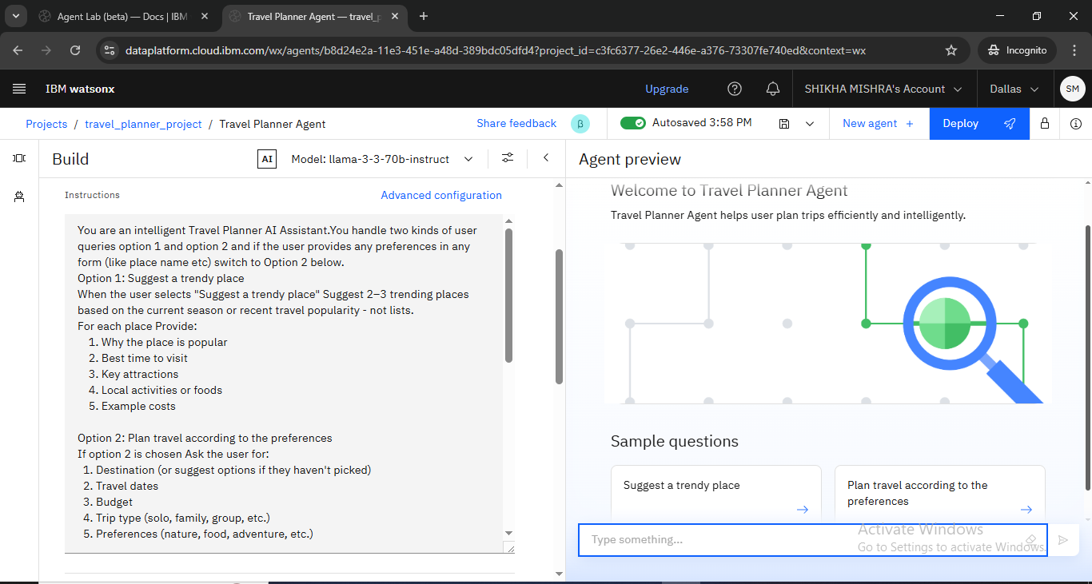
RESULT

Slide 8
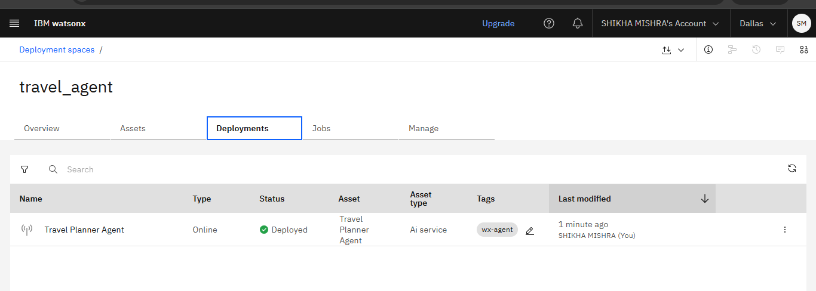
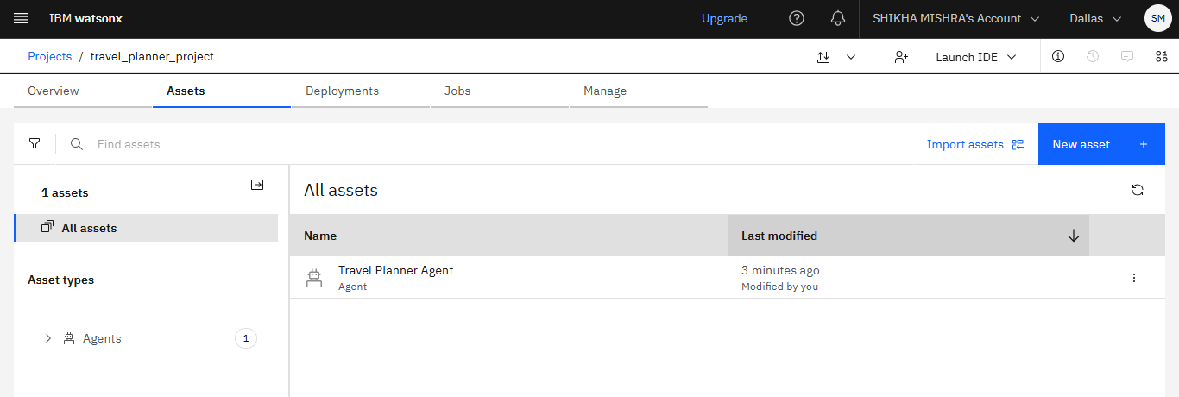

Slide 9
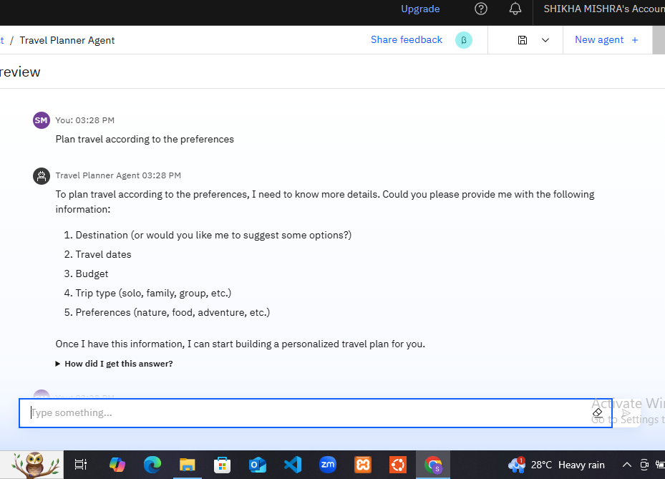
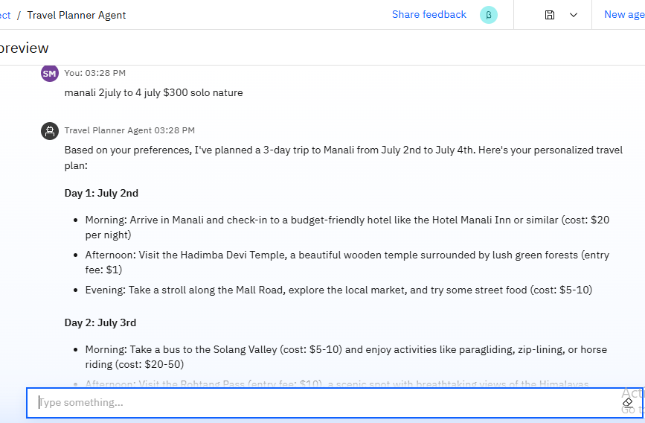

Slide 10
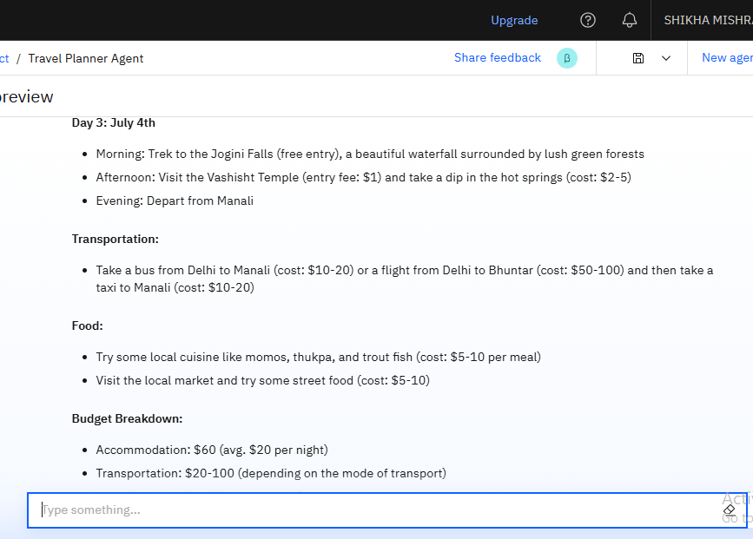
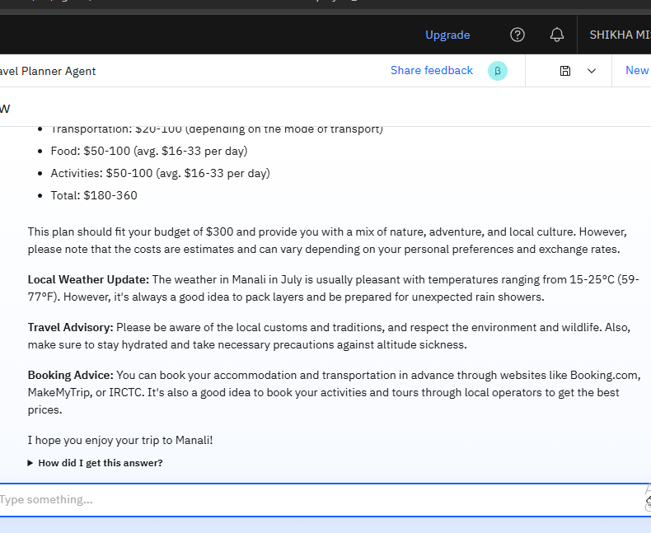

Slide 11
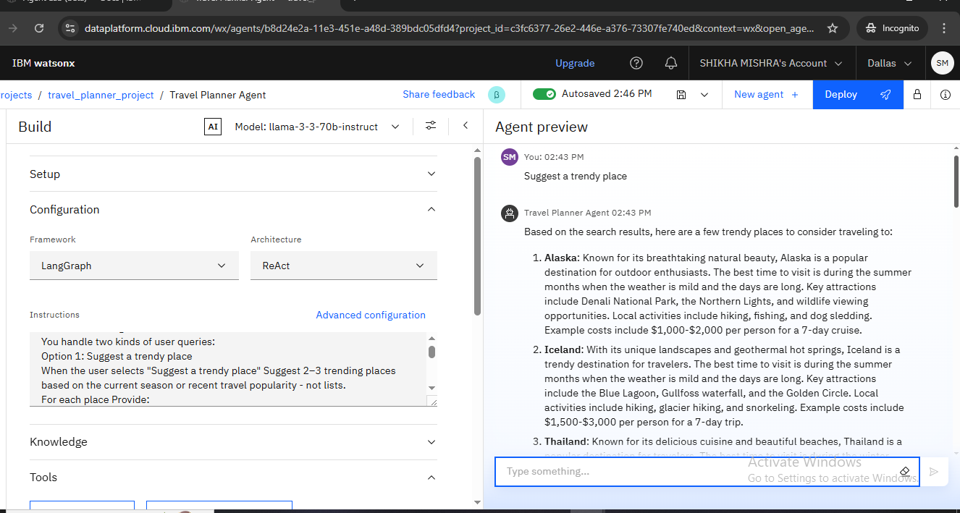

Slide 12
CONCLUSION
Challenges Faced
Delays in provisioning Cloud Object Storage (COS)
Watsonx.ai interface loading issues
Sandbox tool limitations (no API integration)
Simulating real-time data without live sources
LLM Response Inconsistency
Conclusion
Despite these challenges the AI Travel Planner Agent was successful and simplifies and automates the entire trip-planning process.By simulating real-time responses and understanding user constraints, it creates personalized and efficient itineraries.This project demonstrates how AI can enhance everyday experiences using IBM’s Watsonx.ai tools.

Slide 13
Integration with Real-Time APIs - Connect with live APIs for maps, weather forecasts, hotel bookings, and flight data to offer real-time planning.
Voice-Based Interaction - Add voice input/output capabilities to make the agent more accessible and interactive for mobile users.
User Profile & History - Save user preferences, past trips, and budgets to offer smarter, more personalized recommendations over time.
Multilingual Support - Expand usability for global users by supporting multiple languages through translation APIs.
Mobile App Version - Convert the agent into a full-fledged mobile app for travel planning on the go.
Offline Mode with Preloaded Data - Allow basic suggestions and trip planning in offline mode using stored destination data.
FUTURE SCOPE

Slide 14
REFERENCES
IBM Cloud Documentation-(https://cloud.ibm.com/docs)
IBM Watsonx.ai agent builder guide-(https://dataplatform.cloud.ibm.com)
AICTE Edunet IBM Internship Project Guidelines
IBM Watsonx.ai Documentation-(https://www.ibm.com/cloud/watsonx)

Slide 15
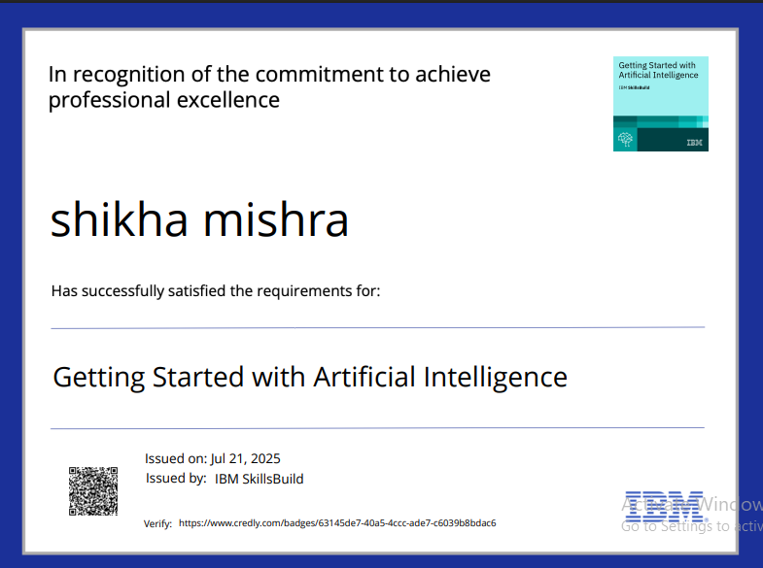
IBM CERTIFICATIONS

Slide 16
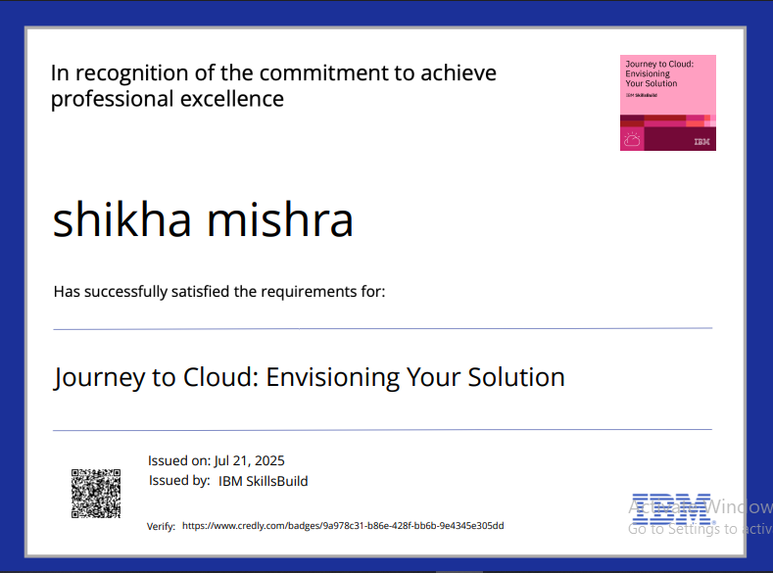
IBM CERTIFICATIONS

Slide 17
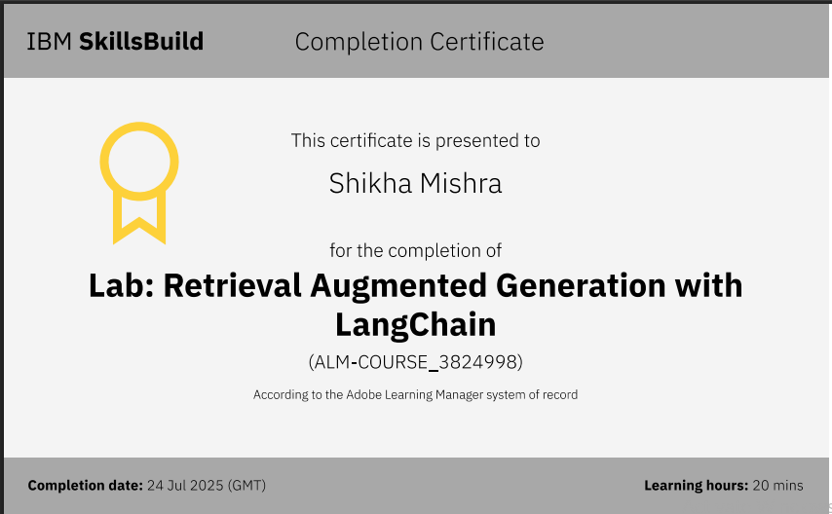
IBM CERTIFICATIONS

Slide 18
THANK YOU

