Slide 1
Monitor Traffic Flow through In-band Network Telemetry (INT)
Chih-Yuan Sun (cs2368)
Yu-Hsuan Chen (yc2423)

Slide 2
Outline
Goal
The Header Structure
Testing

Slide 3
Goal
Understand how the packet is forwarded in the network.
What to monitor?
The forwarding path
The length of queue in each switch
Time stayed in queue
Ingress Timestamp
Timestamp when the packet is first enqueued
Users can select the information that they want to know.

Slide 4
Header Structure
Byte 0 | Byte 1 | Byte 2 | Byte3
Ethernet
IPv4
TCP
INT Identifier
INT Type | Rsvd | INT length | Rsvd
ins_cnt | max_hop_cnt | total_hop_cnt | Instruction map
INT INFO
Payload
INT Identifier <4 bytes>
0 off / 1 on
INT Type <1 byte>
destination based 0
hop by hop 1
INT length <1 byte>
Size of INT data

Slide 5
Header Structure
ins_cnt <1 byte>
number of instruction
instruction map < 1 byte>
e <1 bit>
inst0 <1 bit>
switch id
inst1 <1 bit>
time stayed in queue
inst2 <1 bit>
enqueued timestamp
Length of queue
inst3 <1 bit>
Ingress timestamp
rsvd <3 bits>
Byte 0 | Byte 1 | Byte 2 | Byte3
Ethernet
IPv4
TCP
INT Identifier
INT Type | Rsvd | INT length | Rsvd
ins_cnt | max_hop_cnt | total_hop_cnt | instruction map
INT INFO
Payload

Slide 6
Example
ins_cnt | max_hop_cnt | total_hop_cnt | Instruction map
INT INFO
Payload
The information that the user want to know will be stored in the ‘INT INFO’ field.
Host 1
Switch 1
Switch 2
Switch 3
Host 2
2 | 5 | 0 | 01100000
“Hello World”
2 | 5 | 1 | 01100000
(sw1) id = 1
(sw1) t in q = 0x11
“Hello World”
2 | 5 | 2 | 01100000
(sw2) id = 2
(sw2) t in q = 0xd
(sw1) id = 1
(sw1) t in q = 0x11
“Hello World”
2 | 5 | 3 | 01100000
(sw3) id = 3
(sw3) t in q = 0x7
(sw2) id = 2
(sw2) t in q = 0xd
(sw1) id = 1
(sw1) t in q = 0x11
“Hello World”
2 | 5 | 3 | 01100000
(sw3) id = 3
(sw3) t in q = 0x7
(sw2) id = 2
(sw2) t in q = 0xd
(sw1) id = 1
(sw1) t in q = 0x11
“Hello World”

Slide 7
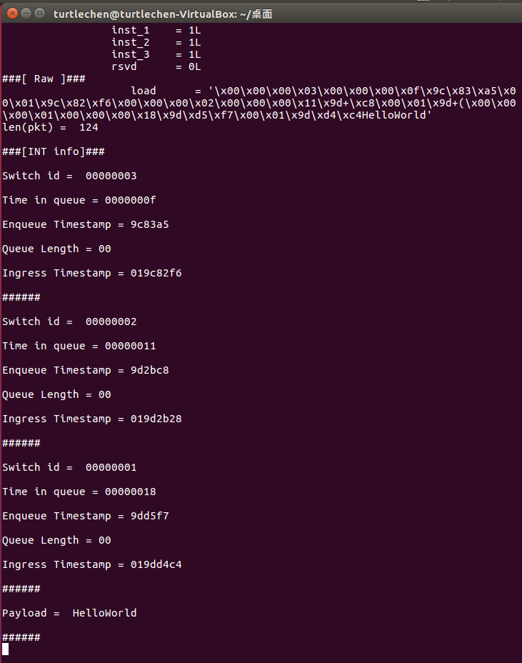
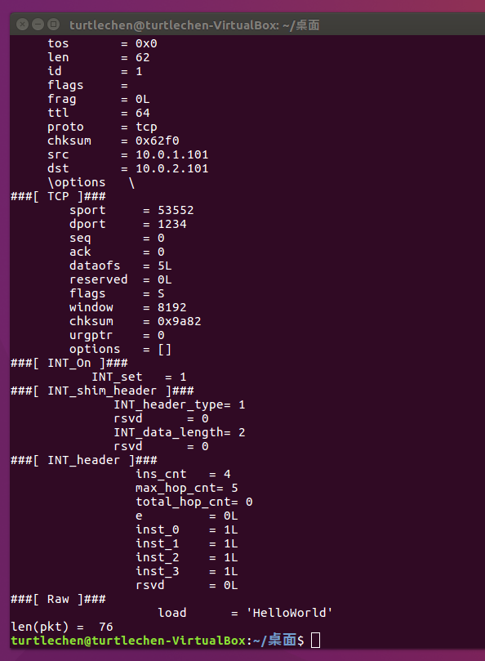
Test Result

