Slide 1

HTTP-based KV server with in-mem Cache
By: Siddhesh Shinde
25M2113
1

Slide 2
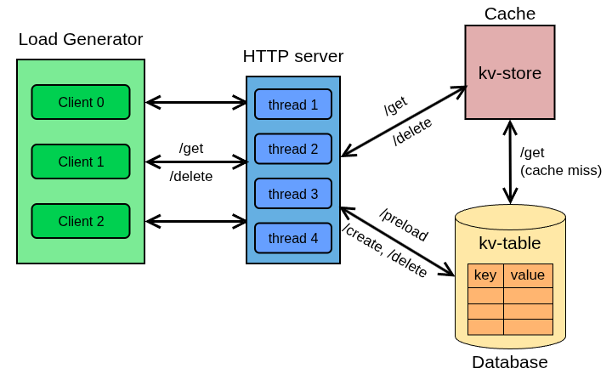




System Architecture
get_popular
Workloads:
get_popular
put_all
put_all
2

Slide 3
Project Implementation
Server :
  Using C++ / cpp-httplib
  File : server.cpp
  Code size : ~128 lines
In-memory cache:
  Using C / pthread
  Files : kv-store.h, kv-store.c
  Code size : ~123 lines
Database Layer :
  libpq database connector for Postgresql
  Files : db.h, db.c
  Code size : ~112 lines
Load generator :
  Closed loop client program in C++
  File : loadgen.cpp
  Code size : ~284 lines
run_exp.sh :
  Bash script that runs the server and load generator across workloads.
plot_script.py :
  Python script to generate the required plots given the results from the load test.
Github : https://github.com/s1ddh3sh/CS744-project
3

Slide 4
Load Generator
Multi-threaded design:
  One worker thread emulates one client; threads run independently and concurrently.
  Shared, lock-free statistics container (atomic counters) aggregates successful/failed requests and
  total latency.
Closed‑loop model:
  Each worker issues one request and waits for the response before issuing the next request.
  Deterministic request sequencing: each thread uses a fixed-seed (seed = 12345u + thread_id) so runs are repeatable.
To stress the system:
  Number of client threads is configurable; increasing threads increases concurrent load until the server saturates. Closed-loop zero-think mode forces each client to keep the request pipeline full.
  Ability to tune cpu affinity lets you drive heavy concurrent traffic and control where work executes.
4

Slide 5
Load Test Setup
Core Affinity :
  Server program runs on cores 0,1.
  taskset -c 0-1 ./server
  Load generator is ran on the rest of the cores, which spawns thread clients .
  taskset -c 2-7 ./loadgen <threads> <duration> <workload>
  README.md for more details regarding the execution.
Total Number of Runs :
  For each workload, i.e get_popular and put-all, the experiments are ran across load levels from levels 1-16, until throughput plateau / performance bottleneck is achieved.
  The duration of each experiment run is fixed at 300 seconds (5 min) to ensure results are collected from a stable, steady-state system.
  The /results folder stores the result logs from each run and csv files used for plots.
5

Slide 6
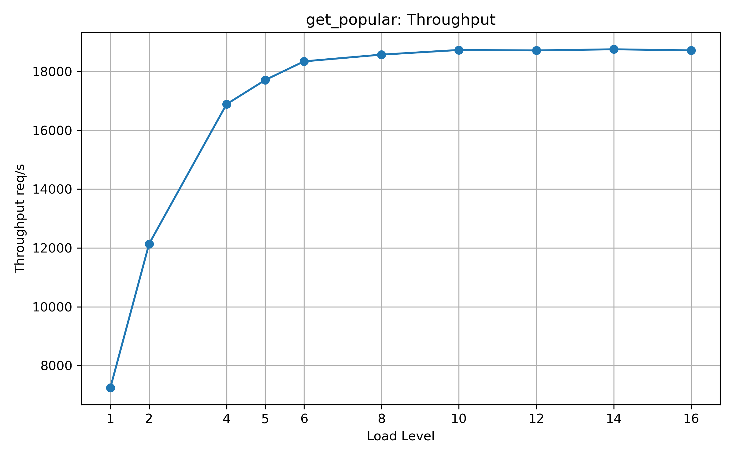
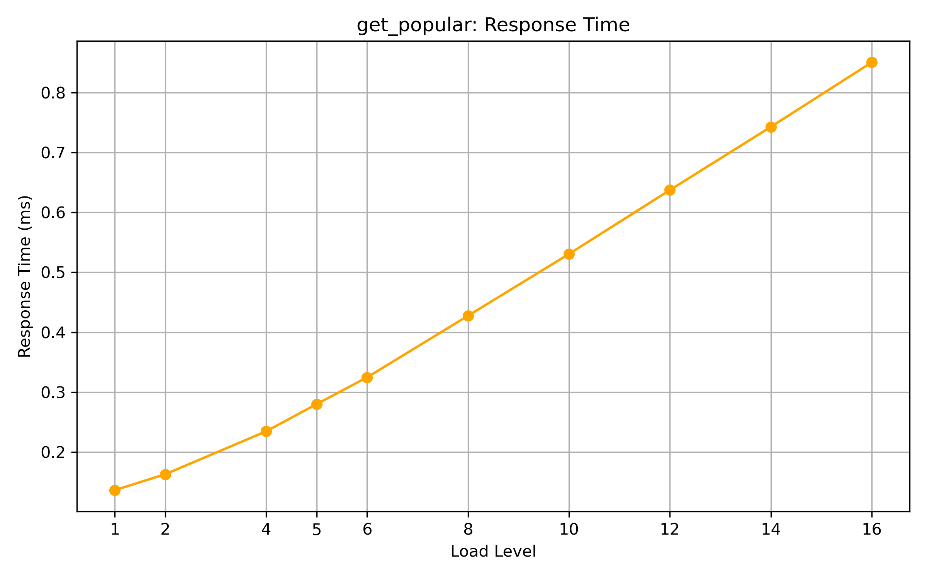
Load test results
get_popular : Data for the following plots is available in get_popular.csv
Throughput Vs Load level
2. Response time Vs Load level
6

Slide 7
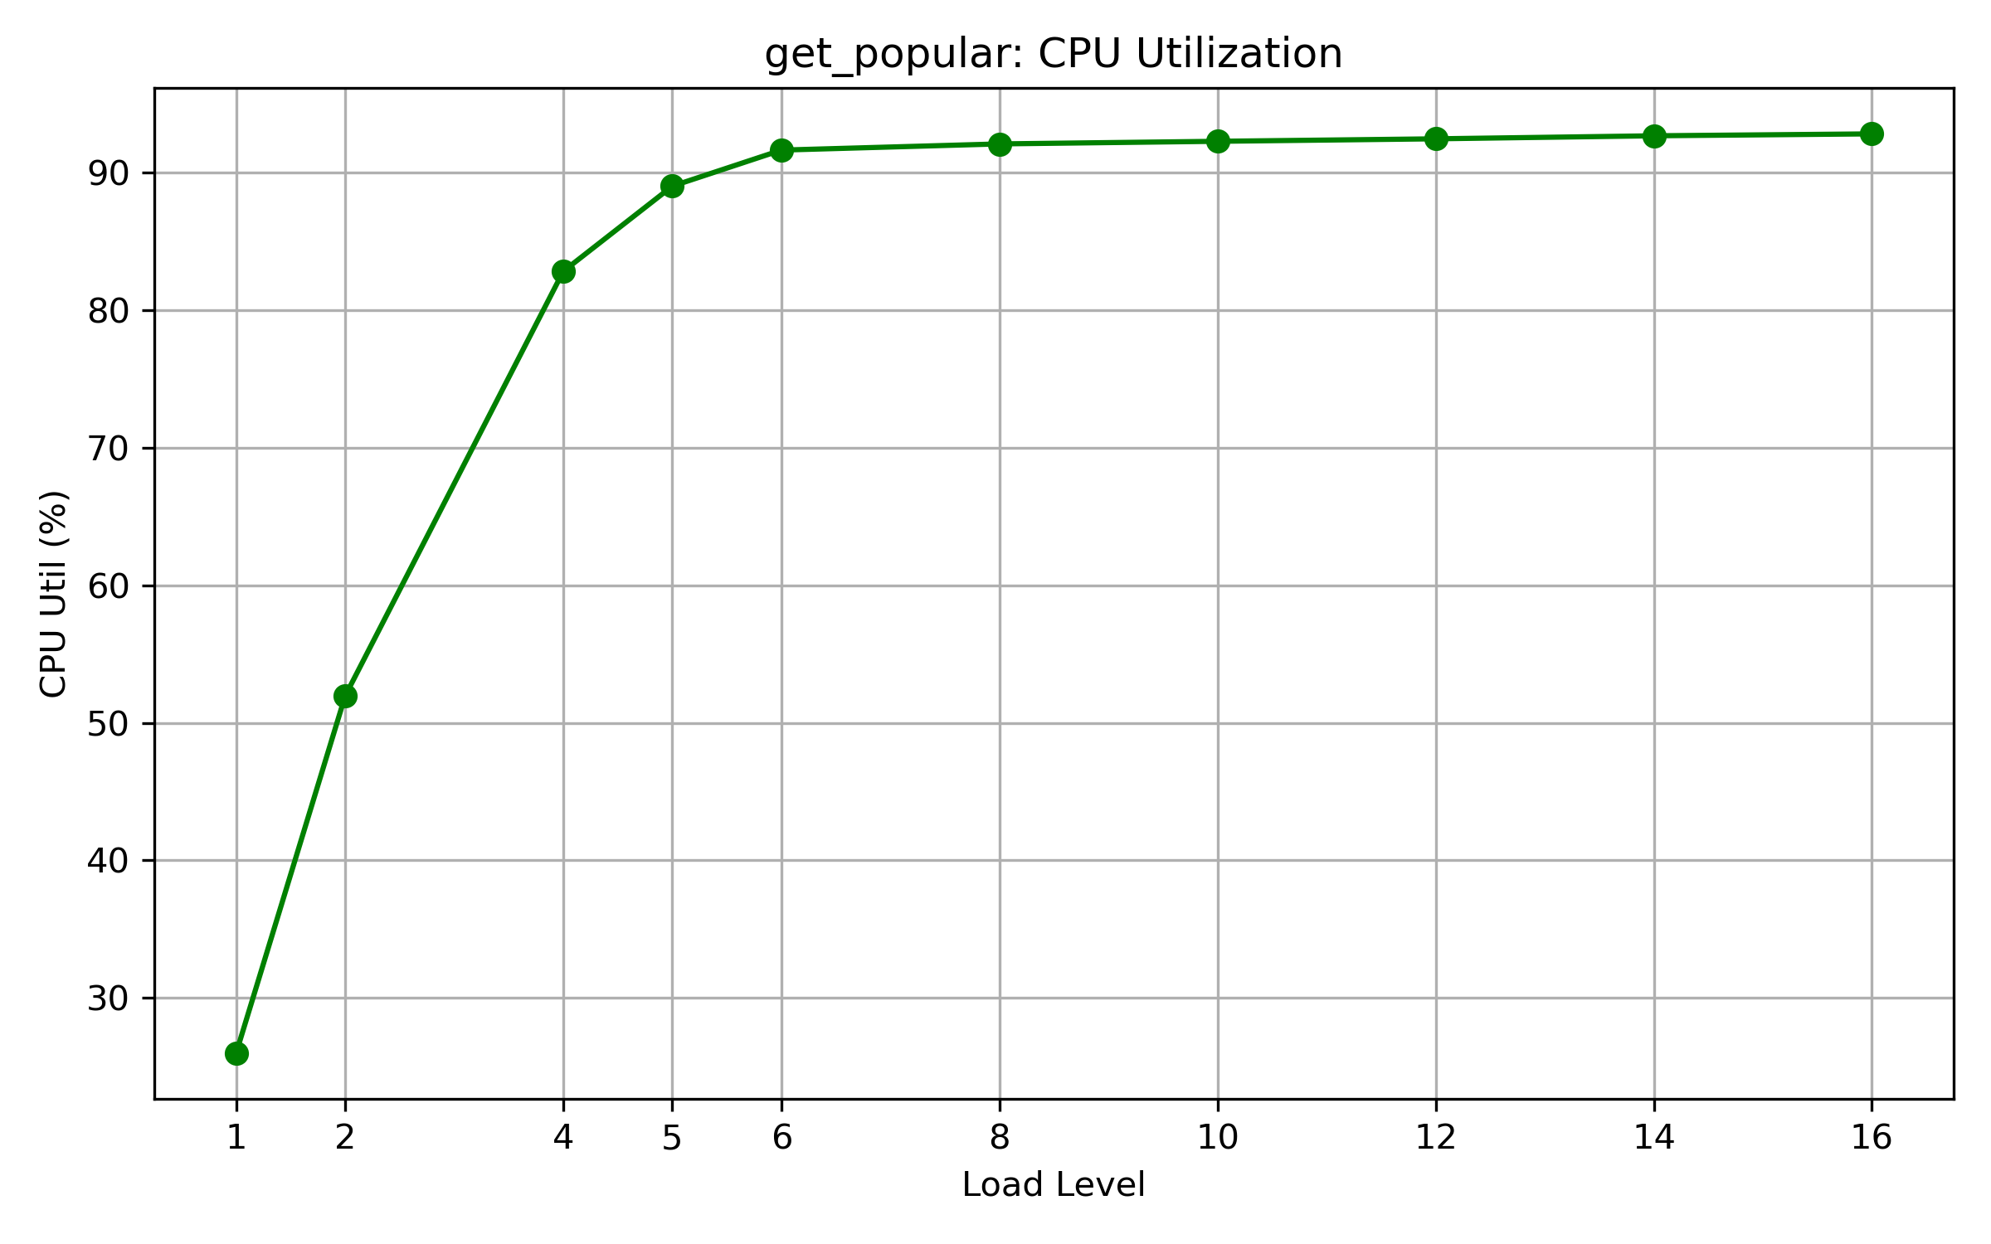
Load test results
get_popular : Data for the following plots is available in get_popular.csv
3. Server CPU utilization(%) Vs Load level
7

Slide 8
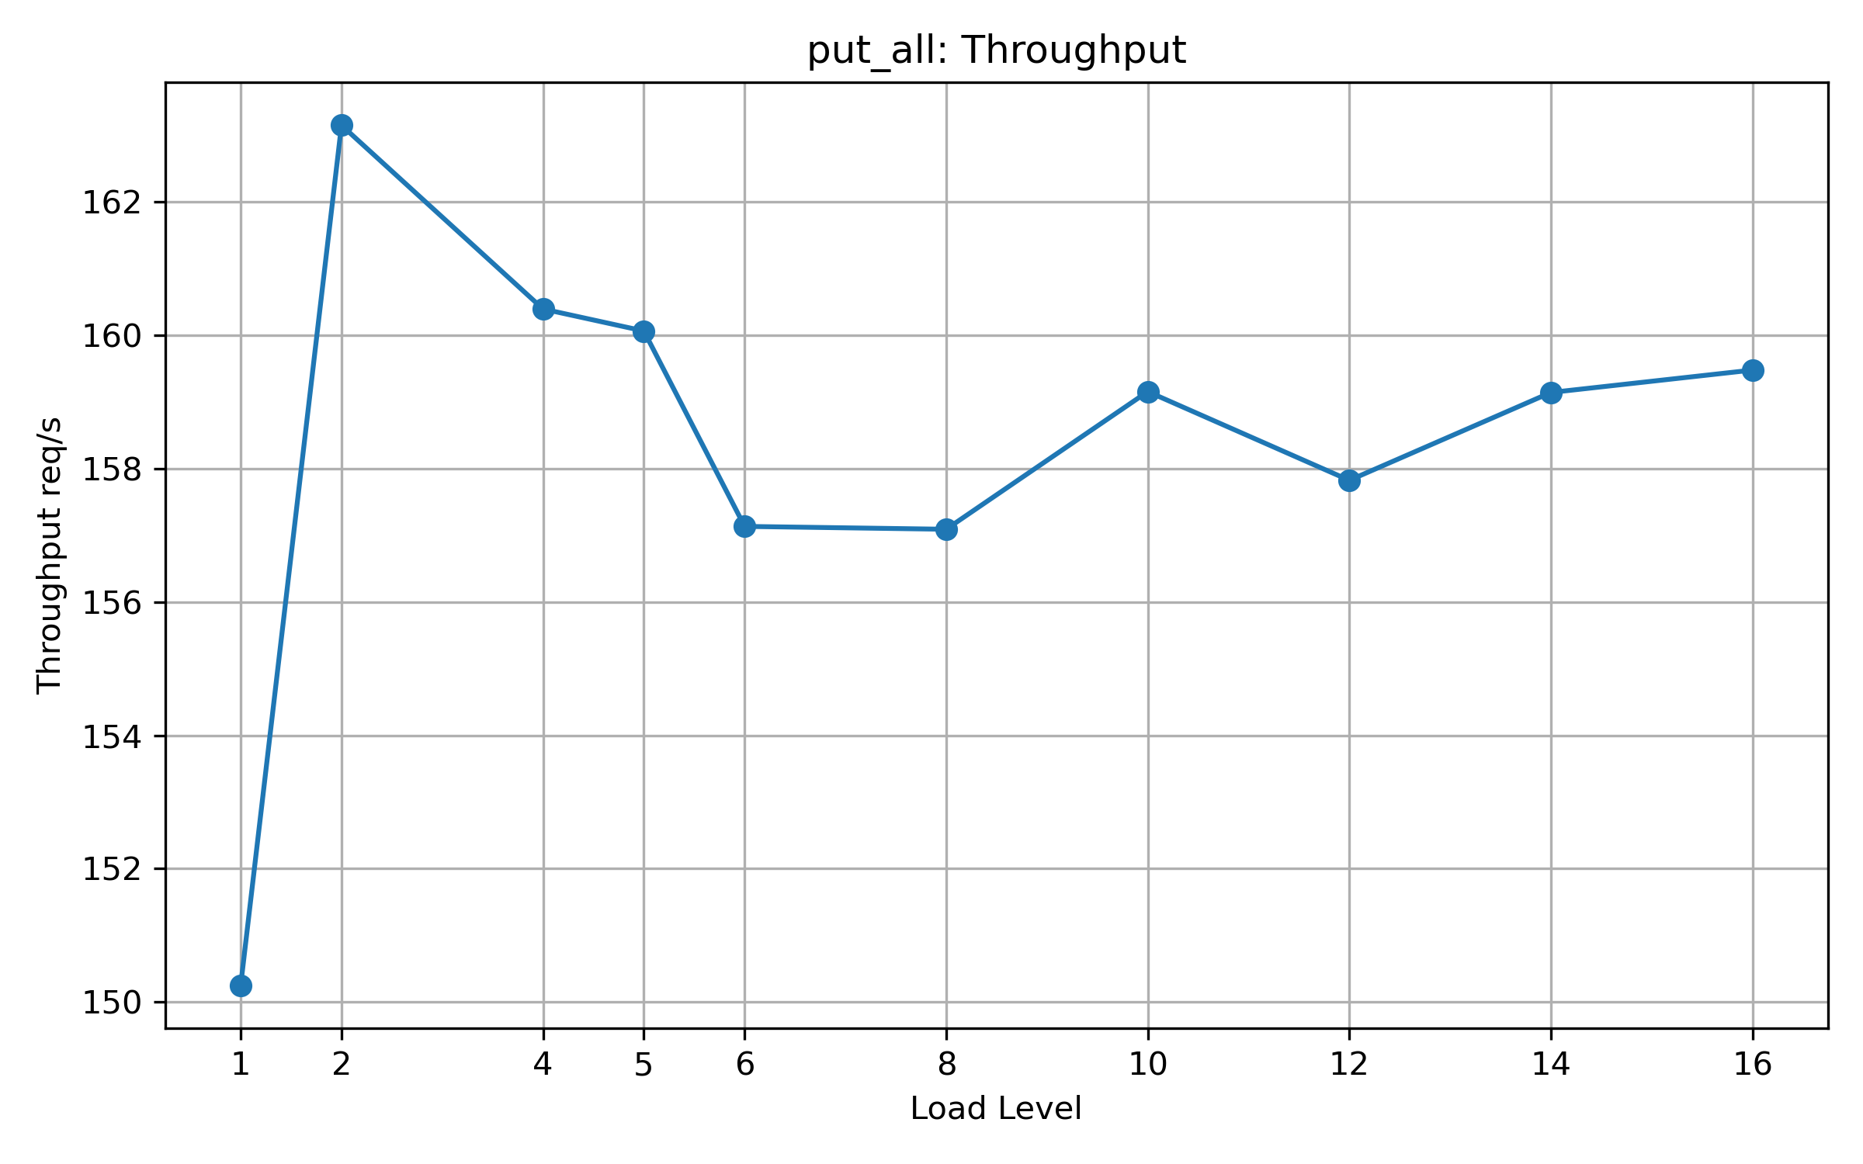
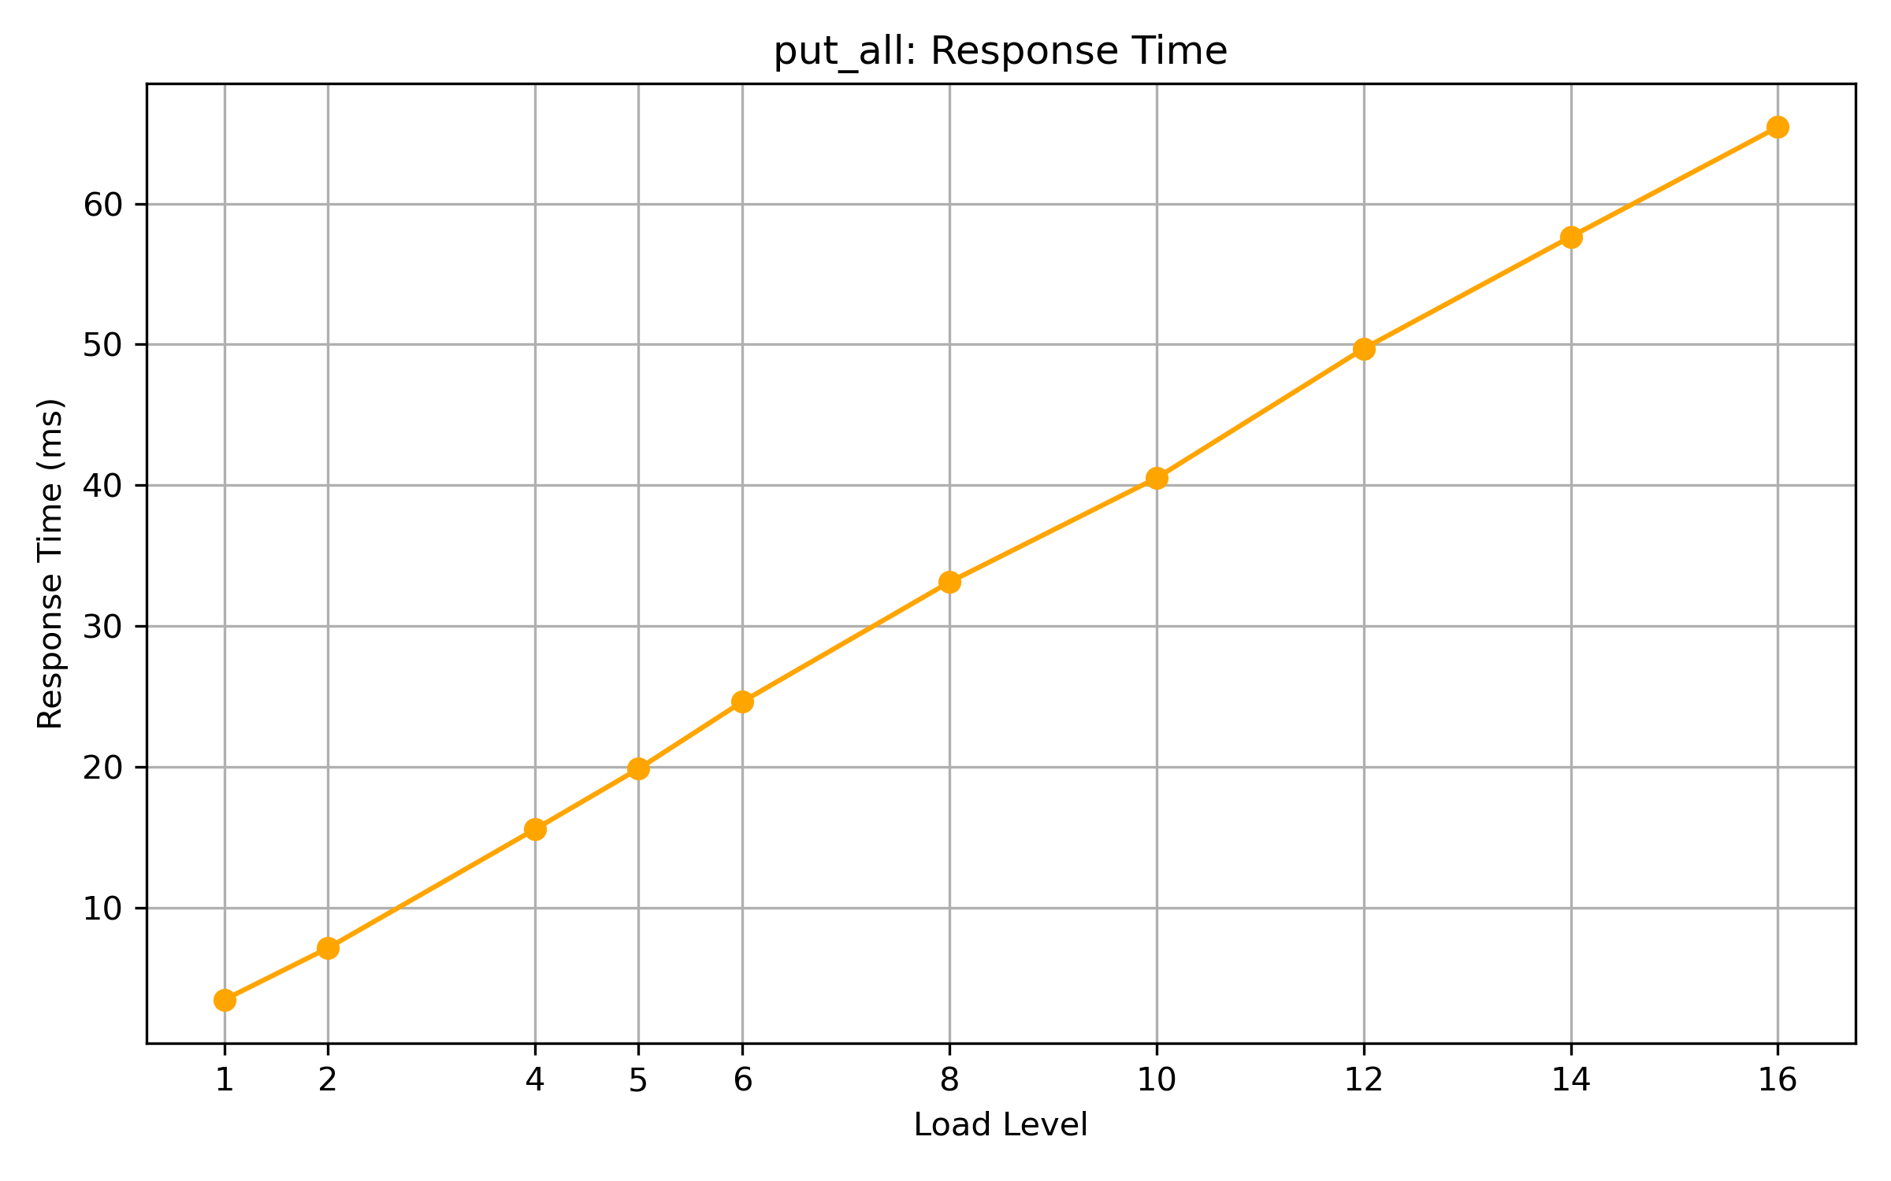
Load test results
put_all : Data for the following plots is available in put_all.csv
Throughput Vs Load level
2. Response time Vs Load level
8

Slide 9
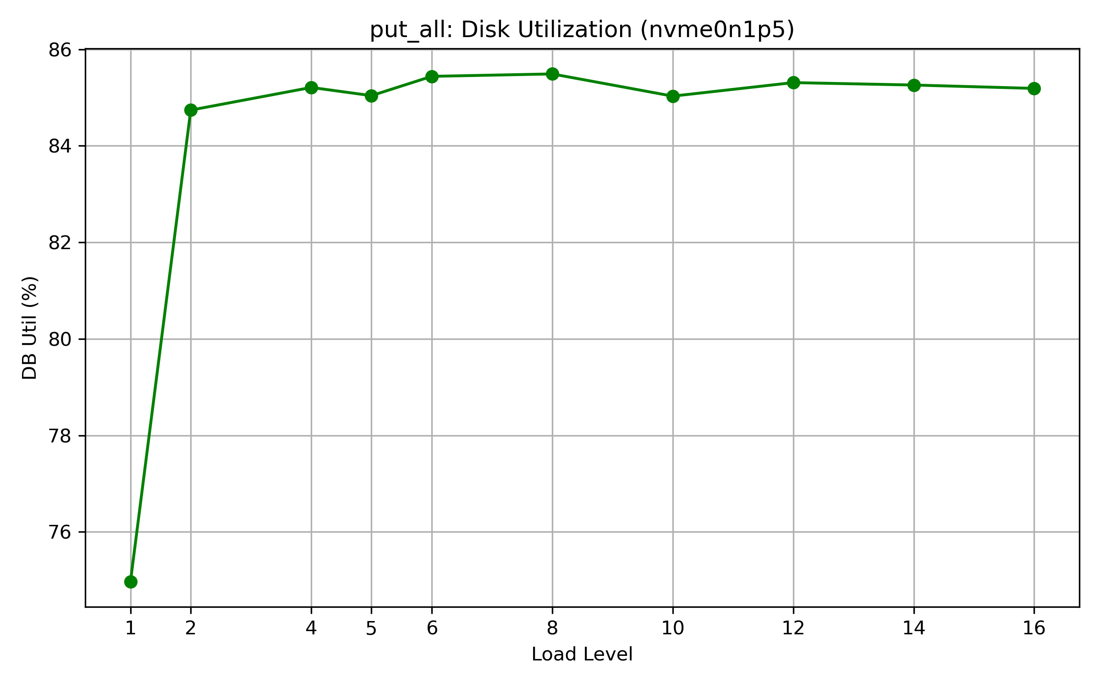
Load test results
put_all : Data for the following plots is available in put_all.csv
3. Disk utilization(%) Vs Load level
Detailed report : 25M2113_project_report.pdf
9

