Slide 1

EXPLORING OUTRIGHTS, SPREADS, AND FLIES
AVERAGE DAILY RANGES| Outrights
Range CLOSE
C1 0.014465969
C2 0.01821466
C3 0.020659686
C4 0.023560209
C5 0.025743455
AVERAGE DAILY RANGES| Spreads
AVERAGE DAILY RANGES| Flies
Range CLOSE
C1-C2 0.012680628
C2-C3 0.009890052
C3-C4 0.00982199
C4-C5 0.008602094
Range CLOSE
(C1-C2)-(C2-C3) 0.01678
(C2-C3)-(C3-C4) 0.014194
(C3-C4)-(C4-C5) 0.013963

Slide 2
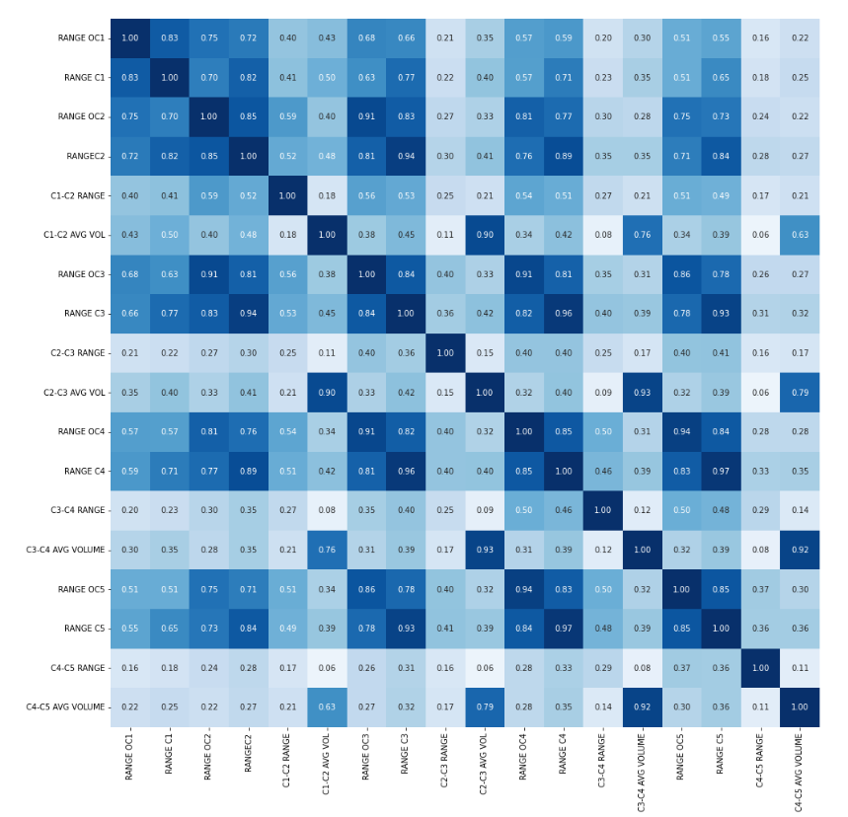
CORRELATION MATRIX| Outrights & Spreads
Strong positive correlation (>0.9) in high-low ranges among c3, c4, & c5
Strong positive correlation (0.94) in high-low ranges for c2 and c3
Open-close range of c2 and c3 have a strong positive correlation (0.91)
Open-close range of c3 and c4 have a strong positive correlation (0.91)
Open-close range of c4 and c5 have a strong positive correlation (0.94)
No significant correlation between the ranges of spreads and outrights

Slide 3
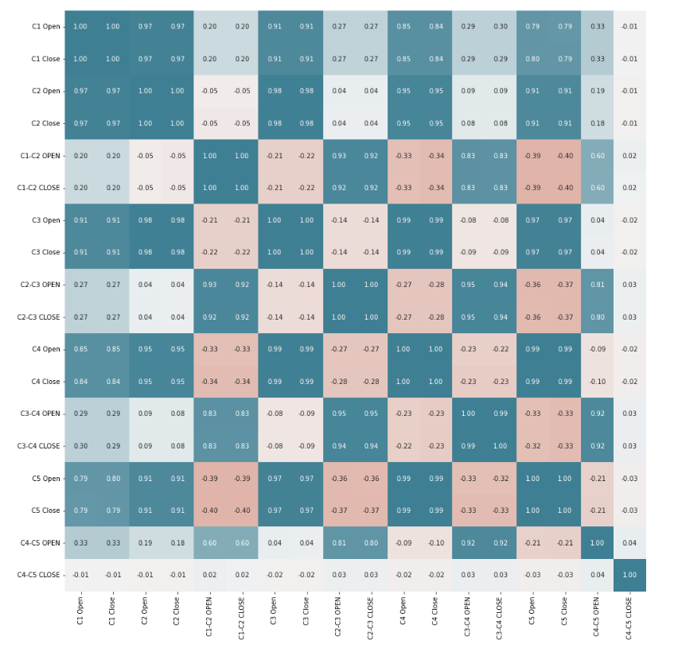
CORRELATION MATRIX| Outrights & Spreads
Strong positive correlation is present between adjacent contract prices (both outrights and spreads) and decreases as they go apart.

Slide 4
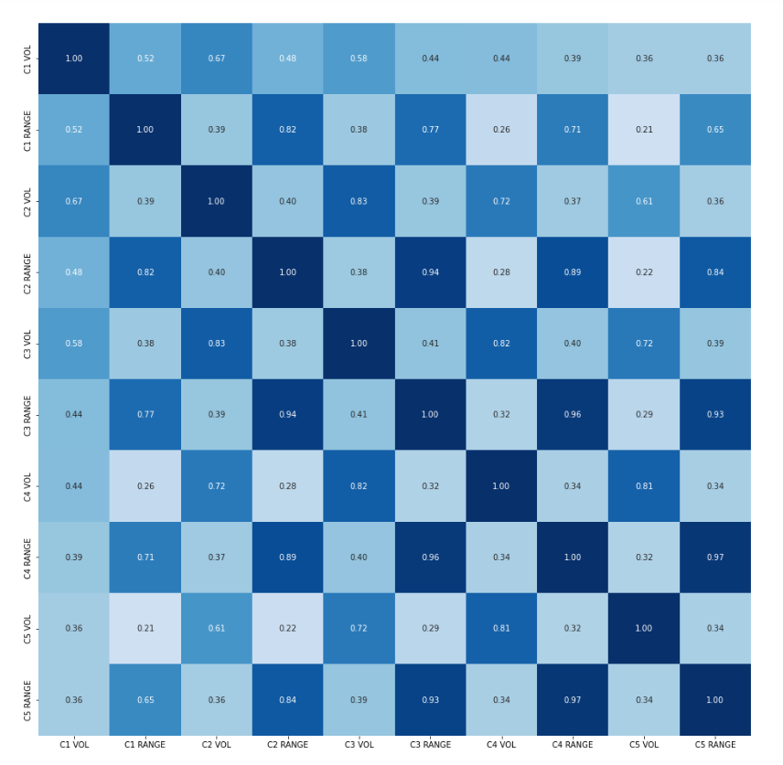
CORRELATION | Volume and Range
No strong correlations between volume and range of a contract.

Slide 5
DIGGING DEEPER FOR INSIGHTS AND TRENDS
SIMILARITIES | Days with volume more than last 30 days average volume
In this section, we’ll try to see the similarities between days having volume more than the last 30 days average volume for.
SIMILARITIES | Average Days
C1 • 99 days
38% of working days
C2 • 100 days
38% of working days
C3 • 105 days
40% of working days
C4 • 107 days
41% of working days
C5 • 104 days
40% of working days
SIMILARITIES | Average High-Low range
C1 • 0.03
52% more than other days
C2 • 0.04
52% more than other days
C3 • 0.05
52% more than other days
C4 • 0.05
38% more than other days
C5 • 0.05
42% more than other days
SIMILARITIES | Average Volume traded
C1 • 27788
172% more than average of other days
C2 • 35466
127% more than average of other days
C3 • 29070
124% more than average of other days
C4 • 22484
118% more than average of other days
C5 • 15855
45% more than average of other days
Key Insights
Around 40% of working days have volume more than the previous 30 day average volume
High-Low ranges increases by 40%-50% in such days
Volume traded are more than 100% for such days than other days
Volume traded decreases in subsequent contracts

Slide 6
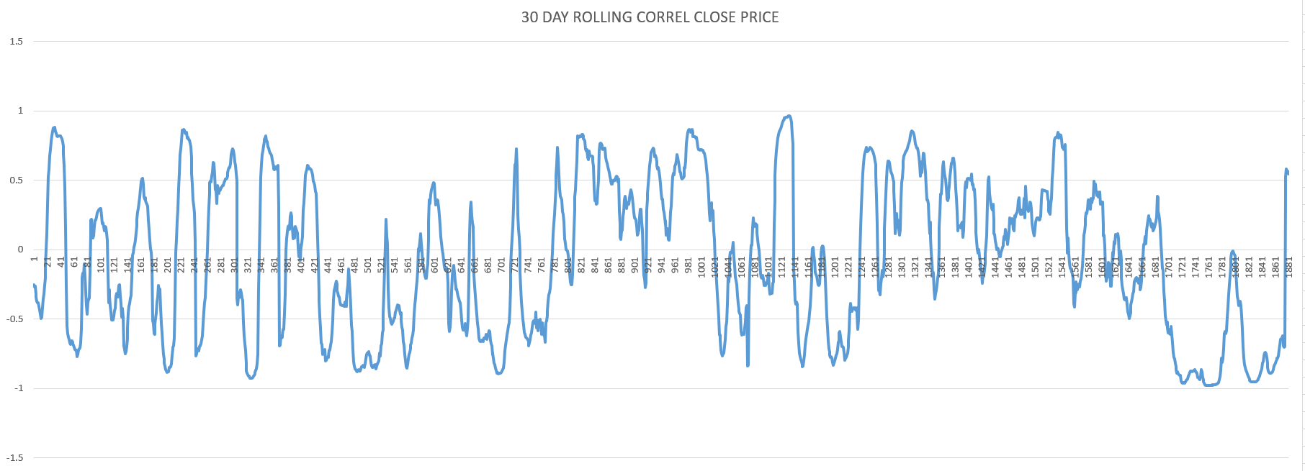
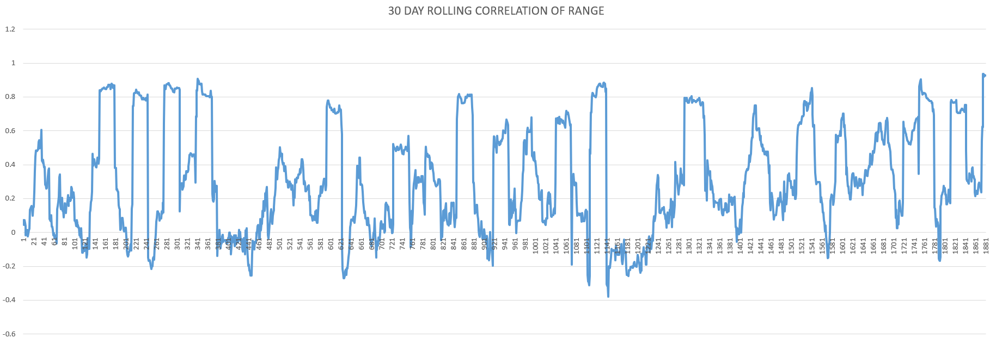
CORRELATION | c1-c2 and c1 for a rolling 30 days window

Slide 7
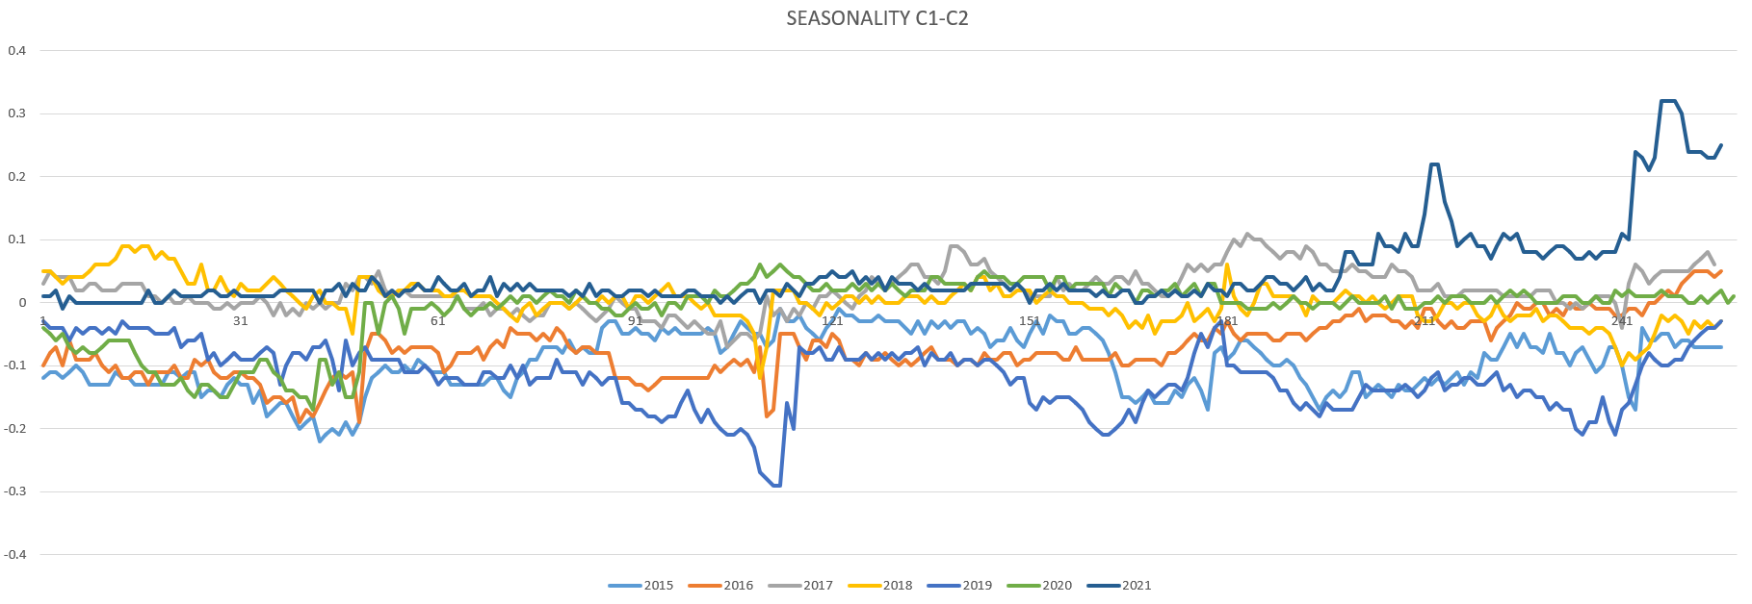
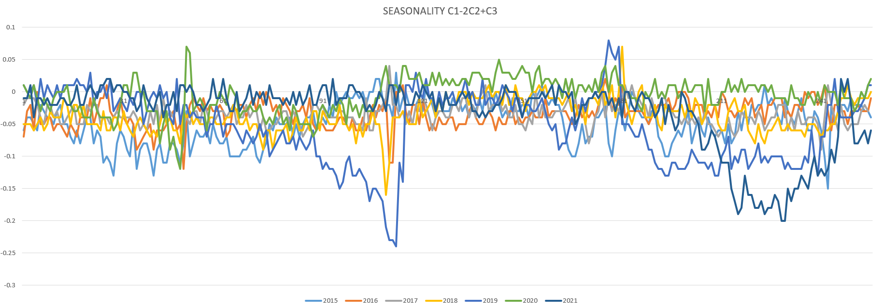
SEASONALITY | Pattern in c1-c2 and c1-2c2+c3

Slide 8
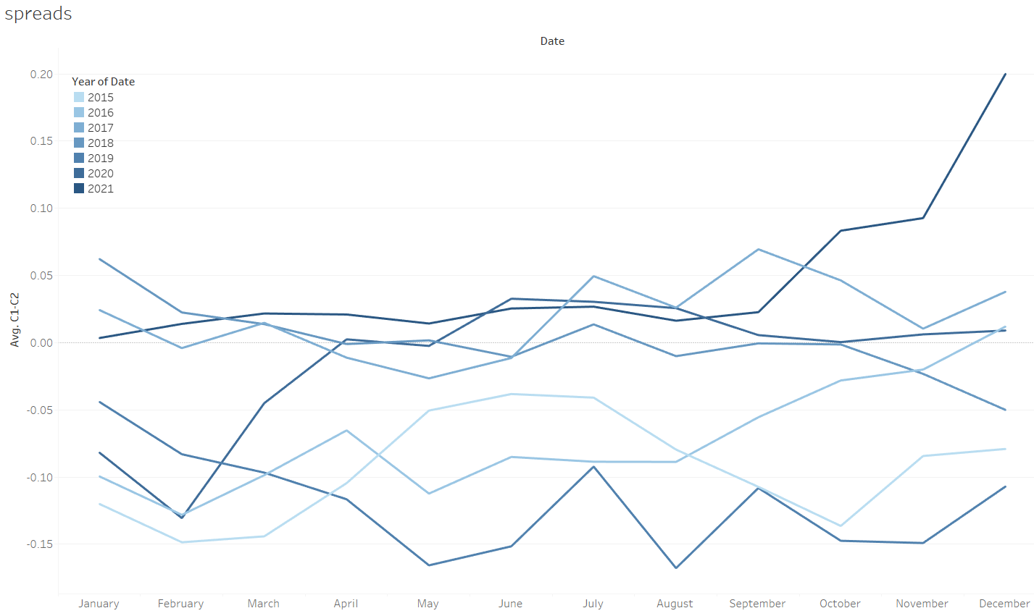
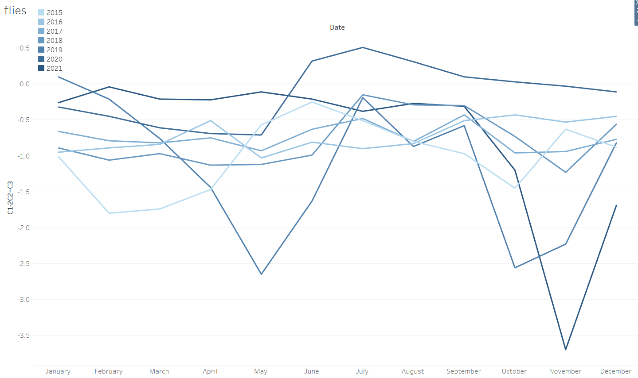
SEASONALITY | Pattern in c1-c2 and c1-2c2+c3

Slide 9
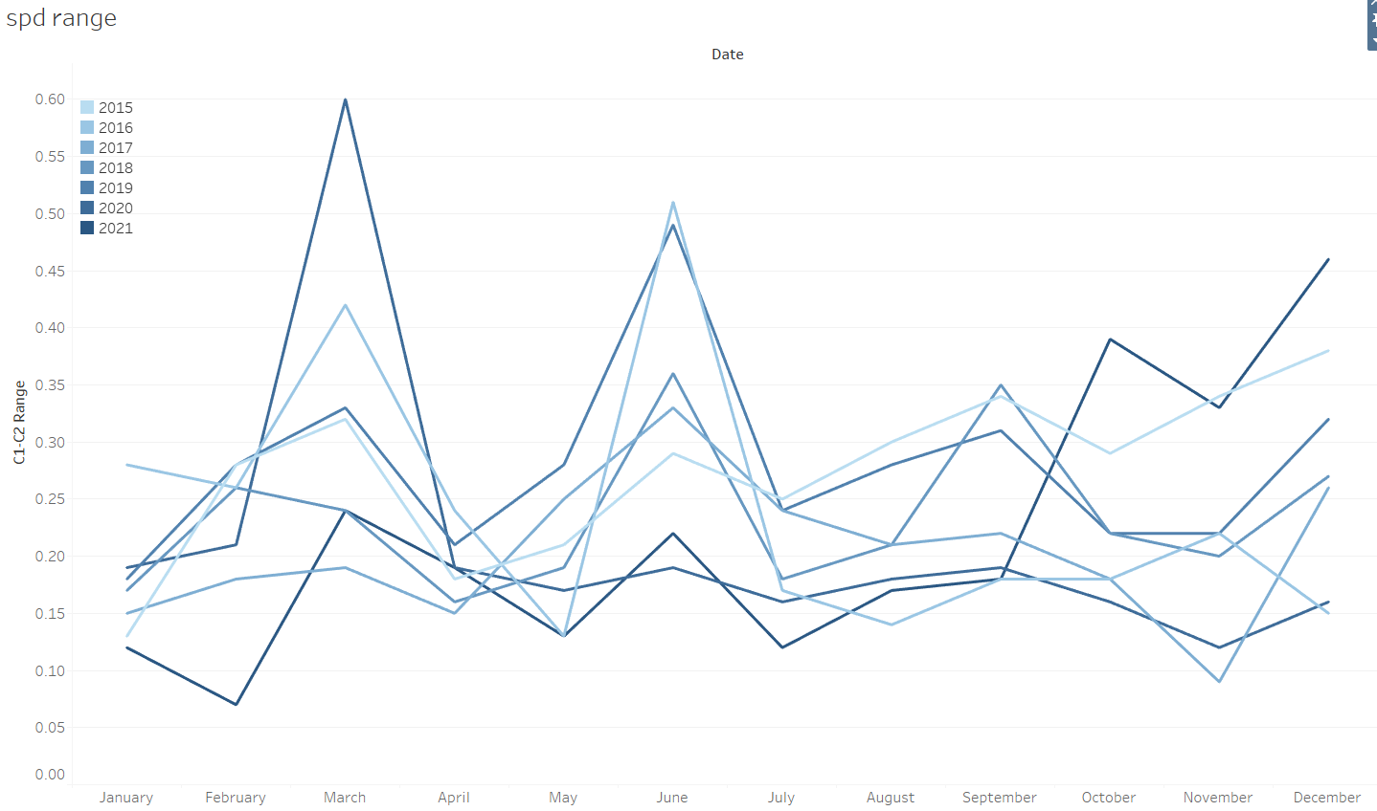
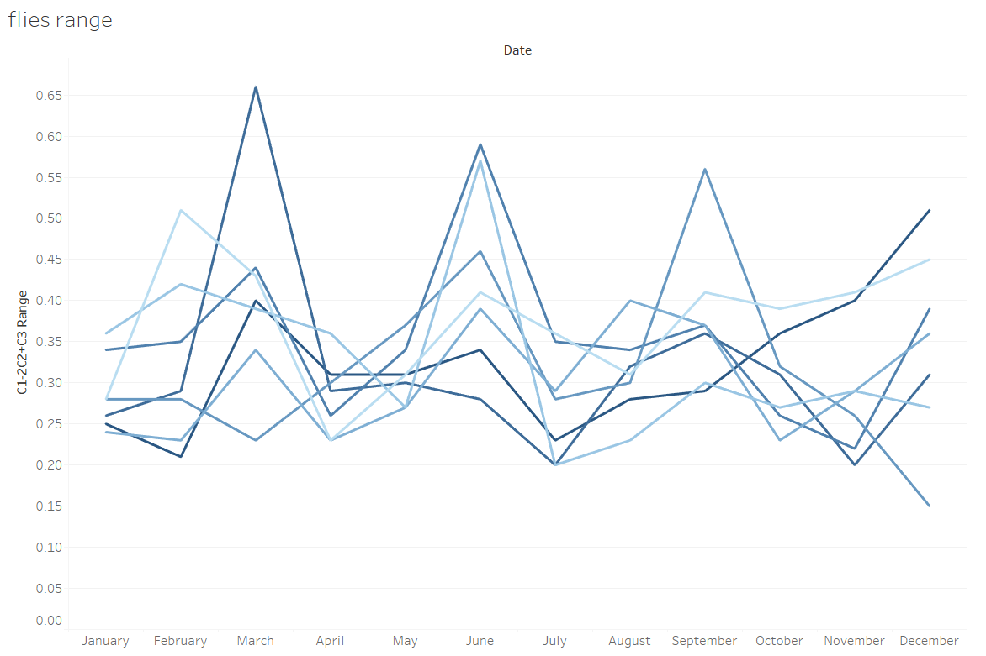
SEASONALITY | Pattern in c1-c2 and c1-2c2+c3

Slide 10
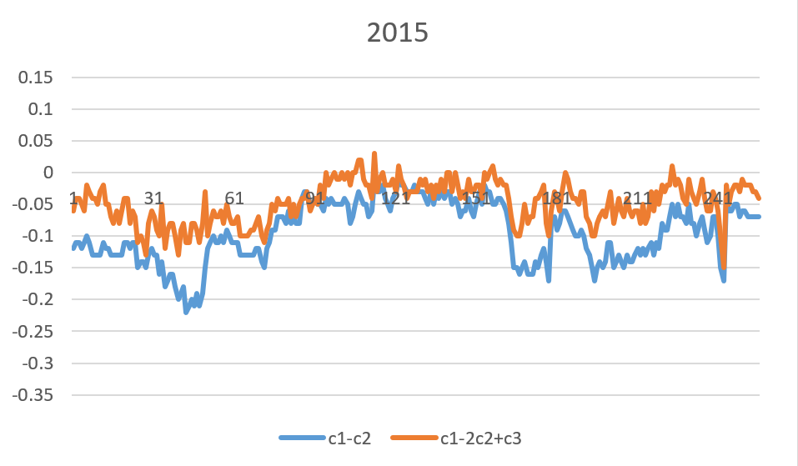
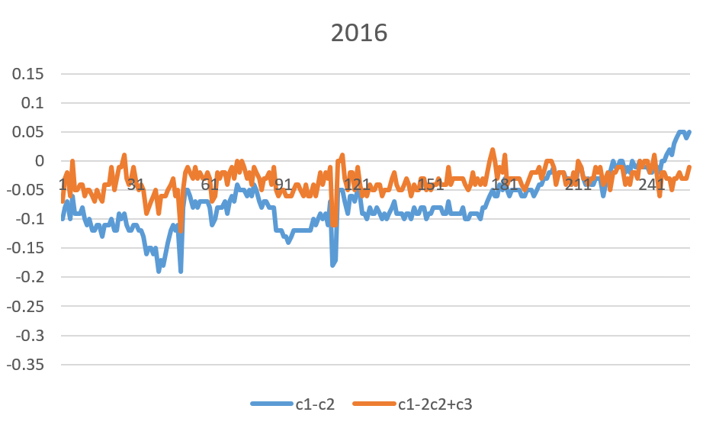
SEASONALITY | Pattern in c1-c2 and c1-2c2+c3

Slide 11
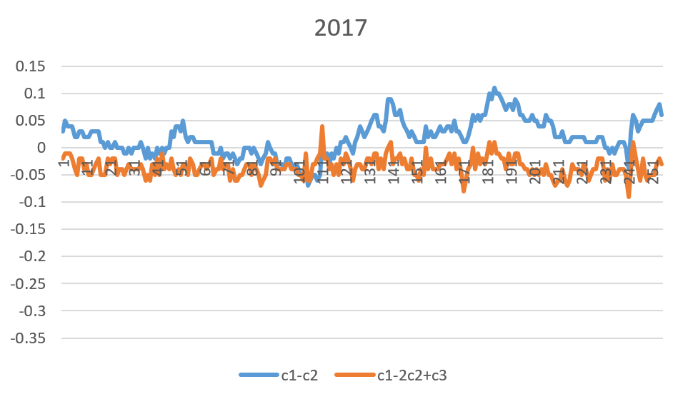
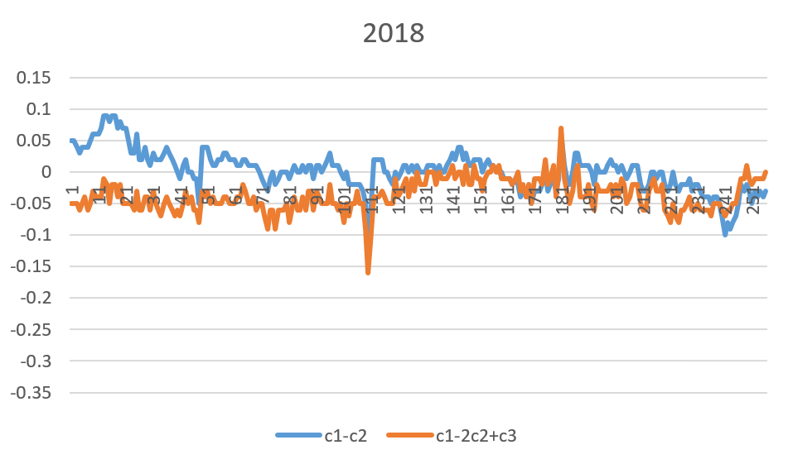
SEASONALITY | Pattern in c1-c2 and c1-2c2+c3

Slide 12
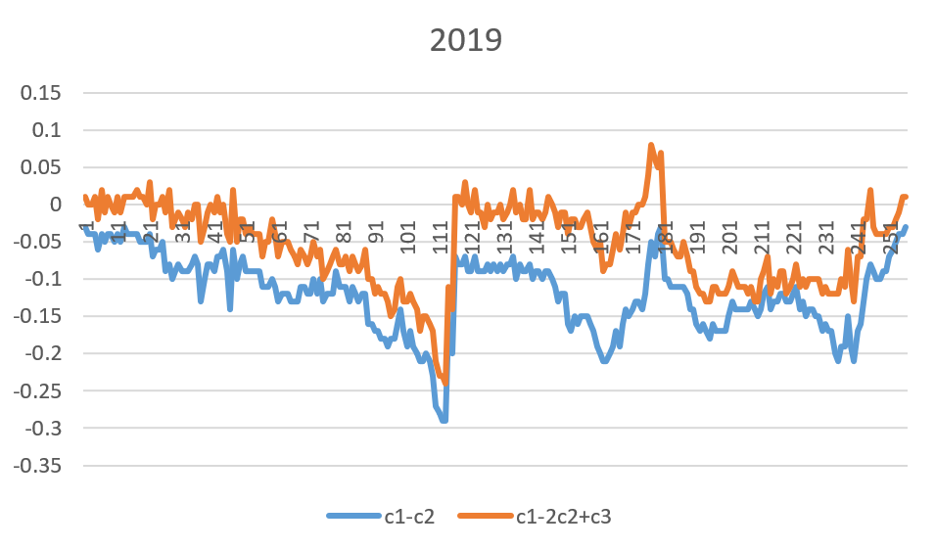
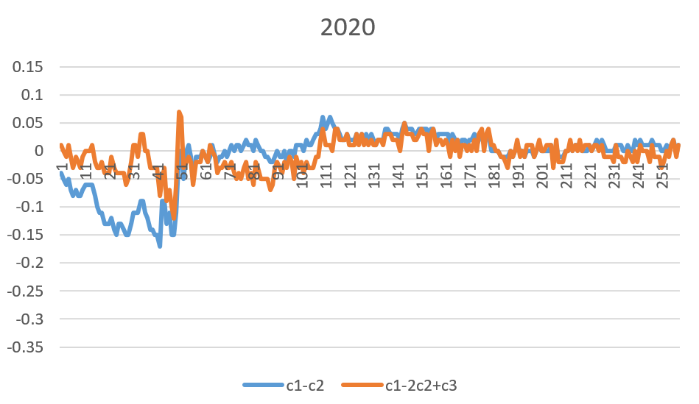
SEASONALITY | Pattern in c1-c2 and c1-2c2+c3

Slide 13
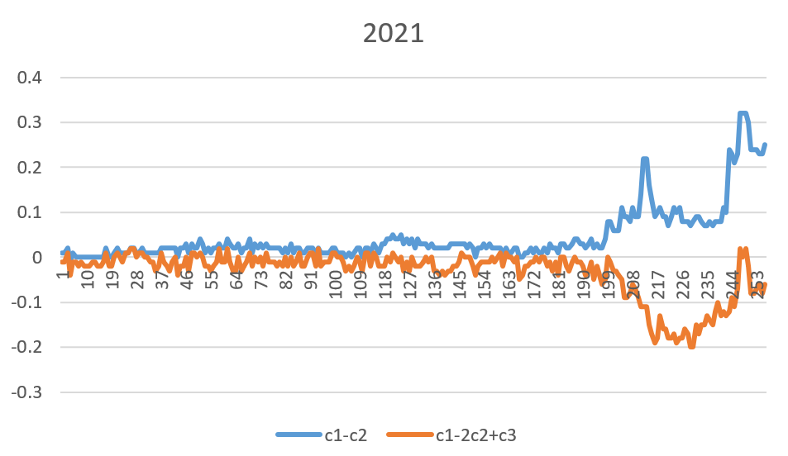
SEASONALITY | Pattern in c1-c2 and c1-2c2+c3

