Slide 1
Week3_DAM

Slide 2
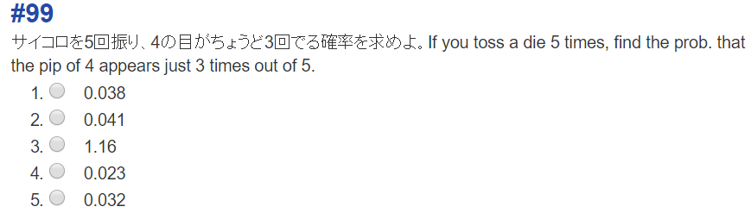

Slide 3
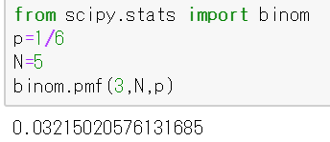

Slide 4
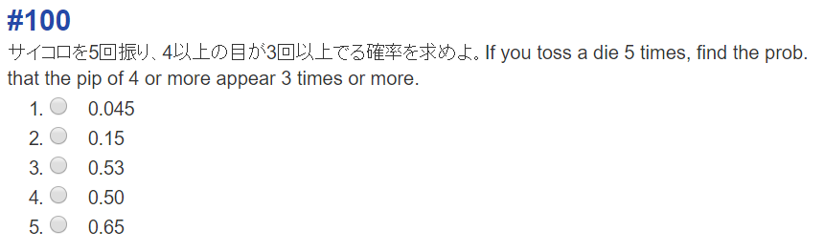

Slide 5
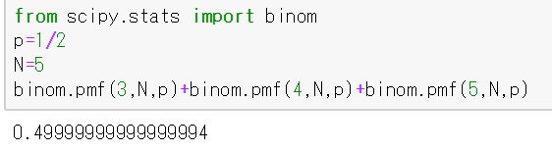

Slide 6
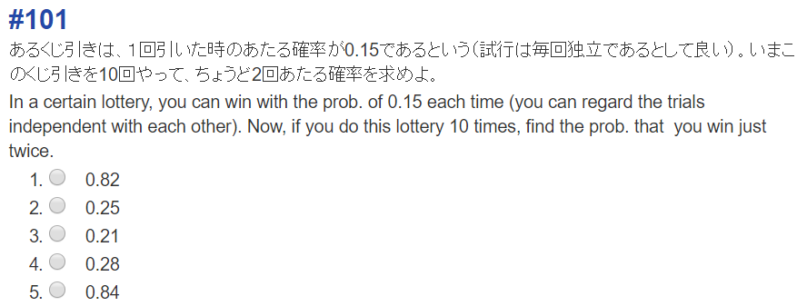

Slide 7
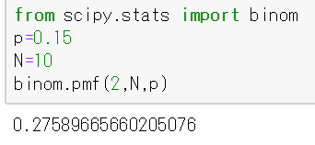

Slide 8
Week3 DAO

Slide 9
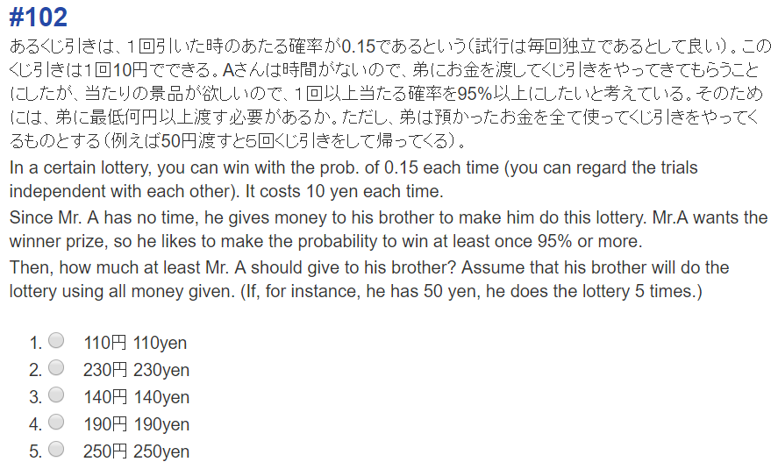

Slide 10
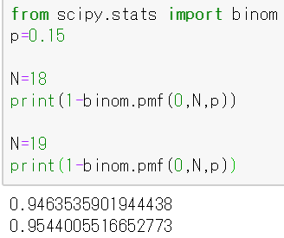
“あたりが０個の確率”を5%未満にすればよい。
そのような最小のNを探す。
You should make the prob. that no winning
piece is included out of N.
Seek for the least value of such N.

