Slide 1
Week5 DL answers

Slide 2
Week5_DL1

Slide 3
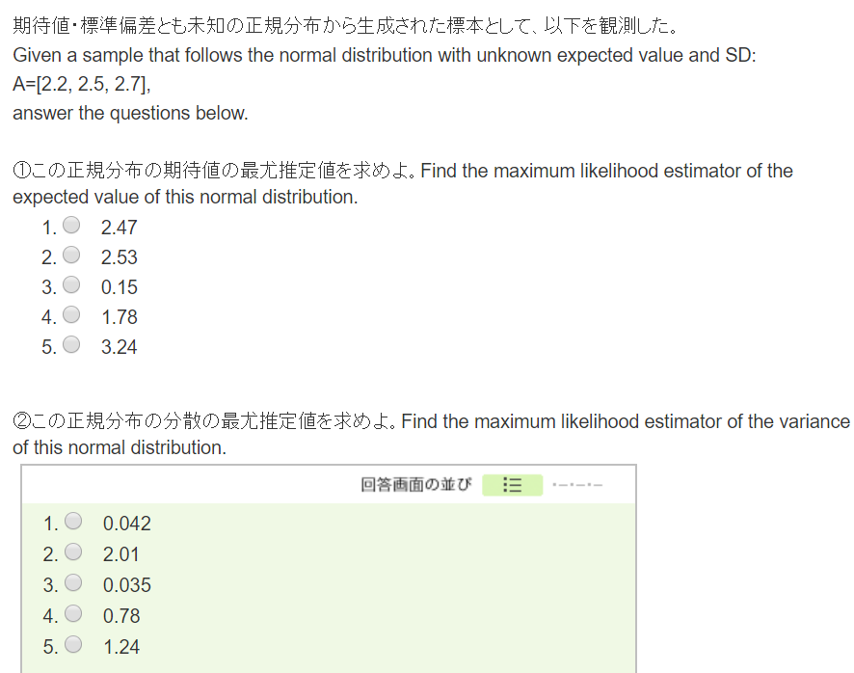

Slide 5
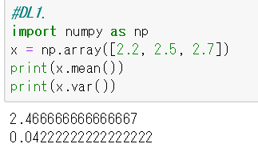

Slide 6
Week5_DL2

Slide 7
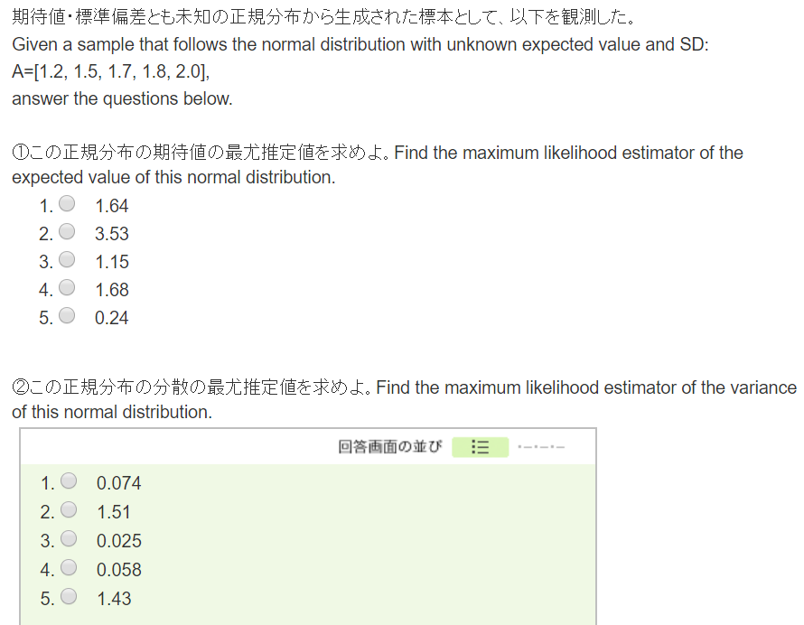

Slide 9
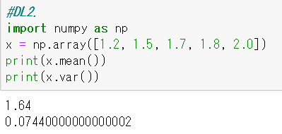

Slide 10
Week5_DL3

Slide 11
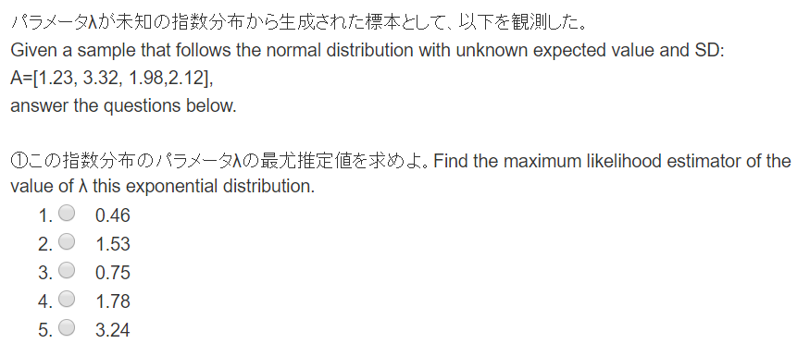

Slide 13
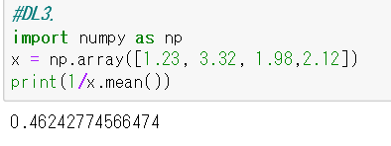

Slide 14
Week5_DL4

Slide 15


Slide 17


Slide 18
Week5_DL5

Slide 19
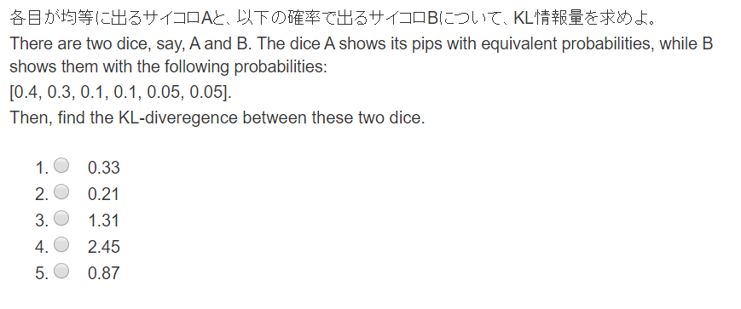

Slide 21
