Slide 1
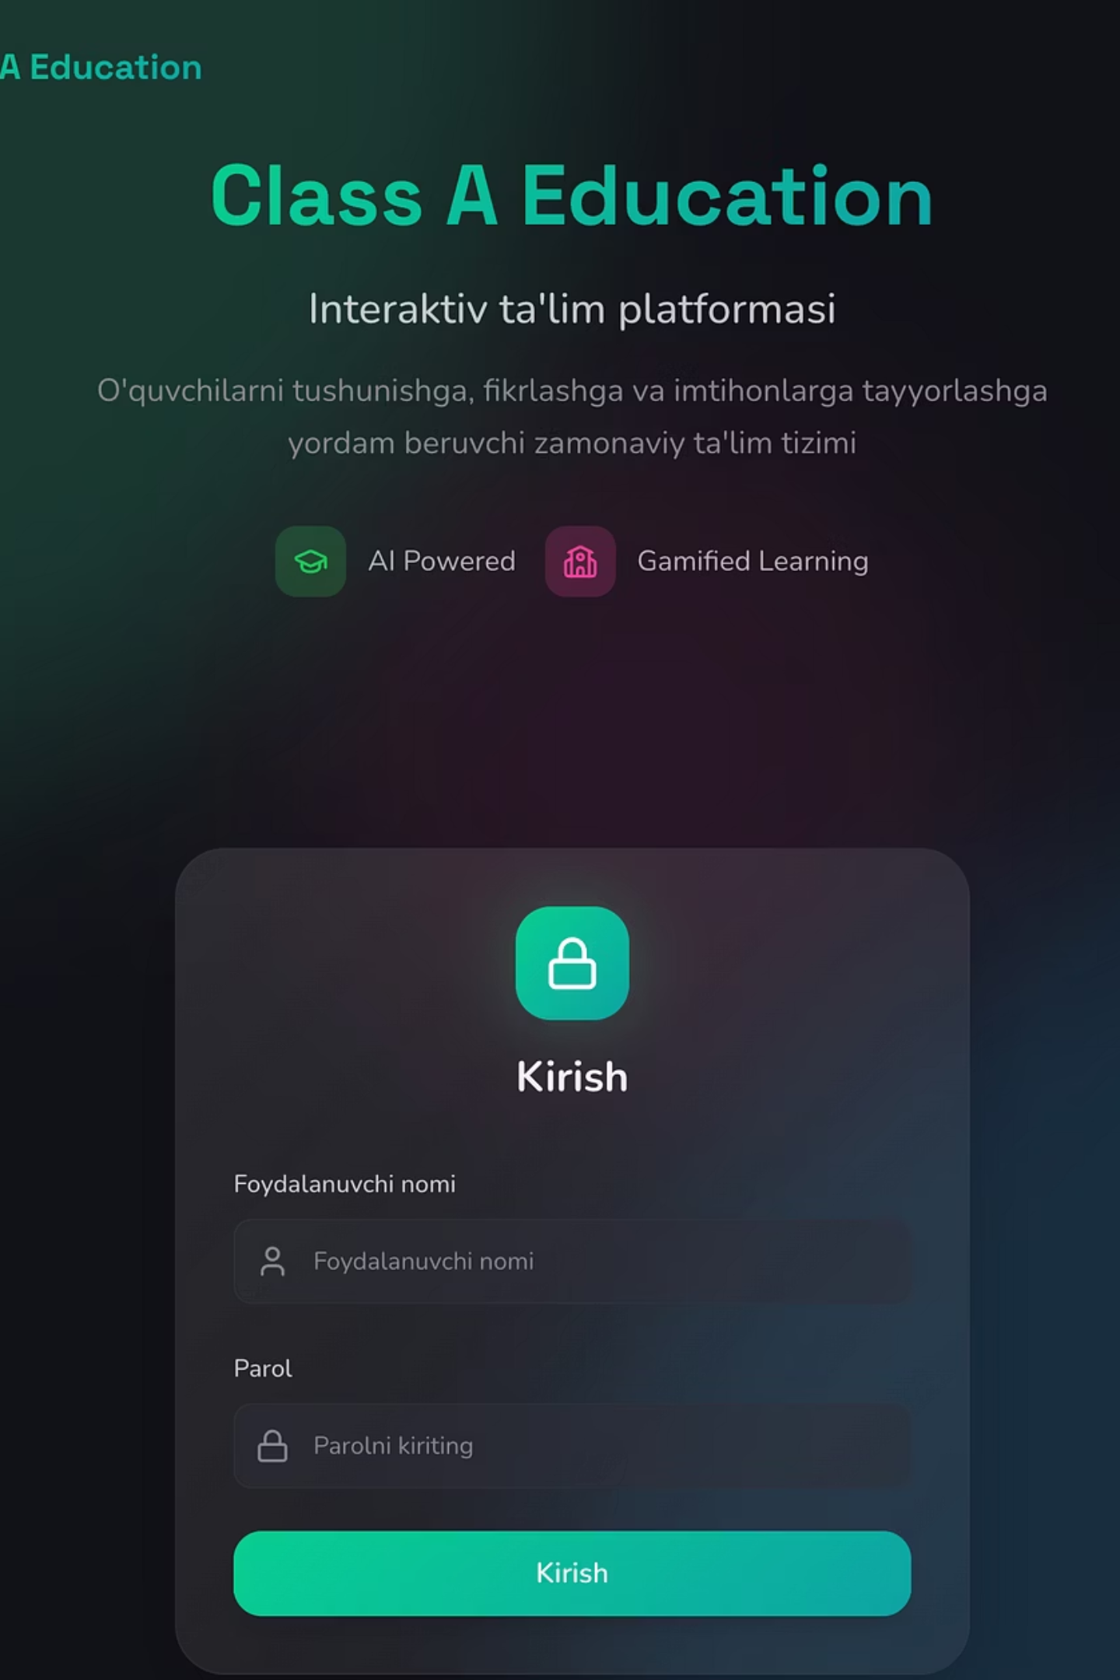
Class A Education Platform — Phase 1 Implementation
API integration completed pages and functions

Slide 2
Authentication (Login Page)
System Access
Key Features
Connected API Endpoints
User logs in via login and password
Access and refresh tokens obtained via API
Token automatically refreshes when expired (refresh token)
User role identified and directed to appropriate panel: Admin, School, Teacher, Student, Parent
"Remember me" function — session saved via localStorage
POST /auth/login
POST /auth/token/refresh
GET /auth/users/me

Slide 3
Admin — Library Page (Subjects and Grades)
Admin: Library Management — Subjects and Grades
Subject Management
Grade Levels
Curriculum Creation
Create, edit, delete subjects (3 languages: uz, ru, en)
Manage grade levels (1st grade, 2nd grade, ...)
Create curriculum for each subject with class + language combinations
Bulk Operations
View & Filter
Create multiple classes simultaneously with bulk create functionality
View curriculum list and apply filters
Connected API Endpoints
CRUD /library/subjects • CRUD /library/grades • CRUD /library/curriculum + bulk create

Slide 4
Admin — Library: Chapters and Topics
Admin: Library — Chapters (Chapter) and Topics (Topic)
Core Functionality
API Endpoints
Create chapters within each curriculum
Add topics within chapters
Change topic order
Load topics with pagination
Add content types to topics: lesson_content (lesson) and homework (assignment)
Reorder content types
CRUD /library/chapters
CRUD /library/topics
CRUD /library/content-types + reorder

Slide 5
Admin — Lesson Creation (Lesson Builder)
Admin: Lesson Builder — Creating Lesson Content
Visual Builder Interface
Sections
Elements
Create and manage sections
Add elements to each section
Reorder
Duplicate
Drag-and-drop to reorder elements
Duplicate content (copy)
Media
Preview
Upload and manage files (images, videos, audio)
Live preview of lesson
Element Types
Info — text, image, video, audio, file, accordion, step
Test — 8 types of questions
Game — matching, memory, sorting, hotspot
Exercise — text, file upload, image, voice recording
AI Boss — challenge with artificial intelligence
Connected API Endpoints
CRUD /library/sections + reorder • CRUD /library/content-infos + duplicate + reorder • CRUD /library/blocks + reorder • CRUD /library/media + bulk delete • POST /upload/, POST /upload/image

Slide 6
Admin — Test Creation (8 Question Types)
Admin: Test Creation — 8 Question Formats
Test Question Types
01
02
Single Choice
Multiple Choice
One correct answer
Multiple correct answers
03
04
True/False
Short Text
True or false
Short text answer
05
06
Fill in the Blank
Matching
Fill in the blank
Matching pairs
07
08
Ordering
Open Answer
Ordering sequence
Open-ended answer
Additional Features
Duplicate tests
Create multiple tests simultaneously (bulk create)
Get random tests
Automatically check answers (check answer)
Connected API Endpoints
CRUD /library/tests + duplicate + bulk create • GET /library/tests/by-section/{id}/random • POST /library/tests/check-answer

Slide 7
Admin — School Management
Admin: Schools Page
Key Features
API Endpoints
All schools list (filtering, search)
Add new school (select region, district, village)
School statistics: total, premium, active, expired
Each school detail includes general information, teacher list, student list, and parent list
CRUD /schools/schools
GET /schools/schools/statistics
GET /schools/schools/{id}/students
GET /schools/schools/{id}/classes
GET /regions, GET /districts, GET /villages

Slide 8






School Role — Class Management
School Admin: Classes Page
View Classes
Create Class
Assign Teacher
View school classes list
Create new class (class name, academic year, language)
Assign teacher to class
Class Details
Categories
View students list in class
Manage class categories
Connected API Endpoints
CRUD /schools/classes • CRUD /schools/class-categories

Slide 9
School Role — Students and Teachers
School Admin: Student and Teacher Management
Students
Teachers
Parents
List, search, filter
Add new student (first name, last name, class)
Edit and delete student information
View list and filter
Add new teacher (specialization, experience, education level)
Edit and delete teacher
List and management
Link to child
Connected API Endpoints
CRUD /schools/students • CRUD /schools/teachers • CRUD /schools/parents

Slide 10
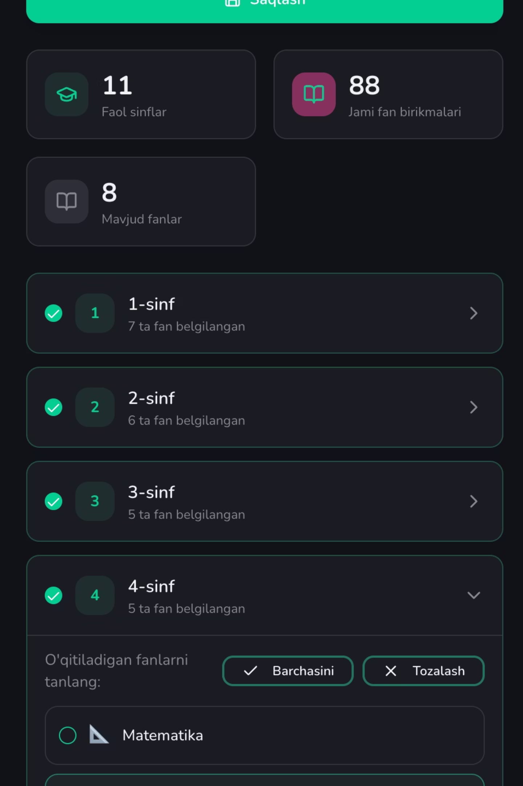




School Role — Curriculum Selection
School Admin: Curriculum (Educational Program) Page
Select Subjects
Choose subjects from admin-created library
Set Combinations
Define class + subject + language combinations for school
Assign Teachers
Assign teachers to subjects and classes (Teacher Curriculum)
Academic Year
Assign by academic year
Connected API Endpoints
CRUD /schools/school-curriculums • CRUD /schools/teacher-curriculums

