Slide 1

TOP 15 HISTORIC FORTS
of Chhatrapati Shivaji Maharaj
Fort Architecture, History & the Role of Swarajya
A College Seminar Presentation • Compiled from ASI, Maharashtra Tourism & established Maratha-history sources

Slide 2
Forts: The Backbone of Swarajya
Why Chhatrapati Shivaji Maharaj built his kingdom around fortified strongholds
Hill Forts (Giri-durg)
The majority of Swarajya’s strongholds sat atop the steep, table-topped hills of the Sahyadri range. Their height and difficult approach made large-scale assault costly, letting a small garrison hold territory against much larger armies.
Coastal / Sea Forts (Jal-durg)
Built or expanded along the Konkan coastline, forts such as Sindhudurg and Vijaydurg protected trade and gave the new Maratha navy secure harbours from which to challenge the Siddis of Janjira and European trading powers.
Strategic Route Forts
Forts guarding mountain passes (ghats) and trade routes — like Lohagad, Rajmachi and Karnala — controlled the flow of goods, revenue and troops between the Konkan coast and the Deccan plateau.
Together, this connected network of forts allowed Shivaji Maharaj to establish, expand and defend an independent Maratha state — Swarajya — against the far larger Mughal, Adilshahi and Siddi powers surrounding it.
Introduction
1

Slide 3
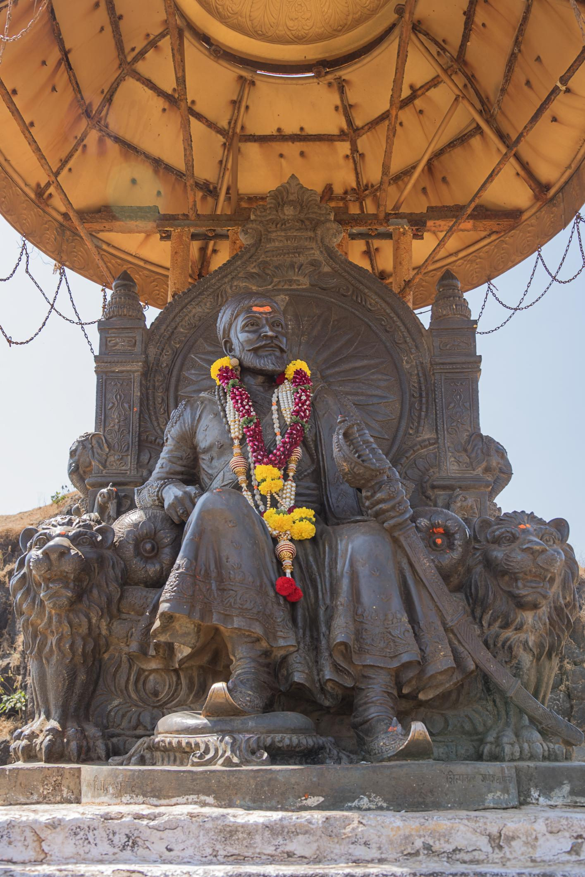
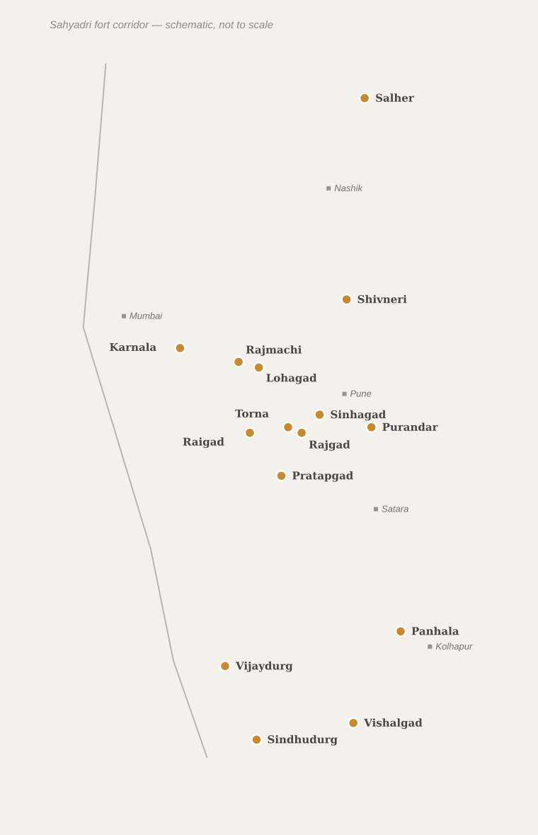
The Fifteen Forts on the Map
Approximate locations across the Sahyadri (Western Ghats) corridor of Maharashtra
● Fort location ■ Reference city
Most forts cluster along the Sahyadri hill belt between Nashik and Kolhapur, with Sindhudurg and Vijaydurg guarding the Konkan coast further west and Salher marking the northern frontier near Baglan.
Overview map
2

Slide 4
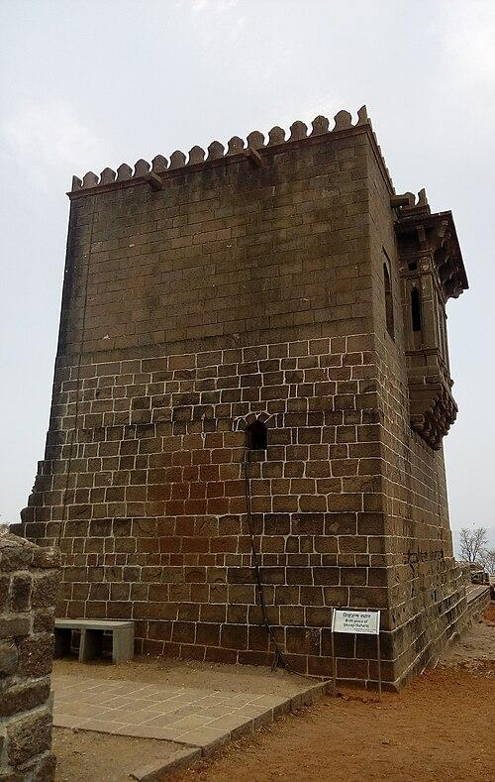
Shivneri Fort
Hill fort
Junnar Fort • Junnar, Pune District, Maharashtra
■ HISTORY
Ancient hill fort, likely raised under the Yadavas of Devagiri
Later held by the Bahmani Sultanate, then the Nizamshahi (Ahmadnagar) kingdom
Shivaji's grandfather Maloji Bhosale served as a Nizamshahi jagirdar here
SHIVAJI MAHARAJ'S ASSOCIATION
Associated with Shivaji from his birth in 1630; remained under Mughal / Bijapur control for most of his later life
■ ROLE IN SHIVAJI'S SWARAJYA
Birthplace of Chhatrapati Shivaji Maharaj (19 Feb 1630)
Sheltered Jijabai and infant Shivaji during a turbulent political period
Revered as the symbolic starting point of Swarajya, though not a later military conquest of Shivaji
■ KEY EVENTS
1630 Birth of Shivaji Maharaj
1637 Fort passed from Nizamshahi rule to the Mughals
1673 Brief, unsuccessful Maratha attempt to retake the fort
Shivneri Fort (1/2)
3

Slide 5
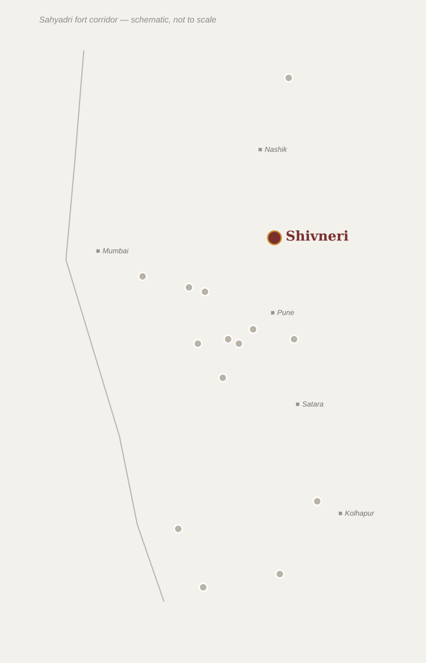
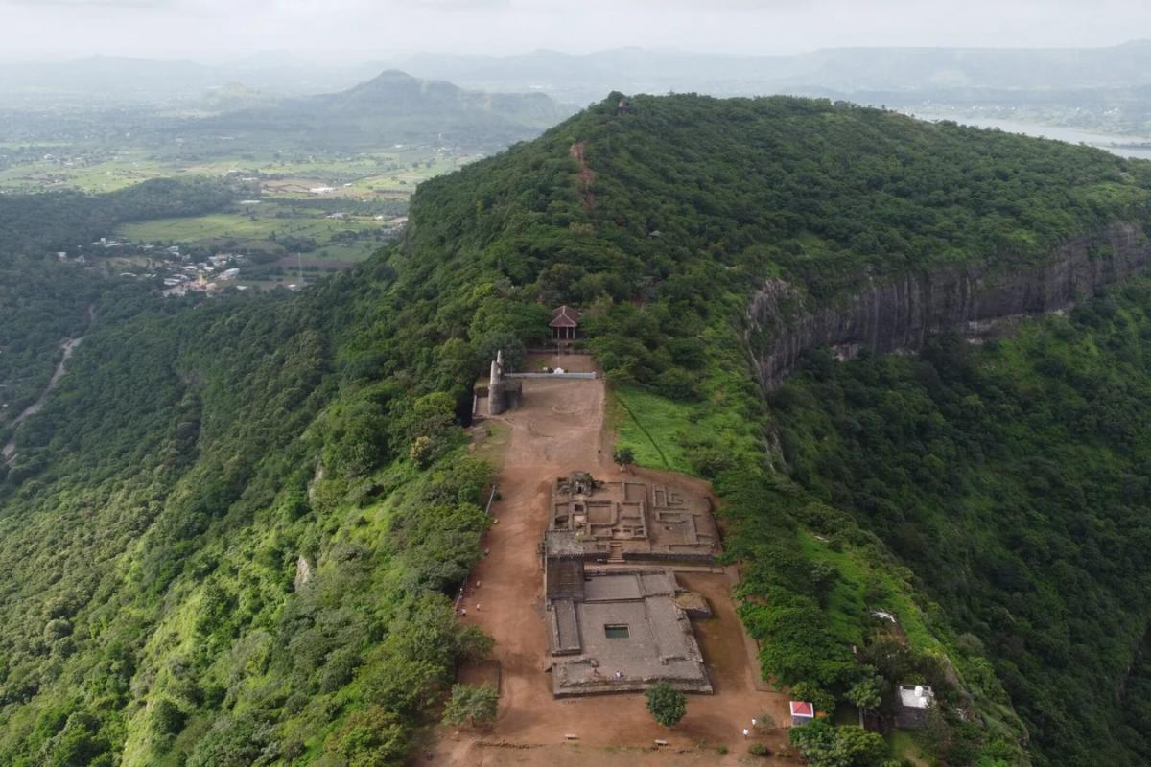
Shivneri Fort
Hill fort
Architecture, Location & Legacy
■ ARCHITECTURAL FEATURES
Seven consecutive fortified gates along a winding entry path
Shivai Devi temple, after whom Shivaji was named
Badami Talav — almond-shaped stepped water tank
Ganga & Jamuna springs, said to have provided water at Shivaji’s birth
Small birth-chamber shrine (Shivkunj) on the upper plateau
Location within Maharashtra
▢ SUGGESTED PHOTOGRAPHS
DID YOU KNOW?
The fort is built on a spur shaped like a shark’s fin, with seven gates designed so that no two are visible to each other at once — a defence against sudden storming.
▢ Add photo:
Main entrance & stepped gateways
▢ Add photo:
Shivai Devi temple
▢ Add photo:
Badami Talav water tank
▢ Add photo:
Panoramic view from the plateau
Shivneri Fort (2/2)
4

Slide 6
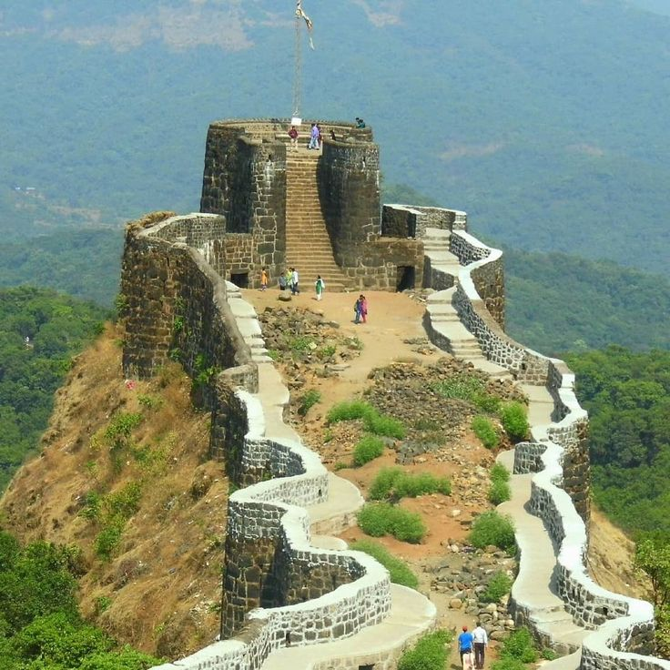
Torna Fort
Hill fort
Prachandagad • Velhe, Pune District, Maharashtra
■ HISTORY
SHIVAJI MAHARAJ'S ASSOCIATION
1646 onward — Shivaji’s first conquest and an early anchor of Swarajya
An old hill fort referenced in Deccan records from at least the 13th–14th century
Passed through Bahmani, Nizamshahi and Adilshahi (Bijapur) control before 1646
■ ROLE IN SHIVAJI'S SWARAJYA
The first fort captured by a teenage Shivaji Maharaj in 1646, traditionally marking the start of Swarajya
Its rugged, near-inaccessible ridge made it a natural stronghold guarding the routes toward Rajgad and the Konkan
Treasure reportedly recovered here helped finance new construction at nearby Rajgad
■ KEY EVENTS
1646 Captured by Shivaji Maharaj; renamed Prachandagad
1704 Besieged and taken by Mughal forces under Aurangzeb
1705 Recaptured by the Marathas
Torna Fort (1/2)
5

Slide 7
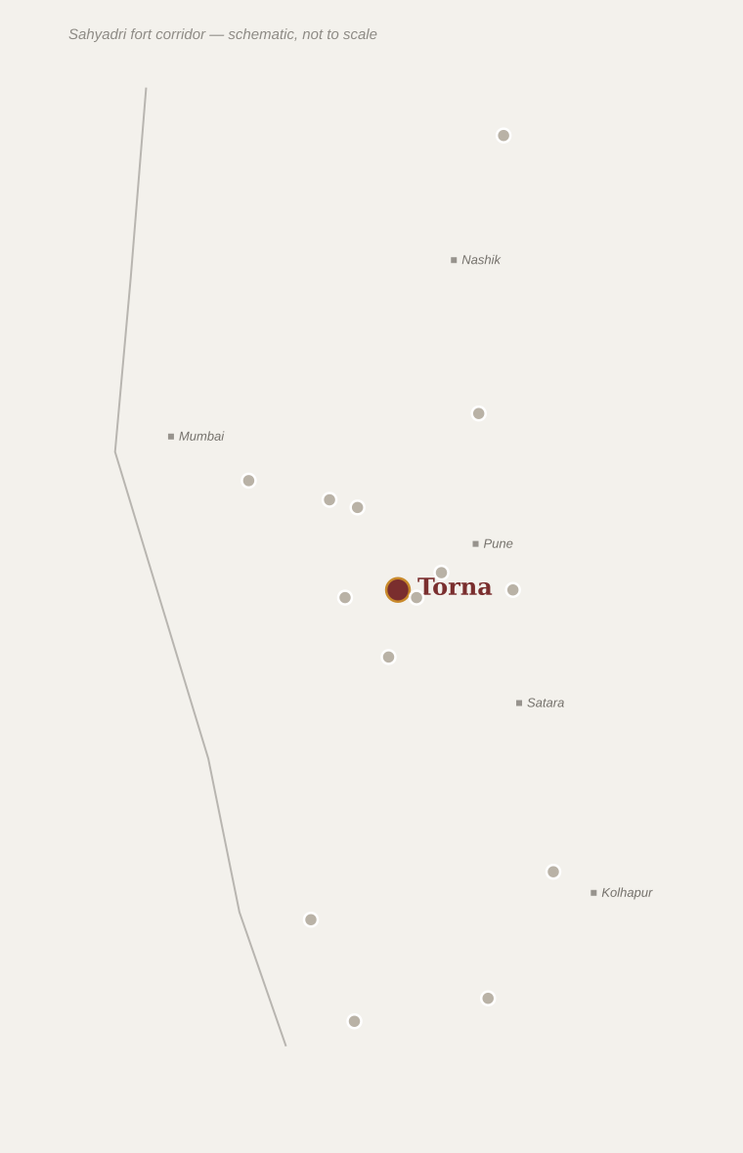
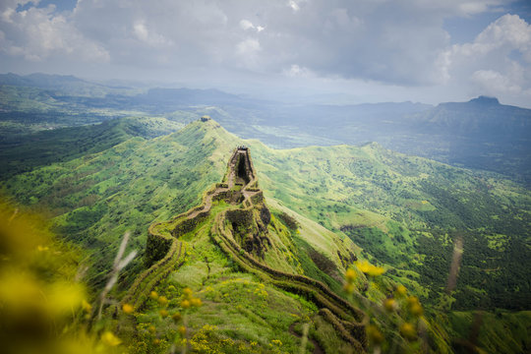
Torna Fort
Hill fort
Architecture, Location & Legacy
■ ARCHITECTURAL FEATURES
Massive walls following the natural rock contours of the ridge
Budhla Machi and Zunjar Machi — fortified spur bastions on either flank
Menghai Devi temple near the fort entrance
Kothi Darwaza and ruined granary structures
▢ SUGGESTED PHOTOGRAPHS
Location within Maharashtra
▢ Add photo:
Approach ridge & fortification walls
▢ Add photo:
Zunjar Machi bastion
DID YOU KNOW?
Local tradition holds that Shivaji found a hoard of gold coins during the fort’s repair, which he used to help build Rajgad nearby.
▢ Add photo:
Menghai Devi temple
▢ Add photo:
View toward Rajgad
Torna Fort (2/2)
6

Slide 8
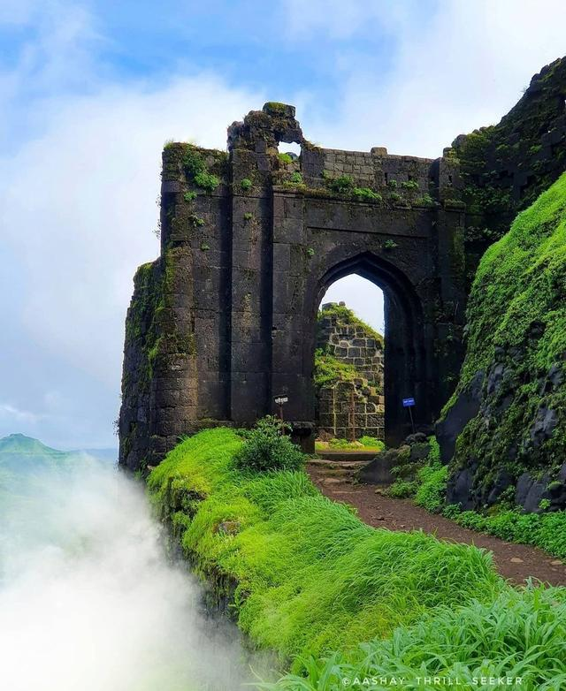
Rajgad Fort
Hill fort
Murumdev (earlier name) • Gunjavane, Pune District, Maharashtra
■ HISTORY
SHIVAJI MAHARAJ'S ASSOCIATION
c.1645–1674 — capital of Swarajya before the shift to Raigad
Originally a modest hill fort called Murumdev under Bahmani and later Adilshahi control
Taken over and greatly strengthened after Shivaji secured the region in the mid-1640s
■ ROLE IN SHIVAJI'S SWARAJYA
Served as the capital of Swarajya for about 26 years (c.1645–1674)
Functioned as Shivaji’s main administrative, military and family residence before Raigad
Its three fortified spurs (machis) allowed defence in depth and control of surrounding passes
■ KEY EVENTS
c.1645 Established as the capital of Swarajya
1662 Sanjeevani Machi fortifications strengthened
1674 Jijabai (Shivaji’s mother) passes away here shortly after his coronation
Rajgad Fort (1/2)
7

Slide 9
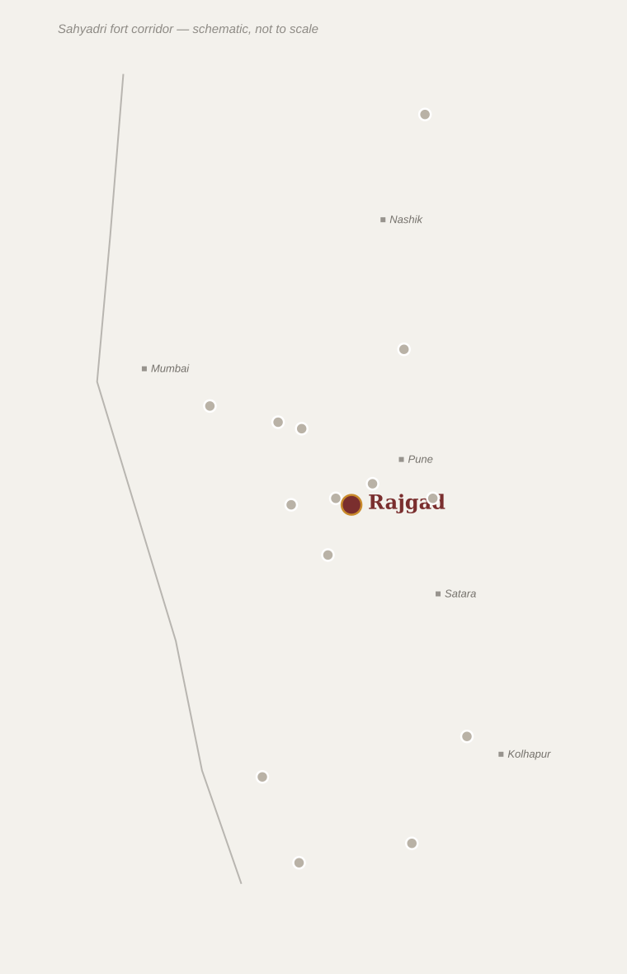
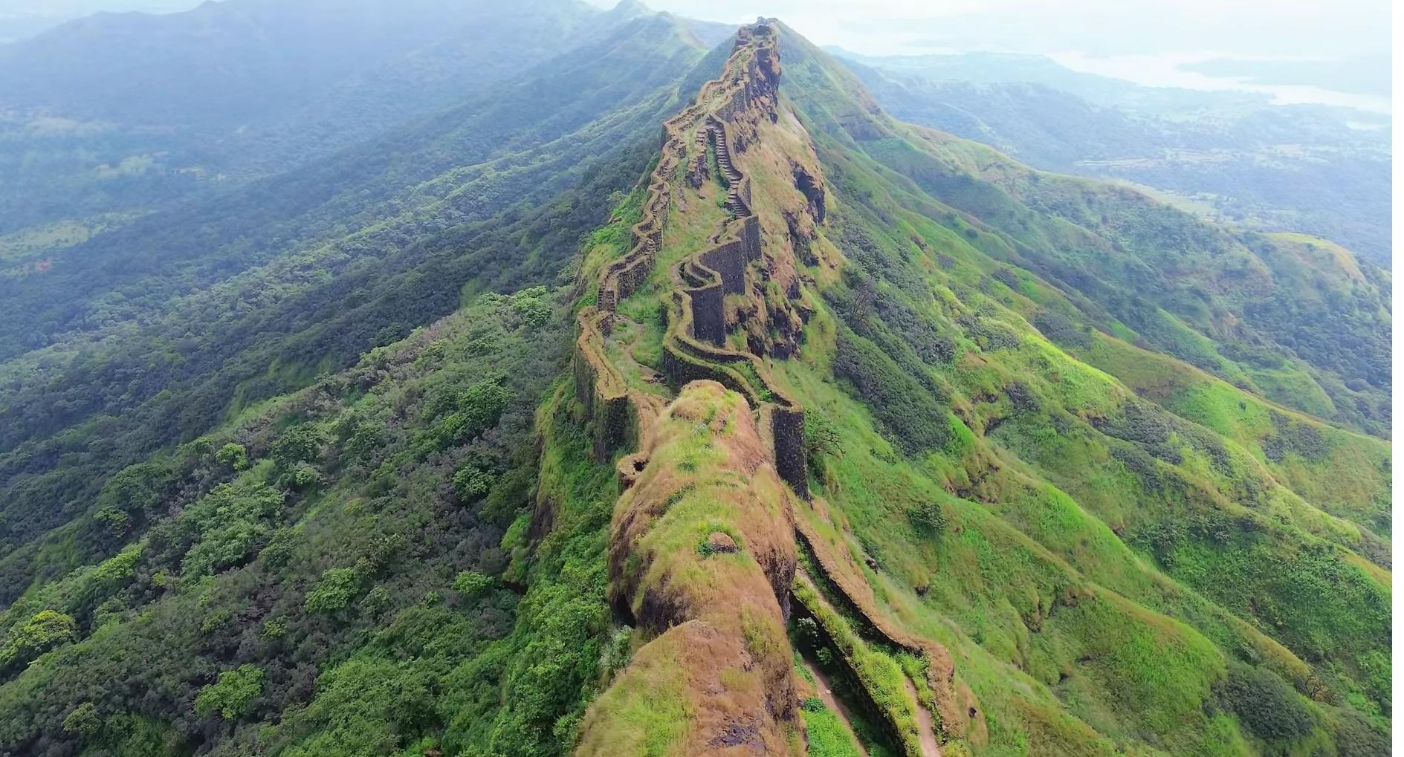
Rajgad Fort
Hill fort
Architecture, Location & Legacy
■ ARCHITECTURAL FEATURES
Three machis — Padmavati, Sanjeevani and Suvela — radiating from the central citadel
Balekilla (royal citadel) on the summit with palace foundations
Padmavati temple and royal granaries
Chor Darwaza — a concealed escape gate
Extensive stepped water cisterns cut into rock
Location within Maharashtra
▢ SUGGESTED PHOTOGRAPHS
DID YOU KNOW?
Rajgad remained Shivaji’s primary base for nearly three decades — longer than any other fort — earning it the title "Raja-gad", the King of Forts.
▢ Add photo:
Balekilla citadel walls
▢ Add photo:
Padmavati Machi & temple
▢ Add photo:
Suvela Machi ridge
▢ Add photo:
Panoramic view of the three machis
Rajgad Fort (2/2)
8

Slide 10
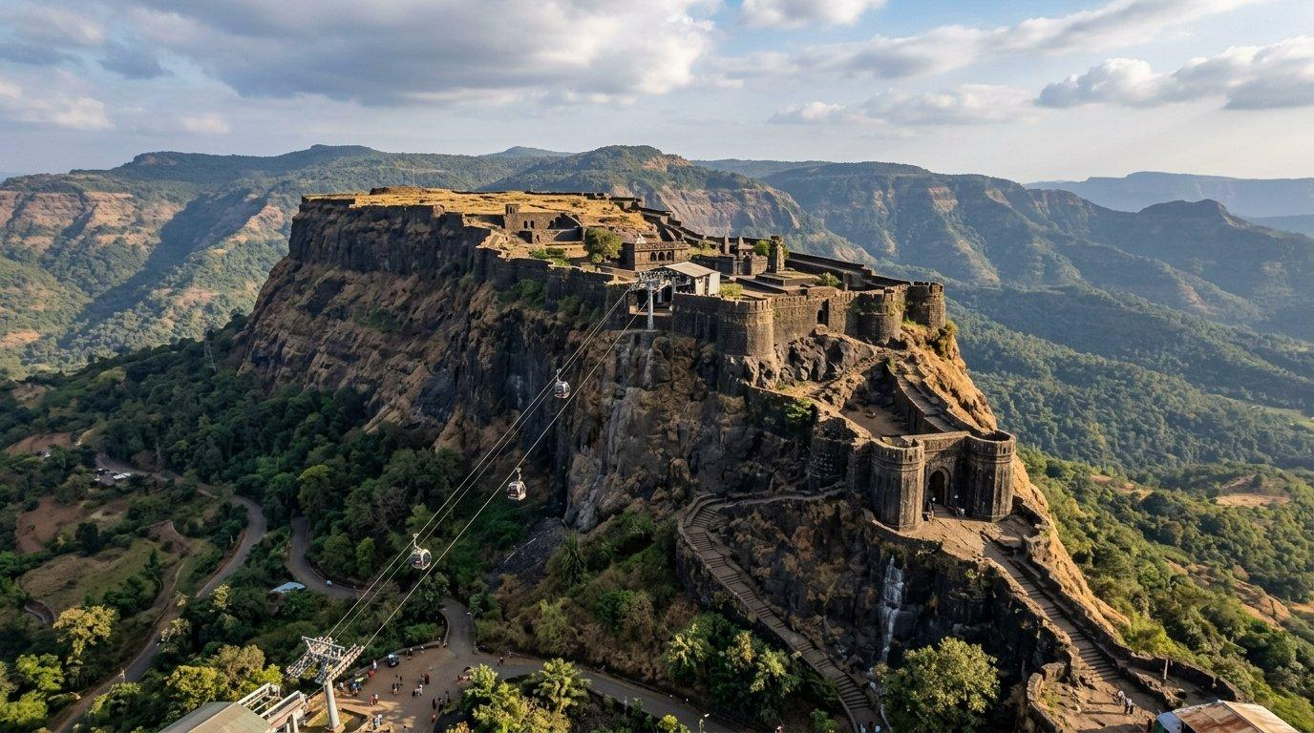
Raigad Fort
Hill fort
Rairi (earlier name) • Mahad, Raigad District, Maharashtra
■ HISTORY
SHIVAJI MAHARAJ'S ASSOCIATION
1656 capture; capital of Swarajya from 1674 until 1689
Originally a smaller fort called Rairi, held by the local chieftain Chandrarao More
Annexed by Shivaji Maharaj in 1656 after the defeat of the More family
■ ROLE IN SHIVAJI'S SWARAJYA
Rebuilt and declared the new capital of Swarajya in 1674 for its central, defensible location
Site of Shivaji Maharaj’s formal coronation as Chhatrapati on 6 June 1674
Housed the royal court, mint, treasury and administration of the growing Maratha state
■ KEY EVENTS
1656 Captured by Shivaji Maharaj
1674 Coronation of Shivaji as Chhatrapati; declared capital
1680 Death of Shivaji Maharaj at Raigad
1689 Fort falls to Mughal forces after a prolonged siege
Raigad Fort (1/2)
9

Slide 11
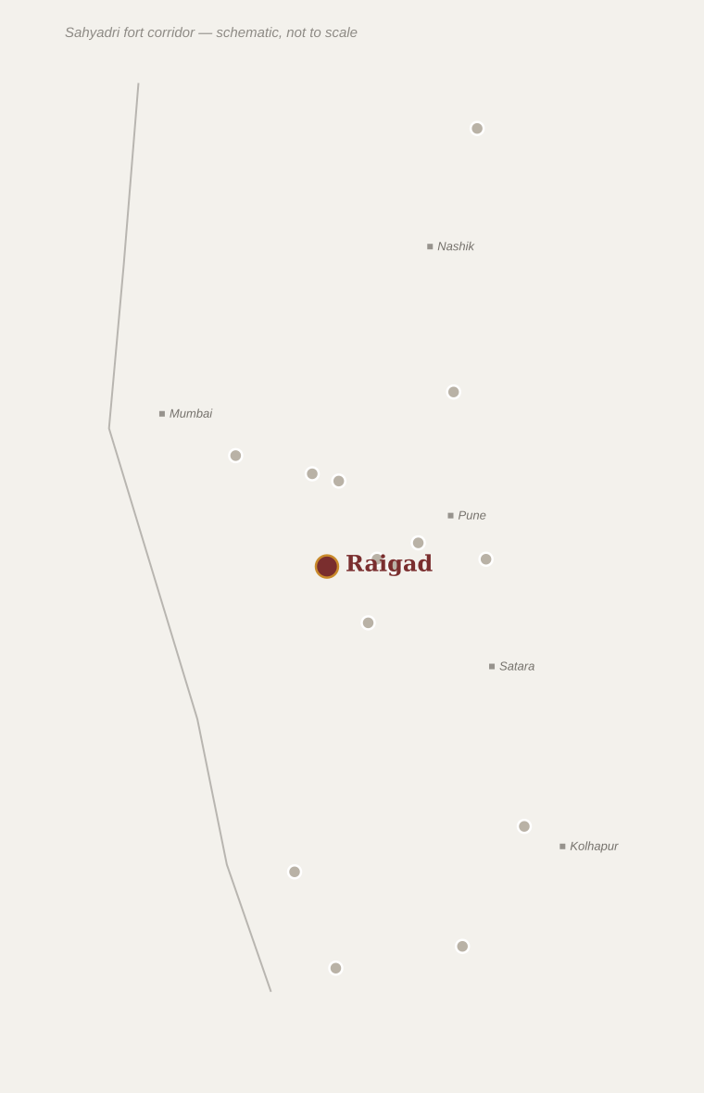
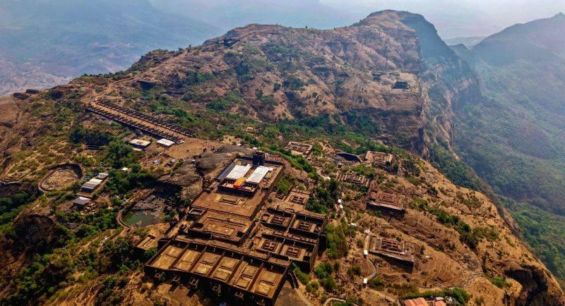
Raigad Fort
Hill fort
Architecture, Location & Legacy
■ ARCHITECTURAL FEATURES
Maha Darwaza (main gate) and the imposing Hirakani Buruj bastion
Raja Sabha — the coronation hall with the royal throne platform
Bazarpeth — a fortified market street lined with shop foundations
Ganga Sagar Lake, Jagdishwar temple, and Shivaji Maharaj’s samadhi (memorial)
Nagarkhana (drum-house) gate structure
Location within Maharashtra
▢ SUGGESTED PHOTOGRAPHS
DID YOU KNOW?
British traveller descriptions likened Raigad’s approach — a single narrow stairway of over 1,700 steps — to a natural fortress gate that made the summit nearly impregnable.
▢ Add photo:
Maha Darwaza main gate
▢ Add photo:
Raja Sabha coronation hall
▢ Add photo:
Hirakani Buruj bastion
▢ Add photo:
Shivaji Maharaj’s samadhi
Raigad Fort (2/2)
10

Slide 12
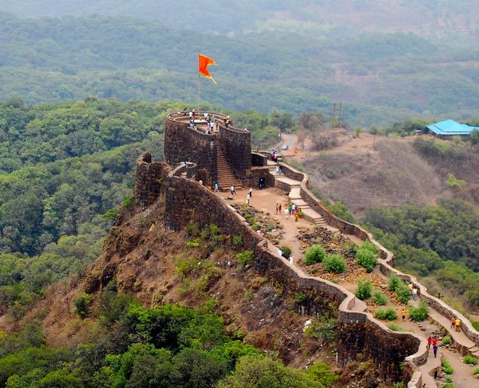
Pratapgad Fort
Hill fort
Near Mahabaleshwar, Satara District, Maharashtra
■ HISTORY
SHIVAJI MAHARAJ'S ASSOCIATION
Built c.1656; site of the pivotal 1659 encounter with Afzal Khan
Unlike most forts on this list, Pratapgad was newly built rather than captured
Constructed around 1656 on Shivaji’s orders, supervised by Moropant Pingle, to guard the Par Ghat pass
■ ROLE IN SHIVAJI'S SWARAJYA
Built specifically to secure a strategic Konkan-facing mountain pass
Became the stage for the decisive meeting between Shivaji Maharaj and the Bijapur general Afzal Khan
The resulting Maratha victory broke Bijapur’s military threat and dramatically boosted Swarajya’s standing
■ KEY EVENTS
1656 Fort construction completed
10 Nov 1659 Shivaji Maharaj kills Afzal Khan in their fortified meeting; Maratha forces rout the Bijapur army
Pratapgad Fort (1/2)
11

Slide 13
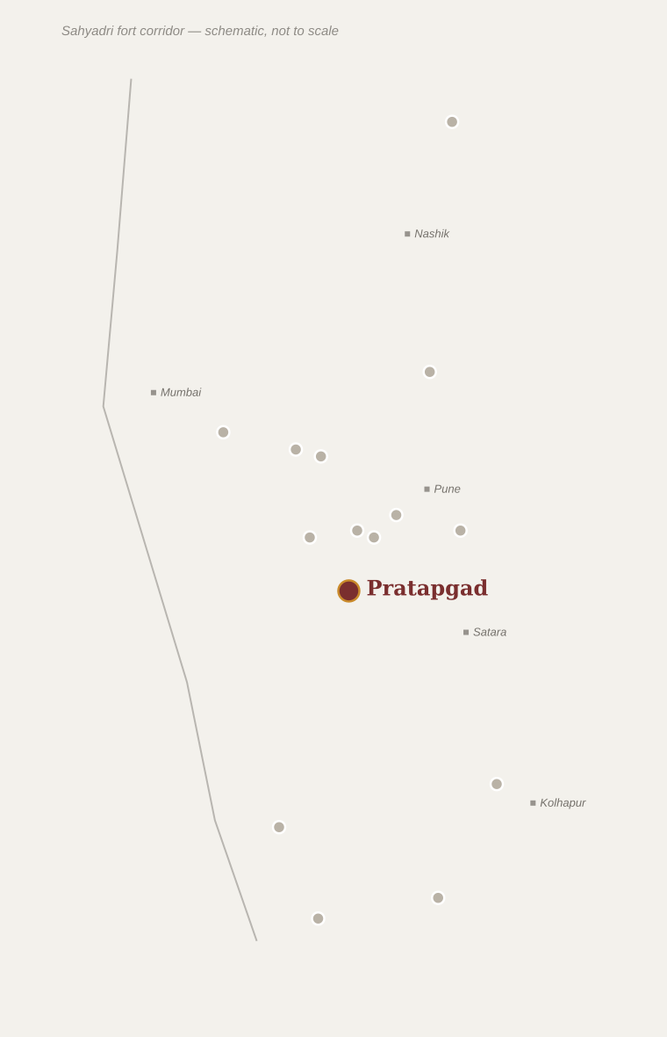
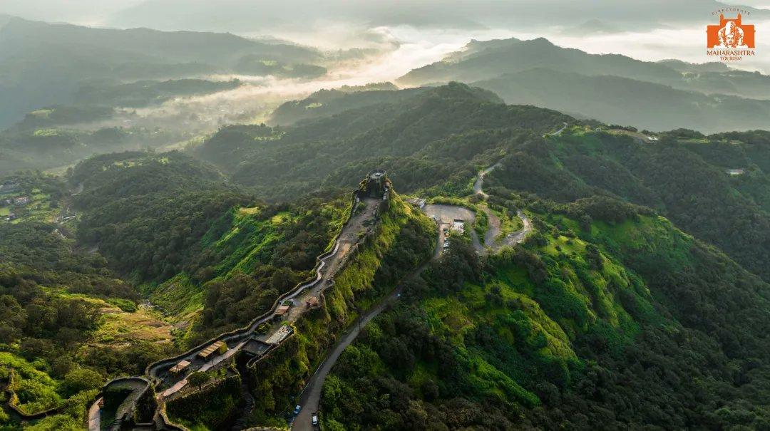
Pratapgad Fort
Hill fort
Architecture, Location & Legacy
■ ARCHITECTURAL FEATURES
Distinct upper fort (Balekilla) and lower fort connected by fortified paths
Bhavani Mandir, where Shivaji is said to have installed a Bhavani idol before the battle
Afzal Khan’s tomb at the base of the fort
Strong bastions with commanding views over the Konkan lowlands
▢ SUGGESTED PHOTOGRAPHS
Location within Maharashtra
▢ Add photo:
Upper fort (Balekilla) ramparts
▢ Add photo:
Bhavani Mandir
DID YOU KNOW?
The steel "wagh nakh" (tiger claws) associated with the Afzal Khan encounter remain one of the most famous artefacts in Maratha popular memory.
▢ Add photo:
View over the Konkan escarpment
▢ Add photo:
Fortification walls & bastions
Pratapgad Fort (2/2)
12

Slide 14
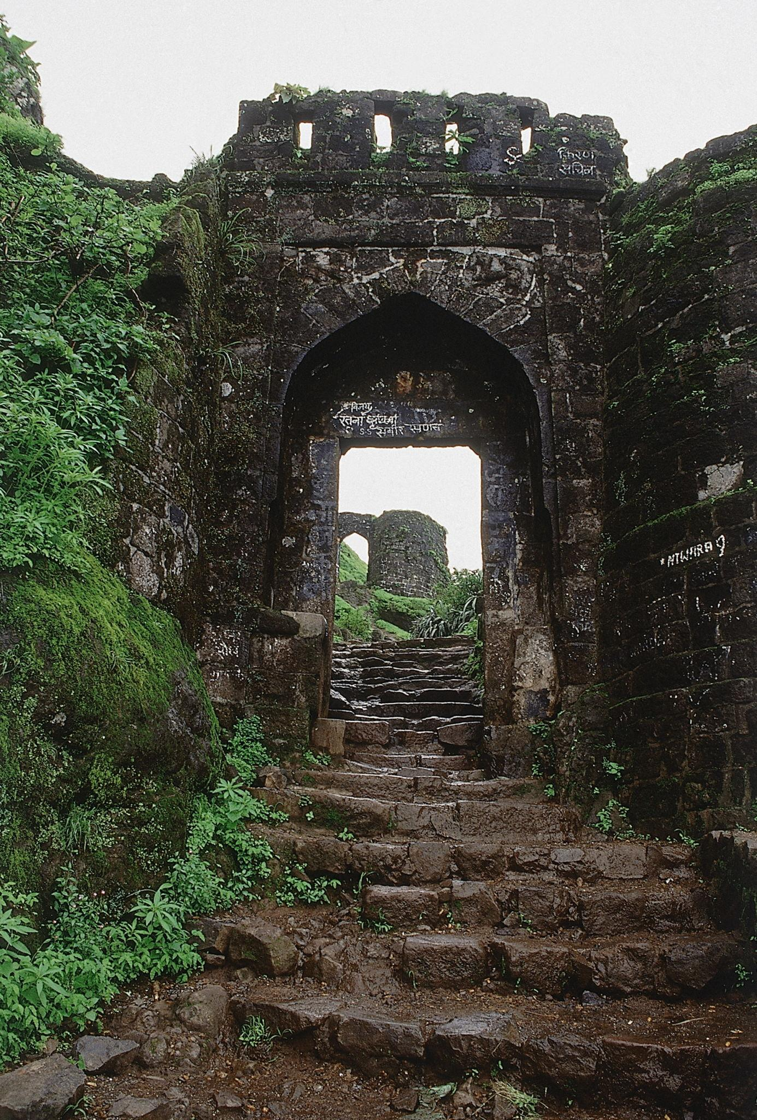
Sinhagad Fort
Hill fort
Kondhana (earlier name) • Near Pune city, Maharashtra
■ HISTORY
An ancient fort known as Kondhana, held successively by Bahmani and Adilshahi (Bijapur) rulers
Ceded to the Mughals under the 1665 Treaty of Purandar
■ ROLE IN SHIVAJI'S SWARAJYA
Recaptured in a daring night assault on 4 February 1670 led by Tanaji Malusare, using rope-and-lizard climbing techniques on a sheer cliff face
Tanaji was killed in the fierce fighting; the fort was renamed Sinhagad ("Lion’s Fort") in his honour
Its recapture symbolised the Maratha resurgence after the setbacks of 1665
■ KEY EVENTS
1665 Ceded to the Mughals under the Treaty of Purandar
4 Feb 1670 Battle of Sinhagad — Tanaji Malusare recaptures the fort and dies in battle
SHIVAJI MAHARAJ'S ASSOCIATION
Recaptured in 1670; held by the Marathas thereafter
Sinhagad Fort (1/2)
13

Slide 15
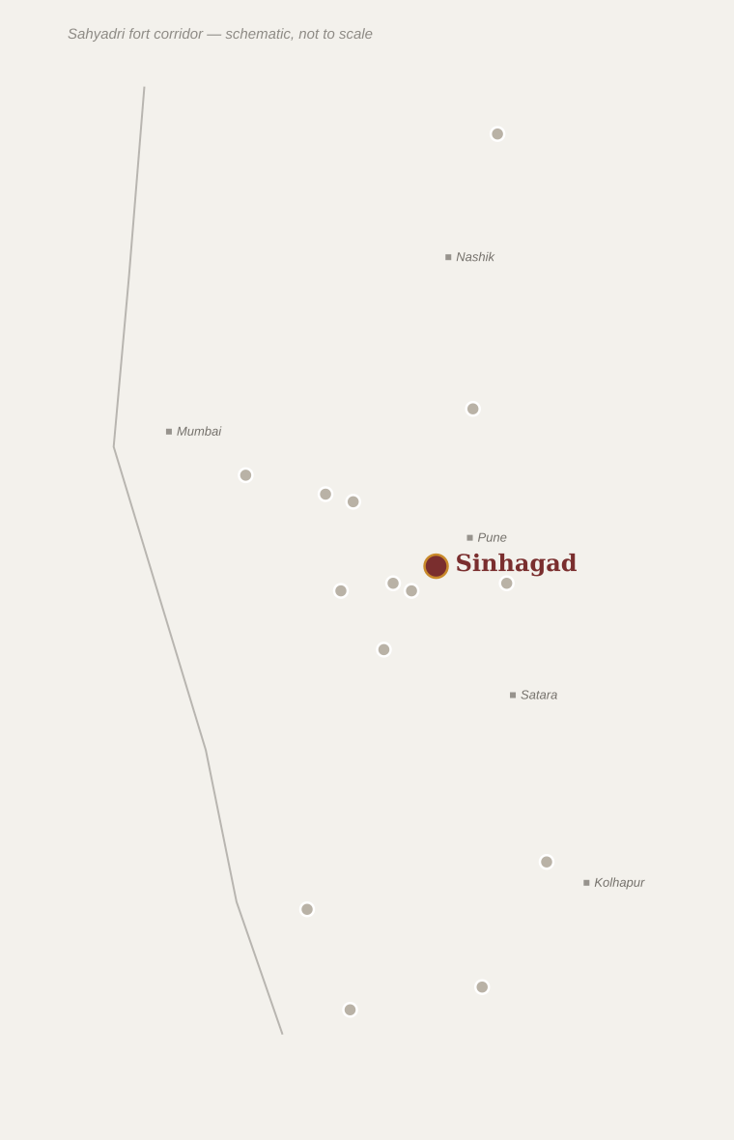
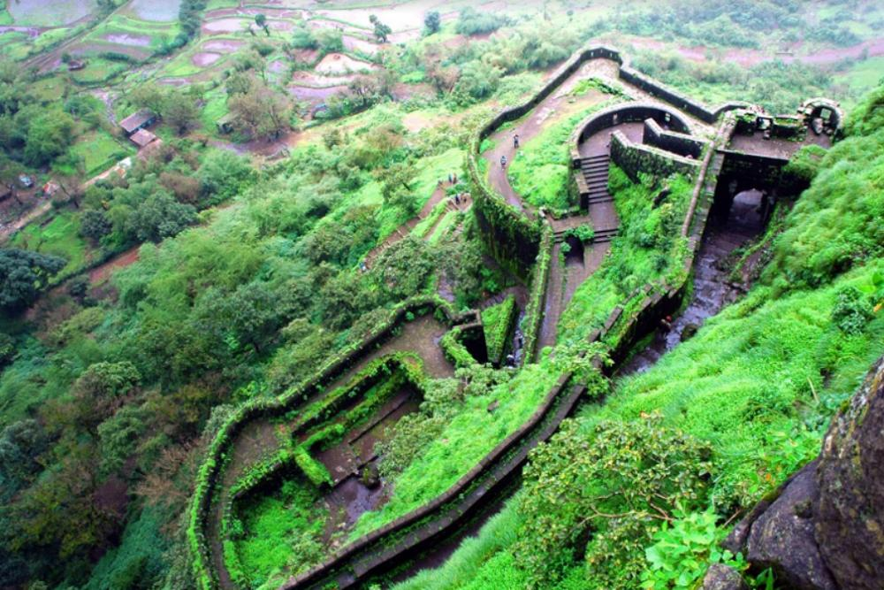
Sinhagad Fort
Hill fort
Architecture, Location & Legacy
■ ARCHITECTURAL FEATURES
Kalyan Darwaza and Pune Darwaza — the fort’s two main gates
Tanaji Malusare’s memorial near the point of assault
Amruteshwar temple and Dev Tak water tank
Zunjar Buruj bastion with sheer rock-face defences
▢ SUGGESTED PHOTOGRAPHS
Location within Maharashtra
▢ Add photo:
Kalyan Darwaza gate
▢ Add photo:
Tanaji Malusare memorial
DID YOU KNOW?
Shivaji Maharaj is said to have remarked on hearing of Tanaji's death, "Gad ala pan Sinha gela" — "The fort is won, but the lion is lost."
▢ Add photo:
Zunjar Buruj cliff bastion
▢ Add photo:
Panoramic view near Pune
Sinhagad Fort (2/2)
14

Slide 16
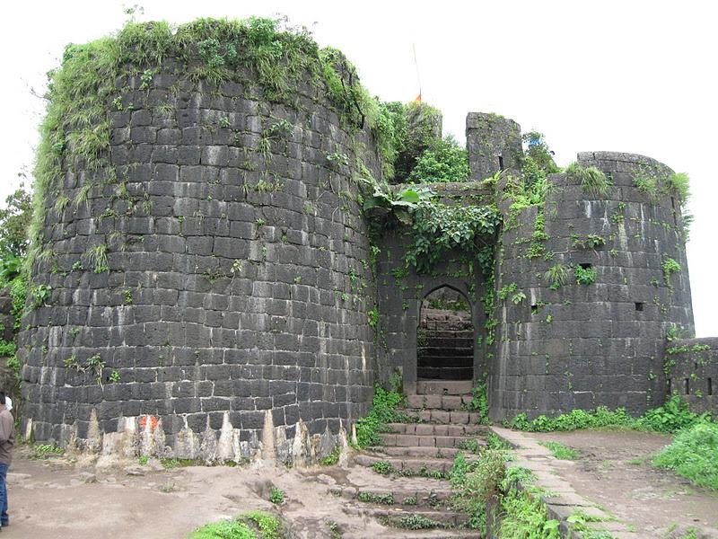
Purandar Fort
Hill fort
Twin fort with Vajragad • Saswad, Purandar Taluka, Pune District, Maharashtra
■ HISTORY
■ KEY EVENTS
An ancient fort with roots in Bahmani, Nizamshahi and Adilshahi rule before coming under Shivaji’s control in the late 1640s
Twin-fortified with the adjoining Vajragad on the same ridge
1657 Birth of Sambhaji, Shivaji’s son and successor
1665 Siege of Purandar and the Treaty of Purandar with Mirza Raja Jai Singh
1670 Recaptured by the Marathas
■ ROLE IN SHIVAJI'S SWARAJYA
Served as an important early military base and treasury for Swarajya
Site of the fierce 1665 siege where commander Murarbaji Deshpande died defending the fort against Mirza Raja Jai Singh
The resulting Treaty of Purandar (1665) forced Shivaji to cede 23 forts to the Mughals, but preserved the core of Swarajya
SHIVAJI MAHARAJ'S ASSOCIATION
Under Maratha control from the late 1640s; briefly ceded in 1665, recovered in 1670
Purandar Fort (1/2)
15

Slide 17
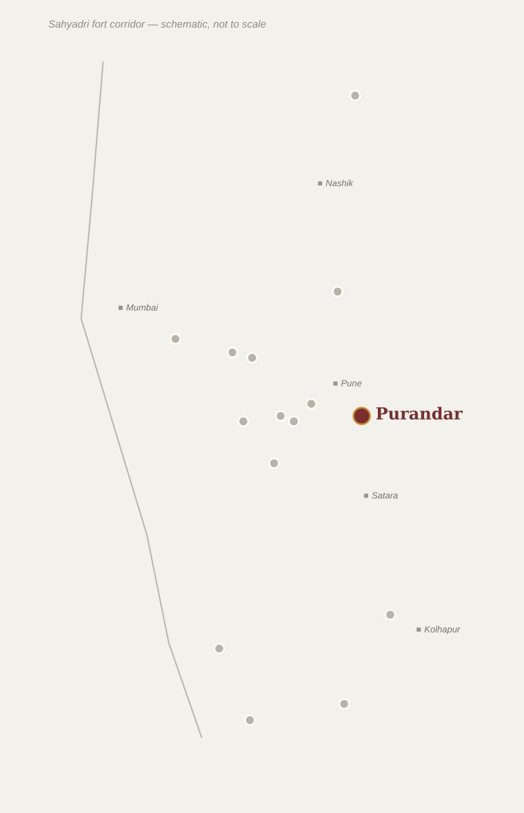
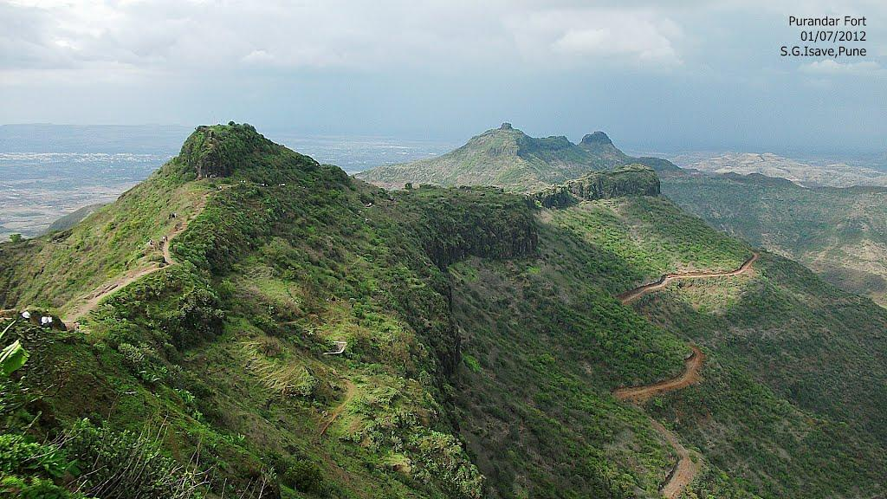
Purandar Fort
Hill fort
Architecture, Location & Legacy
■ ARCHITECTURAL FEATURES
Twin summits of Purandar and Vajragad linked by a fortified saddle
Bini Darwaza and Delhi Darwaza gates with deep dry moats
Kedareshwar temple on the upper plateau
Ruins of administrative buildings and water cisterns
▢ SUGGESTED PHOTOGRAPHS
Location within Maharashtra
▢ Add photo:
Bini Darwaza gate
▢ Add photo:
Kedareshwar temple
DID YOU KNOW?
The 1665 Treaty of Purandar was the only formal treaty Shivaji ever signed with the Mughals — and he began reversing its terms within five years.
▢ Add photo:
View of Vajragad from Purandar
▢ Add photo:
Fortification walls & moat
Purandar Fort (2/2)
16

Slide 18
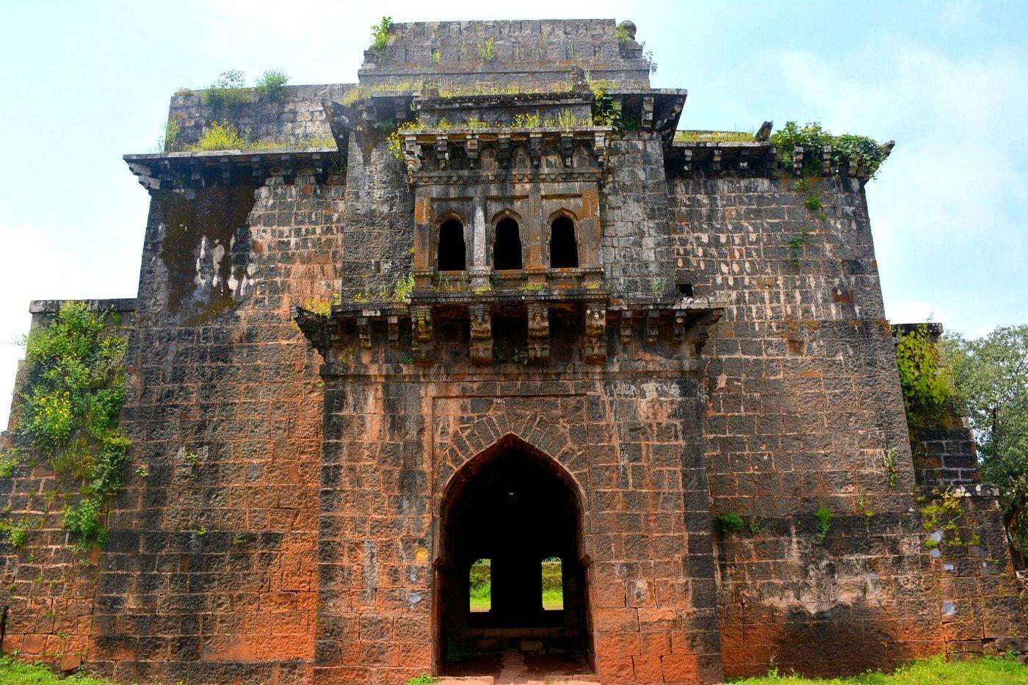
Panhala Fort
Hill fort
Panhalgad • Near Kolhapur city, Maharashtra
■ HISTORY
Built by the Shilahara king Bhoja II in the 12th century
Later held by the Bahmani Sultanate and then the Adilshahi (Bijapur) kingdom
One of the largest hill forts in the Deccan by area
SHIVAJI MAHARAJ'S ASSOCIATION
1659 capture; contested through 1660s, secured firmly by 1673
■ ROLE IN SHIVAJI'S SWARAJYA
Captured by Shivaji Maharaj in 1659, extending Swarajya into the Kolhapur region
Besieged by the Bijapur general Siddi Jauhar in 1660, trapping Shivaji inside for months
Scene of Shivaji’s celebrated night escape to Vishalgad, covered by Baji Prabhu Deshpande’s rearguard stand
■ KEY EVENTS
1659 Captured by Shivaji Maharaj
1660 Siege of Panhala by Siddi Jauhar; Shivaji’s escape to Vishalgad
1673 Recaptured by the Marathas after a period of Bijapur control
Panhala Fort (1/2)
17

Slide 19
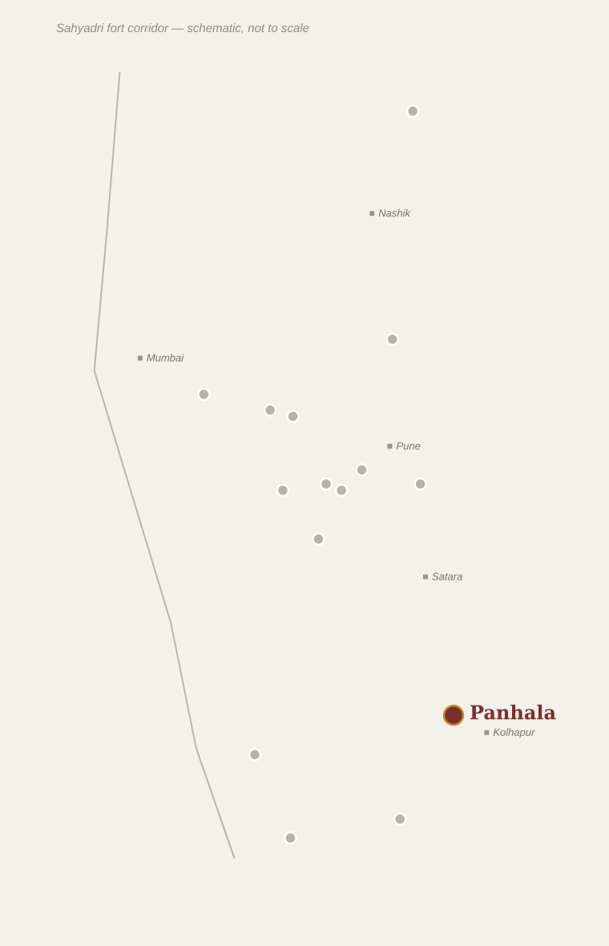
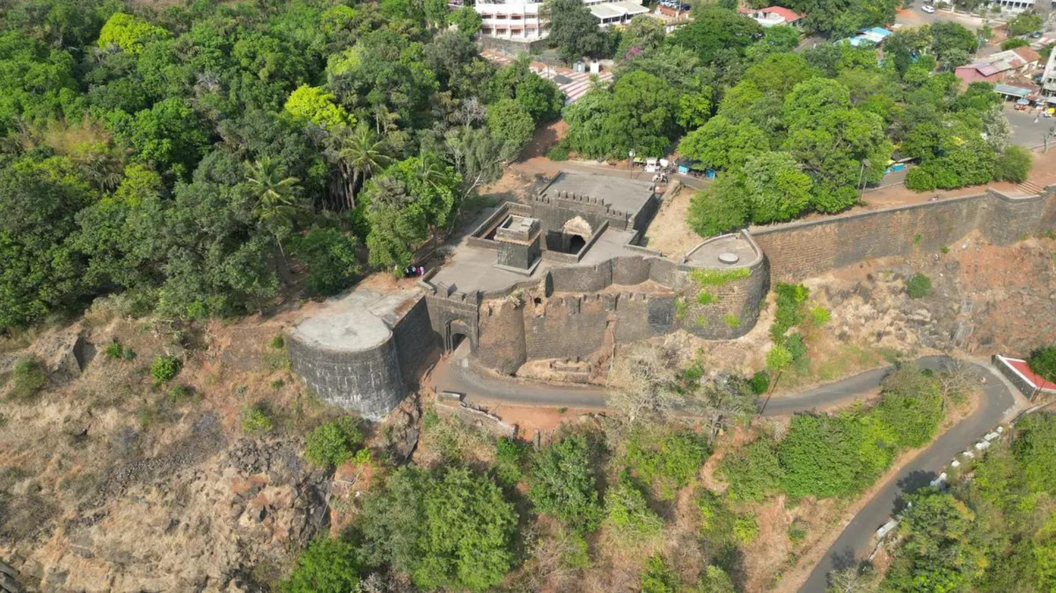
Panhala Fort
Hill fort
Architecture, Location & Legacy
■ ARCHITECTURAL FEATURES
Teen Darwaza — an imposing triple-gated entrance
Ambarkhana — three linked granary structures (Ganga, Jamuna, Saraswati)
Sajja Kothi, traditionally linked to Sambhaji’s later imprisonment
Andhar Bavडी — a concealed stepped well
▢ SUGGESTED PHOTOGRAPHS
Location within Maharashtra
▢ Add photo:
Teen Darwaza triple gate
▢ Add photo:
Ambarkhana granaries
DID YOU KNOW?
Panhala changed hands so often in the 17th century that Maratha chronicles describe it as being "won thrice" by Shivaji and his successors.
▢ Add photo:
Sajja Kothi
▢ Add photo:
Panoramic view over Kolhapur plateau
Panhala Fort (2/2)
18

Slide 20
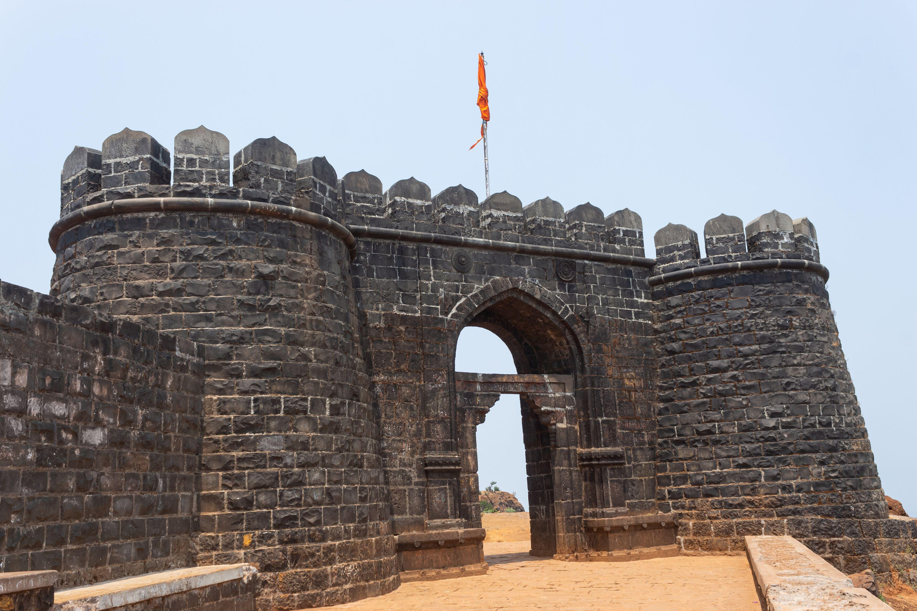
Vishalgad Fort
Hill fort
Khelna (earlier name) • Shahuwadi Taluka, Kolhapur District, Maharashtra
■ HISTORY
SHIVAJI MAHARAJ'S ASSOCIATION
c.1659–60 — closely tied to the Panhala escape
An old fort of Shilahara-Yadava origin, later held by the Adilshahi (Bijapur) kingdom
Came under Maratha control around 1659 as Shivaji expanded through the Kolhapur region
■ ROLE IN SHIVAJI'S SWARAJYA
Destination of Shivaji Maharaj’s escape from the siege of Panhala in 1660
Reached safely only because of the rearguard stand of Baji Prabhu Deshpande and Fuloji at Ghod Khind
The pass was renamed Pavan Khind ("sacred pass") in honour of their sacrifice
■ KEY EVENTS
c.1659 Comes under Maratha control
13 Jul 1660 Battle of Pavan Khind; Shivaji reaches Vishalgad safely
Vishalgad Fort (1/2)
19

Slide 21
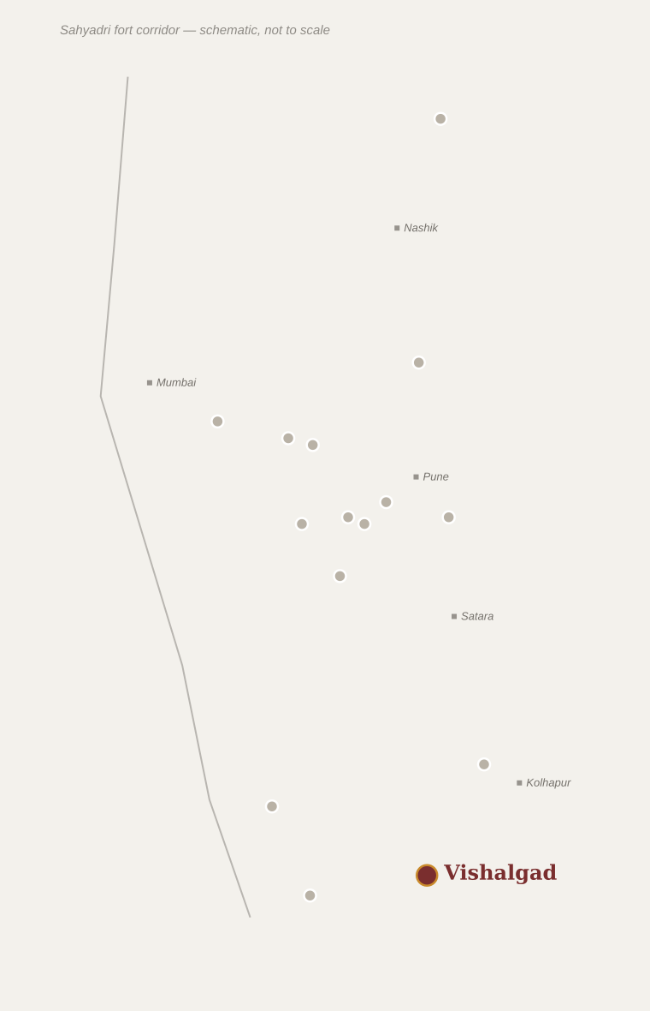
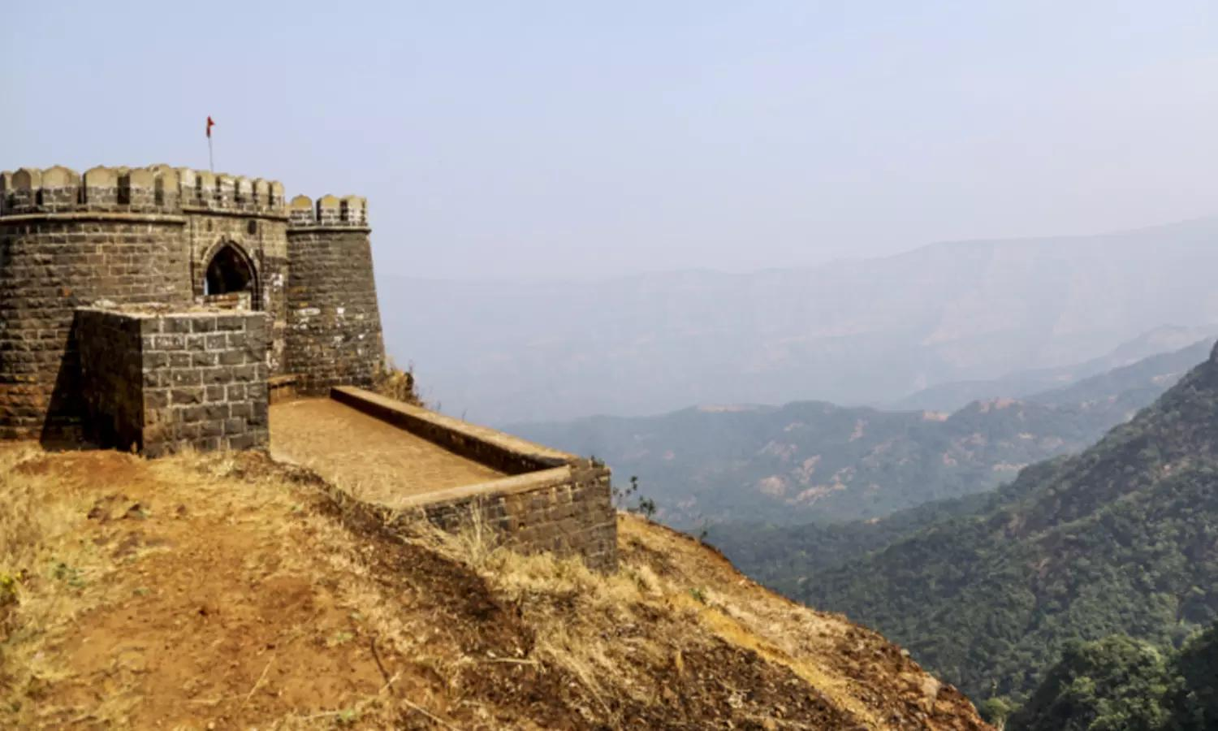
Vishalgad Fort
Hill fort
Architecture, Location & Legacy
■ ARCHITECTURAL FEATURES
Three concentric tiers of fortification following the hill’s contours
Samadhis (memorials) of Baji Prabhu and Fuloji Deshpande near Pavan Khind
Amruteshwar temple on the plateau
Remnants of watchtowers along the ridge
▢ SUGGESTED PHOTOGRAPHS
Location within Maharashtra
▢ Add photo:
Fortification tiers
▢ Add photo:
Pavan Khind pass nearby
DID YOU KNOW?
Baji Prabhu Deshpande reportedly held the narrow pass with a small band of men just long enough to hear the sound of cannon fire confirming Shivaji had reached Vishalgad safely.
▢ Add photo:
Baji Prabhu Deshpande memorial
▢ Add photo:
View across the Sahyadri ridge
Vishalgad Fort (2/2)
20

Slide 22
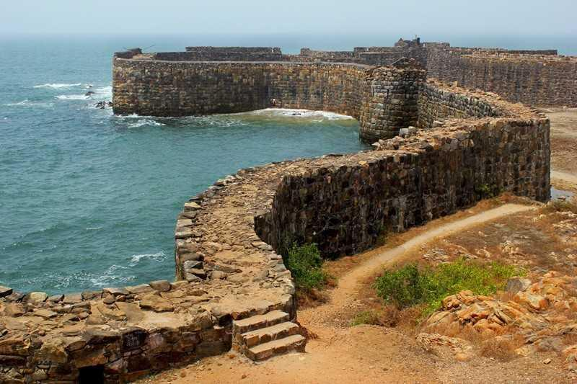
Sindhudurg Fort
Coastal / sea fort
Malvan, Sindhudurg District, Maharashtra
■ HISTORY
SHIVAJI MAHARAJ'S ASSOCIATION
1664–67 — purpose-built as a naval stronghold
Built entirely new on Kurte island by Shivaji Maharaj, with no earlier ruler occupying the site
Construction began around 1664–65, reportedly guided by the architect Hiroji Indulkar
■ ROLE IN SHIVAJI'S SWARAJYA
Anchored Shivaji’s growing naval power along the Konkan coast
Countered the Siddis of Janjira as well as Portuguese and English trading interests
Served as the principal headquarters of the early Maratha navy (Aarmar)
■ KEY EVENTS
1664–67 Fort constructed on Shivaji’s orders
Late 1600s Established as the main base of the Maratha navy
Sindhudurg Fort (1/2)
21

Slide 23
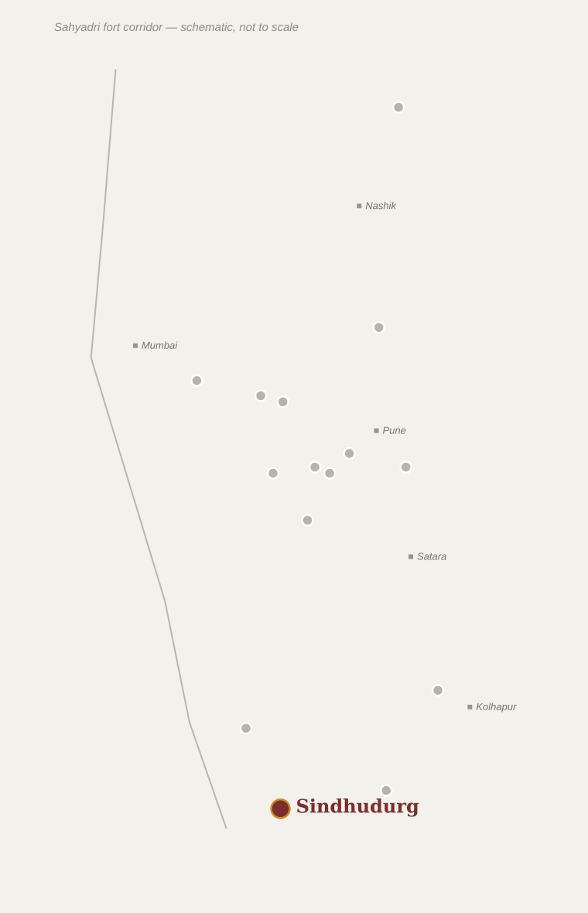
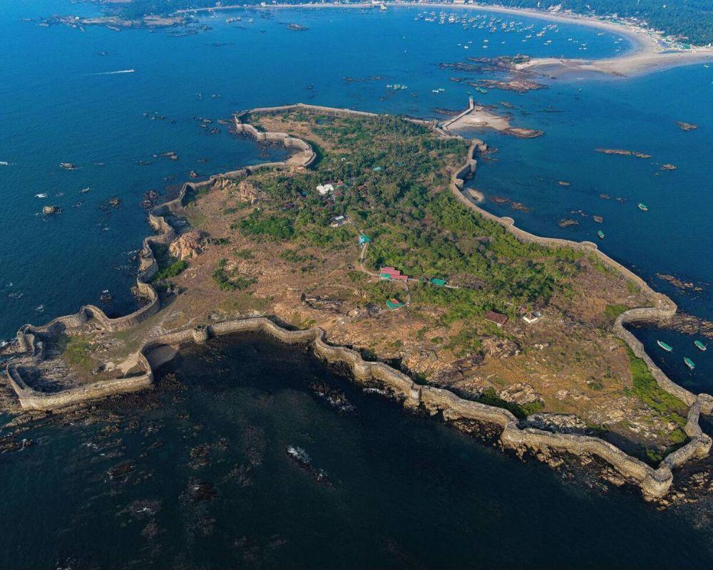
Sindhudurg Fort
Coastal / sea fort
Architecture, Location & Legacy
■ ARCHITECTURAL FEATURES
Roughly 3 km of massive basalt walls, up to 9 m high, with iron-clamped foundations
42 bastions positioned to command the surrounding sea approaches
Freshwater wells that remain sweet despite the surrounding seawater
A shrine said to preserve Shivaji Maharaj’s handprint and footprint
Shri Shivrajeshwar temple, built later by his son Rajaram in his memory
Location within Maharashtra
▢ SUGGESTED PHOTOGRAPHS
DID YOU KNOW?
Local tradition holds that the fort’s foundations were sealed with molten lead to withstand the pounding of the Arabian Sea — an engineering feat unusual for its time.
▢ Add photo:
Sea-facing basalt ramparts
▢ Add photo:
Bastions along the shoreline
▢ Add photo:
Shivrajeshwar temple
▢ Add photo:
Aerial view of the island fort
Sindhudurg Fort (2/2)
22

Slide 24
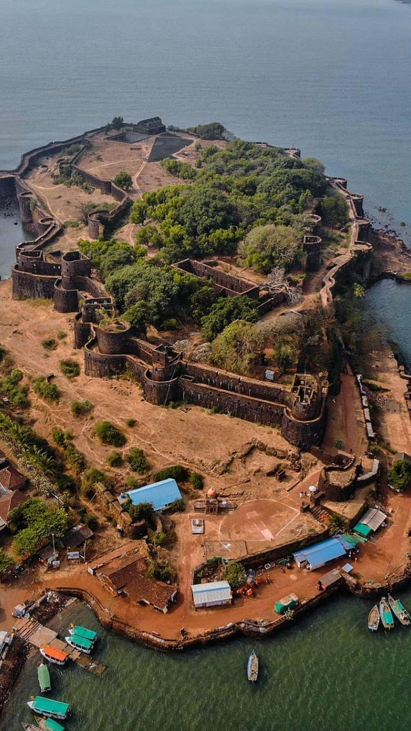
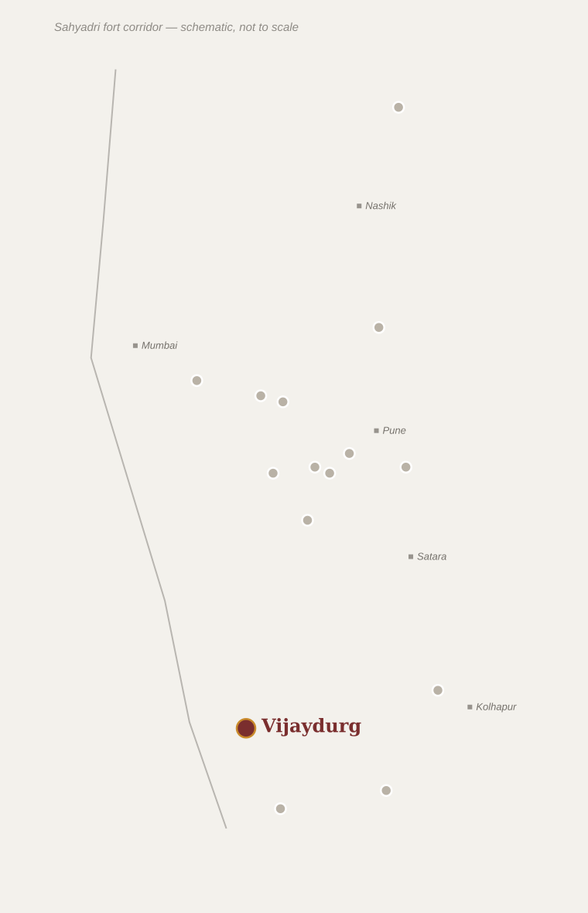
Vijaydurg Fort
Coastal / sea fort
Gheria (earlier name) • Devgad, Sindhudurg District, Maharashtra
■ HISTORY
■ ARCHITECTURE
Originally built by the Shilahara king Bhoja II in the 12th century
Later held by the Adilshahi (Bijapur) kingdom before being taken and greatly expanded by Shivaji Maharaj in the 1650s–60s
Triple line of fortification walls with 27 bastions
A concealed underwater defensive wall along the approach channel
Dockyard facilities for building and repairing war vessels
■ ROLE IN SWARAJYA
A key naval base and shipbuilding yard defending the Konkan coastline
Its innovative submerged stone wall, hidden at high tide, was designed to wreck enemy ships approaching the harbour
SHIVAJI MAHARAJ'S ASSOCIATION
Secured and expanded during the 1650s–1660s
■ KEY EVENT
18th century — Later served as the base of Kanhoji Angre’s Maratha navy against European fleets
DID YOU KNOW?
Vijaydurg’s hidden underwater wall is considered one of the earliest known examples of a purpose-built anti-ship defence in Indian coastal fortification.
Vijaydurg Fort
23

Slide 25
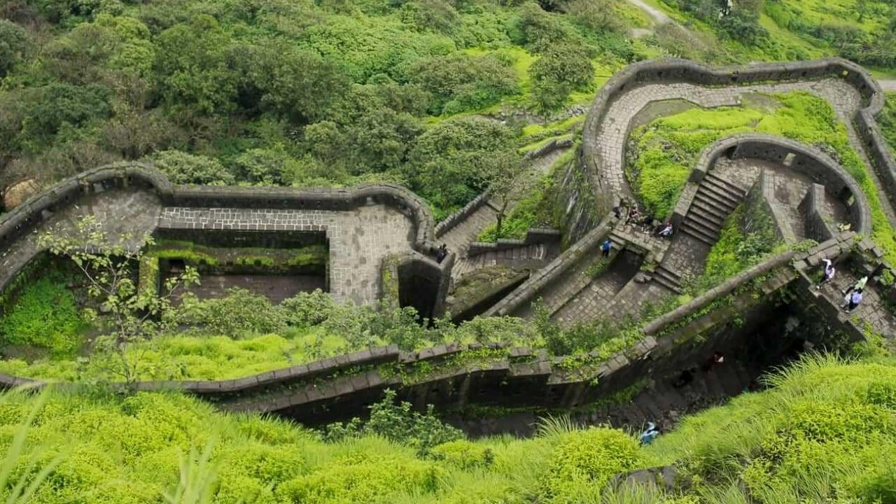
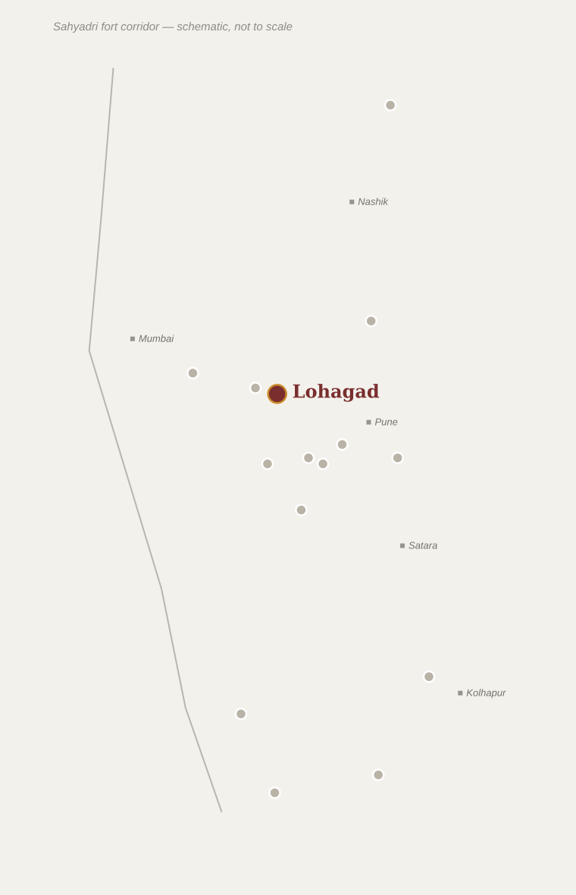
Lohagad Fort
Hill fort
Twin fort with Visapur • Near Lonavala, Pune District, Maharashtra
■ HISTORY
■ ARCHITECTURE
An old fort in the Sahyadri range, passed through Nizamshahi and Adilshahi control
Captured by Shivaji Maharaj in 1648 during the early expansion of Swarajya
Four gateways — Ganesh, Narayan, Hanuman and the Maha Darwaza
Vinchu Kata ("scorpion’s tail") — a narrow rock spur linking Lohagad to Visapur
Rock-cut caves near the fort associated with earlier Buddhist activity in the region
■ ROLE IN SWARAJYA
Briefly ceded to the Mughals under the 1665 Treaty of Purandar, then recaptured in 1670
Reportedly used to store treasure brought back from the 1664 raid on Surat
Its connection to Visapur fort via the narrow "Vinchu Kata" ridge gave it strong natural defence
SHIVAJI MAHARAJ'S ASSOCIATION
1648 onward, with a 1665–70 Mughal interlude
■ KEY EVENT
1670 — Recaptured by the Marathas; used to store Surat treasure
DID YOU KNOW?
The narrow, precipice-edged "Vinchu Kata" ridge connecting Lohagad to Visapur is one of the most photographed trekking routes in the Sahyadris today.
Lohagad Fort
24

Slide 26
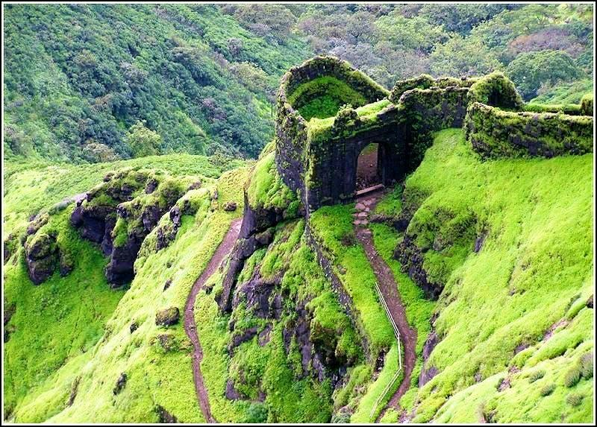
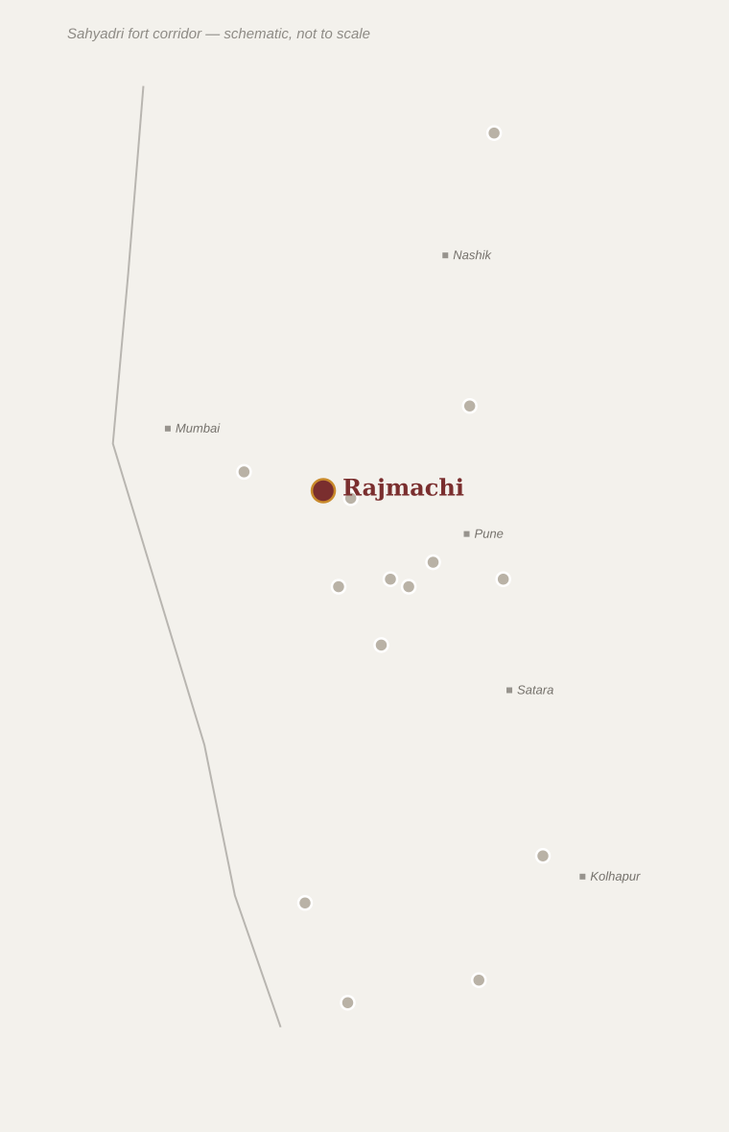
Rajmachi Fort
Hill fort
Twin bastions: Shrivardhan & Manaranjan • Near Lonavala, Pune District, Maharashtra
■ HISTORY
■ ARCHITECTURE
An old fort guarding the Bor Ghat trade route linking the Konkan coast to the Deccan plateau
Held by earlier Deccan sultanates before coming under Maratha control around 1657
Twin peaks — Shrivardhan and Manaranjan — linked by a fortified plateau
Bhairavnath temple and the adjoining Rajmachi village
Commanding views over the Ulhas valley below
■ ROLE IN SWARAJYA
Secured the vital Bor Ghat pass used for trade and troop movement between Konkan and Desh
Garrisoned to protect Swarajya’s supply and communication lines through the Sahyadris
SHIVAJI MAHARAJ'S ASSOCIATION
Secured c.1657 as part of Konkan-Deccan route defence
■ KEY EVENT
18th century — Continued strategic use through the Peshwa period
DID YOU KNOW?
Rajmachi’s twin summits make it one of the most recognisable silhouettes on the Mumbai–Pune Sahyadri skyline.
Rajmachi Fort
25

Slide 27
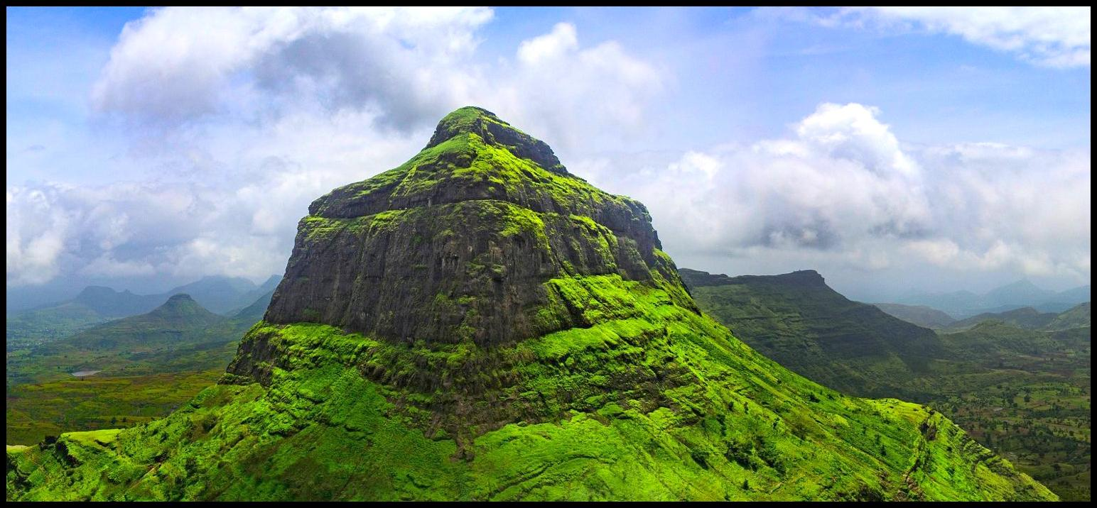
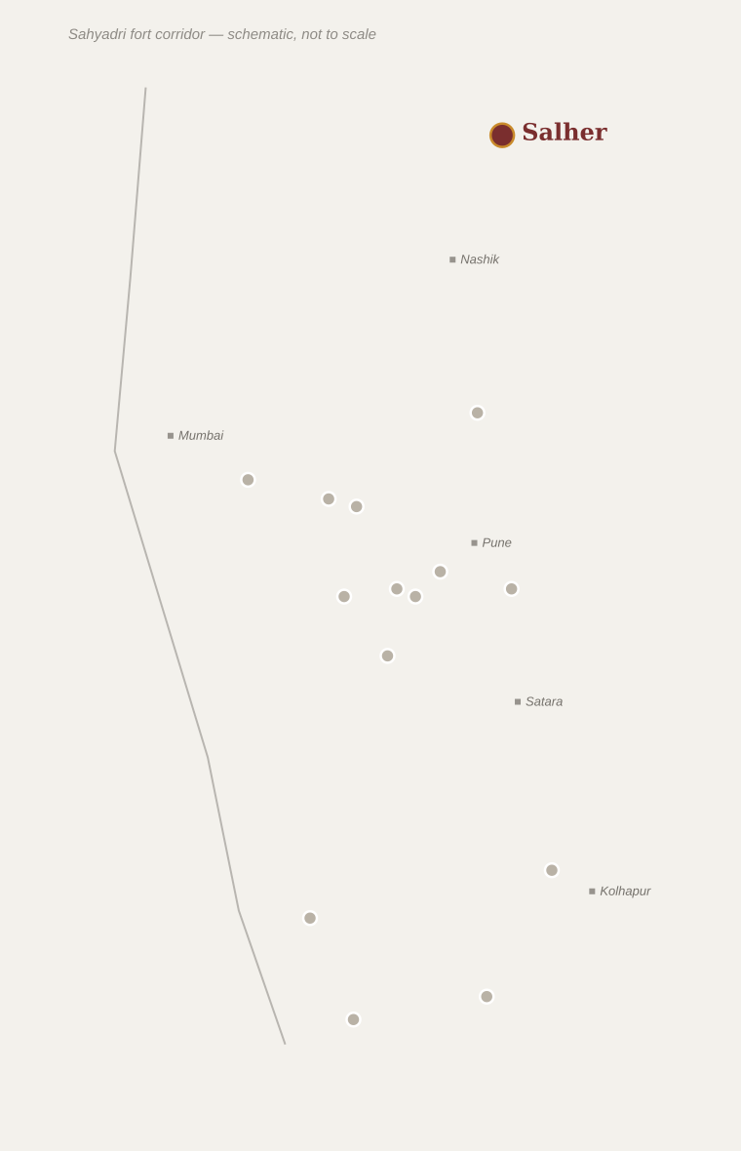
Salher Fort
Hill fort
Twin fort with Salher-Mulher • Baglan Region, Nashik District, Maharashtra
■ HISTORY
■ ARCHITECTURE
An ancient hill fort in the Baglan region near the Gujarat border
Under Mughal control from 1636, well before Shivaji’s campaigns reached the area
A vast summit plateau with extensive, now partly ruined fortification walls
Twin-fort arrangement with neighbouring Mulher
Remains of old temples on the plateau
■ ROLE IN SWARAJYA
Site of the decisive Battle of Salher (February 1672) — a rare open-field pitched battle victory for the Marathas over a large Mughal force
Led by generals Moropant Pingle and Prataprao Gujar, the victory secured the northern Baglan–Khandesh frontier
Helped reverse territorial losses from the 1665 Treaty of Purandar
SHIVAJI MAHARAJ'S ASSOCIATION
Captured 1671–72; a turning point in Maratha–Mughal conflict
■ KEY EVENT
Feb 1672 — Battle of Salher — decisive Maratha victory over a large Mughal army
DID YOU KNOW?
Historians regard Salher as the first major battle after centuries in which an Indian army defeated a large Muslim-ruled army in open field combat, rather than through siege or guerrilla tactics.
Salher Fort
26

Slide 28
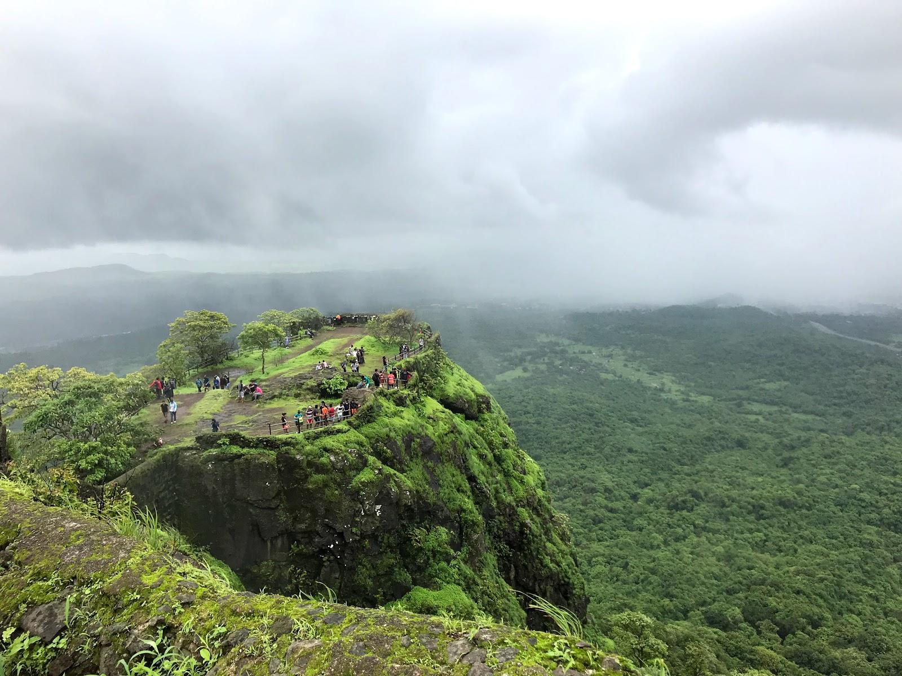
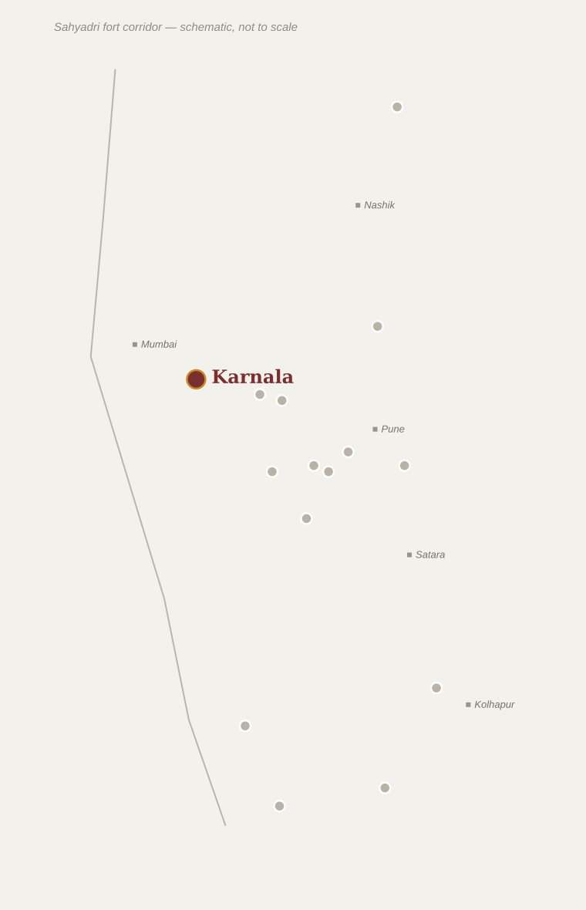
Karnala Fort
Hill fort
Near Panvel, Raigad District, Maharashtra
■ HISTORY
■ ARCHITECTURE
An old fort of the Konkan lowlands, held in turn by the Ahmadnagar and Bijapur sultanates
Briefly contested by the Siddis and the Portuguese before Maratha control
A distinctive needle-like rock pinnacle (minar) rising from the fort plateau
Rock-cut water cisterns and ruined bastions
Today surrounded by the Karnala Bird Sanctuary
■ ROLE IN SWARAJYA
Captured by Shivaji Maharaj during his Konkan campaigns to secure the coastal lowlands near Kalyan and present-day Mumbai
Ceded to the Mughals under the 1665 Treaty of Purandar, and later recaptured by the Marathas
SHIVAJI MAHARAJ'S ASSOCIATION
c.1657–70, guarding the Konkan approach to Mumbai
■ KEY EVENT
Later 1600s — Recaptured by the Marathas
DID YOU KNOW?
Karnala’s sheer rock pinnacle is a well-known rock-climbing landmark today, visible from the Mumbai–Goa highway below.
Karnala Fort
27

Slide 29
Comparative Summary
The fifteen forts at a glance
Fort | Location | Type | Major Importance | Major Historical Event
Shivneri | Junnar, Pune | Hill fort | Birthplace of Shivaji Maharaj | Birth of Shivaji, 1630
Torna | Velhe, Pune | Hill fort | First fort captured; start of Swarajya | Capture, 1646
Rajgad | Pune | Hill fort | Capital of Swarajya, c.1645–74 | Jijabai's death, 1674
Raigad | Mahad, Raigad | Hill fort | Capital & coronation site | Coronation, 1674
Pratapgad | Satara | Hill fort | Purpose-built strategic fort | Death of Afzal Khan, 1659
Sinhagad | Pune | Hill fort | Recaptured, guarding Pune | Battle of Sinhagad, 1670
Purandar | Saswad, Pune | Hill fort | Early military base & treasury | Treaty of Purandar, 1665
Panhala | Kolhapur | Hill fort | Largest Deccan fort; siege & escape | Siege of Panhala, 1660
Vishalgad | Kolhapur | Hill fort | Refuge fort after Panhala escape | Battle of Pavan Khind, 1660
Sindhudurg | Malvan | Coastal fort | Headquarters of the Maratha navy | Constructed 1664–67
Vijaydurg | Devgad | Coastal fort | Naval base & shipyard | Underwater defence wall
Lohagad | Lonavala, Pune | Hill fort | Treasury / storage fort | Recapture, 1670
Rajmachi | Lonavala, Pune | Hill fort | Guarded the Bor Ghat trade route | Secured c.1657
Salher | Baglan, Nashik | Hill fort | Tallest fort; northern frontier defence | Battle of Salher, 1672
Karnala | Panvel, Raigad | Hill fort | Guarded Konkan coast near Mumbai | Ceded in Treaty of Purandar, 1665
Comparative summary
28

Slide 30
Conclusion
No single fort made Swarajya possible — it was the connected network of hill, coastal and route forts that let Shivaji Maharaj hold and expand territory far beyond what his army’s size alone could defend.
Hill forts like Rajgad, Raigad and Torna gave Swarajya secure, near-impregnable centres of administration and command.
Coastal forts like Sindhudurg and Vijaydurg extended Maratha power onto the Arabian Sea, checking the Siddis and European trading fleets.
Route-guarding forts such as Lohagad, Rajmachi and Karnala controlled the ghats and passes that moved trade, revenue and troops between the Konkan and the Deccan.
Together, this fort network allowed a regional kingdom to repeatedly absorb losses — as after the 1665 Treaty of Purandar — and still recover and expand, laying the foundation for the wider Maratha Empire that followed.
Conclusion
29

Slide 31
References & Sources
Information compiled from established heritage and historical sources
Archaeological Survey of India (ASI) — protected monument records for individual forts
Maharashtra Tourism Development Corporation (MTDC) — official fort and heritage-site information
Maharashtra State Gazetteers, District Gazetteer volumes (Pune, Raigad, Satara, Kolhapur, Sindhudurg, Nashik)
Sabhasad Bakhar and other traditional Maratha court chronicles (bakhars), as cited in standard secondary histories
James Grant Duff, "A History of the Mahrattas" (1826) — early standard reference history
Jadunath Sarkar, "Shivaji and His Times" — widely used academic history of the period
G. B. Mehendale and other modern Marathi-language fort-history researchers
District administration and forest/heritage department websites for individual forts (e.g. Raigad, Sindhudurg, Panhala)
Note: where sources differ on exact dates, the most commonly accepted account among these references has been used, with approximate years (“c.”) shown where evidence is not precise.
References
30

