Slide 1

Mini Project On Sentiment Analysis Using Twitter Data
Harsh Gupta
Section- CCIS
University Roll.no- 2014670
Contact- 9140943594
Class Roll no- 25
Gmail- harshc2303@gmail.com

Slide 2

What is Sentiment Analysis?
Sentiment Analysis examines the problem of studying texts, like posts and reviews, uploaded by users on microblogging platforms, forums, and electronic businesses, regarding the opinions they have about a product, service, event, person, or idea.
Mainly the sentiments are of three types :
• Positive Sentiment • Negetive Sentiment • Neutral Sentiment

Slide 3
Block Diagram This demonstrates all the steps required in this project
Import Libraries
Plot the Scatter Plot and pie chart
Get the Twitter API and authenticate it
Gathering the tweets
Create a DataFrame with a column called tweets
Compute Negative, Neutral and Positive Sentiments
Word Cloud Visualization
Cleaning the data
Calculating the Subjectivity and Polarity of tweets

Slide 4
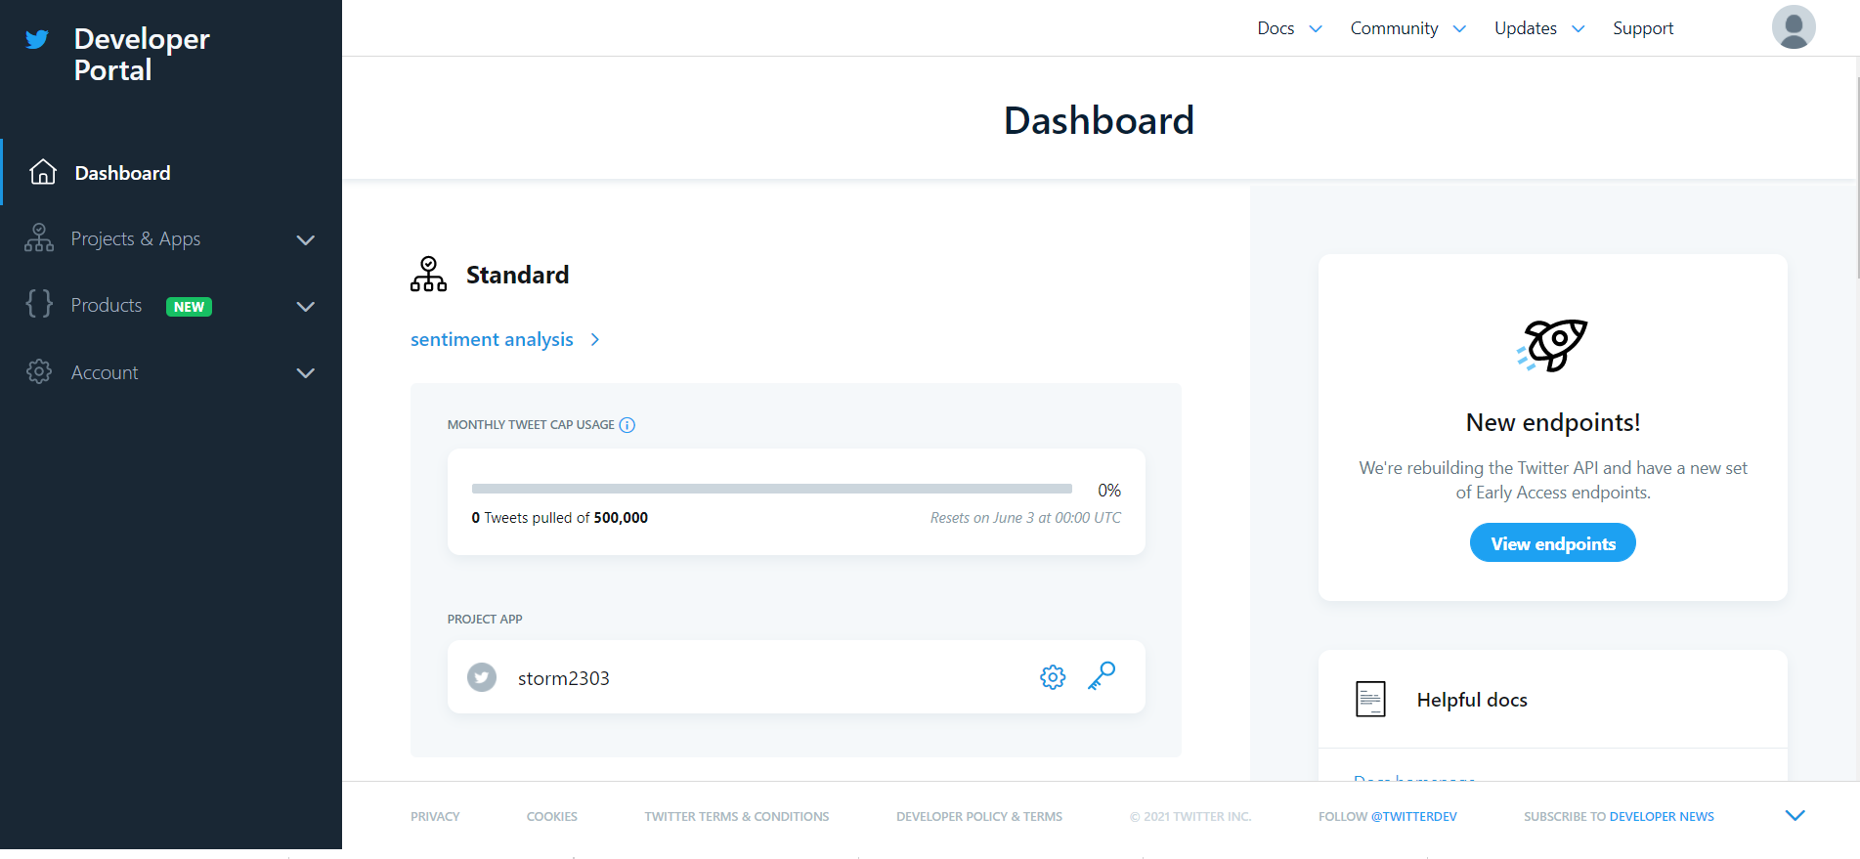
IMPORTING THE DATA BY TWITTER API
For the Twitter API, we need the Developer Account of Twitter and then we need to create an app. I have created an app named the Sentiment Analysis data app.

Slide 5
LIBRARIES USED
Tweepy
textblob
pandas
matplotlib.pyplot
re
wordcloud

Slide 6
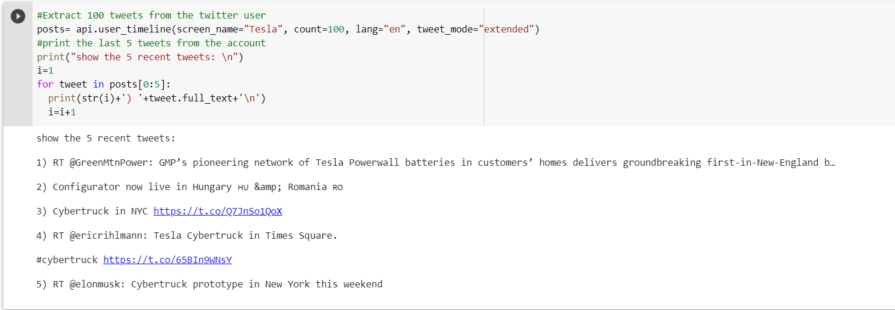
Getting the Tweets
By using the user_timeline() function present in the tweepy library I have got the tweets from Twitter on a specific topic. For example: I have searched 5 recent tweets related to Tesla in the English Language by using the user_timeline() function and printed them using a for a loop.

Slide 7
CREATE A DATAFRAME WITH A COLUMN CALLED TWEETS
After the extraction of the tweets, I have created a dataframe having a column named Tweets with the help of the pandas library.
After That
Cleaning the data
Removing unwanted data such as “#” , “@” or mentions, hyperlinks, retweets, etc.
cleanText(text)
This function helps in cleaning the data

Slide 8
Subjectivity and Polarity of Tweets
The main part of sentiment analysis is the Subjectivity and Polarity from which we can differentiate between the positive, negative, and neutral tweets.
Subjectivity is a float value that lies in the range of [-1,1]. It describes whether the data is a fact or an opinion. Subjective sentences generally refer to opinion, emotion, or judgment
Polarity is a float value that lies in the range of [-1,1] where 1 means a positive statement and -1 means a negative statement. If the value of polarity is less than 0 then the Sentiment of the data is Negative. If the value of polarity is greater than 0 then the Sentiment of the data is Positive. If the value of polarity is equal to 0 then the Sentiment of the data is Neutral.

Slide 9

Word Cloud Visualization
A word cloud (or tag cloud) is a word visualization that displays the most used words in a text from small to large, according to how often each appears.

Slide 10
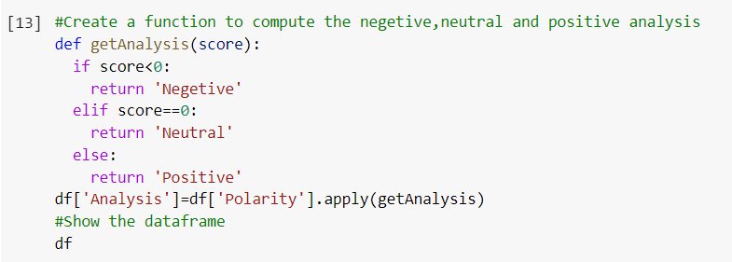
COMPUTING NEGATIVE, NEUTRAL AND POSITIVE
I have created a function getAnalysis() to analyze the score of the data by differentiating it into three parts :
Negative
Neutral
Positive

Slide 11
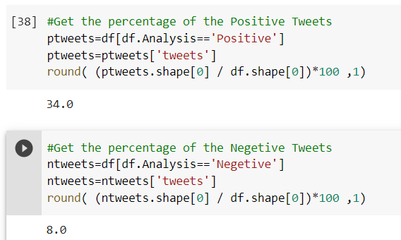
Get The Percentage of Positive and Negative Tweets
This will help to decide what majority of people think about the term or the product which we want to analyze from tweets so that we can have a complete idea about the topic and opinion of people.

Slide 12
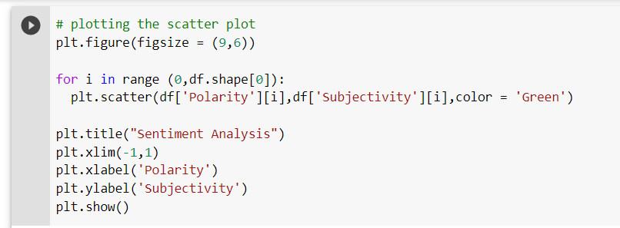
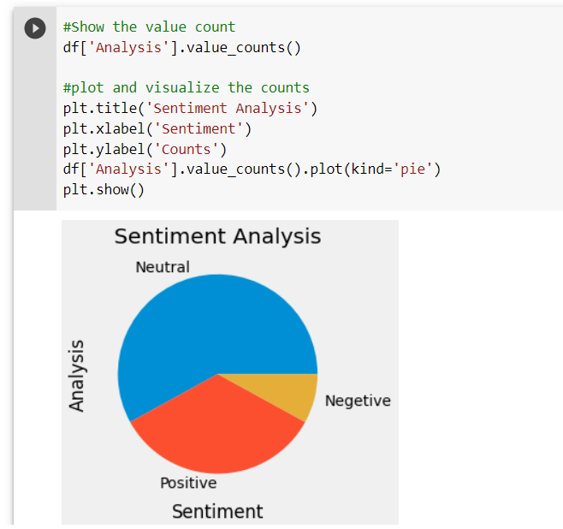
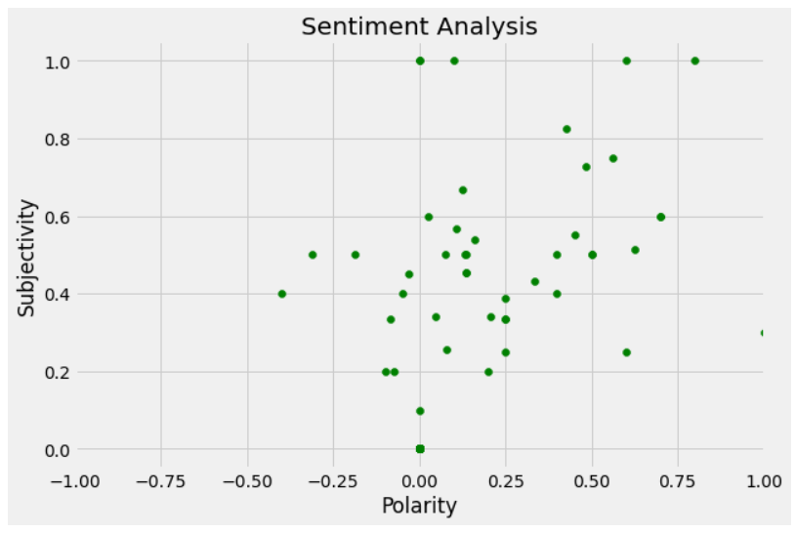
PLOTTING THE SCATTER PLOT AND PIE CHART

Slide 13
CONCLUSION
Sentiment Analysis helps the brands and Analyst to analyze what people think about a product or a service or any political idea. Do people have a positive thinking about it negative or neutral. If there are negative thoughts they can be worked upon and can be used to provide a better service to the people which will benefit both the people and the brands to a better extend.
People nowadays are very frequently posting their thoughts on social media which will make this project more affective and they are ways to decide the polarity of the sentences which can be worked upon to improve the accuracy of this kind of project.

