Slide 1
Mutation detection accuracy improvement
By Semi-Supervised Learning – Random Forest
9

Slide 2
Single mutant detector
Mutect2
Strelke
VarScan
Freebayes
--------
False positive: about 15%
False negative: 10-15%
Cause:
Tumor/normal coverage
Mutation base quality
Mutation mapping quality
10

Slide 3
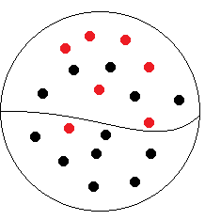
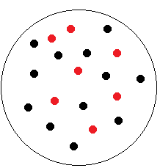
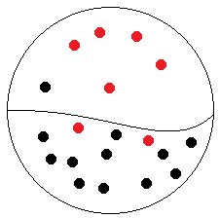
Improving Mutation Detection Accuracy
semi-supervised learning
No “Ground truth” for real sample
Up: Positive
Down: Negative
Mutation
Non mutation
one detector
Supervised learning with “Ground truth”
Up: Reliable Positive;
Down: Unlabeled
Positive+Negative
Multiple detectors
Semi-Supervised learning without “Ground truth”
*
*
Challenge: find out positive mutations from Unlabeled group
False positive calls by regular methods were frequently associated with indicators such as poor
tumor/normal coverage, low mutation base quality, and mutation low mapping quality.
11

Slide 4
Variants distribution
Mutect2, Strelka, Varscan2
Dataset: synthetic.challenge.set3
mutation detection by mutect2, strelka, varscan2
M:mutect2(15616)
S:strelka(13840)
M+S
918/1828
S
26/1434
M
290/3560
M+S+V
9789/9973
S+V
155/605
7 Areas: M, V, S, M+V, M+S, V+S, M+V+S
Three types of numbers:
Black: number of detection in each area;
Red: number of detection for ground truth;
M+V
127/255
V
84/15759
V:varscan2(26592)
12

Slide 5
Algorithms Testing
BAMSurgeon: utility for generating artificial mutations
PU Bagging – DecisionTree
– BaggingClassifierPU
Two-step approaches
Step1: reliable negative
Step2: identify positive-negative
Deep neural network
Performance Testing
Accuracy, F1
Speed
learning
prediction
Resource requirements
Scalability
13

Slide 6
Feature Design semi-supervised learning
Fisher’s exact test calculating ref/allele coverage in tumor/normal
Measure of statistically significant of mutant allele in tumor VS normal
Base quality of the mutant bases at the variant position
Base quality from sequencer at the position
Mapping quality of mutant fragment
Mapping quality score at the position
Standard deviation of variant’s distance to end of read
Distance from the position to the end of read
Mutant allele frequency
Mutant fragments/distinct coverage
14

Slide 7
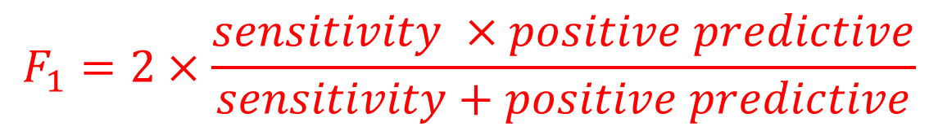
Measure PU learning Accuracy
Ground Truth
 | Mutation (number) | Non Mutation (number)
Positive (number) | TP | FP | Positive Predictive TP/(TP+FP)
Negative (number) | FN | TN | Negative Predictive TN/(TN+FN)
 | Sensitivity TP/(TP+FN) | Specificity TN/(FP+TN)
Test result
$$F_{1}=2×\frac{sensitivity ×positive predictive}{sensitivity+positive predictive}$$
15

Slide 8
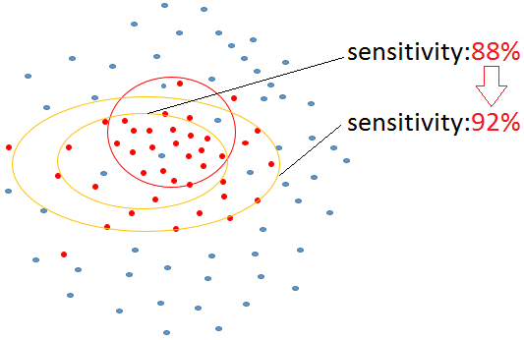
Final Result
True Positive
False Positive
Inside red circle, Positive intersection;
outside, Unlabeled (P+N)
After training, positive predictive
Expanding prediction size
Original data | GroundT | FALSE
positive | 10098 | 433 | 10531(0.96)
negative | 1291 | 21359 | 22650
 | 11389(0.88) | 21792(0.98)
Expanded predicted | GroundT | FALSE | Predictive
positive | 10433 | 712 | 11145(0.94)
negative | 956 | 21080 | 22036
 | 11389(0.92) | 21792(0.97)
1. Improve training data selection
2. Semi-supervised learning -- PU learning
3. The trained model predicts and expands
sensitivity from 88% increasing to 92%
4. F1 = 2*0.96*0.88/(0.96+0.88)=0.918 (pre)
F1 = 2*0.94*0.92/(0.94+0.92)=0.930(post)
16

