Slide 1
AgroInspector: Deep Learning-based Crop Legality and Disease Detection
Yeswanth Chitturi, Neeraj Kumar Gummadi, Kush Shah
CSE676B - Deep Learning
May 1, 2025

Slide 2
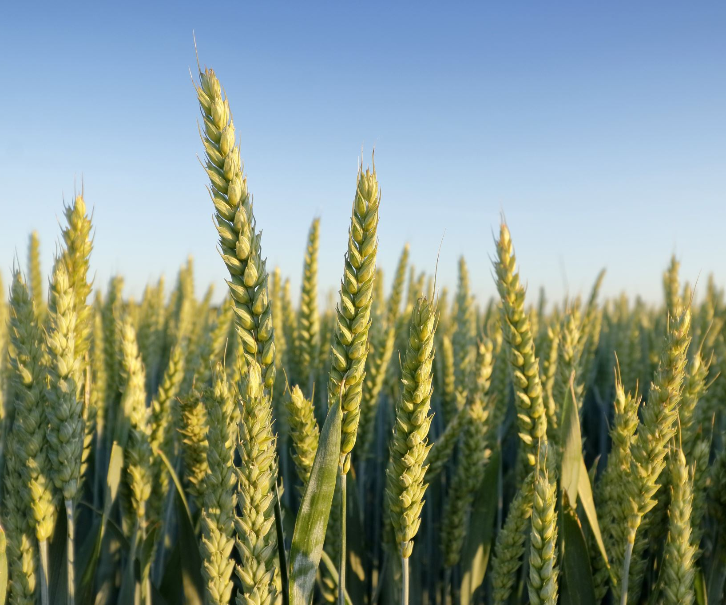
Project Description
AgroInspector is a deep learning system for classifying crop legality and diagnosing plant diseases.
This dual-purpose tool helps in enforcing legal compliance and promoting crop health awareness among farmers and policymakers.
AgroInspector offers a powerful and scalable solution to agriculture's modern challenges. With climate change and increased scrutiny on crop legality, this solution can support regulatory agencies and farmers alike.

Slide 3
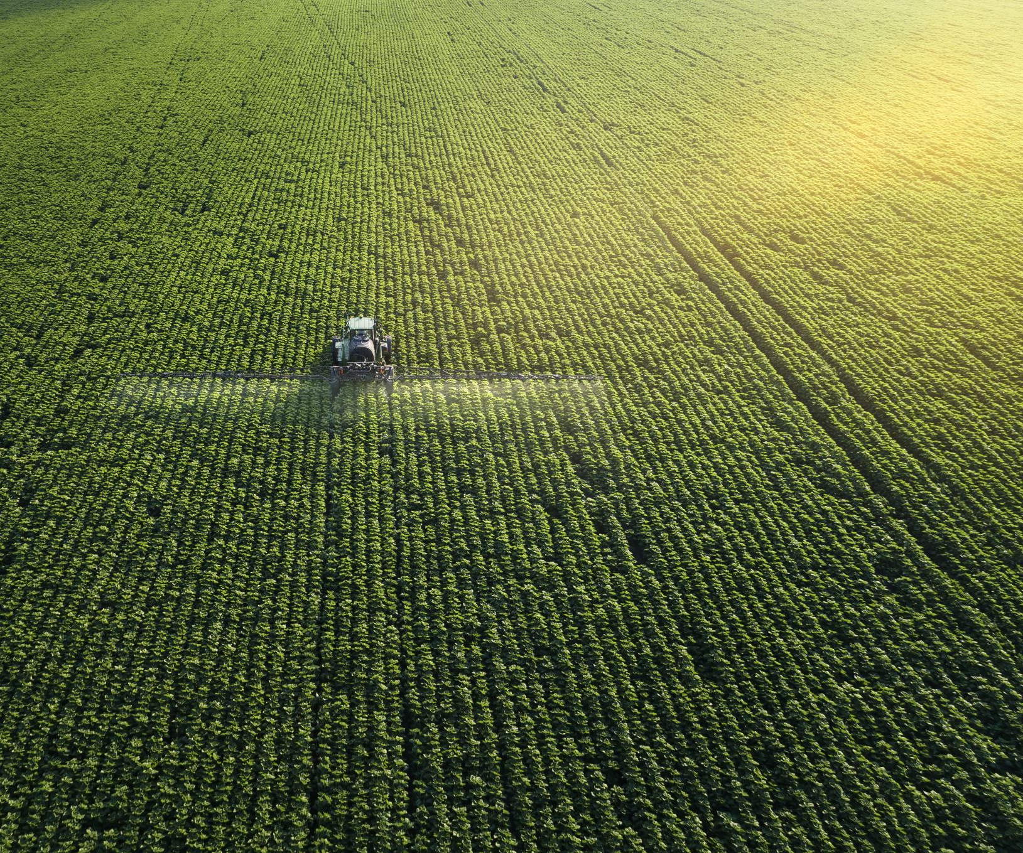
Background
Existing agricultural monitoring systems usually target either disease detection or crop classification.
AgroInspector combines both tasks into a unified pipeline with modular CNN models.
Our approach is unique in including illegal crop detection using custom datasets from web scraping.

Slide 4

Inspiration from Existing Work
Competitive Accuracy: Our Disease Type Classifier achieved 98.74% accuracy, performing on par with or surpassing recent state-of-the-art models, including ensemble and attention-based CNNs.
Robust Design: Compared to studies using Dense Attention CNNs (99.93%) and enhanced residual CNNs (98%), AgroInspector’s performance confirms the strength of our custom modular pipeline, which generalizes well across 36 disease classes.
Simpler Yet Effective: While other models rely on complex architectures or ensemble strategies, our standalone CNN-based classifier achieves similar accuracy with greater efficiency and deployment readiness.

Slide 5

Related Work
Existing models like ResNet, InceptionNet, and EfficientNet have achieved high accuracy on structured disease datasets. However, they are mostly confined to specific crops and lack cross-crop generalization or multi-stage diagnosis, limiting real-world usability. Illegal crop detection remains underexplored due to data scarcity and its sensitive nature. While satellite imagery is used in surveillance, no known AI pipeline performs plant-level legality classification.
AgroInspector fills this gap by leveraging plant disease datasets and standard CNNs, while introducing a hierarchical decision flow across legality, health, and classification. Unlike single-output models, AgroInspector mirrors expert workflows, integrating legality detection, species recognition, and disease typing into a unified, real-world–aligned system.

Slide 6
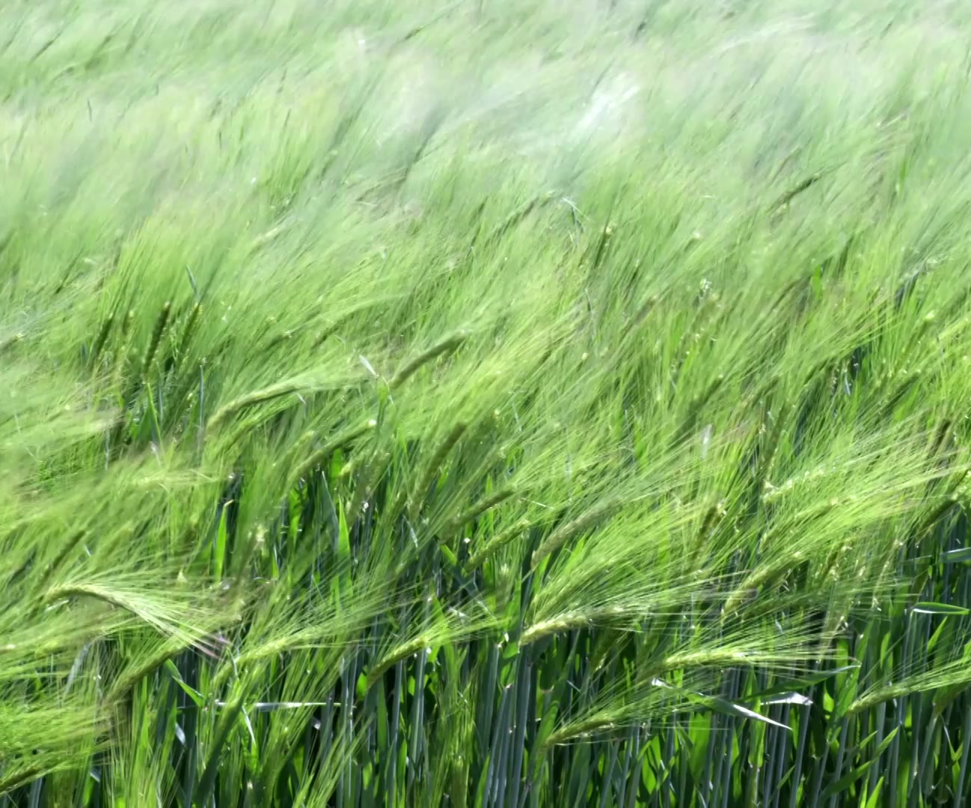
Dataset Overview
Used 5 datasets:
- Illegal Crop Detection
- Illegal Crop Type
- Healthy vs Diseased
- Disease Classification
- Healthy Crop Type
Total: Around 90,000 images from Kaggle and web scraping.

Slide 7
Dataset Preprocessing
Images resized to 256x256, normalized, and converted to PyTorch tensors.
Ensured class balance and consistent resolution. Applied image verification and filtering where needed.
We also analyzed dimensional consistency via boxplots, ensuring robust feature extraction across classes. Clean datasets minimized training artifacts and improved convergence speed.

Slide 8
Methods Overview
Developed 5 custom CNN models:
1. Legal vs Illegal
2. Illegal Crop Type
3. Healthy vs Diseased
4. Healthy Crop Type
5. Disease Type
All models use Conv-BN-ReLU-MaxPool and FC layers. Models were trained with optimized dropout rates, learning rate schedules, and regularization techniques. Each was benchmarked to ensure low validation loss and reproducibility.

Slide 9

Pipeline Architecture
Pipeline Flow:
- Step 1: Legal vs Illegal
- Step 2a: Illegal Crop Type
- Step 2b: Healthy vs Diseased
- Step 3a: Healthy Crop Type
- Step 3b: Disease Type
Implemented in PyTorch with Streamlit deployment.

Slide 10
Results – Accuracy Summary
Step 1: Legal vs Illegal – 93.62%
Step 2: Illegal Crop Type – 93.47%
Step 3: Healthy vs Diseased – 59.17%
Step 4: Disease Type – 98.74%
Step 5: Healthy Crop Type – 85.42%
Metrics used included precision, recall, F1-score, and confusion matrices. We fine-tuned thresholds for optimal F1-score due to some class imbalances, especially in diseases.

Slide 11
Model Performance (Legal vs Illegal & Disease Type)
Binary Classifier: 98% test accuracy, strong confusion matrix
Disease Classifier: 93.04% test accuracy
Robust classification across 36 disease classes, especially in Tomato and Holy Basil
False positive rates were minimized via data augmentation and confusion analysis.
Ensuring no mislabeling in legality was a design priority given the legal implications.

Slide 12
Model Performance (Others)
Illegal Crop Type Classifier: 76% test accuracy
Healthy vs Diseased: 97.98%
Healthy Crop Type: 97%+ for most crops
Strong generalization and low validation loss across models

Slide 13
Autoencoder-Based Enhancements
Autoencoders were used in:
Legal vs Illegal classification
Healthy vs Diseased classification
Latent-space features extracted using the encoder were used for classification
Benefits:
Reduced input dimensionality
Faster training and convergence
Improved generalization and class separation
Accuracy improvements:
Legal vs Illegal: 93.67% → 95.01%
Healthy vs Diseased: 59.17% → 95.00%

Slide 14
GAN-Augmented Training for Rare Classes
DCGANs were trained to generate synthetic images for underrepresented classes:
Illegal crop types
Plant diseases
~200 images per class were generated and added to the training data
Benefits:
Improved class balance and model robustness
Better generalization for low-sample classes
Accuracy improvements:
Illegal Crop Type Classifier: 99.35% → 100.00%
Disease Classifier: 98.74% → 100.00%

Slide 15
Demo (Streamlit Web App)
Web deployment on Streamlit Cloud with:
- Drag-and-drop upload
- Live legality, health, and type prediction
- Modular, responsive interface
Real-time results displayed for user-uploaded crop images.
https://agroinspector.streamlit.app/

Slide 16
Key Observations / Summary
AgroInspector achieves high accuracy and modular inference.
Combines legal enforcement with disease prevention.
Future work: expand dataset, mobile deployment, and real-time alert integration.

Slide 17
Team Contribution Summary
Yeswanth Chitturi: Dataset preparation, Model training and tuning, CNN and Autoencoder model development, Streamlit deployment, Neeraj Kumar Gummadi: Model training and tuning, GAN augmentation, evaluation analysis, documentation Kush Shah: Model testing, Model training and tuning, Streamlit deployment, presentation, report writing , Dataset preparation

Slide 18
Thank You

