Slide 1
Introduction
Workplace safety is a critical concern for businesses and employees.
Data-driven analysis helps identify risk factors and improve safety measures.
This project analyzes OSHA injury and fatality data to uncover trends and make recommendations.

Slide 2
Data Source & Methodology
Dataset: OSHA workplace safety records (2023)
Tools Used: Python (Pandas, Matplotlib) for data processing and visualization
Key Metrics Analyzed:
Total injuries per sector & industry
Fatalities in high-risk industries
Correlation between job restrictions and injury trends
Goal: Identify safety risks and suggest data-driven improvements

Slide 3
Workplace Injuries by Sector
Manufacturing, Healthcare, and Retail Trade report the highest injury rates.
Construction & Transportation also show significant safety risks.
These sectors need stronger safety training and compliance enforcement

Slide 4
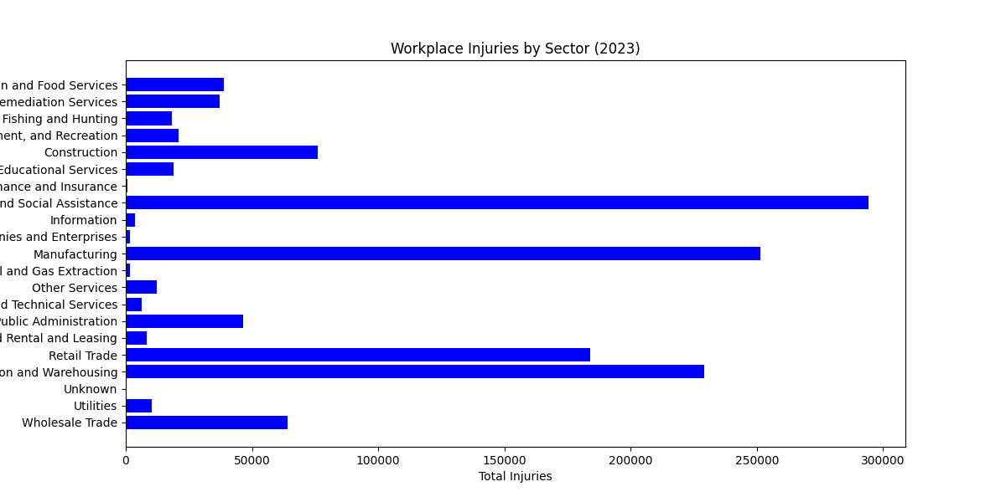

Slide 5
Fatalities by Industry
Highest fatalities found in Mail & Parcel Delivery, Construction, and Trucking.
These industries face high-risk working conditions and safety violations.
Improvement Needed: Enhanced safety protocols & stricter enforcement.

Slide 6
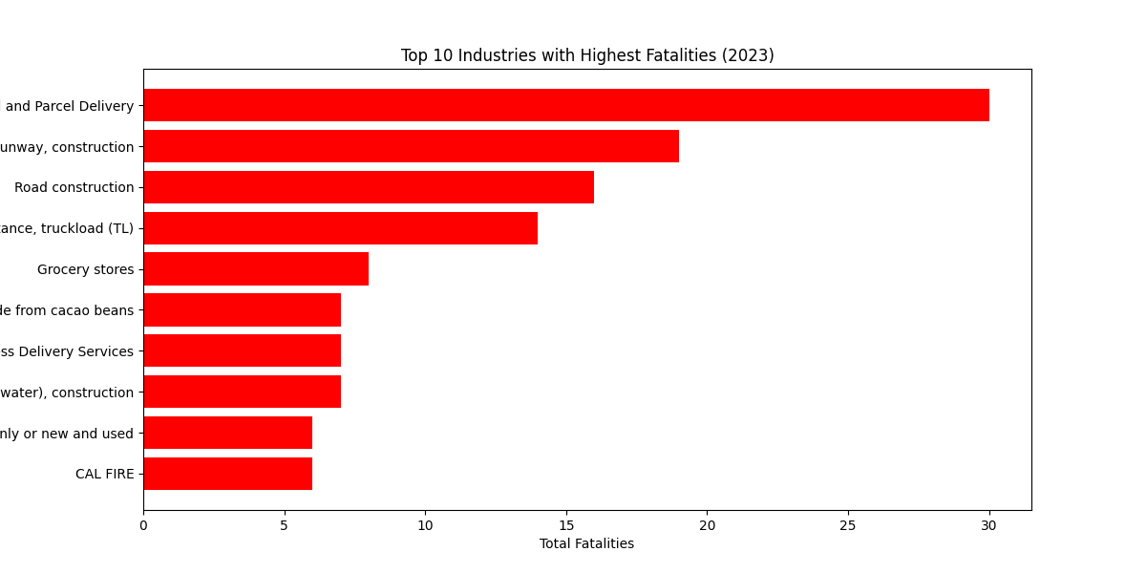

Slide 7
Correlation Between Job Restrictions and Injuries
A positive correlation exists between job restrictions (DJTR cases) and injury rates.
This suggests workplaces with more injuries also experience higher work restrictions.
Solution: Preventive safety programs to reduce injury rates and downtime.

Slide 8
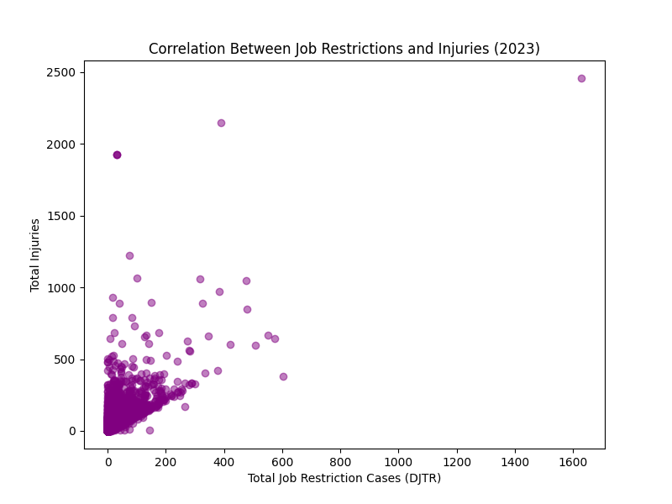

Slide 9
Key Findings & Recommendations
Key Insights:
High injury rates in manufacturing, healthcare, retail, and construction.
Fatalities most common in construction, delivery, and trucking.
More job restrictions = higher workplace injuries.
Recommendations:
Stronger safety training for high-risk sectors.
Predictive analytics to forecast injury trends and prevent accidents.
Compliance monitoring to enforce OSHA regulations effectively.

Slide 10
Conclusion & Next Steps
Data-driven insights help improve workplace safety.
Companies should invest in proactive safety measures.
Further research can explore predictive safety models using machine learning.
Next Step: Apply findings to real workplace safety improvements.

Slide 11
Thank You!
Questions?
Contact: lisakrasiuk@gmail.com
LinkedIn: https://www.linkedin.com/in/lisa-krasiuk-84092a302/

