Slide 1
Decentralized Reputation Model and General Trust Framework
    Blockchain and Smart contracts
Sujata Tamang

Slide 2
Outline
Introduction
Design and Implementation
Results and Evaluation
Conclusion & Future works
Notes:
Introduction - We will look at the motivation of the project along with the purpose and research questions.
Design & Implementation - The system design and design considerations along with the implementation details and the overall system architecture is presented.
Results & Evaluation - to show how the design and implementation meets the system requirements
Finally conclude with analysis and future works.

Slide 3
1. Introduction

Slide 4
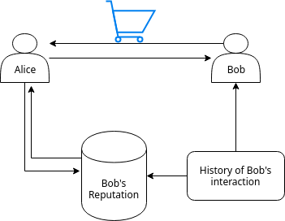
Motivation
Fig: Steps when Alice wants to interact with Bob.
Notes:
If we consider a scenario where Alice wants to buy something from an online store, the first step for her would be to search for the desired product and then to find a reliable seller willing to sell it.
Let's say, Bob is a seller with a good trust score on the transaction system based on the history of transactions and the score assigned to his identity. Thus, Alice decides to interacts with Bob.
Now, depending on the correctness of Bob's reputation score that was presented by the online system, this transaction outcome can either be a success or a failure.

Slide 5




What is Trust and Reputation?
(Relevance to Online interaction system)
Trust: subjective probability by which an agent assess other agent’s action will be beneficial.
Reputation: perception of an individuals character/standing.
A complete “trust and reputation system” helps to evaluate the probability of success or failure of outcome of an online interaction.
Interaction
Online System
Identities
Trust and
Reputation
Notes:
This notion of trust and reputation when used in online interaction system can help to evaluate the outcome of a transaction, i.e., if it will be a success or failure.
Entities in Online system are recognized by their online identities,
Since entities rely on this Reputation score presented by the transaction network to predict the outcome of transaction, it is significant for this score to be correct and reliable.
The formulation mechanism, calculation and dissemination of this score has to be secure and always available.
Therefore, it is essential to have a secure trust and reputation system to maintain the security of an online system and increase the amount of successful interactions. s

Slide 6
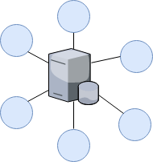
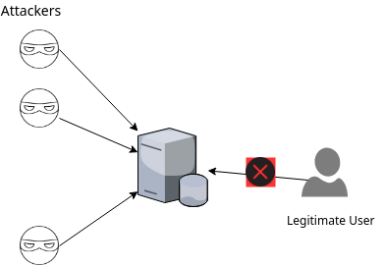
Problem Definition
The Centralized nature of current online system leaves the reputation information vulnerable to both internal and external attacks.
Centralized Storage and governance.
Proposed Solution: Blockchain network
Notes:
The centralized nature of current online system leaves the reputation
information vulnerable to both internal and external attacks.
Failure to the server node would render the whole system unusable as the
clients cannot access the data anymore. Also, attackers can overload the server
with multiple requests and make the network resource unavailable for intended
users.
Similarly, the formulation mechanism of reputation score is vulnerable to sybil
attacks, self-promoting attacks and the identities are not anonymous.
So, with this thesis, we propose a blockchain based solution to implement a trust framework and assign a reputation score to the entities.
Which offers a decentralized storage and governance of data and the use of cryptographic functions guarantees the security and immutability of the stored data.

Slide 7
Related works
(Trust and Reputation systems)
Aggregation based, e.g., eBay, yelp, uses ratings/feedback.
  Formulation mechanism can be exploited to perform sybil attacks, self-promotion attacks, has a centralized architecture.
EigenTrust, distributed reputation algorithm for P2P system.
  Uses the notion of transitive trust path and pre-trusted peers.
  Group of nodes can form malicious collectives and act honestly with pre-trusted peers only and get a good ranking.
  Principles: self-policing, Anonymity, no profit to newcomers.
Other examples: TrustDavis, AuthenticPeer++, BarterCast, PowerTrust.
  Takes the feedback from the user about a transaction and aggregates this information to assign a trust score to either the involved peer or the file.
Notes:
Here, we can see some of the examples of system that implement a reputation
system to assign trust scores to its participants.
Online systems such as eBay and yelp uses an aggregation based mechanism to get
the total of positive and negative ratings and assign a final score based on
it.
EigenTrust is a distributed reputation algorithm designed for P2P systems. It
uses the notion of transitive trust path and pre-trusted peers. So, to get the
trust score of a peer, it has to query the friends and friends of friends of
peer to get the final score. It also uses the notion of pre-trusted peers.
The principles of a reputation system as defined by EigenTrust is that it has
to be self-policing, anonymity should be accounted for, and there should be no
profit to newcomers. These principles are taken into account during the system
design phase of this thesisl
Other examples of reputation system that takes feedback from user about a
transaction and aggregates these information to assign trust scroes are
trustdavis, authenticpeer, bartercast etc.

Slide 8
Purpose and Research Questions
Question 1:
  What are the requirements for storing trust values and linking them to respective identities?
  How does the overall system architecture look like for a blockchain application to define a general trust framework?
Question 2:
  How can the endorsement network ensure trustworthiness while preserving user anonymity?
  Can it be generalized to other use cases?
Notes:
The primary goal of this thesis was to use blockchain technology and smart
contracts to model an interaction system that allows the participants who
trusts each other to endorse the information or identity of one another.
And finally based on this interaction to assign trust score to each participant
such that their trustworthiness could be inferred from it.
So, the research questions are divided into two phases that this thesis aims to
address.
First is to outline the requirements for storing trust values and linking them to respective identities and then presenting the overall system architecture for a blockchain application to define a trust framework.
Second question is related to the correctness of the proposed model and states how can the proposed endorsement model ensure trustworthiness while also preserving user anonymity and if it can be generalized to other use cases.

Slide 9
Contribution
Design of an Endorsement model where entities can endorse each other and a method to aggregate this endorsement information such that a trust score can be assigned to individual entities.
Deployment of endorsement system to blockchain network that can update and compute the trust scores by executing the immutable contract.
Evaluation of endorsement model by applying it to an existing data set and discussion of relevant threat models.

Slide 10
2. Design and Implementation

Slide 11
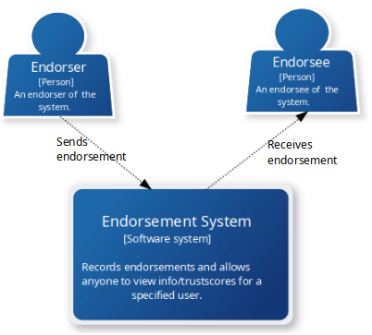
Endorsement Model
(Design and System Requirements )
Functional requirements
  Anyone can join the network.
  Able to send and receive endorsements to/from the desired entity.
  Able to view and compute trust scores.
Non functional requirements
  Security, Reliability of the stored information.
  Trust metrics correctly describe the actual trust score of the node.
Notes:
We propose a decentralized endorsement system to model trust among participating entities, and therefore the two distinct roles of users are endorsers and endorsee.

Slide 12
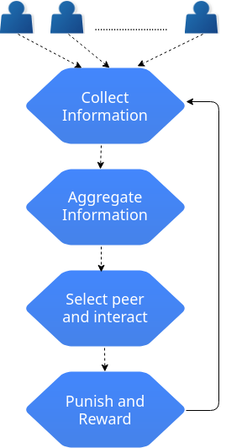
Trust and Reputation System
(Design and Characteristics of trust)
Dynamic: Ability to remove endorsement previously assigned.
Asymmetric: not required to endorse back the endorser.
Non-transitive: Only direct endorsement interactions are addressed.
Image source:
F. G. Mármol and G. M. Pérez, “Security threats scenarios in trust and reputation models for distributed systems”, Computers & Security, vol. 28, no. 7, pp. 545–556, 2009
Notes:
The four steps that is essential for a complete trust and reputation system is given by the figure,
First step is to collect interaction information among entities, aggregate the collected information.
The aggregated information should allow participant to select a reliable peer to interact with.
The interaction or the outcome of interaction should be evaluated by the reputation system such that the peer or the transaction can be either punished or rewarded and the information is updated by providing a feedback loop back to the first step of the system.
The characteristics of trust taken into account by the endorsement system are that
The dynamic characteristics of trust is represented by the endorsement system by allowing participants to remove endorsement previously assigned.
Trust is asymmetric, to address this, the participants are not required to endorse back the endorser.
Trust is non-transitive, so only direct endorsement interactions are considered in the endorsement system.

Slide 13





Data and variables for
Computation of Total Endorsement Impact (TEI)
, Number of endorsements given by a participant A.
, Number of endorsements received by a participant A.
, Consumable points of a participant A is given by
Total Received Points (TRP),which is the accumulated sum of consumable points received by a participant A from his/her endorsers, and is given by :
where E = {e₁ , e₂ ,e₃ , ….. ,e_{n}} is a set of endorsers for a peer A and the size of E is n.
Total Endorsement Impact (TEI), made by participant A, is given by :
Notes:
The data and variables that is required by the endorsement system to compute TEI, which represents the impact a node has made on the network, and it shows the trustworthiness of the given user.
The nEG and nER is recorded by the endorsement system and is responsible for showing the degree of connectivity a participant has in the network.
Also, to have a formulation method that is resilient against whitewashing attacks, to be considered a starting node, one has to have at least one incoming/outgoing connections and to be considered an impactful node, one has to have more than one incoming/outgoing connections. Only an impactful node is taken into account for computation of TEI.
Ratio is always less than or equal to 1, because we take the minimum as the numerator and the maximum as denominator out of nEG and nER. And is there to address the free-riders issue of a P2P network where endorsements are voluntary contributions.
CP is another factor that is taken into account to limit the number of outgoing connections a node can make. Therefore, it keeps getting depleted with each outgoing connections.
TRP is there to make sure that the endorsers also need to be equally impactful in the network for their sent endorsements to be valuable in the network.
Finally TEI takes into account both the ratio and the TRP, and therefore, to have a high TEI value, one has to maintain the ratio between incoming and outgoing connections, ensure that their endorsers are impactful and have enough Consumable points as well.

Slide 14
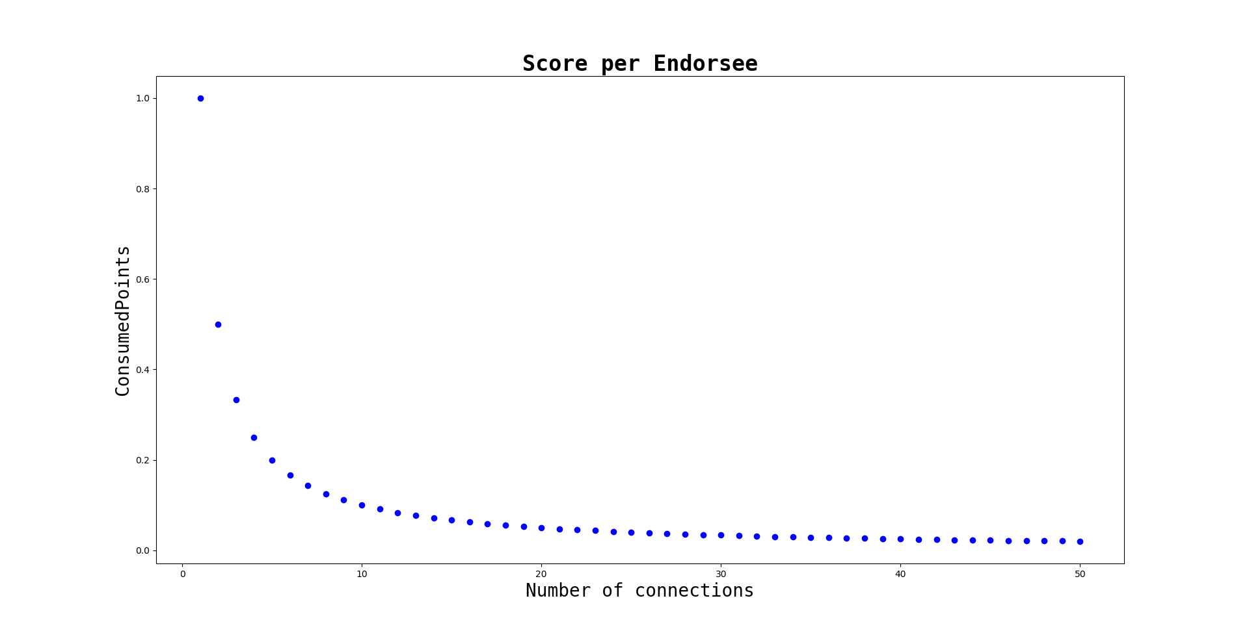
Design Considerations (1/2)
False endorsements with pseudonymous identities
Fig: Convergent behavior of consumable points as number of connections ‘n’ increases.
- Though there is no limit to the number of connections one can make, higher the connection, lower is the value they can contribute to the network.
Notes:
The first consideration taken into account by the EDS system was false endorsement with pseudonymous identities.
As it is possible for a user to create multiple accounts and initiate multiple transactions to inflate the trust score of an account, (self-promoting attack), the EDS system has Consumable points in order to limit this kind of behavior.
Since, the CP keeps depleting with each outgoing connections, a rational decision for a user would be make fewer endorsement connections and contribute larger value than to make many connections with minimal value.
As such, the assumption is that the CP factor will limit too many outgoing connections.
Another factor that can avoid a user to make too many identities is the cost of transaction, Every transaction on ethereum costs gas which is to be paid for in ether, and so every account that initiates the transaction is responsible for paying the gas cost of the transaction.

Slide 15
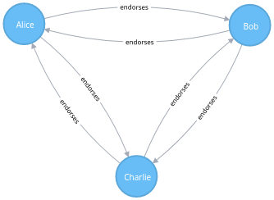
Design Considerations(2/2)
Transaction cost and Free-riders issue
All pseudonymous accounts need to maintain the endorsement connection.
Every “endorse” call consumes gas, so more pseudonymous identities to manage, more operations to pay the gas price of.
Free riders: Ratio need to be close or equal to one.
Fig: Interaction between participants
that endorses each other
Notes:
Another factor that can avoid a user to make too many identities is the cost of transaction, Every transaction on ethereum costs gas which is to be paid for in ether, and so every account that initiates the transaction is responsible for paying the gas cost of the transaction.
The interaction subgraph shows 3 entities where everyone endorses each other.
If Alice, Bob and Charlie are all honest and distinct users than each of them has to pay for only 2 transactions whereas if Bob and Charlie are the pseudonymous account of Alice than Alice has to pay for all 6 transactions.
Free riders is addressed by requiring the nodes to maintain the outgoing and incoming connections , i.e., ratio

Slide 16
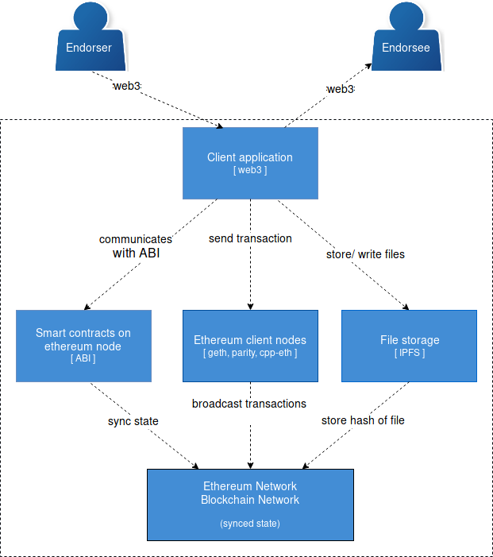
Components of Endorsement System
Notes:
The figure shows the components of endorsement system,
First, the participants invokes the method provided by the endorsement system which is controlled by the smart contract code.
The client application communicates with the smart contract via Application Binary Interface and it can sign the transaction initiated by the user with the user’s private key stored locally, after which the transaction is sent over to the ethereum client node.
After the communication with the respective smart contracts and the transactions get sent to the client nodes, then the transaction is broadcasted over to the ethereum network and once they are recorded on the blockchain, which is an append only data structure, the endorsement information stays there as an immutable record.

Slide 17
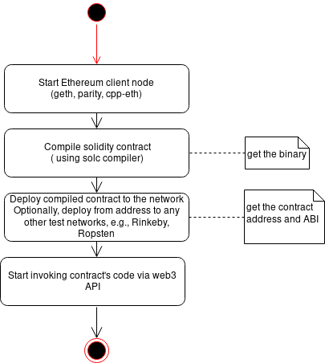
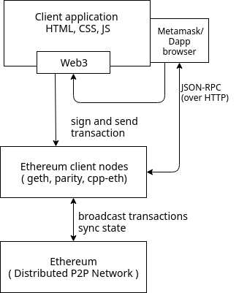
Smart contracts
Deployment to the Blockchain network
Ownable - tracks the owner of contract by setting the address of owner.
Killable: allow owner to destroy the contract.
Endorsement: specifies the core logic of endorsement system.
Notes:
The smart contracts written for this project were :
Ownable to track the owner of contract and it sets the address of owner to identify the owner of contract.
The address from where the contract is deployed gets registered as the owner of the contract.
Killable to allow the capability for owner to destroy the contract if necessary.
Endorsement to specify the core logic of endorsement system.
The figure shows different steps for deploying the contract to the blockchain network,
First step is to start the ethereum client node, current implementation of client nodes are geth, parity and cpp-eth.
The contract code is written using solidity language and so it can be compiled using solc compiler which is provided by Ethereum. Once compiled, the binary of the contract code is given.
This compiled contract can now be deployed to the network which give us the contract address and the ABI of the contract.
The ABI acts as a layer of translation and we can now start invoking any contracts code or function via web3 API.

Slide 18
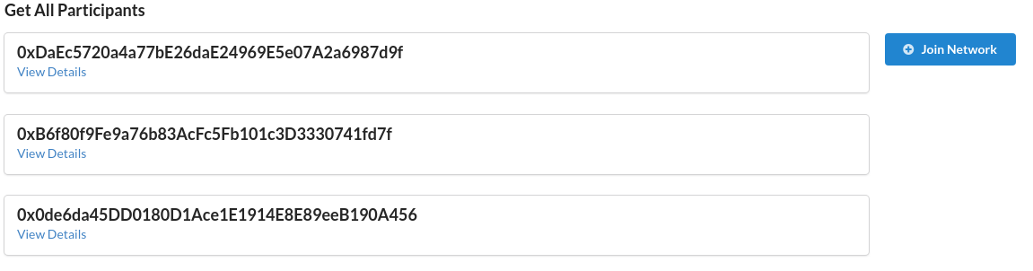
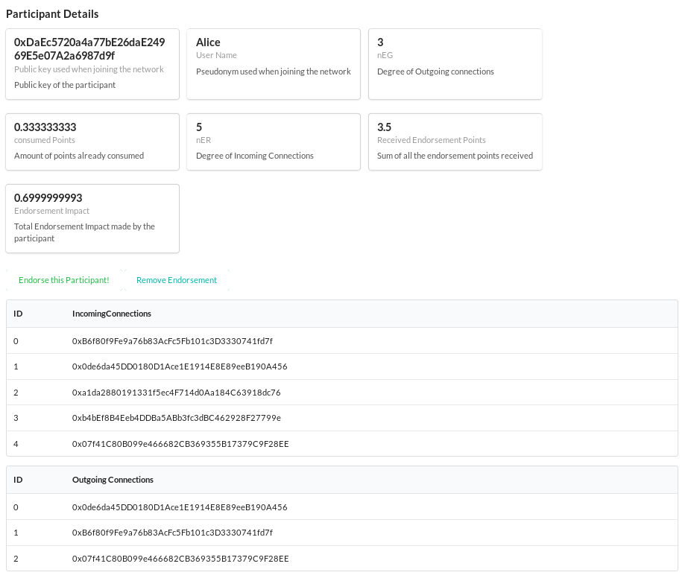
Functional requirements
(Invoke endorsement method from client side)
Notes:
Here, we can see the client application which has the methods as listed by the functional requirements during the design phase.

Slide 19
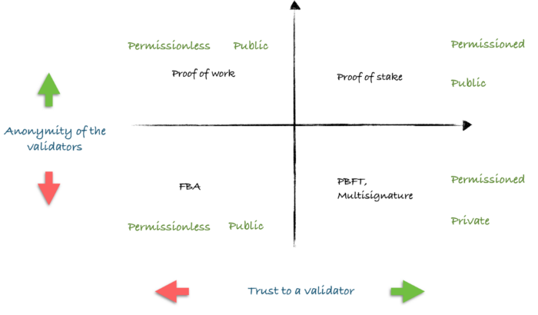
Blockchain and Consensus algorithms
Requirements: Publicly available and verifiable records, Free for anyone to join, Anonymity of participants and validators, self-policing.
Public, Permissionless Blockchain network
Proof-Of-Work as Consensus.
Fig: Blockchain types
Image Source, Available [Online] https://www.evolute.be/thoughts/blockchain101.html
Notes:
So, for the endorsement system, we recommend the use of a public,
permissionless blockchain setup as the requirements for the endorsement system
is that anyone should be able to join the network as participants or to act as
a validator and collect transactions.
On a permissioned setup, the participants and the writer has to be known a
prior, and therefore does not meet the requirements for endorsement system.
Similarly, for the consensus mechanism, PoW is recommended. There are several
disadvantages to PoW, such as high computational requirements, low network
throughput and latency issues. However, using PoS or DPoS requires finding
enough trustworthy validators that can be trusted to collect transactions and
act as writer. Since, we allow anyone to participate in the network, it is not
possible to assign this responsibility to one node.
3) There is no central entity in control of the data, so there is no one node that can be assigned the responsibility of acting as a validator.
4) The disadvantage of using PoW with a public, permissionless setup is the
scalability issue, low network throughput and latency. However, if the
requirement grows, voting mechanisms can be used to select a leader node that
can validate the transactions.

Slide 20
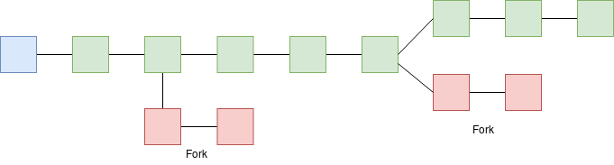
Blockchain and Consensus algorithms
(Security and Reliability)
Contract code first checks conditions and then updates the state of account.
System Security:
  Resilient to node failures, guaranteed immutability of stored data, but vulnerable to attacks that forks the blockchain.
Notes:
The proof-of-work consensus algorithm on a public permissionless blockchain setup gurantees the security of the propagation and storage of data.
Every endorsement transactions is send over to the network and is signed by the private key of the user and so one can always verify the source of transaction where it originated from.
Once the transaction is validated, executed and recorded on the blockchain, its modification is computationally infeasible.
However, as we can see in the figure, it may be possible for more than 2 miners to solve the same block simultaneously that is linked to the same parent hash.
In this case, the PoW consensus solves this conflict by telling the network participants to switch to the longest chain because the longer the chain, more amount of work has been done on it.
So, as long as the honest nodes control majority of computational power, the network is secure.

Slide 21
Results and Evaluation

Slide 22
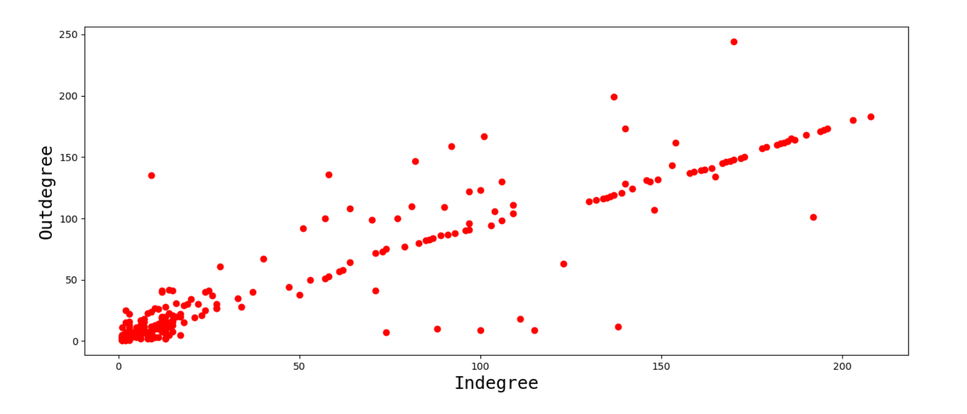
Interaction graph
Trust metrics describes the trust score of the nodes
Dataset available online of a trust network with 3,783 nodes and 24,186 edges,
Scale of -10 to +10, 93% were positive edges.
Fig: Distribution of incoming and outgoing connections.
Notes:
To evaluate the trust metrics, an interaction graph was simulated to show the
interaction among the nodes in the network.
We can see a linear distribution in the graph and most of the nodes are concentrated on the lower region and only few nodes seem to have a high incoming or outgoing connections.
We can also see few nodes that have relative high outgoing connections compared to the incoming and also few nodes that have too many incoming connections and very few outgoing connections.

Slide 23
Computation of TEI (1/3)
(Nodes with TEI zero)
Nodes with edge weight above +2 was considered for the endorsement network.
Starting nodes: 70% (1175 out of 1677) of the nodes had TEI score of zero, reason being they were starting node by definition.
Only 502 nodes to account for computation of TEI to have score above zero.
Notes:
After applying the endorsement model to the dataset, the Total Endorsement Impact score was computed for each nodes.
which showed that 70% of the nodes had a TEI score of zero, and on examining them, they were found to be a starting node. As discussed earlier as well, any
node that has only one or less than one incoming/outgoing connections is
considered a starting node.
So, this left us with only 502 nodes to account for having a TEI score above zero.

Slide 24
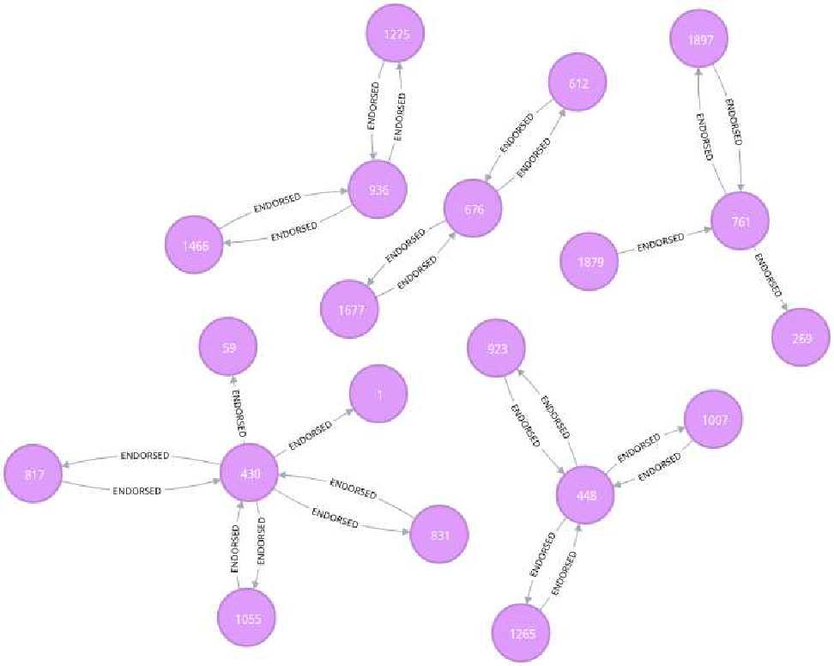
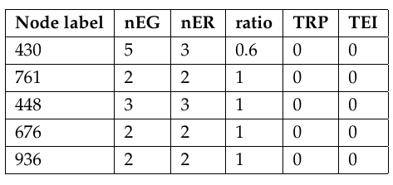
Computation of TEI (2/3)
(Behavior of non starting nodes with zero TEI score)
Table: Zero impact due to non impactful endorsers.
Figure: Interaction subgraph of nodes with zero TEI.
Notes:
Among the 502 nodes, there were still 5 nodes that had a TEI score of zero even though they did not fall under the definition of starting node.
The interaction subgraph shows the behaviour of these 5 nodes. We can see from the figure that even though the nodes are not starting node, their endorsers do not have a higher degree of connection as a result of which their contribution was not valuable and so their TRP was zero which resulted in them having a TEI of zero.
Reason for low TEI:
Non impactful Endorsers
Start node, with only one incoming/outgoing connections.
Impactful node, node with more than one connections.
Low ratio, low TRP
.

Slide 25
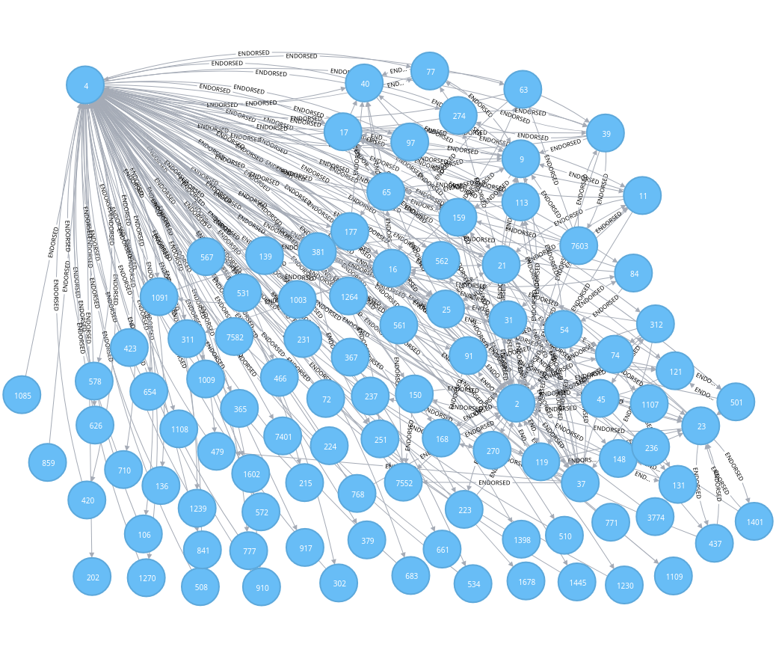
Computation of TEI (3/3)
(Behavior of nodes with high TEI score)
Nodes labeled 2 and 4 depict the
behavior of node with higher TEI
score.
Higher degree of connectivity.
High ratio and TRP
Notes:
Different color for node label 2 and 4

Slide 26
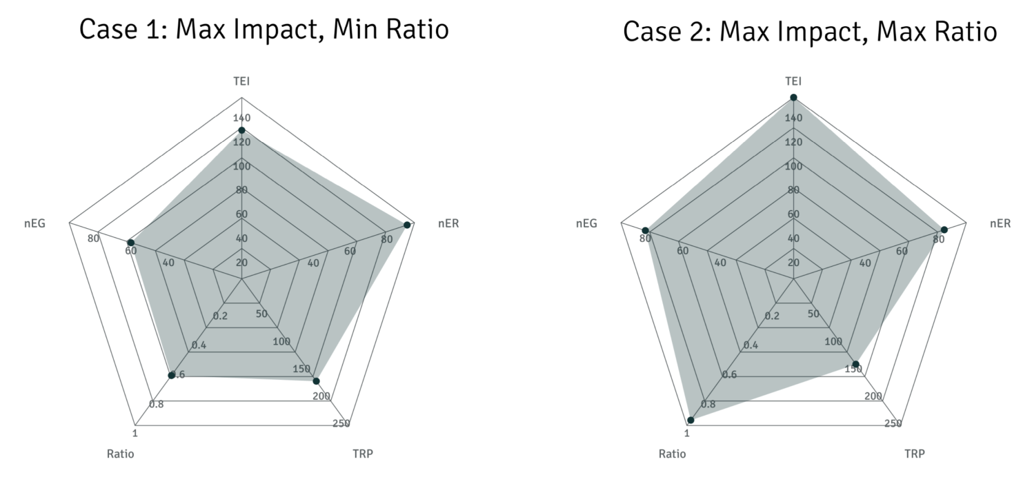
Total impact across several factors (1/2)
High impact node should have a higher ratio
Case1- Among nodes with maximum impact
Lowest ratio: 0.6, Highest TEI: 120
nEG ~49, nER ~87, TRP ~153
Case2- Among nodes with maximum impact
Highest ratio: 1, Highest TEI: 145
nEG ~82, nER ~82, TRP ~150
Notes:
Here, we can see the distribution across several factors for a node with high TEI score. As expected, they have an even distribution across all factors.
Case 1 takes the node with lowest ratio among the highest impact value and as we can see, the lowest ratio is 0.6 which is still high enough to be a high impact node.
Similarly, Case 2 takes the node with highest ratio among the highest impact node and as expected the value of ratio is one and has even distribution across all factors. This shows the most impactful node in the network.
Both the cases have even distribution of value across all factors and therefore satisfies the requirement of a high impact node.

Slide 27
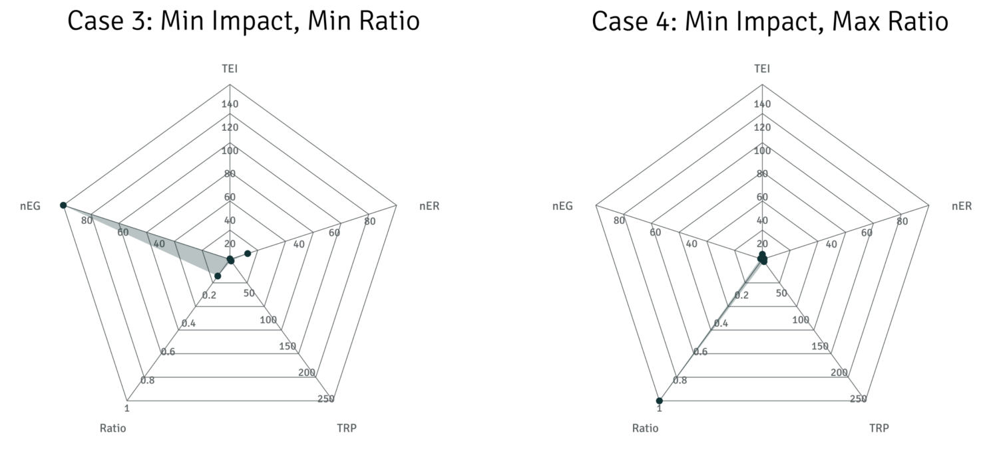
Total impact across several factors (2/2)
A high ratio does not necessarily imply a high TEI
Case3- Among nodes with low impact
Lowest ratio: ~0.1, TEI: negligible
nEG ~100, nER ~20, TRP:negligible
Case4- Among nodes with low impact
Highest ratio: 1, TEI: negligible
nEG ~49, nER ~87, TRP: negligible
Notes:
For case 3 and case4, the nodes with low impact were taken to see how ratio between incoming and outgoing connection is maintainted.
Our assumption that a high ratio does not necessarily imply a high TEI score is given by these two cases.
As we can see in Case 3, that the nEG is high but relatively verly low nER and so ratio is very low and the TRP is neglibile and so is the TEI. Therfore, if this node sends endrsement to other node, their TEI will not be affected at all.
Similarly in Case 4, the ratio is 1 but it still has a negligible TEI score because the TRP is negligible, which is because of starting node.

Slide 28
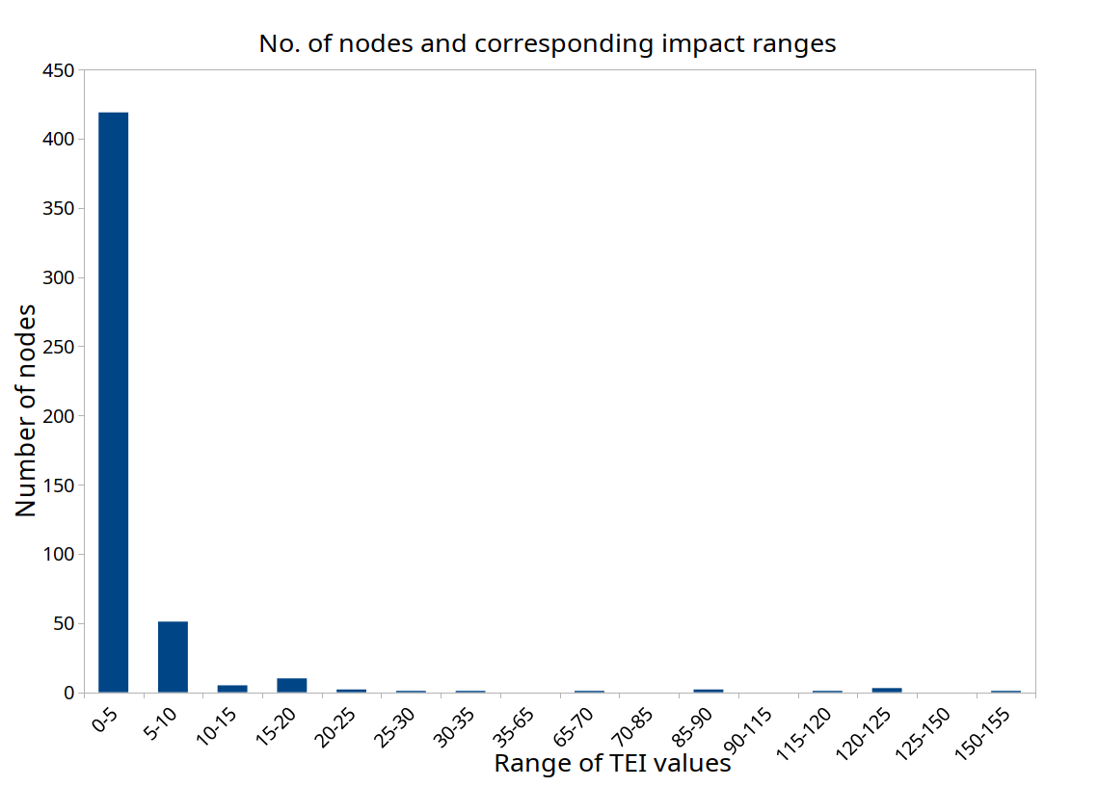
Distribution of TEI across the network for all nodes
Only few nodes with a higher TEI scores.
Majority of the nodes have TEI score within range of 0-5.
Notes:
So, it shows that it takes time and several interactions in the network to make a significant impact in the network.
These few trustworthy nodes can be used for PoR or taken as a pre trusted peers to sign the block like other reputation systems we discussed earlier.

Slide 29
Threat scenarios addressed by Endorsement system
Sybil attack: The endorsers of a peer should have a high TEI value.
Whitewashing: Start node have ignorant value and is not considered for TEI computation, notion of punishment to reduce TEI by half and quarter based on transaction outcome.
Free-riders, resilient to DDOS attacks.
Self-promoting and Slandering attack:
  Data source authentication and data integrity verification is offered by BC protocol.
  Sybil identities addressed by (gas) cost of operation to do so.

Slide 30
Discussion and Analysis
Principles defined by EigenTrust and Resnick et. al
  Self-policing: No trusted central entity.
  Anonymity: Reputation score linked with the unique account identifier and not with externally associated identity such as IP address or govt. issued identity.
  No profit to newcomers: takes several interactions on the network to maintain values across all factors to make significant impact on the network.
Formulation of trust score, TEI:
  Overcomes the limitations of formulation mechanisms such as that of eBay.
  Uses direct endorsement interactions to get the trust score, without use of transitive trust path or a notion of pre-trusted peers to propagate trust scores.
  Anyone can compute or query the trust score of the participants.
Notes:
A decentralized endorsement system on a public, permission-less blockchain network without a trusted central entity.

Slide 31
Discussion and Analysis
(Research questions)
Question 1: What are the requirements for storing trust values and linking them to associated identities? How can a blockchain application be built to define a general trust framework for a transactional network and how could the overall system architecture look like?
  Storage of data and variables along with the computation of trust score is done on blockchain network and a distributed P2P file system is recommended as the requirement grows.
Question 2: How can the endorsement network ensure trustworthiness while also preserving user anonymity and how can it be generalized to other transactional network?
  Endorsement system is designed as a general model that can be implemented by any tx. Network and the simulated graph shows the behavior of nodes is expected for the given final trust score.

Slide 32
Conclusion and Future works
The Total Endorsement Impact, TEI score assigned by the EDS system can be used to infer the trustworthiness of an entity in question.
The participants can claim or verify the score made on the endorsement system before engaging in a transaction.
Future Works:
  Methods of communication between Endorsement and transaction system to directly update the trust scores to reflect the real world transaction outcome.
  Use of existing trust and reputation algorithms such as EigenTrust,PowerTrust on a Blockchain network to evaluate its performance based on accuracy and usability.
  Use of anomaly detection algorithms to detect malicious behavior.
  Extend the current implementation to include more information by entities, (e.g., email, other online accounts) .

Slide 33
Thank you!

