Slide 1
Decentralized Reputation Model and General Trust Framework
    based on Blockchain and Smart contracts
Master’s Thesis
Department of Information Technology,
Uppsala University

Slide 2
Outline
Introduction
Background
Methodology & Implementation
Results
Conclusion & Future works

Slide 3
1. Introduction

Slide 4




Trust infers reputation and Reputation incites trust
Online
interaction
Trust: subjective probability by which an agent asseses other agent’s action will be beneficial.
Reputation: perception of an individuals character/standing.
A complete “trust and reputation system” helps to evaluate the probability of success or failure of outcome of an online interaction.
Online identities
Trust
and
Reputation

Slide 5
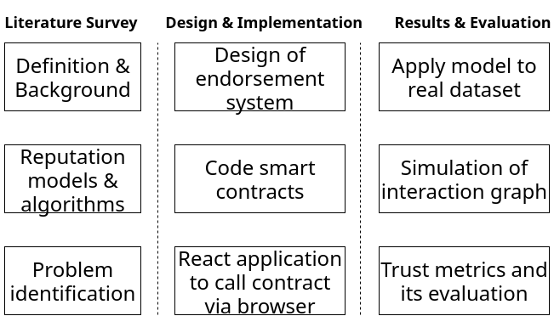
Phases of the project

Slide 6
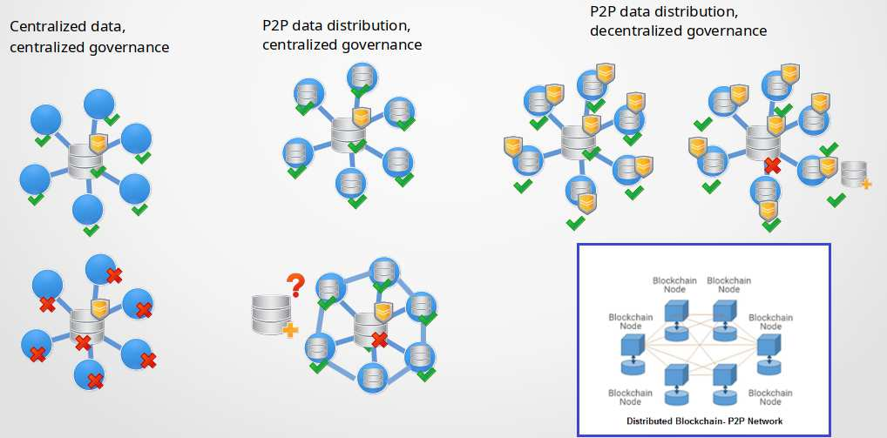
Why Blockchain
Notes:
Censorship resistance
Decentralized, distributed
Immutable data, resilient to internal and external attacks

Slide 7
Purpose and Research questions
Question 1: What are the requirements for storing trust values and linking them to associated identities? How can a blockchain application be built to define a general trust framework for a transactional network and how could the overall system architecture look like?
  Interpretation of connection between nodes and quantification of scores to represent trustworthiness of entity.
  Overall system design and architecture for a blockchain application.
Question 2: How can the endorsement network ensure trustworthiness while also preserving user anonymity and how can it be generalized to other transactional network?
  Threat models of trust and reputation systems and how the proposed system addresses them is presented.

Slide 8
2. Background

Slide 9
Classification of trust
Personal | One person trusts another person(s) or things in a particular situation
Interpersonal | More than one trusting entities, two or more people (or groups) trust each other.
Dispositional | General trust based on personality attribute of trusting party.
Impersonal/structural | Trust in institutional structure, e.g., contract law, judiciary systems
Table1: Classification of trust

Slide 10
Classification of trust and reputation measure
 | Specific | General
Subjective | Survey questionnaires on specific aspects, e.g., rating a merchant on scale of 1-5 for response time | ebay, voting, e.g., aggregate all individual scores and provide average standing of user on the network
Objective | Product tests, e.g., how good is the transfer rate for a given hard disk | Synthesized general score from product tests, i.e., account for all relevant aspects and averages the perfformance.
Table2: Classification of trust and reputation measures

Slide 11
Threat scenarios in trust and reputation systems
Self-promoting attack: inflate the reputation score of target account.
White-washing: exit the system with a bad reputation and enter afresh with a new account.
Slandering: damage reputation score of target account by generating false feedbacks.
Orchestrated: attackers collude and combine multiple strategies and adapts to the situation.
Denial of Service: disrupt the service by sending too many requests to central server and make the network resource unavailable to the intended users.
Free riders: individual rationality at the expense of collective welfare.

Slide 12
Trust values and reputation systems
Trust values
  expressed as numbers or labels
  Domain: binary, discrete or continuous
  Semantics: ratings (range of values), ranking (relative), probability of a trust value
Characteristics/ requirements of reputation system
  Provide enough information to infer trustworthiness of entities, encourage trustworthy behavior
  Self-policing, anonymity, no profit to newcomers, minimal overhead

Slide 13
Existing reputation systems and formulation methods
Aggregation based method that uses feedback-based rating, e.g., eBay, yelp
Trustdavis, where role of insurer is introduced for each transactions.
Eigentrust, uses transitive trust path and uses pre-trusted peers as a start vector for propagation of trust.
AuthenticPeer++, peer and file-based combined.
Bartercast, uses max flow algorithm to create graph based on data transfers between peers and compute reputation values for each node.

Slide 14
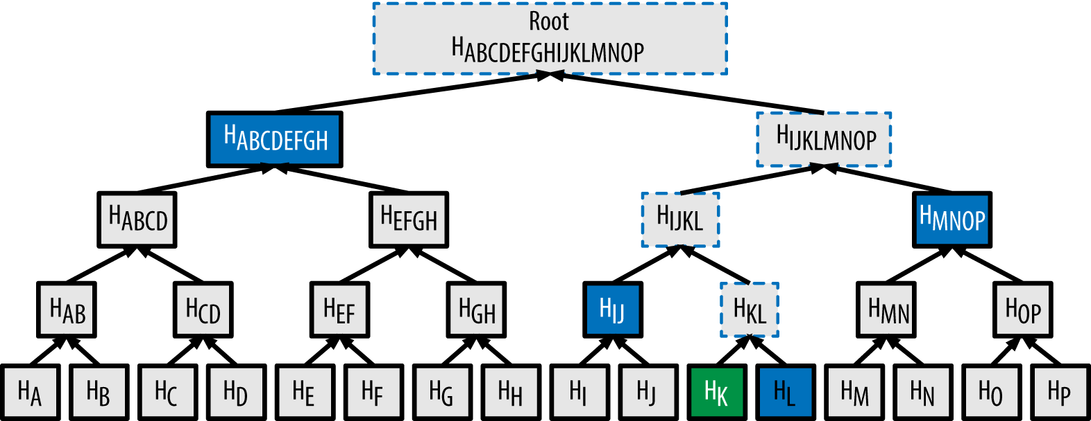
Hash functions
Merkle root for Data integrity and inclusion verification
Mathematical trapdoor functions that transforms an input message to a fixed length binary output.
  One-way: Given a key k and an output w, computationally infeasible to find x, s.t. H_{k}(x) = w.
  Second pre-image resistant: Given a key k and a string x, computationally infeasible to find y, s.t. H_{k}(x) = H_{k}(y).
  Collision-resistant: Given a key k, computationally infeasible to find x and y s.t., H_{k}(x) = H_{k}(y)

Slide 15
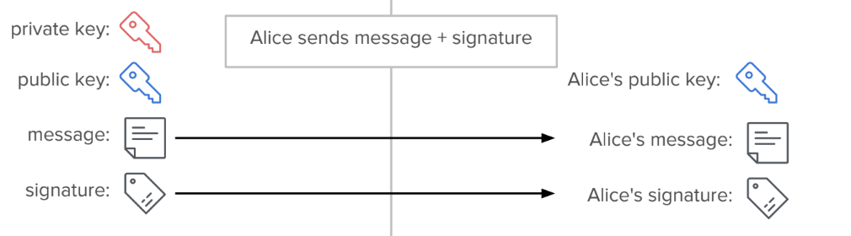
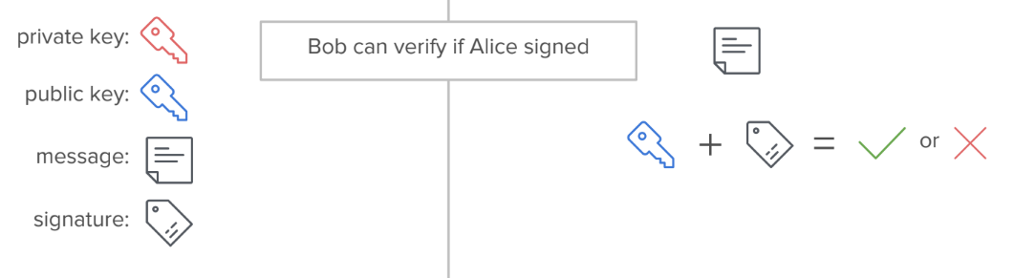
Digital Signature for message authentication and non-repudiation
Mathematical scheme that presents authtenticity of digital messages or documents
Signature creation:
Signature verification:
Image source: Blockchain at Berkeley, [Online]. Available: https://blockchain.berkeley.edu/workshops/

Slide 16
Components of Open, public blockchain
P2P network connecting participants and propagating transactions and blocks of verified transactions.
Messages, in the form of transactions, representing state transitions.
Set of consensus rules, governing what constitutes a transaction and what makes for a valid state transition.
State machine that processes transactions according to the consensus rules.
Consensus algorithm that decentralizes control over the blockchain, by forcing participants to cooperate in the enforcement of consensus rules.
Game-theoretically sound incentivization scheme (e.g., PoW plus block rewards) to economically secure the state machine in an open environment.

Slide 17
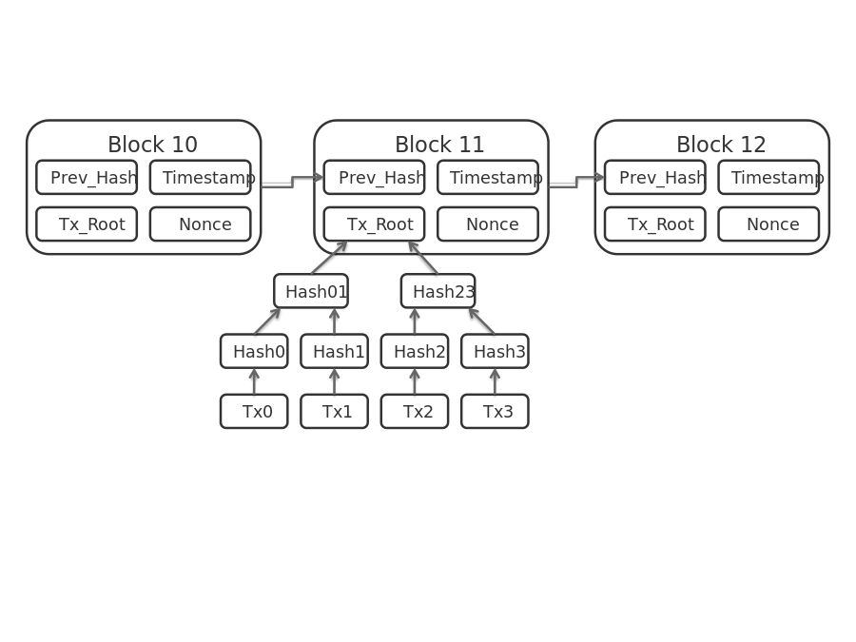
Blockchain: Consensus mechanisms and Categories
Consensus mechanisms
  Proof-of-Work: show proof of work to the network, computationally expensive, e.g., Bitcoin, Ethereum (Ethhash).
  Economy based: Stake platform based token to become writer of the block, PoS, DpoS, e.g., Casper, Ouroboros.
  Leader based: Elect a leader node responsible for collecting transactions and appending new records to the blockchain, e.g., PBFT, RAFT, Implementations by: Hyperledger Fabric, R3 Corda
Categories
  Public permissionless: Publicly available and verifiable data, free to join network and be writer for anyone.
  Public permissioned: Anyone can join the network where the writer is known but not necessarily a trusted entity, publicly verifiable records
  Private permissioned: similar to public permissioned except that records are not made public.

Slide 18
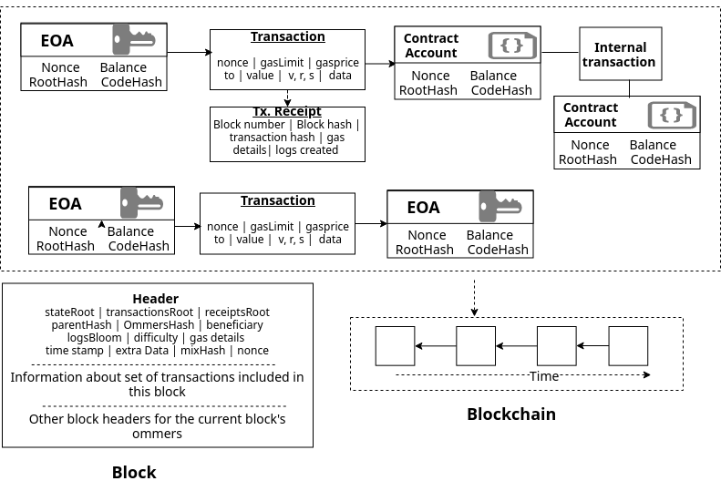
Ethereum specific concepts
Notes:
Gas consumption
Merkle proof

Slide 19
3. Methodology and Implementation

Slide 20
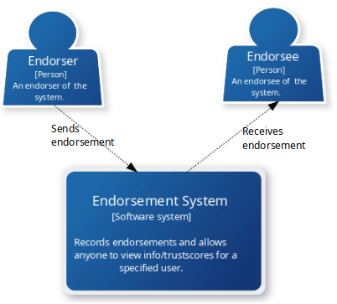
Endorsement Model and System Requirements
User roles
  Endorser, Endorsee
Functional requirements
  Send and receive (not actively) endorsements
  View list of endorsers or endorsees for the account.
  Ability to view or compute trust score of participants along with other endorsement details.
Non-functional requirements
  Security: take into account relevant security considerations while writing contract code.
  Reliability: trust and reputation information should be reliable.
  Trust metrics should describe the actual trust score of the node.

Slide 21
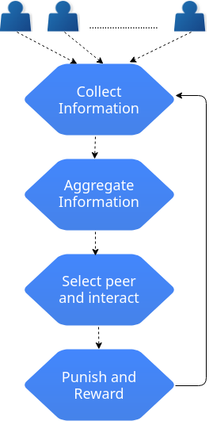
Trust and reputation system
Characteristics of trust
Dynamic: Ability to remove endorsement previously assigned
Asymmetric: not required to endorse back the endorser.
Non-transitive: Only direct endorsement interactions are addressed.

Slide 22





Data and Variables for
Computation of Total Endorsement Impact (TEI)
, Number of endorsements given by a participant A.
, Number of endorsements received by a participant A.
,
, Consumable points of a participant A is given by
Total Received Points (TRP), which is the accumulated sum of consumable points received by a participant A from his/her endorsers, and is given by :
where E = {e₁ , e₂ ,e₃ , ….. ,e_{n}} is a set of endorsers for a peer A and the size of E is n.
Total Endorsement Impact (TEI), made by participant A, is given by :

Slide 23
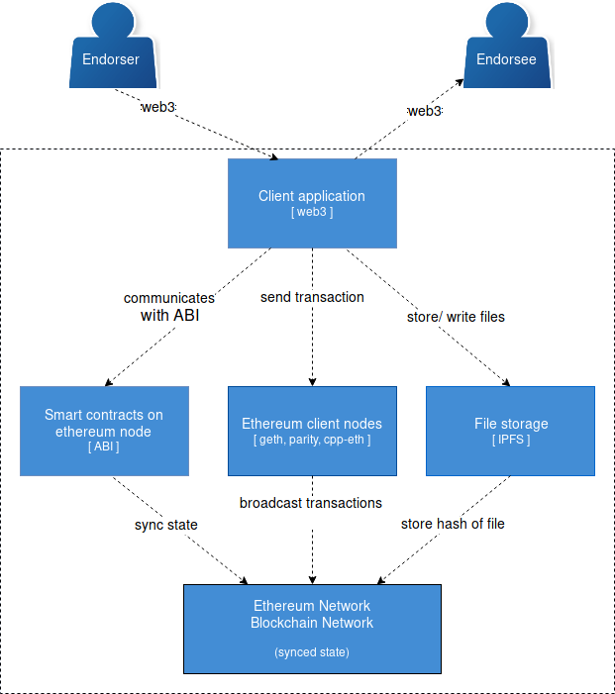
Components of Endorsement System

Slide 24
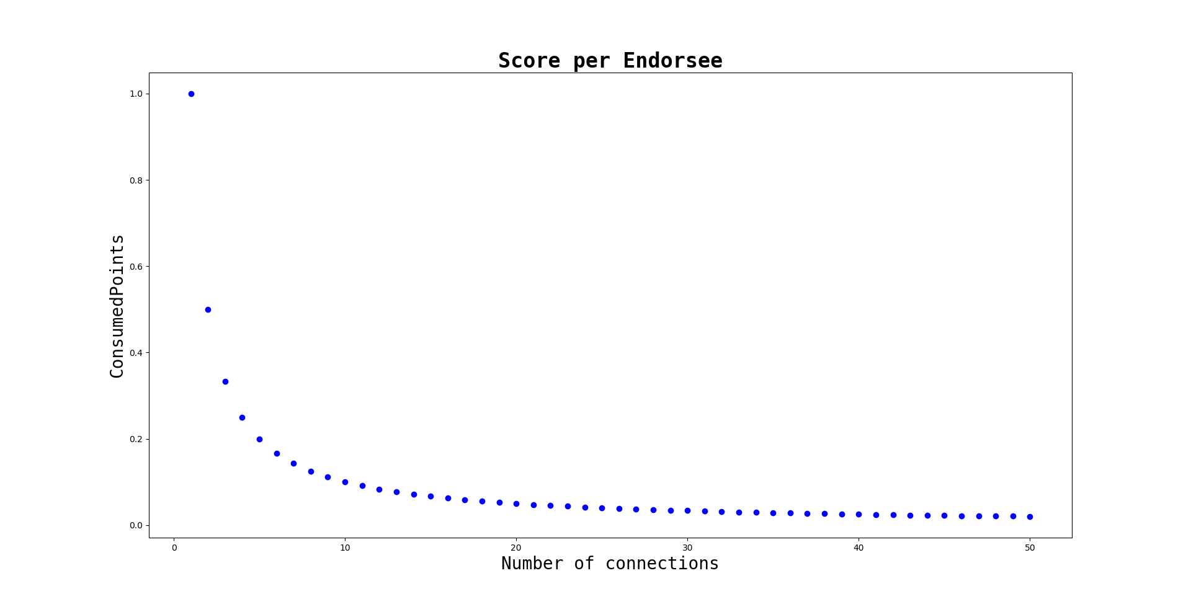
Design Considerations(1/2)
False endorsements with pseudonymous identities
Fig: Convergent behavior of consumable points as number of connections ‘n’ increases.
- No limit to the no. of connections one can make but higher the connection, lower is the value they can contribute to the network.

Slide 25
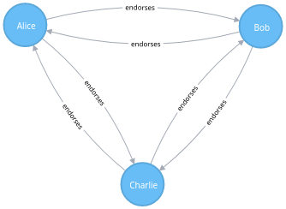
Design Considerations(2/2)
Transaction cost and Free-riders issue
All pseudonymous accounts need to maintain the endorsement connection.
Every “endorse” call consumes gas, so more pseudonymous identities to manage, more operations to pay the gas price of.
Free riders: Ratio need to be close or equal to one.
Fig: Interaction between participants
that endorses each other

Slide 26
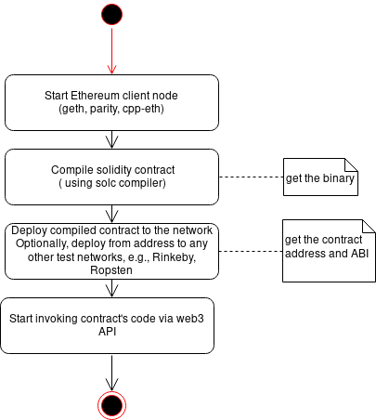
Deployment of Endorsement contract
Ownable: tracks the owner of contract by setting the address of owner.
Killable: allow owner to destroy the contract.
Endorsement: specifies the core logic of endorsement system.

Slide 27
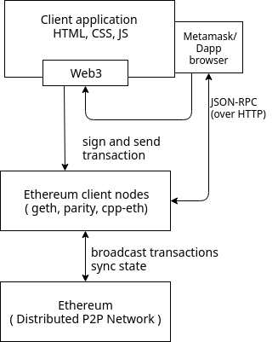
Client Application
Metamask, browser plugin that acts as a web3 provider.
Key store managed by Metamask
Sign and send “endorse” or “computeImpact” transaction via the client application (that retrieves key) to the client nodes.
The client nodes receive the transaction, validates them and broadcasts it over to the blockchain network where the transaction details gets recorded.
Rinkeby, Ethereum test network,
PoW as consensus

Slide 28
4. Results

Slide 29
Threat models addressed by Endorsement system
Sybil attack: The endorsers of a peer should have a high TEI value.
Whitewashing: The misbehaving nodes and their endorsers have their TEI value reduced by half and quarter, but still more than a new node.
Free riders: A bad ratio does not help for a high TEI score.
Denial of service: Implementation of PoW consensus on a public, permissionless blockchain network, does not allow anyone to know a priori, the address of writer that will sign the next block.
Self-promoting and Slandering attack:
  Data source authentication and data integrity verification is offered by BC protocol.
  Sybil identities addressed by cost of operation to do so

Slide 30
Evaluation of requirements
Smart contract security, contract code ordered as
  Conditions: make all the necessary checks, e.g., who called the function, valid arguments?
  Actions: change the state of the current contract
  Interactions: interaction with other contracts
Reliability:
  Trust and reputation information stored as publicly verifiable information
  Resilient to both internal and external attacks.
Trust metrics describe the actual trust of the nodes, Interaction graph

Slide 31
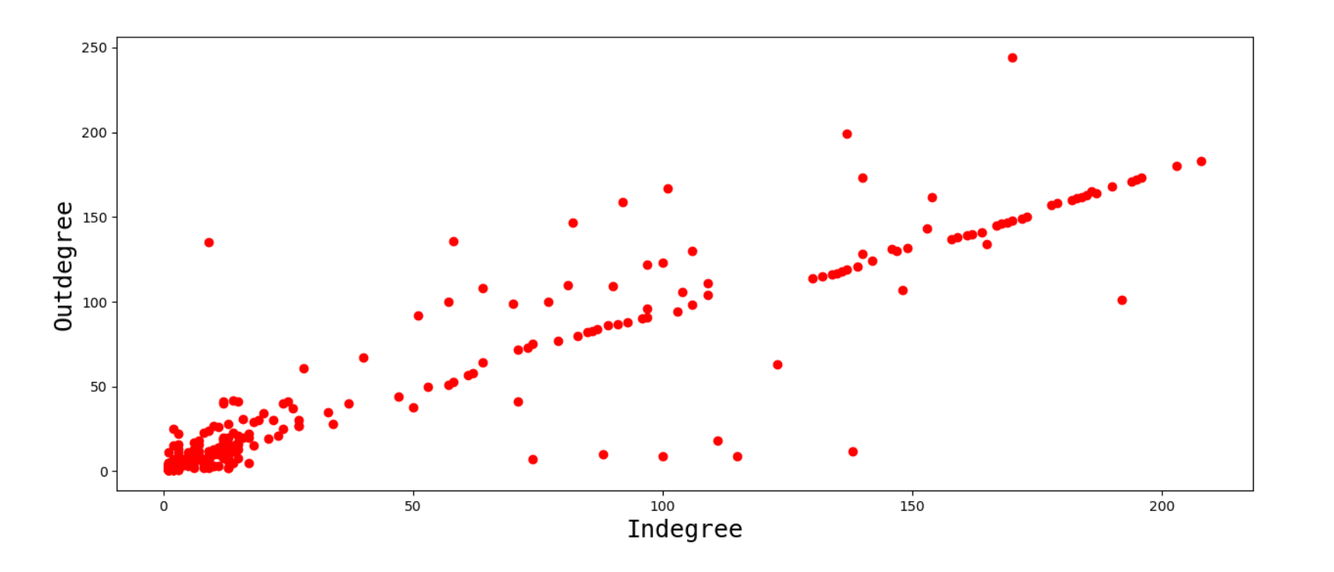
Interaction graph
Trust metrics describes the trust score of the nodes
Dataset with 3,783 nodes that make 24,186 edges out of which 93% were positive edges.
Figure shows distribution of incoming and outgoing connections.

Slide 32
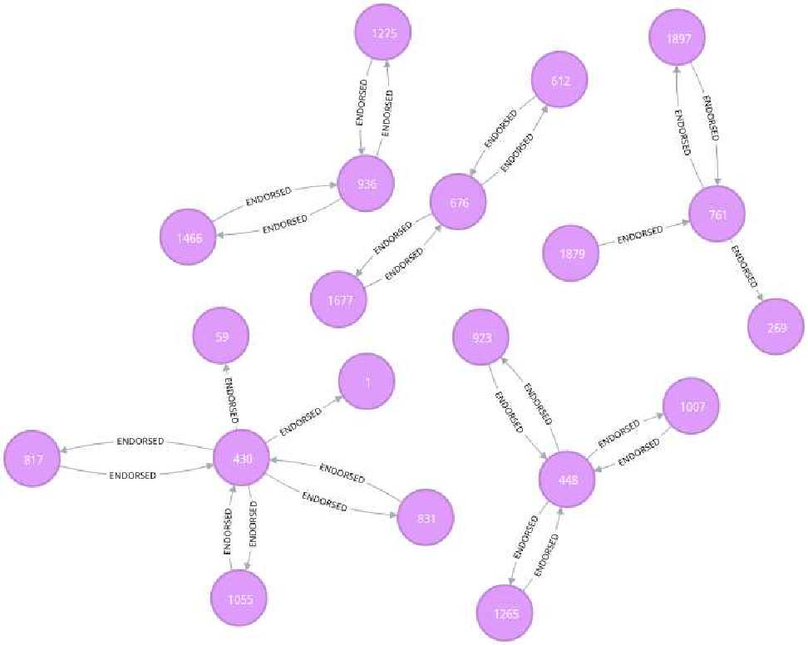
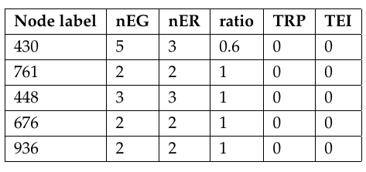
Computation of TEI (1/2)
(Behavior of nodes with low TEI score)
70% (1175 out of 1677) of the nodes had TEI score of zero, reason being they were starting node by definition.
Only 502 nodes left to account for Endorsement impact, among which 5 of them had TEI score of zero because of TRP.
Reason for low TEI:
Non impactful Endorsers
Start node, with only one incoming/outgoing connections.
Impactful node, node with more than one connections.
Low ratio, low TRP
Figure: Interaction subgraph of nodes with zero TEI.
Table: Zero impact due to non impactful endorsers.

Slide 33
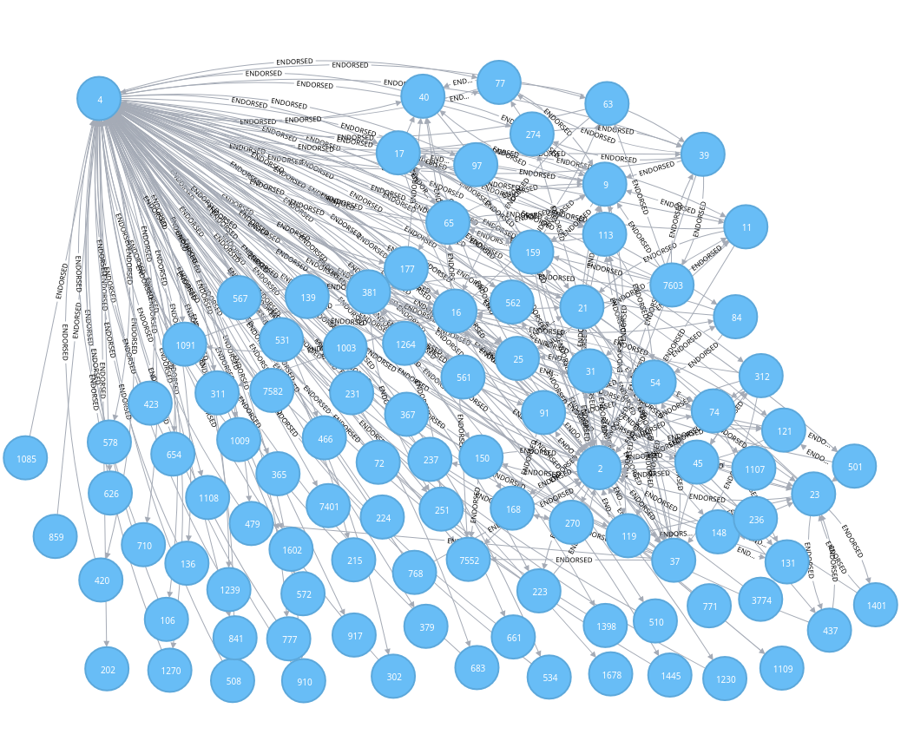
Computation of TEI (2/2)
(Behavior of nodes with high TEI score)
Nodes labeled 2 and 4 depict the
behavior of node with higher TEI
score.
Higher degree of connectivity.
High ratio and TRP

Slide 34
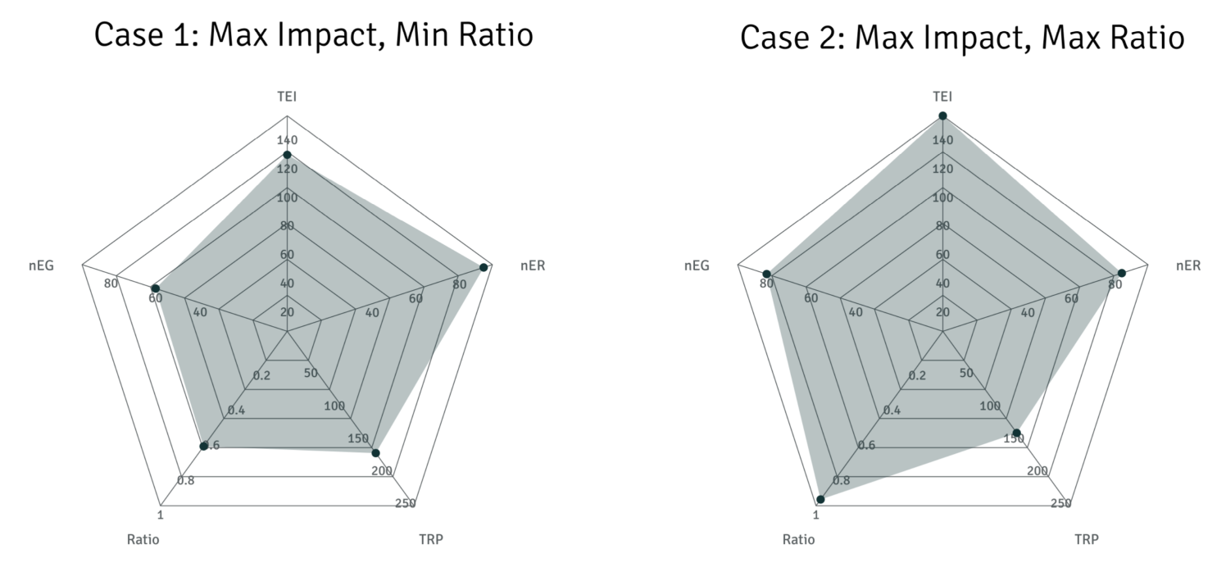
Total impact across several factors (1/2)
High impact node should have a higher ratio
Case1- Among nodes with maximum impact
Lowest ratio: 0.6, Highest TEI: 120
nEG ~49, nER ~87, TRP ~153
Case2- Among nodes with maximum impact
Highest ratio: 1, Highest TEI: 145
nEG ~82, nER ~82, TRP ~150

Slide 35
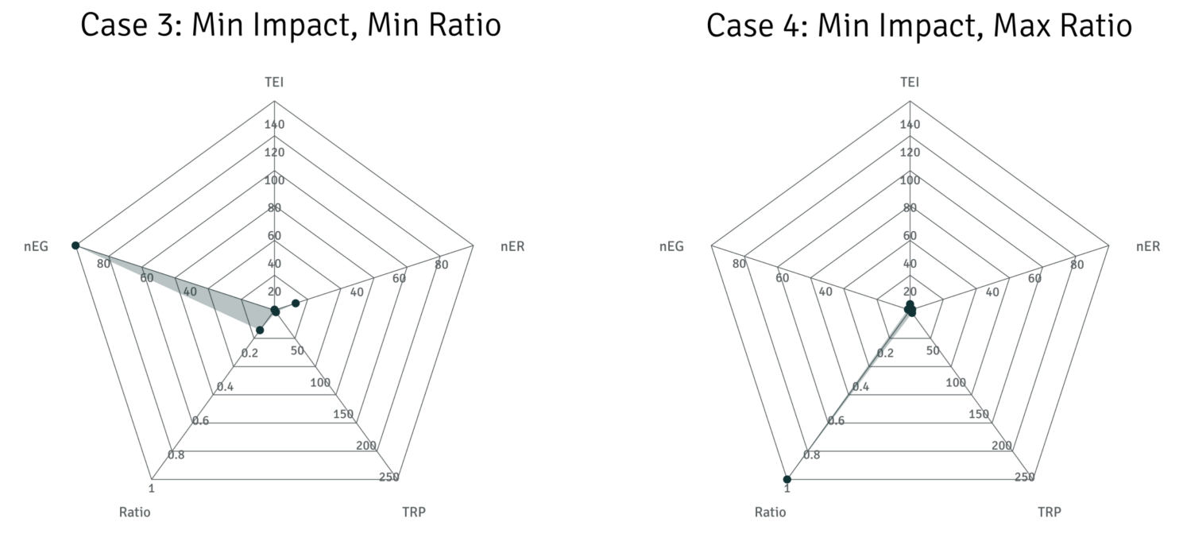
Total impact across several factors (2/2)
A high ratio does not necessarily imply a high TEI
Case3- Among nodes with low impact
Lowest ratio: ~0.1, TEI: negligible
nEG ~100, nER ~20, TRP:negligible
Case4- Among nodes with low impact
Highest ratio: 1, TEI: negligible
nEG ~49, nER ~87, TRP: negligible

Slide 36
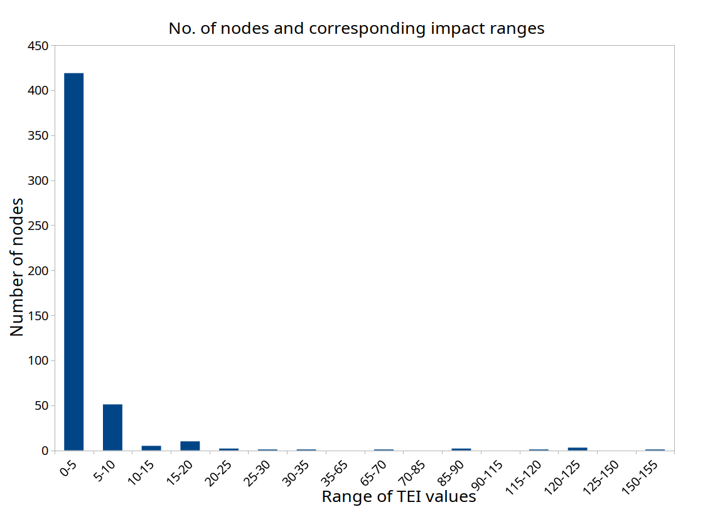
Distribution of TEI across the network for all nodes
Only few nodes with a higher TEI scores.
Majority of the nodes have TEI score within range of 0-5.

Slide 37
Discussion and analysis (1/2)
(Principles of reputation system)
Principles of Reputation system
  Self-policing: A decentralized endorsement system on a public, permission-less blockchain network without a trusted central entity.
  Anonymity: Reputation score of a peer is associated with the unique account identifier and not with externally associated identity, such as IP address or govt. issued identity.
  No profit to newcomers: It takes several incoming and outgoing endorsement connections along with maintenance of several factors to make significant impact on the network.
  Minimal overhead: Any node can submit the transaction, the network throughput is less than 100 tx. Per second,
  Robust to malicious collectives: Future work
Formulation method:
  overcomes the simple aggregation mechanism such as that of eBay.
  Simple computation (without including transitive path) to assign a trust score.

Slide 38
Discussion and analysis (1/2)
(Research Questions)
Question 1: What are the requirements for storing trust values and linking them to associated identities? How can a blockchain application be built to define a general trust framework for a transactional network and how could the overall system architecture look like?
Question 2: How can the endorsement network ensure trustworthiness while also preserving user anonymity and how can it be generalized to other transactional network?

Slide 39
Conclusion and Future works
An endorsement model where entities can endorse each other and provides a method to aggregate those endorsements to assign a reputation score.
Future works:
  Communication between endorsement and transaction system.
  Use of existing trust and reputation models on Blockchain network to evaluate the performance
  Use of anomaly detection algorithms to detect malicious behavior
  Extend the ability to include more information

Slide 40
Questions !!

Slide 43
Merkle-Patricia Tries
A trie, radix tree, or prefix tree
PATRICIA – Practical Algorithm To Retrieve Information Coded In Alphanumeric
Ethereum blocks include three merkle tries :
  Transactions
  Receipts
  state
Four node types to improve efficiency:
  Empty nodes: blank nodes
  Leaf nodes: standard node with key and value
  Branch nodes: list of length 17
  Extension nodes: key-value node where value is hash of another node.
Notes:
Ordered tree data structure used to store key-value mappings where key is actual path taken through the tree to get to its corresponding value.
Receipts: gas used, tx. Log, State: info about accounts,
State Tree:
State is key-value mapping, where keys are accounts addresses and values are account declarations, including acct. balance, nonce, code(contract account)
Changes frequently
Transaction trie
Also key-value mapping where key is tx. ID
List of tx. In block never changes

Slide 44
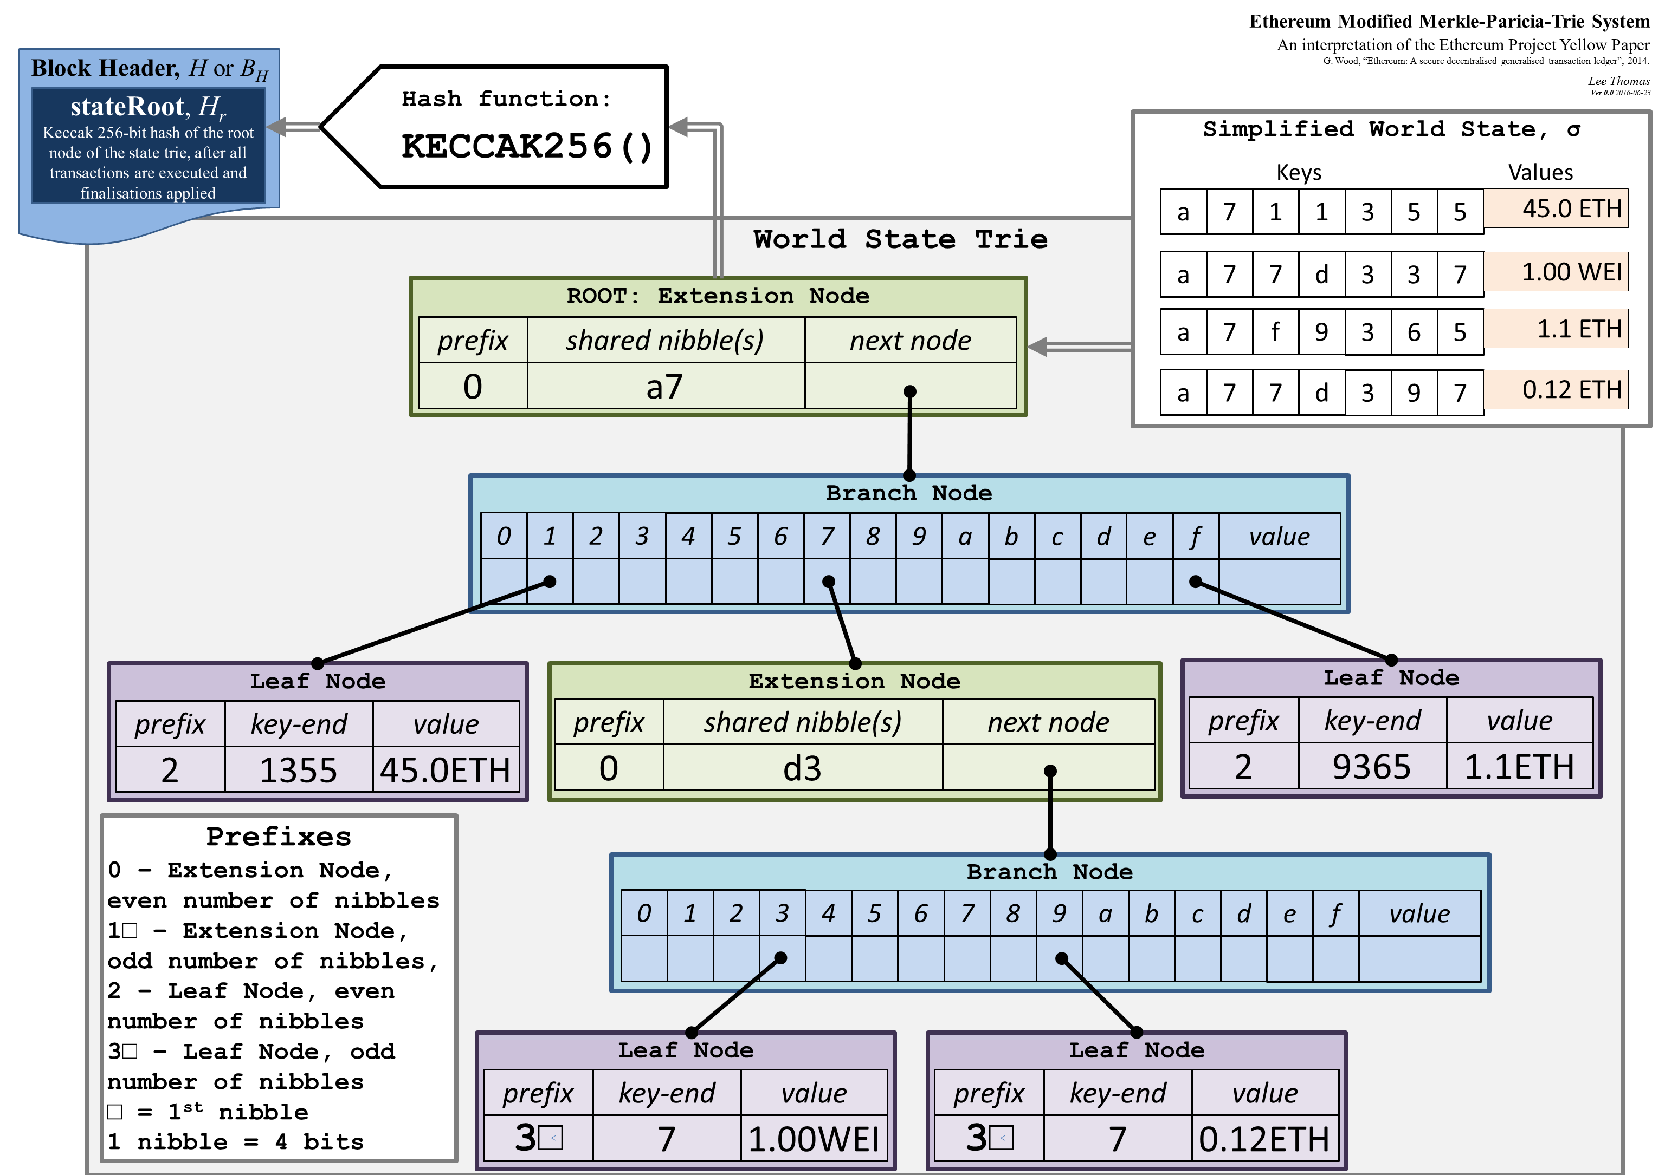
Merklee-patricia Tries
PATRICIA – Practical Algorithm To Retrieve Information Coded In Alphanumberic
Notes:
When inserting into MPT
If you stopped at an empty node, you add a new leaf node with remaining path and replace the empty node with hash of the new leaf node
If you stopped at leaf node, you need to convert it to an extension node and add a new branch and a new leaf node.
If you stopped at an extension node, you convert it to another extension node with shorter path and create a new branch and leaves

