Slide 1
Decentralized Reputation Model and General Trust Framework Based on Blockchain and Smartcontracts
  Masters’ Thesis
  Department of Information Technology, Uppsala University

Slide 2
Outline
Introductio
  Online identiites and interaction
  Trust and Reputation steps
  Why Blockchain for a Reputation System
  Consensus mechanism
Methodology & Implementation??
  Blockchain
  Endorsement Model
  System of Smartcontracts
Results and Evaluation
Conclusion & Future works
Demo (EdS from browser)

Slide 3
Research Questions
How can graph theories and relevant reputation algorithms be used to model the interaction between entities and detect/identify honest and malicious nodes in the network? How can the interaction graph be modeled?
What are the requirements for storing trust values and linking them to associated identities stored off a blockchain network? How can a blockchain application be built to define a general trust framework for a transactional network? How could the overall system architecture look like?
How can the discussed endorsement network ensure trustworthiness while also preserving users anonymity and how can it be generalized to other transactional network or added on top of it to serve other use cases such as content filtering, E-Commerce etc?

Slide 4




Trust infers Reputation and Reputation incites Trust
Trust: subjective probability by which an agent asseses other agent’s action will be beneficial.
Reputation: perception of an individuals character/standing.
Online identities
Trust &
Reputation
Online
Interaction
Notes:
If Alice wants to do a tx. With Bob, she has to trust the information present in the online platform in use and that the information is accurate.
This information is collected based on other entitie’s idea about Bob ie. Other entities that trust Bob gives him a good feedback and collective Bob may make a good or bad reputation.
Individuals in an online system interact via use of their online identities which may or may not be associated with their real-world identites.
Online interaction: shopping, cdn, blogging, social media
Trust score of an entity helps to decide if we wanna interact with them further or not.
Reputation plays a role in determining the trustworthiness of an entity and is context-dependent.
Personal, interpersonal, dispositional, impersonal/struct.
Trust infers reputation and reputation incites trust among unknown entities.
Compute the probability of success/failure of transaction based on the score of an unknown entity

Slide 5
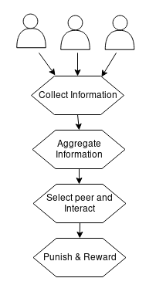
Compute the probability of success/failure before transaction
Provide enough information to infer trustworthiness.
eg. eBay, stack exchange, yelp etc.
Peer-based or file-based
Reputation algorithms in use: EigenTrust, Advogato’s, HonestPeer etc.
Notes:
Ebay: (postive – negative), advogato’s- rates free s/w developers, where users certify each other.
Modeling the interaction: assignment of trust value
Game theory: to model the participation of users in such a way that honest behaviour is rewarded and malignant behaviour is punished and does more harm than good.

Slide 6








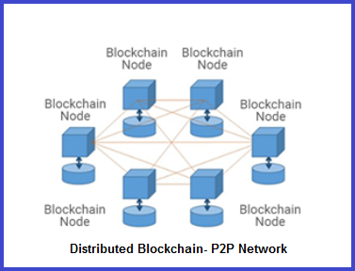
Why Blockchain for a Reputation System?
Centralized data and centralized governance
Distributed data and centralized governance
P2P data distribution, decentralized governance
- Failure in a node results to failure in the entire system
- prone to internal modifications
- Data recovery from any node
- wait for modification node to add new data
Notes:
As discussed earlier, online identities are crucial in online interaction and the informtion available about their reputation must be representative of the entity in question.
Therefore, it is really important that the reputation information about Bob has not been modified.
To ensure a reliable/accurate information, we need to look at the underlying system.
Two essential aspects of any online system being: the storage of data and the logic to manipulate this data.
Most of the Reputation systems in use currentlyemploy a centralized architecture.
How can we have a System such that we don’t need any trusted entity or are not required to trust anyone and still be sure about the correctness of the data.
Modeling the interaction: assignment of trust value
Game theory: to model the participation of users in such a way that honest behaviour is rewarded and malignant behaviour is punished and does more harm than good.
After the assignment of scores, is the System itself reliable enough, always available, attack resistant?, tamper-resistant data? Distributed database – uptime(eg. Google) still single point of control, internal modification possible. Distributed database and decentralized governance/control? Exactly the design principle of blockchain.

Slide 7


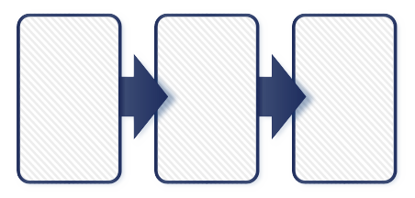
Consensus algorithm helps to maintain consistent database
Blockchain is a database that stores a record of every transaction that has ever taken place.
Modification node is randomly picked every time.
eg.PoW, first to solve a cryptographic puzzle gets to add their block of transactions to the chain.
NO
Yes
Notes:
Fault tolerance is built in P2P distributed network.
Maintains immutability via use of consensus algorithm
Transactions are ordered and bundled in blocks, blocks are chained together cryptographically via hash functions.
Singly linked list data structure.
Consensus algorithm determines the order of blocks in distributed node. Every node can verify that this order is cryptographically valid.
List of ordered tx.s collected by miner node and after solving the puzzle adds to the existing chain of blocs.
If their solution satisfies the underlying protocol, they get to add it to chain.
Problems: privacy is solved by pseudonymity, scalability – volume of data
Design goals : P2P Data distribution: data and the processes that can read/modify the data. Transparent, immutable data.

Slide 8
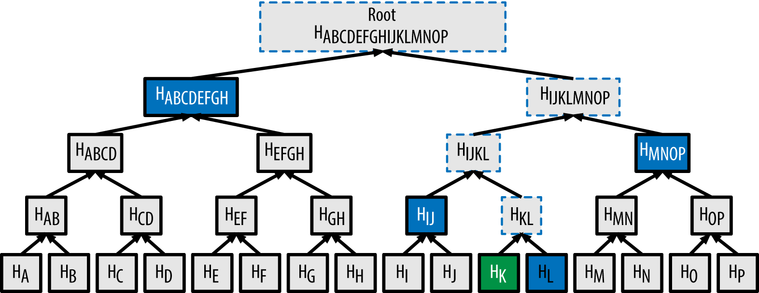
Any change in data changes the root hash
For each (X,Y) in Pairwise(Data):
  Data.append(Hash(X+Y))
  Data.pop(X); Data.pop(Y);
  If Length(Data) == 1:
    Break
                https://www.youtube.com/watch?v=wwrf87bq6jo
                https://bitcoin.stackexchange.com/questions/50674/why-is-the-full-merkle-path-needed-to-verify-a-transaction
Notes:
Hash tree:
Easy to verify data integrity: single hash value(root) represents all tx. Data. Any change in data changes the root hash.
Easy to verify inclusion of a tx(merkle proof): no need to hold a copy of entire chain; light client can

Slide 9


Execution of contract code can change the account state
Smart contracts allow arbitrary computation
In ethereum, smart contract is just an account with code.
Fields: balance, storage, code
Can deploy multiple time or to multiple network.
Ethereum Network, eg. Rinkeby
deploy
Notes:
Contract code execution can change the account state

Slide 10
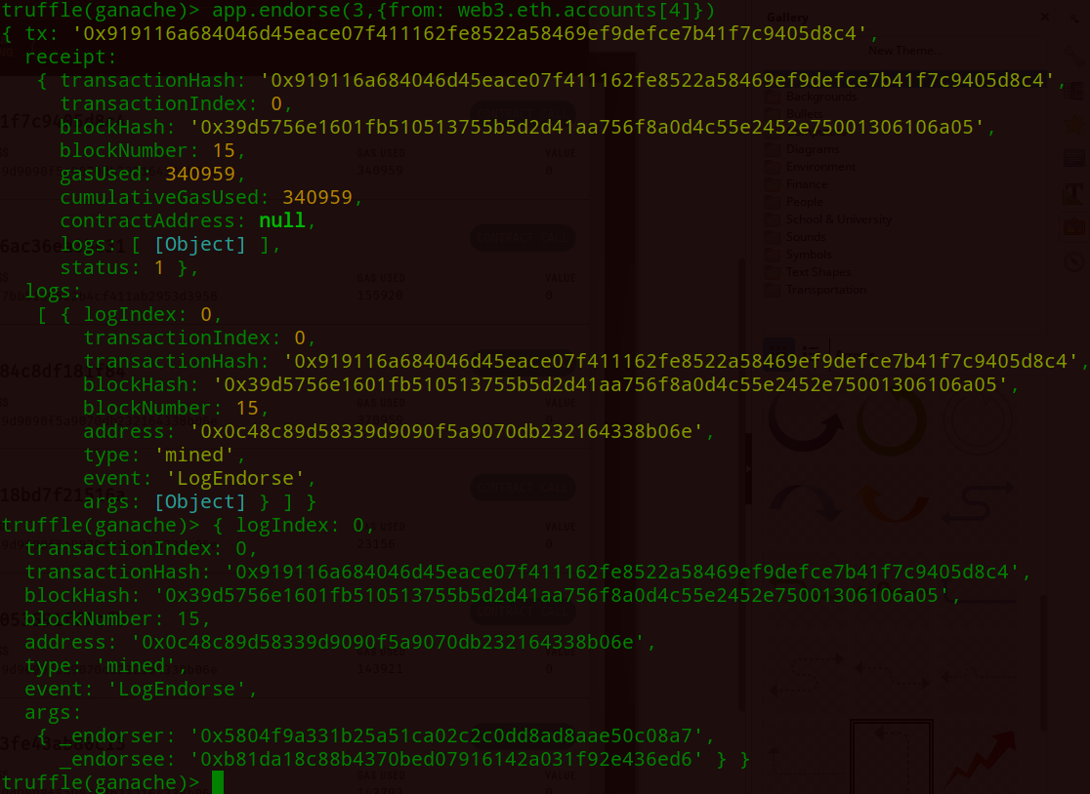
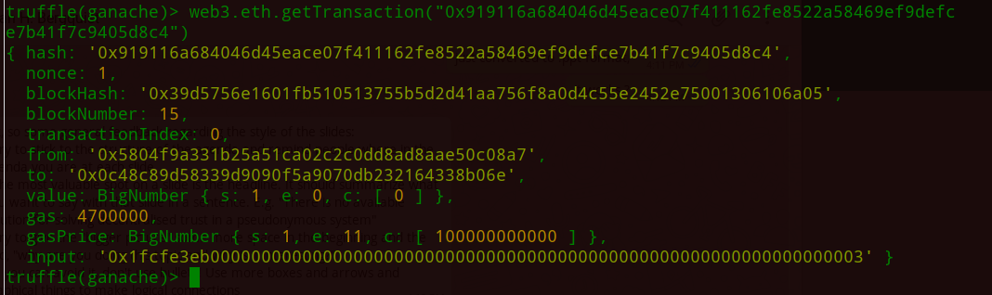
Transaction receipts and gas consumption
Transaction Receipts
Fields: From, to, value, data/input
Notes:
Ordered tree data structure used to store key-value mappings where key is actual path taken through the tree to get to its corresponding value.
Receipts: gas used, tx. Log, State: info about accounts,
State Tree:
State is key-value mapping, where keys are accounts addresses and values are account declarations, including acct. balance, nonce, code(contract account)
Changes frequently
Transaction trie
Also key-value mapping where key is tx. ID
List of tx. In block never changes

Slide 11






2. Methodology & Implementation
Technologies
web3 API for communicating with contract.
Testing of transactions, receipts, contract function call
Graph simulation
Version control

Slide 12
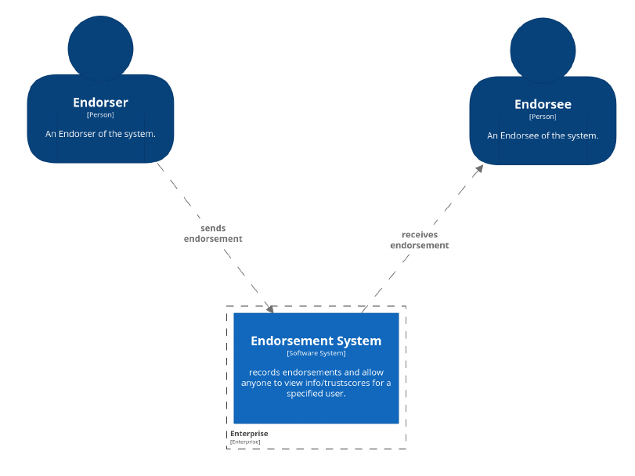
User Stories & Requirement
Anyone can register on the network
Be able to send and receive endorsement as a registered participant.
View a list of endorser and endorsees
Compute the total endorsement impact to infer the trustworthiness of the entity in question.
Privacy by pseudonymity
Secure and reliable data
Trust metrics should correctly describe the actual trust score/impact of the nodes.
Notes:
For the PoC design of an endorsement system, first, User stories and system requirements were outlined.
Two notable role being endorser and endorsee
Anyone can join the network and endorse or get endorsed
EDS system is responsible for recording all the endorsements, compute trust scores and provide enough information to infer the trustworthiness of an entity.
System requirements:
Pseudonymity
Security
Transparent, reliable, verifiable data
Trust metrics should correctly describe the actual trust score/impact of the nodes

Slide 13
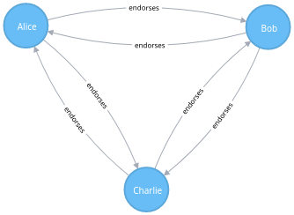
Endorsement Network & Interaction
Transaction cost limits multiple pseudonymous identities
Local information of the current node and all its neighboring nodes
Dynamic behaviour of trust modeled
Discourage extreme one way connection by requiring to maintain nEG and nER
Update TEI based on Tx. network fb.
Notes:
Standard txs: creating multiple pseudonymous identities to make a higher impact on the network costs gas which in turn costs ether.
Local information: every new endorsement changes state for him and for all his endorsees.
If A endorses B, nEG of A and nER of B changes, CP of A changes, in turs TRP of all past endorsees of A also changes.
Storing and updating this info is not possible with an one-time update.
Client-side computation
Dynamism: Since trust is dynamic by nature. A may trust B today but not tomorrow and so, eds previously assigned can be removed by the endorser whenever they want.
Free-riders: necessary to maintain nEG and nER
Endorsement network is a network of all the registered participants in endorsement system.
Once registered, participants can endorse/ get endorsed.
Trust and Reputation steps should consist of the four steps as shown.

Slide 14
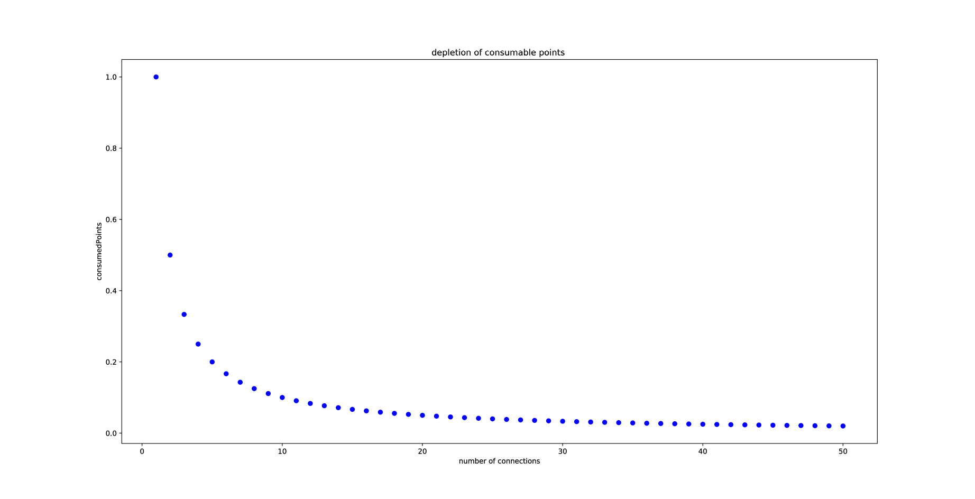
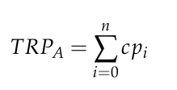

Computation of Total Endorsement Impact
Number of Endorsements given(nEG)
Number of Endorsements received(nER)
Ratio of nEG & nER
Consumable points gets depleted with each connection
Total Received Points
Total Endorsement Impact
Notes:
TEI : good ratio, no extreme one way connection and should have received eds from as impactful nodes.

Slide 15
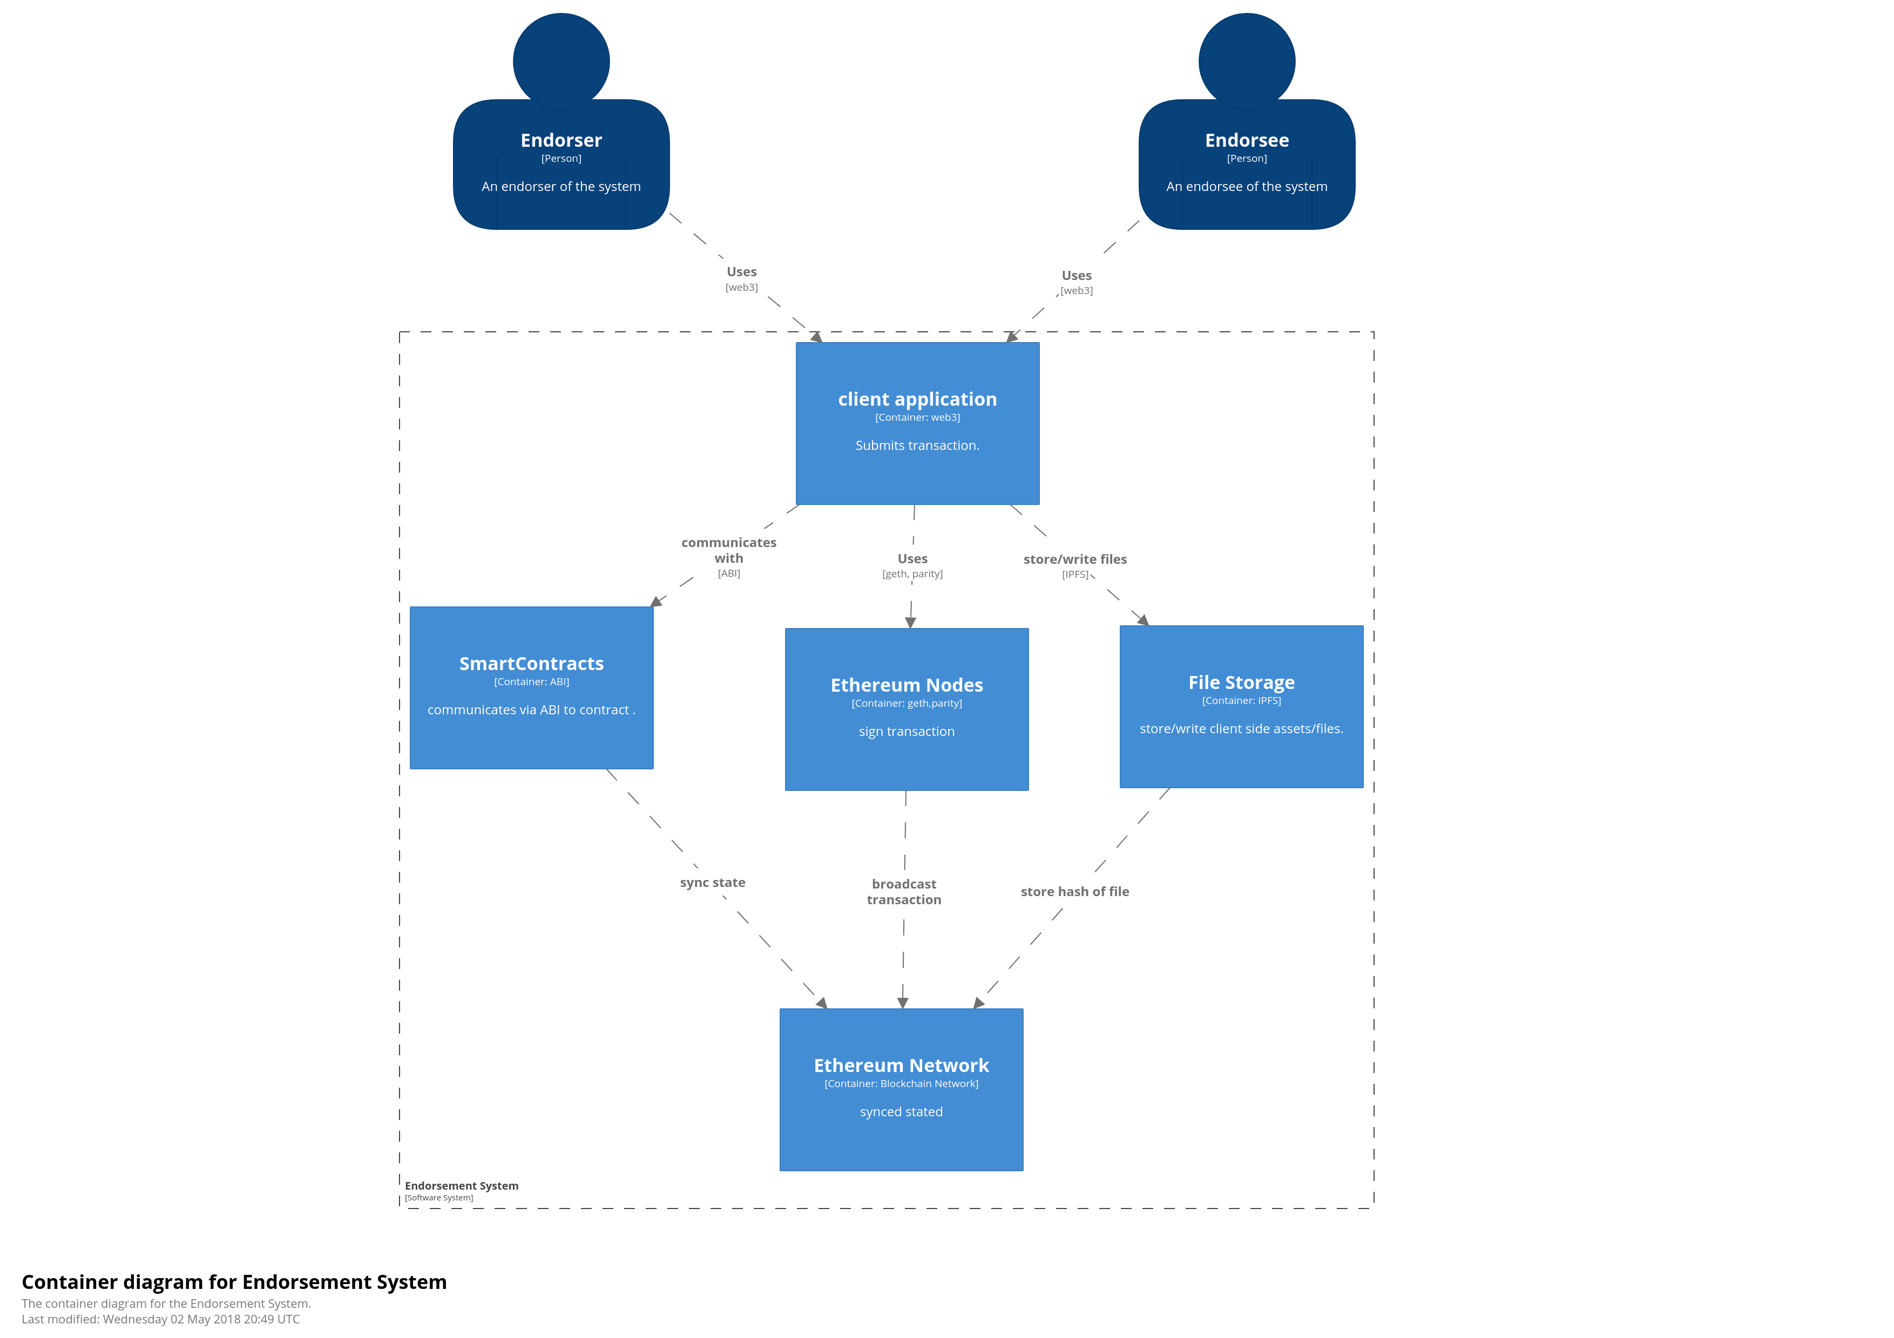
System Architecture

Slide 16
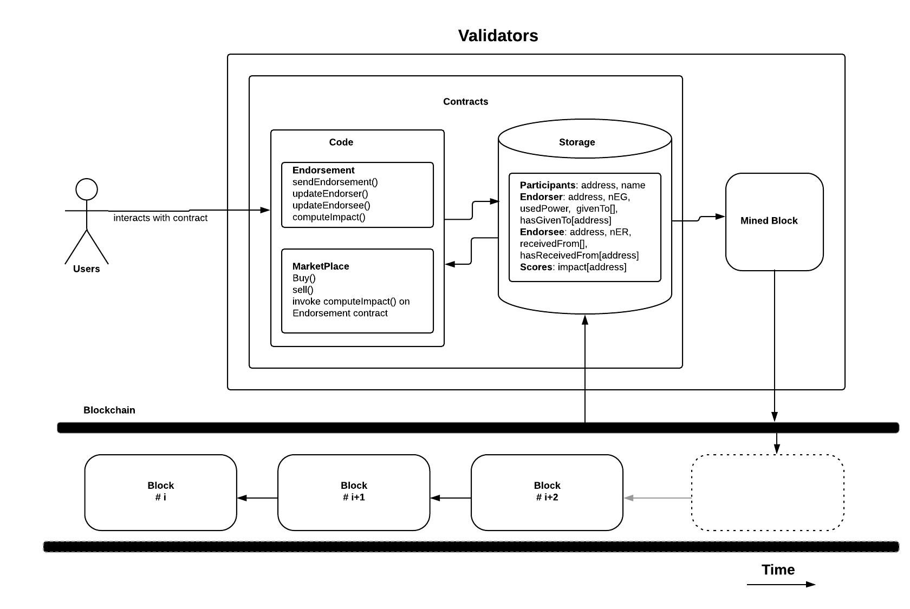
System of smart contracts

Slide 17
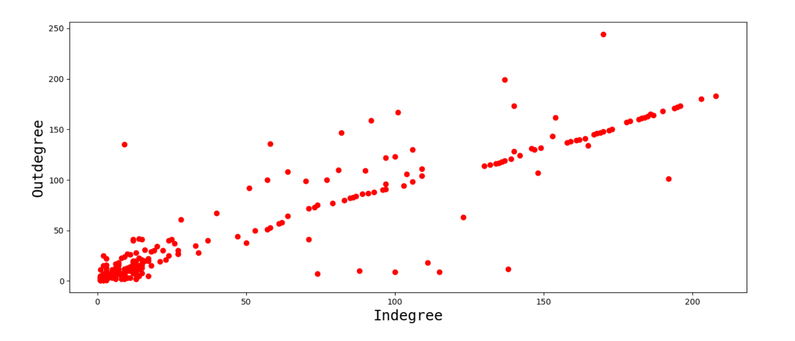
3. Results: Dataset and data distribution
SNAP dataset:
  Bitcoin Alpha wsn
  3,783 nodes, 24,186 edges, 93% positive
  -10 to +10 rating scale
  For EDS, only above +2, 1677 nodes, 4776 edges
Notes:
Distribution of incoming and outgoing connections.

Slide 18
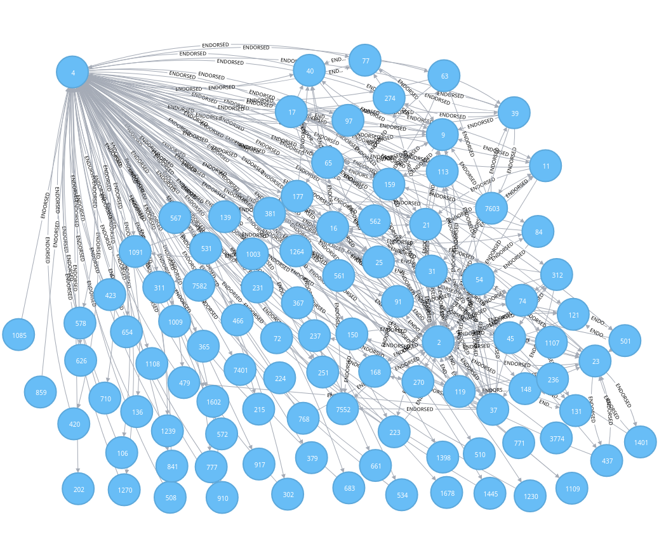
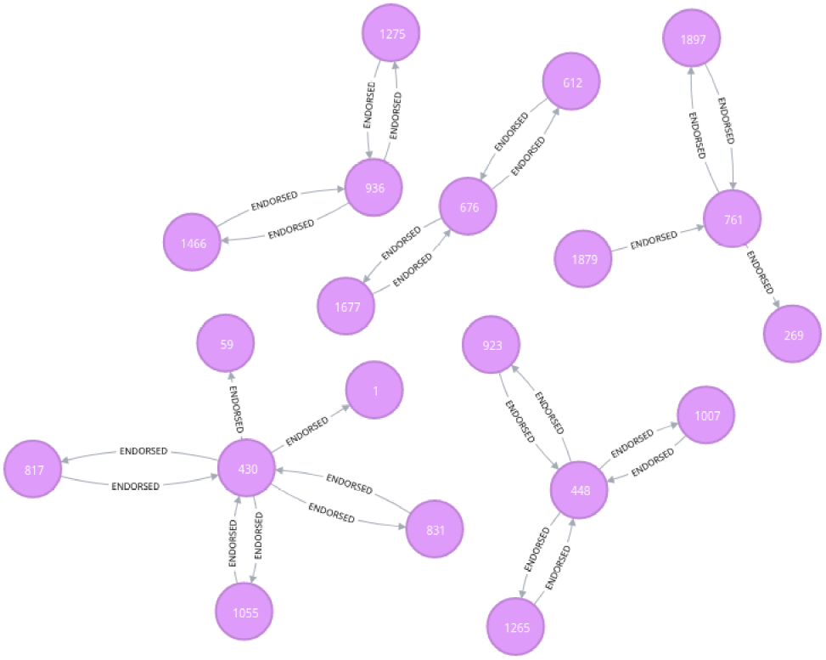
Interaction subgraph: Low Impact vs. High Impact Node
Nodes that have high incoming and outgoing connections and are endorsed by almost equally impactful node as well
Only few nodes have even distribution across all required factors.
TEI follows a power law distribution: very few(~5-7) nodes with high TEI.
Maintained ratio doesn’t help if a node is not endorsed by an impactful node. eg. node430, ratio is 0.6(5/3) but TEI is ignorant.
Notes:
Impact zero because even they themselves have more than 1 in/outgoing conns, their respective endorsers do not have that.
High impact nodes on the right that has large number of incoming as well as outgoing connections.

Slide 19
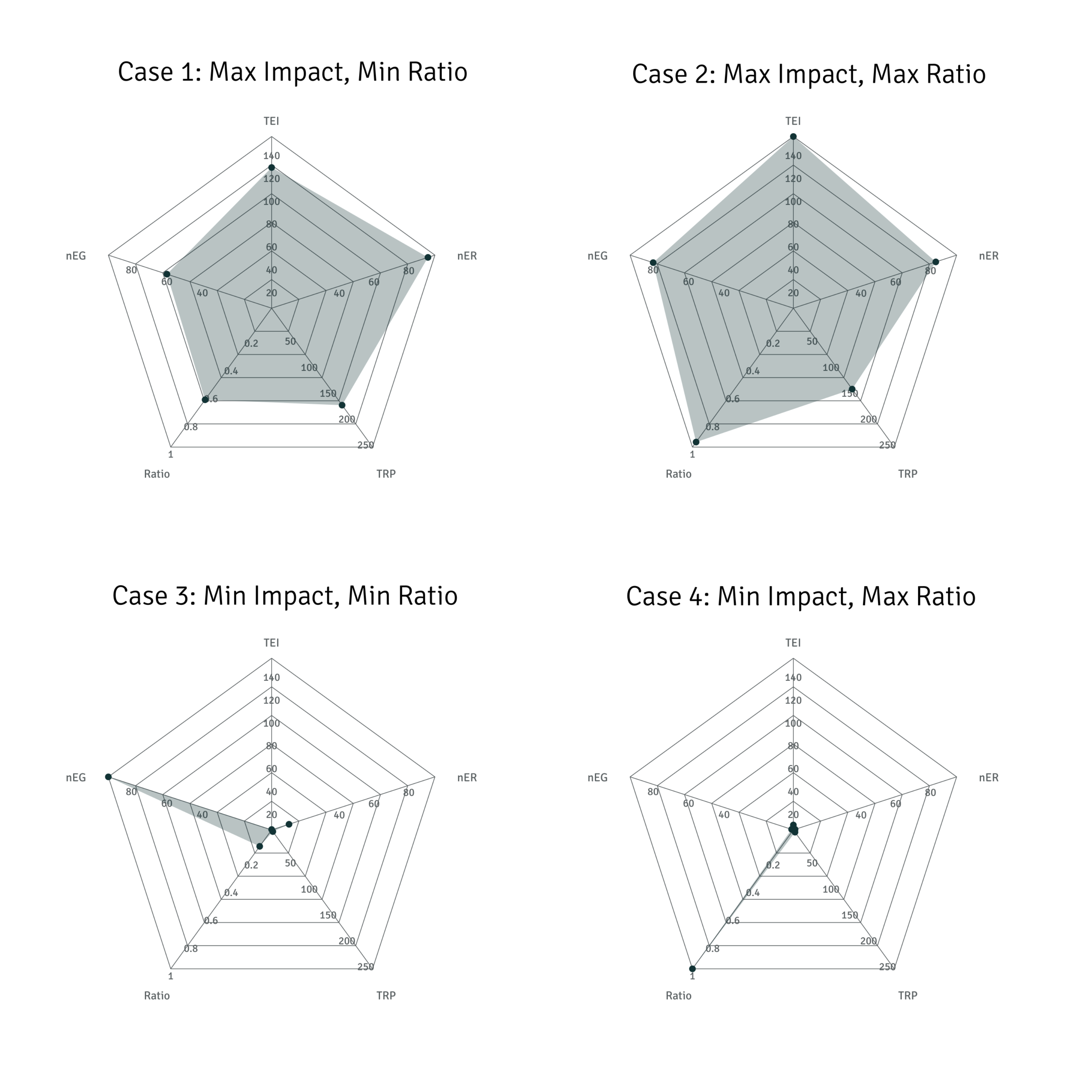
Total impact across all factors
Case1 & 2: Nodes within range of high impact values
even lowest ratio is not that low
Case3 & 4: Nodes within range of low impact values
Worst case behaviour
  Extreme one way connection
New user
Notes:
Max impact node is active participator of the network
Case1: max impact nodes are considered, among them lowest ratio node is extracted, which is 0.6, i.e. max. impact node cannot have too low ratio. Node with maximum impact must have maintained ratio but may not be true the other way around.
Case2: best case scenario. All the nodes with maximum impact is considered and among them the max ratio is 1 as expected.
Case3: all the nodes with minimum impact is considered and as expected, this kind of node has extreme one-way connection and cannot be assumed trustworthy for this system. So neither the ratio nor the impact is significant
Case4: demonstrates the behaviour of a node that has just started making connections.

Slide 20
Threat Models
Collective malicious behaviour: punishment by reducing TEI for both endorser and endorsee.
Sybil attack: Endorsers require high TEI as well.
Whitewashing: New user can never have a TEI more than old user
Freeriders: TEI is never high in case of only one-way connection.
Privacy: Pseudonym not connected to real-world identity.
Reliable and verifiable data on public blockchain
Decentralized governance
Notes:
Various threat models that the eds system manages to address are:
Collective malicious peers: is possible only the first time. If a node is found malignant, their TEI is reduced by half and their endorsers TEI is reduced by 25%. So, honest peers wouldn’t just endorse without enough confidence.
Sybil attack: by requiring all endorsers to have high TEI as well. Creating multiple sybil identities and endorsing themselves will have no impact on the network if that node doesn’t have significant impact value. Maintaining global value for all pseudonymous identity is time consuming and not worth the effort.
Whitewashing: a new user can never have an impact score more than the old user. Even if a user is penalized by the network, their value is never less than 0, since it is reduced by percentage.
Freeriders: by requiring to maintaint nEG and nER
Transparency, immutability by blockchain
Privacy by pseudonymity.

Slide 21
Conclusion & future works
Make it like a summary
Fulfillment of requirements
Research questions answered
General model that can be used by any interaction n/w.
Use of Complex Trust algorithms on scalable network
Notes:
All the functional requirements for interaction of endorser and endorsee were fulfilled by contracts function. Also, frontend implementation was done.
Generalization: EDS is general model that aggregates and assign reputation scores to individuals based on their interaction in the network, so any interaction network can use this design.
More scalable infrastructure that can handle large number of users and more transactions per second will be more efficient.

Slide 22
Questions ?

Slide 23
Merkle-Patricia Tries
A trie, radix tree, or prefix tree
PATRICIA – Practical Algorithm To Retrieve Information Coded In Alphanumeric
Ethereum blocks include three merkle tries :
  Transactions
  Receipts
  state
Four node types to improve efficiency:
  Empty nodes: blank nodes
  Leaf nodes: standard node with key and value
  Branch nodes: list of length 17
  Extension nodes: key-value node where value is hash of another node.
Notes:
Ordered tree data structure used to store key-value mappings where key is actual path taken through the tree to get to its corresponding value.
Receipts: gas used, tx. Log, State: info about accounts,
State Tree:
State is key-value mapping, where keys are accounts addresses and values are account declarations, including acct. balance, nonce, code(contract account)
Changes frequently
Transaction trie
Also key-value mapping where key is tx. ID
List of tx. In block never changes

Slide 24
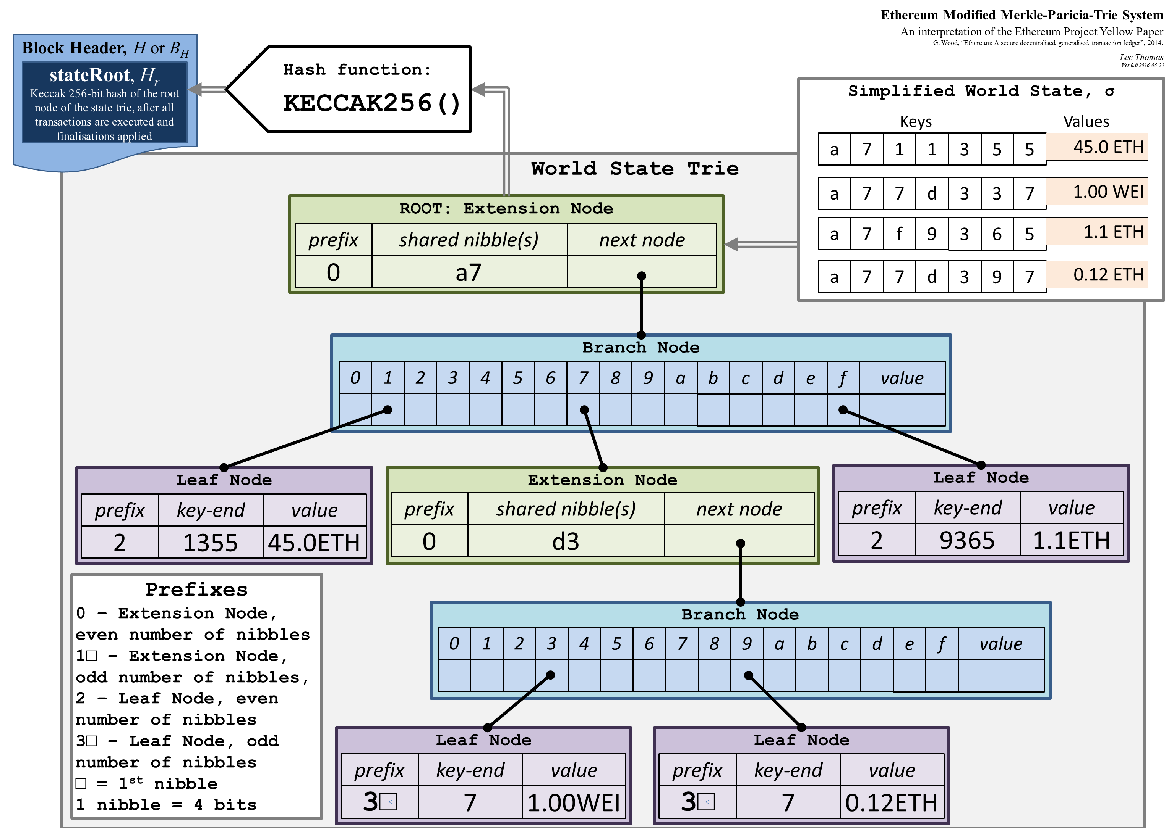
Merklee-patricia Tries
PATRICIA – Practical Algorithm To Retrieve Information Coded In Alphanumberic
Notes:
When inserting into MPT
If you stopped at an empty node, you add a new leaf node with remaining path and replace the empty node with hash of the new leaf node
If you stopped at leaf node, you need to convert it to an extension node and add a new branch and a new leaf node.
If you stopped at an extension node, you convert it to another extension node with shorter path and create a new branch and leaves

Slide 25

Online
Interaction
Online
Identities
Trust and
Reputation

Slide 26

Why Blockchain for a Reputation System?
P2P data distribution, centralized governance
P2P data distribution, decentralized governance
Centralized data, centralized governance
Notes:
As discussed earlier, online identities are crucial in online interaction and the informtion available about their reputation must be representative of the entity in question.
Therefore, it is really important that the reputation information about Bob has not been modified.
To ensure a reliable/accurate information, we need to look at the underlying system.
Two essential aspects of any online system being: the storage of data and the logic to manipulate this data.
Most of the Reputation systems in use currentlyemploy a centralized architecture.
How can we have a System such that we don’t need any trusted entity or are not required to trust anyone and still be sure about the correctness of the data.
Modeling the interaction: assignment of trust value
Game theory: to model the participation of users in such a way that honest behaviour is rewarded and malignant behaviour is punished and does more harm than good.
After the assignment of scores, is the System itself reliable enough, always available, attack resistant?, tamper-resistant data? Distributed database – uptime(eg. Google) still single point of control, internal modification possible. Distributed database and decentralized governance/control? Exactly the design principle of blockchain.

Slide 27
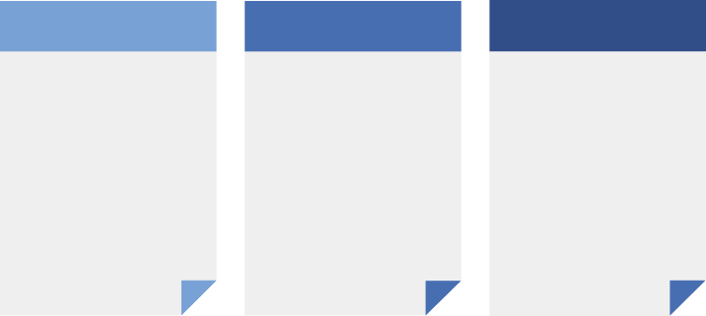
Solution design
&
implementation
Literature survey
Design & implementation
Results & evaluation
Definition: Identify relevant concepts.
Literature review: Graph properties, relevant reputation algorithms, blockchain evolution.
Requirements analysis
Design solution: formulate reputation model, methods to quantify reputation scores, trust values
Write smartcontract code, deploy on blockchain network
Proper evaluation metrics
Test all the contract function calls and trace back to see if requirements are fulfilled.
Test the model on real datasetm, measure and analyze the trust scores.
Analyze model based on relevant threat models

Slide 28
Block n-2
Block n-1
Block n
Previous hash
Timestamp
Nonce
Transactions root hash
List of transactions:
Tx. 1
Tx. 2
……
…..
Tx. n
List of transactions:
Tx. 1
Tx. 2
……
…..
Tx. n
List of transactions:
Tx. 1
Tx. 2
……
…..
Tx. n

