Slide 1

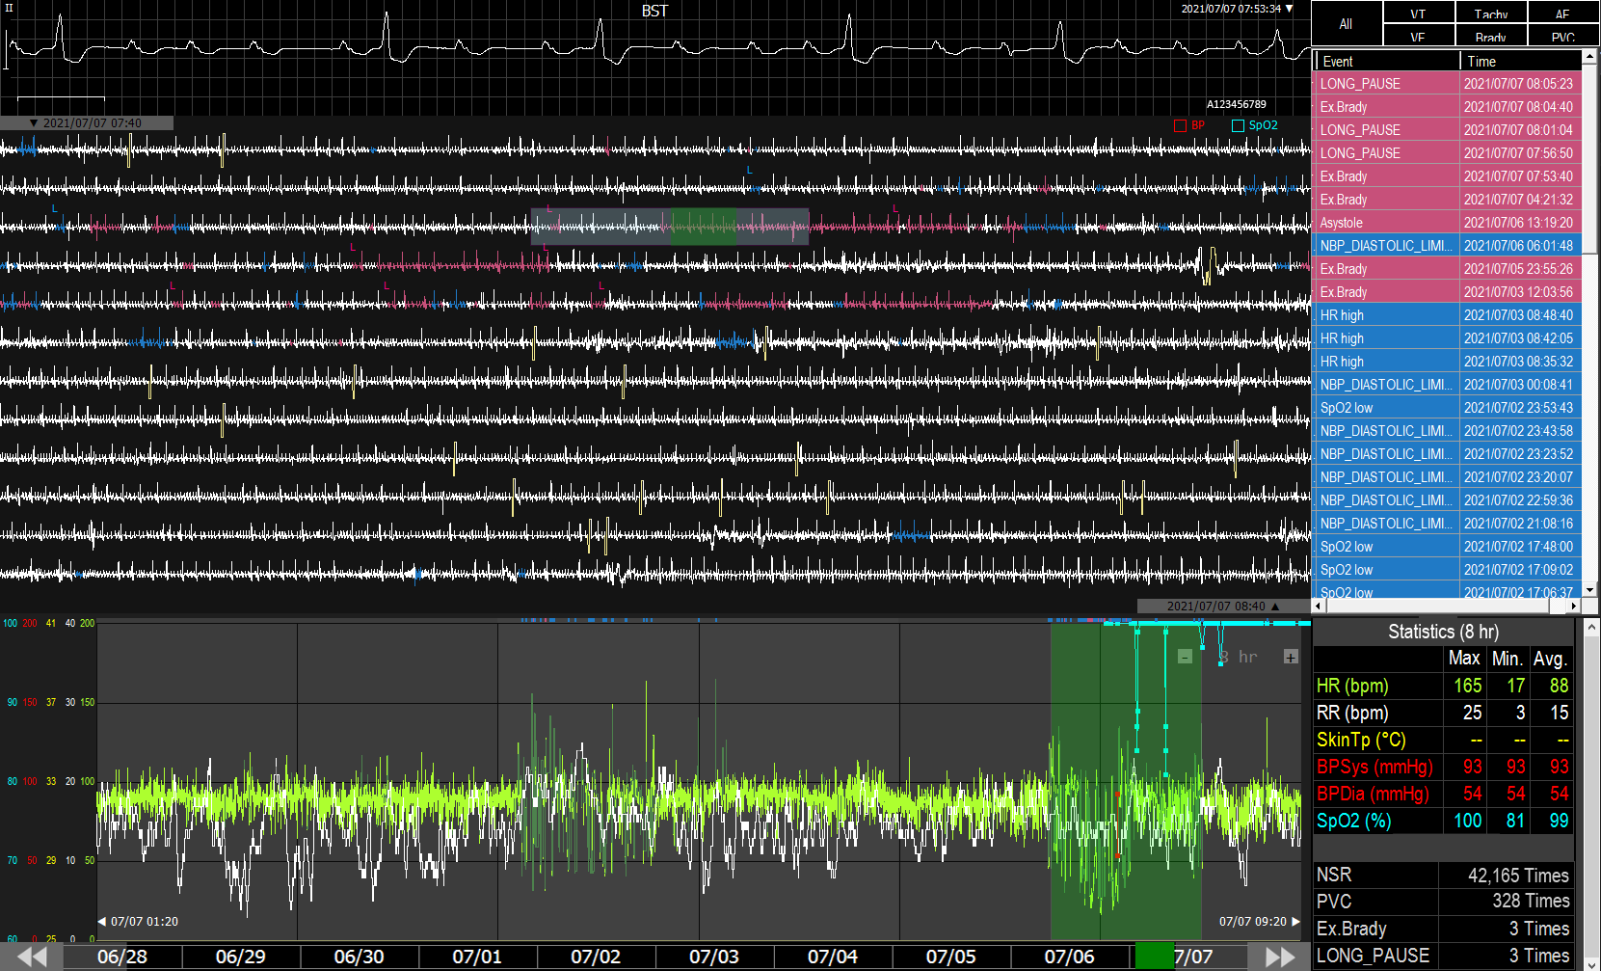



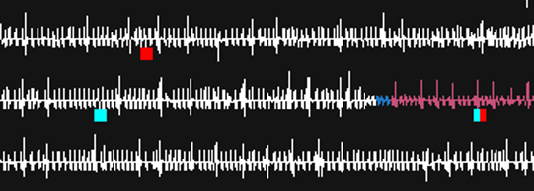
Display of External Data in One-Hour View (for v6.1.15.13 or later)
Default
Display SpO2
Display BP
Display BP and SpO2
BP
BP+SpO2
SpO2

Slide 2


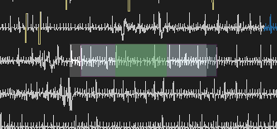
Print Region Adjust (for v6.1.15.?)
1
Double-clicked green region to start print region adjust function.
2
Drop and drag to adjust printout length (white rectangle) of ECG waveforms.
*length = 8*n seconds

Slide 3
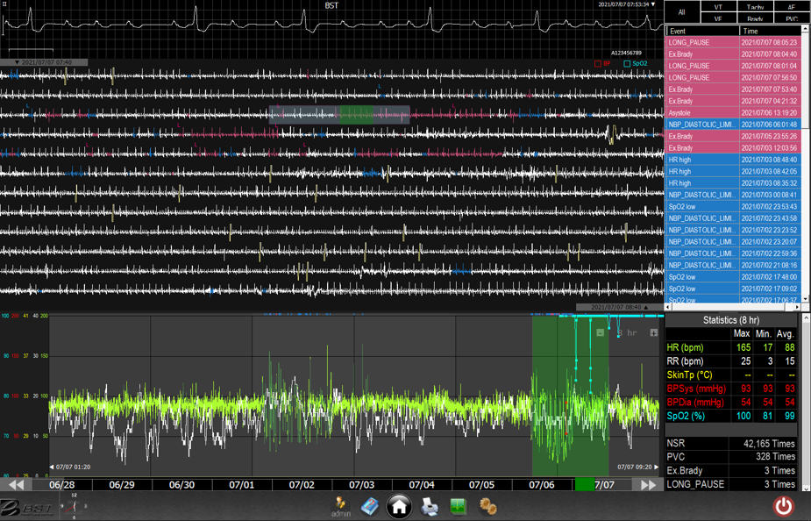
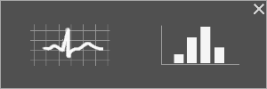
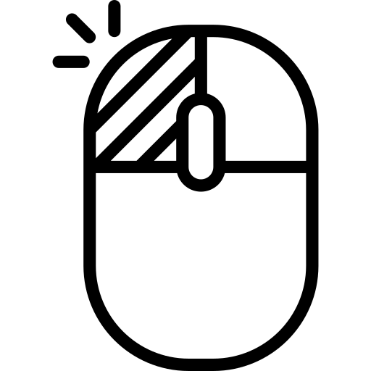
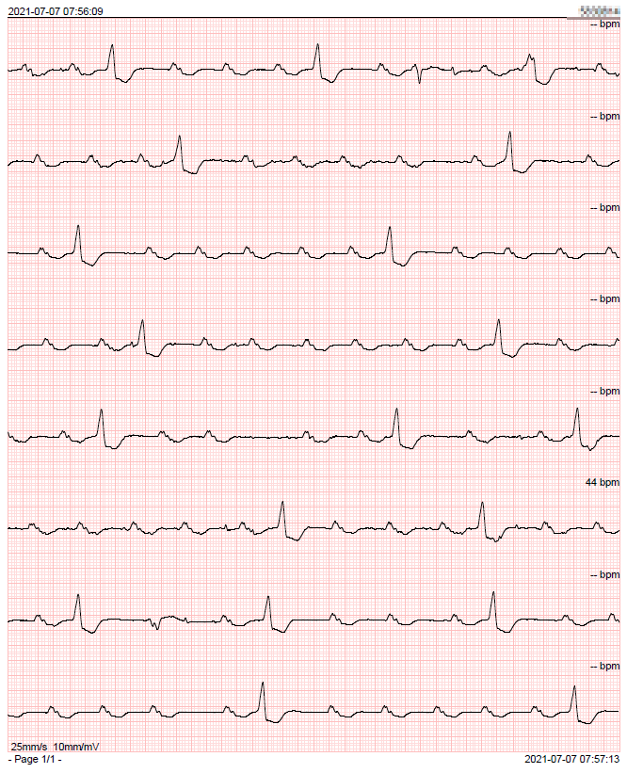
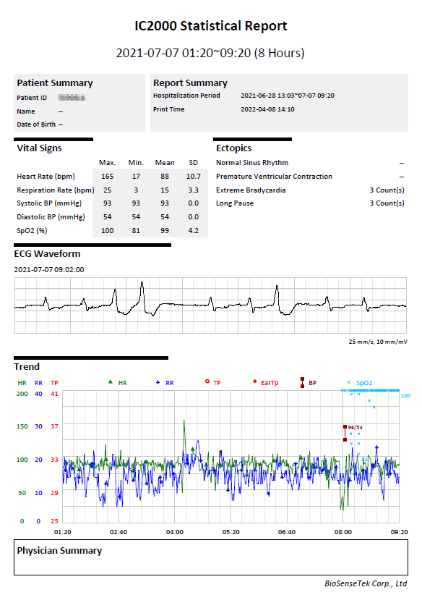


Print Region Select (for v6.1.15.?)
Mouse LEFT-clicked to select.
In Retriever Mode
Mouse LEFT-clicked printer icon to display selector.

Slide 4
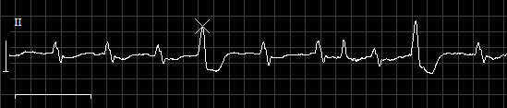
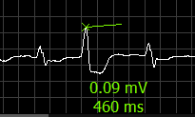
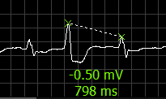

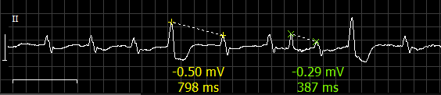
Ruler (Caliper) Measurement (for v6.1.15.?)
Case: Add
1
Mouse moving on standard waveform region. “X” depicts the first point of measurement.
2
Mouse LEFT-clicked to drop the first point and then drag to drop at the second point.
* Max. pairs of measurement = 2

Slide 5
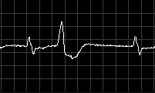
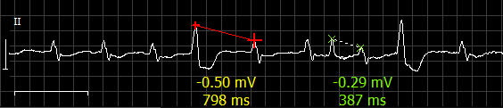
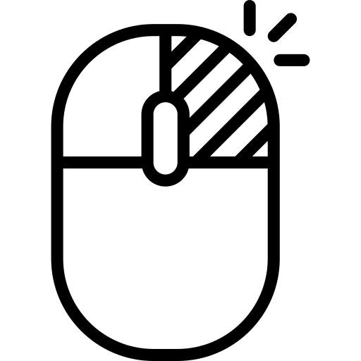
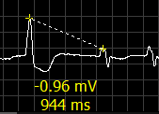
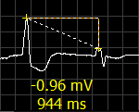
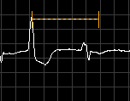
Ruler (Caliper) Measurement (for v6.1.15.?)
Case: Delete
Mouse moving to the region.
Mouse LEFT-clicked to delete certain measurement.
Case: Compare RRI
Mouse RIGHT-clicked to copy x-axis.
2
1
Drag the copied x-axis to compare RRIs.

Slide 6
