Slide 1

Welcome
Interviewer: Zhaomin Sun
Agenda
1. Personal introduction
2. A project of research experience
3. Takeaways

Slide 2

Academica background The University of Edinburgh Edinburgh, UK Master of Science in Computer Science Graduation Date: Nov. 2022 Master of Science in Advanced Technology for Financial Computing Obtained offer Dalian Maritime University Dalian, CN Bachelor of Science in Electronic Information Engineering Graduation Date: Jun. 2017 GPA: 83/100 (top 20%) GRE General Test: 311/340 (Quantitative Reasoning: 170/170)
Awards
ACM International Collegiate Programming Contest (Third Prize)
Mathematical Contest in Modeling (Second Prize)
Annual College Student Innovation Competition (Price in Provincial Level)
Work experience
Intel Corporation (2 years as Param Engineer) Apr. 2017-Nov.2018 Dalian
Huawei Haisi Semiconductor (Internship) Jun. 2022 Remote
BroadSilver Investment Management Company (Internship) Jul. 2023 Beijing
Personal Introduction
A Project of Research Experience
Takeaways

Slide 3
Neural Machine Translation
Introduction:
Build a NMT model for German to English, and optimize its performance.
Motivation:
Understanding and implementing ML algorithms
Problem-solving skills
Teamwork and project management
Next:
1. Compare ML models
2. Disscuss methods for optimization
3. Interesing problems we found
4. Summary
Goal:
Build a reliable NMT for German to English
Research question:
Which model architectures are suitable for NMT work?
After selecting a model, which optimization methods can improve the performance of the NMT model?
Personal Introduction
A Project of Research Experience
Takeaways

Slide 4
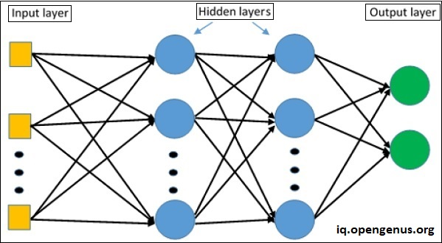
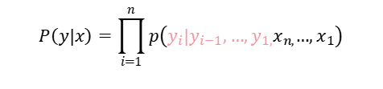
Compare ML models → 2. Disscuss methods for optimization → 3. Interesing problems we found → 4. Summary
MLP
Singal-layer RNN
day is a beautiful Today
Today is a beautiful day
...
N-gram model
capture local dependencies between adjacent words in a sequence
Today
is
a
beautiful
day
...
Y
h
X
Heute
ist
ein
schöner
Tag
f(), g() are sigmoid and softmax activation functions. h, y are the corresponding hidden and ouput vectors. U, V, W are mitrax of hidden layer, input word representation and output word representation.
$$P\left(y|x\right)=\prod_{i=1}^{n}{p\left(y_{i}|y_{i−1},…,y_{1,}x_{n,}…,x_{1}\right)}$$
Heute ist ein schöner Tag
Seq2Seq(RNN) → LSTM →BLSTM
Syntax is very different between language
SUBJECT VERB OBJECT
↓ ↓ ↓
English: "The man reads the book."
German: "Das Buch liest der Mann."
The
man
+
...
The courses are taught by Rose Leslie.
This course talks about rose species.
...
Empirically, this model forgets first input in
the later output.
The student, who got A in the exam, is excellent.
The students, who got A in the exam, ? excellent.
...
Das
Buch
<s>
Personal Introduction
A Project of Research Experience
Takeaways

Slide 5
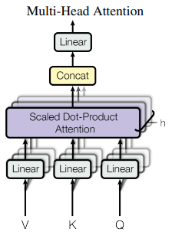
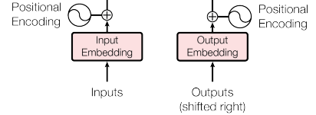
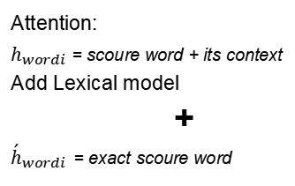

1. Compare ML models → Disscuss methods for optimization → 3. Interesing problems we found → 4. Summary
1. Greedy decoder, BLSTM (baseline)
2. Beam search (width=5)
3. Add layers (encoder=2,decoder=3)
4. Add Lexical Model [1]
5. Multi-Head Attention Transformer Arc.[2]
Attention:
$h_{wordi}$ = scoure word + its context
Add Lexical model
+
${\acute{h}}_{wordi}$ = exact scoure word
multi-head attention
multi-head attention
Y
xn xn
+
...
encoder decoder
h
...
X
$$p\left(y_{i}|y_{i−1},…,y_{1,}x_{n,}…,x_{1}\right)=f\left(Wh^{i}+\acute{W}{\acute{h}}^{i}\right)$$
Methods | Training Loss (Last Epoch) | Validation Perplexity(Last Epoch) | Test Set BLEU
1. Baseline | 2.126 | 27.3 | 10.78
2. Beam search | 2.041 | 26.5 | 11.97
3. Add layers | 2.308 | 29.1 | 9.66
4. Add Lexical model | 1.811 | 24.3 | 13.68
5. Transformer architecture | 1.476 | 38.9 | 10.59
Personal Introduction
A Project of Research Experience
Takeaways

Slide 6
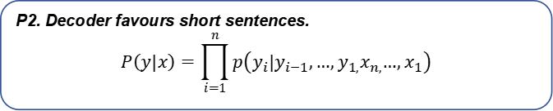
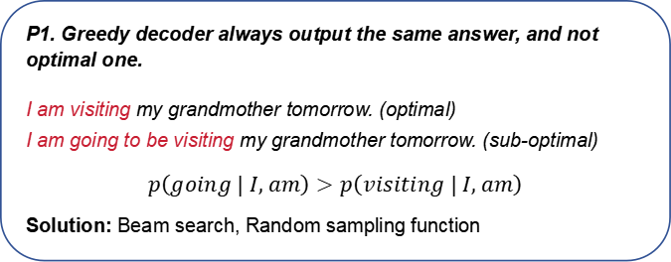
1. Compare ML models → 2. Disscuss methods for optimization → Interesing problems we found → 4. Summary
P1. Greedy decoder always output the same answer, and not optimal one.
I am visiting my grandmother tomorrow. (optimal)
I am going to be visiting my grandmother tomorrow. (sub-optimal)
$$p\left(going | I, am\right)>p\left(visiting | I, am\right)$$
Solution: Beam search, Random sampling function
English: “The”
German: “die”, “der”, “den”, “das”
Translation from English to German need more context information to determine which word corresponding to “The”.
Translation | Test Set BLEU
German to English | 10.78
English to German | 9.37
P2. Decoder favours short sentences.
$$P\left(y|x\right)=\prod_{i=1}^{n}{p\left(y_{i}|y_{i−1},…,y_{1,}x_{n,}…,x_{1}\right)}$$
P4. Lexical model perform better on a specific type of word.
NLTK POS tagger connot tag lots of numbers: 4.8(En) 11.40(Ge) → <UNK>
(German): die zulässige obergrenze für den eu-haushalt beträgt 1,27 % des bsp der mitgliedstaaten .
(True English): the permitted ceiling in the eu budget is 1.27 % of the combined gnp for the member states .
(Baseline): the chinese 2020 is for the eu 's increase % of member states.
(Lexical): the chinese cost in the eu money is 1.27 % combination of member states.
P3. From a language with a lower token ratio to another language with a higher token ratio, performance of NMT will be lower.
Language | Total word | Word type | Token ratio
English | 124,031 | 8,326 | 0.0671
German | 112,572 | 12,504 | 0.1111
Personal Introduction
A Project of Research Experience
Takeaways

Slide 7
1. Compare ML models → 2. Disscuss methods for optimization → 3. Interesing questions we found → Summary
What we did:
Creation of seq2seq NMT with RNN, LSTM, BLSTM
Data preprocessing, model training, model evaluation
Implementation of greedy decoder, beam search, adding lexical model, multi-head attention Transformer architecture
Iteration of training and evaluation
Problem-solving
(My contribution)
Teamwork
Time management
Self-driven learning to new thing
Future Plan:
RNN for China stock price trend prediction
Next:
RNN for sentiment extraction from financial media, LSTM and RL for price trend prediction
Reference:
[1] Toan Q Nguyen and David Chiang. Improving lexical choice in neural machine trans_x0002_lation. arXiv preprint arXiv:1710.01329, 2017.
[2] Ashish Vaswani, Noam Shazeer, Niki Parmar, Jakob Uszkoreit, Llion Jones, Aidan N.Gomez, Lukasz Kaiser, and Illia Polosukhin. Attention is all you need. In NIPS, 2017.
Personal Introduction
A Project of Research Experience
Takeaways

Slide 8
Takeaways: My interest in ML & quantitive finance. My fundation of ML, programming and methmatics. A good teamworker, diligent learner and maybe a good speaker.
Why I believe I am a good fit for this position? My interest: Derivatives pricing, such as equity. Main chanllege: lack of robustness & interpretability in models
Thank you for listenning
Personal Introduction
A Project of Research Experience
Takeaways

