Slide 1

FREE TO BREATHE
Davide Botteon, s201226@studenti.polito.it
Zülal Keskin, zulal.keskin881@gmail.com
Mauro d’Addato, s201511@studenti.polito.it
Amedeo Bertone, s204059@studenti.polito.it
https://ami-2016.github.io/FtB

Slide 2
1. THE PROBLEM
FREE TO BREATHE: interacting monitoring system thought for people affected by allergies, with the aim of supporting them in their daily life by making a safe area out of their home.
WHY? It is studied that one of the main causes of allergic attacks is the presence in the air of allergenic substances (such as mites, pollen and mold), but also of chemical substances (contained for example in cigarette smoke or perfumes).
Wouldn’t it be better if there was a system capable of reducing the amount of these substances in a room?

Slide 3
2. PROJECT IDEA
How does FtB will be able to free the room from the microscopic substances which can cause allergy?
The steps are quite simple:
Sensors analyze the conditions of the room
Through the data provided by the sensors a suitable program will provide the actuators with the information they need to do their job
The actuators will clean the air if the data flow coming from the program running on the system will highlight the need to intervene

Slide 4

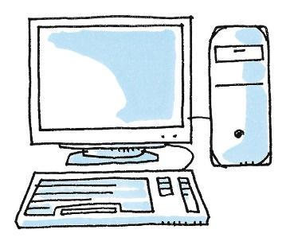
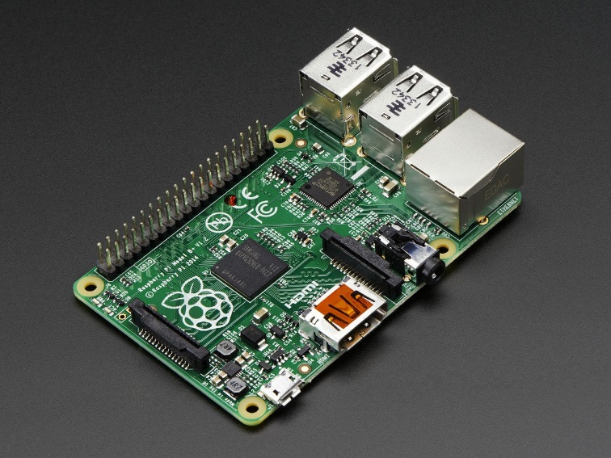
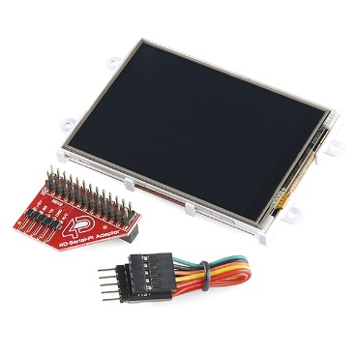

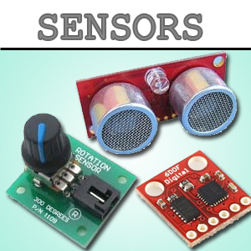
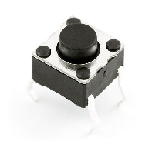
3. SYSTEM OVERVIEW
Fan
RASPBERRY
PC
Particles Sensor
LCD Screen & Buttons
Photocell

Slide 5
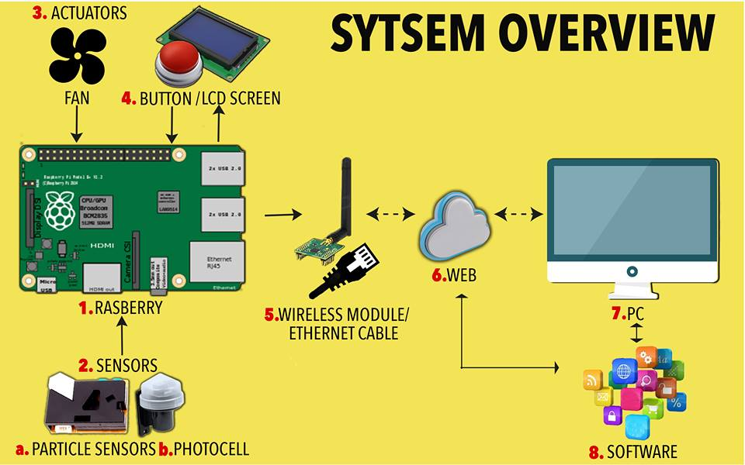
More in the datail…

Slide 6
SW GENERAL SCHEME
SENSORS INTERFACE
DB MANAGER
DB SERVER
MAIN
AUTOMATIC REGULATIONS MANAGER
ACTUATORS INTERFACE
WEBPAGE
USER INTERFACE MANAGER
USER ACCOUNT
W
W
Stands for «web» and indicates that an internet connection is required

Slide 7
4. TECHNICAL HIGHLIGHTS (AmI steps)
SENSING
The air will be constantly monitored (with focus on detecting the presence of substances which can be considered dangerous for the health of the subject) through the ad hoc sensors placed in the room and so will be for temperature and humidity.
Reasoning
On the base of what the sensors read, the system will analyse data and detect dangerous situations from which an attack could grow up
ACTING
If a hot situation is detected during the reasoning phase the system will aim at adjusting the air composition in the room.
INTERACTING
Our device will constantly keep the user informed of what it is doing, both via LCD screen and via web, but there is more. In order to optimize its future behavior the device will is subject to regulations by the user, which can be done in the two described ways.

Slide 8
5. CONCLUSIONS

