Slide 1
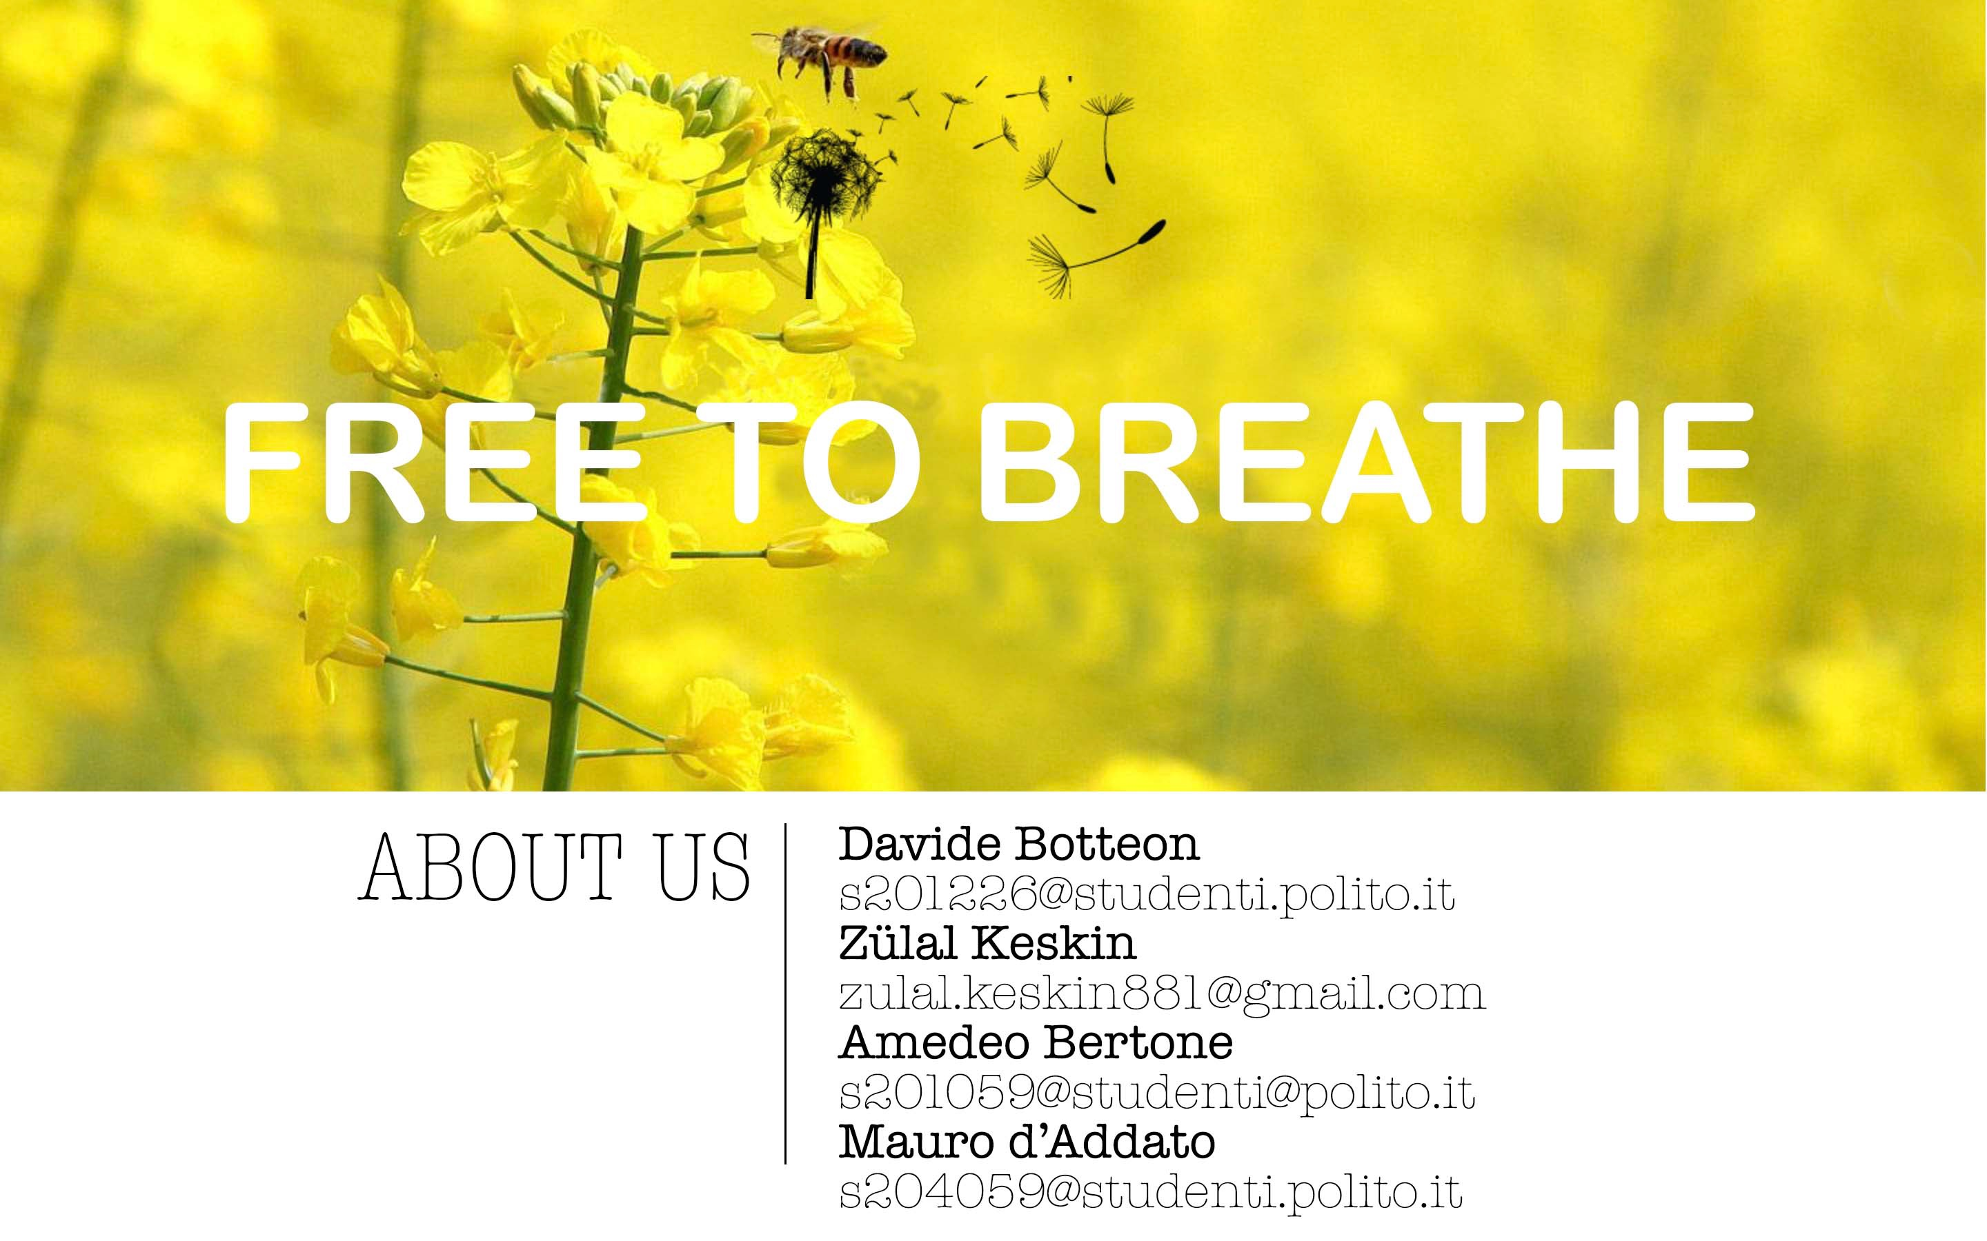
none
https://ami-2016.github.io/FtB

Slide 2

1.THE PROBLEM
none
FREE TO BREATHE: interacting monitoring system thought for people affected by allergies, with the aim of supporting them in their daily life by making a safe area out of their home.
WHY? It is studied that one of the main causes of allergic attacks is the presence in the air of allergenic substances (such as mites, pollen and mold), but also of chemical substances (contained for example in cigarette smoke or perfumes).
Wouldn’t it be better if there was a system capable of reducing the amount of these substances in a room?

Slide 3
2.PROJECT IDEA
none
How does FtB will be able to free the room from the microscopic substances which can cause allergy?
The steps are quite simple:
Sensors analyze the conditions of the room
Through the data provided by the sensors a suitable program will provide the actuators with the information they need to do their job
The actuators will clean the air if the data flow coming from the program running on the system will highlight the need to intervene

Slide 4
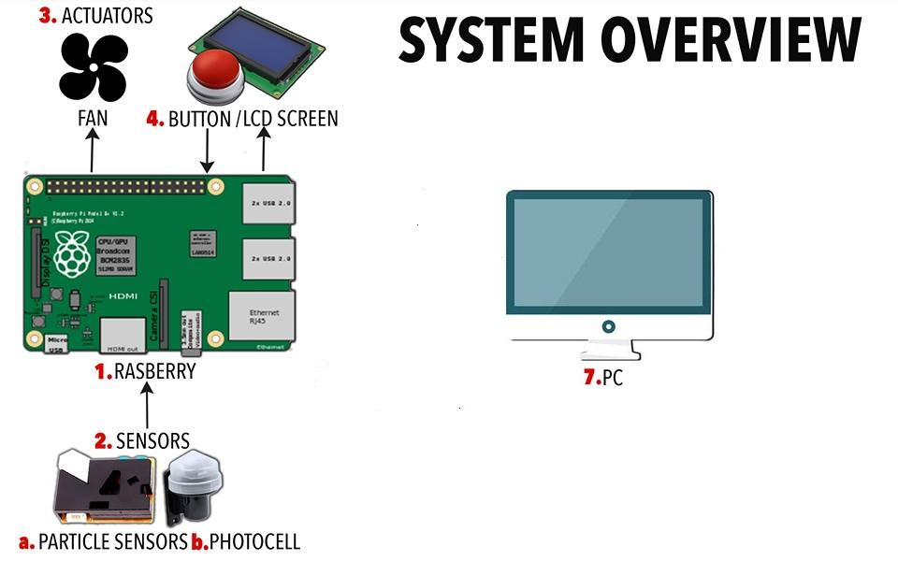
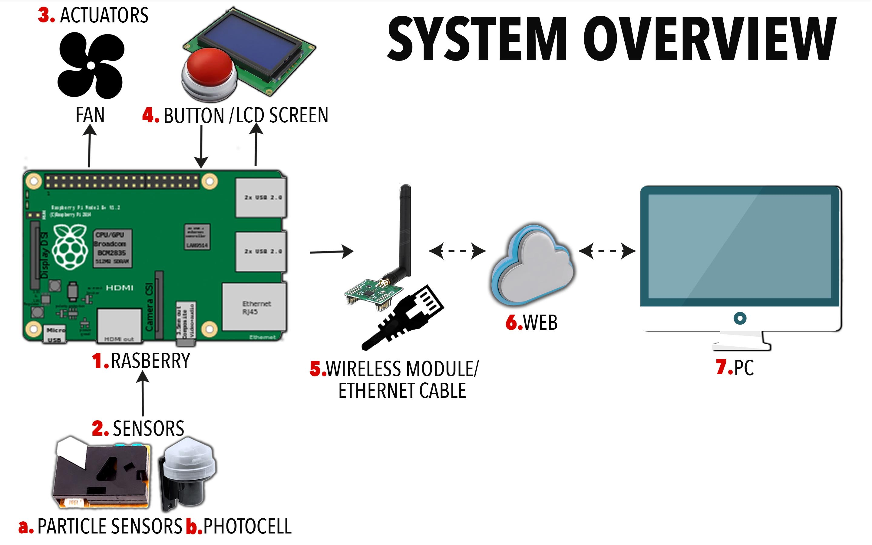

1.THE PROBLEM
FREE TO BREATHE: interacting monitoring system thought for people affected by allergies, with the aim of supporting them in their daily life by making a safe area out of their home.
WHY? It is studied that one of the main causes of allergic attacks is the presence in the air of allergenic substances (such as mites, pollen and mold), but also of chemical substances (contained for example in cigarette smoke or perfumes).
Wouldn’t it be better if there was a system capable of reducing the amount of these substances in a room?
W
W
stands for «web» and indicates that an internet connection is required

Slide 5
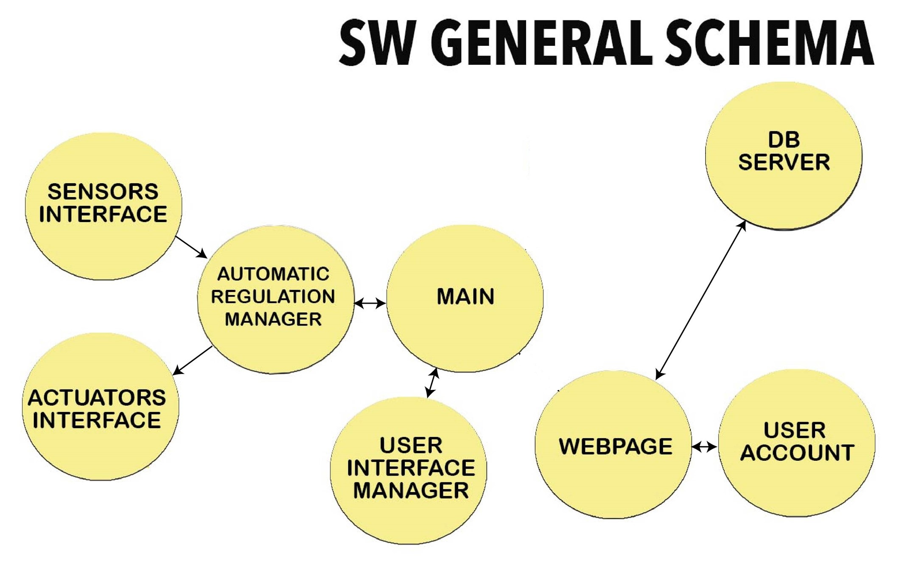
1.THE PROBLEM
E
W
stands for «web» and indicates that an internet connection is required
W
FREE TO BREATHE: interacting monitoring system thought for people affected by allergies, with the aim of supporting them in their daily life by making a safe area out of their home.
WHY? It is studied that one of the main causes of allergic attacks is the presence in the air of allergenic substances (such as mites, pollen and mold), but also of chemical substances (contained for example in cigarette smoke or perfumes).
Wouldn’t it be better if there was a system capable of reducing the amount of these substances in a room?

Slide 6
4.TECHNICAL HIGHLIGHTS(Aml steps)
SENSING
The air will be constantly monitored (with focus on detecting the presence of substances which can be considered dangerous for the health of the subject) through the ad hoc sensors placed in the room.
Reasoning
On the base of what the sensors read, the system will analyse data and detect dangerous situations from which an attack could grow up.
ACTING
If a hot situation is detected during the reasoning phase the system will aim at adjusting the air composition in the room through the sensors installed.
INTERACTING
Our device will constantly keep the user informed of what it is doing, both via LCD screen and via web, but there is more. In order to optimize its future behavior the device will be subject to regulations by the user, which can be done in the two described ways.
NONE

Slide 7
5.CONCLUSIONS
FtB is mainly intended to be a valuable help in everyday life: it will constantly scan the room in order to avoid the incoming of an allergic attack and it will do it responding to the needs of the user, who can provide to suitable regulations in order to make the device act as it most pleases him.
On the other hand, FtB wants to be a smart device, not simply an automatic device: it will analyze the conditions of the environment where it is placed in a crytical way, in order to avoid useless actions. To make it clear with an example: if during the pollen season a window is open it will be useless to activate a system of fans in order to recyle the air, so FtB won’t do it, on the contary it will inform you that you’d better close it!

