Slide 1
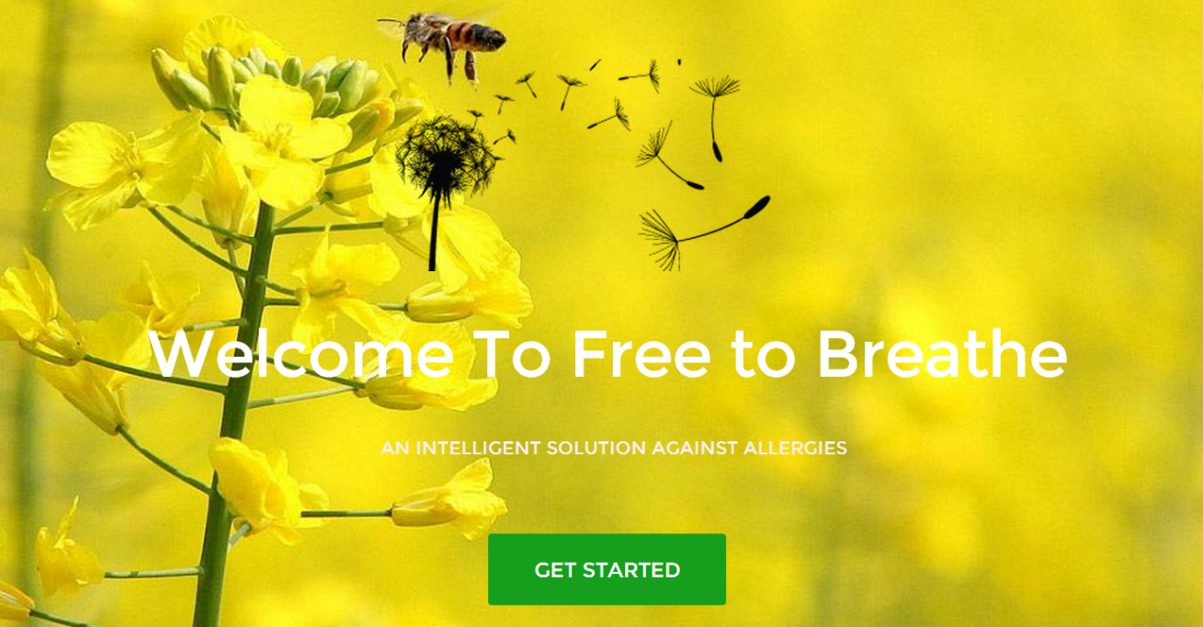
FREE TO BREATHE
Davide Botteon, s201226@studenti.polito.it
Zülal Keskin, zulal.keskin881@gmail.com
Mauro d’Addato, s201511@studenti.polito.it
Amedeo Bertone, s204059@studenti.polito.it
https://ami-2016.github.io/FtB

Slide 2
1. THE PROBLEM
FREE TO BREATHE: interacting monitoring system thought for people affected by allergies, with the aim of supporting them in their daily life by making a safe area out of their home.
WHY? It is studied that one of the main causes of allergic attacks is the presence in the air of allergenic substances (such as mites, pollen and mold), but also of chemical substances (contained for example in cigarette smoke or perfumes).
Wouldn’t it be better if there was a system capable of reducing the amount of these substances in a room?

Slide 3
2. PROJECT IDEA
How does FtB will be able to free the room from the microscopic substances which can cause allergy?

Slide 4

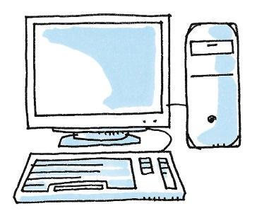
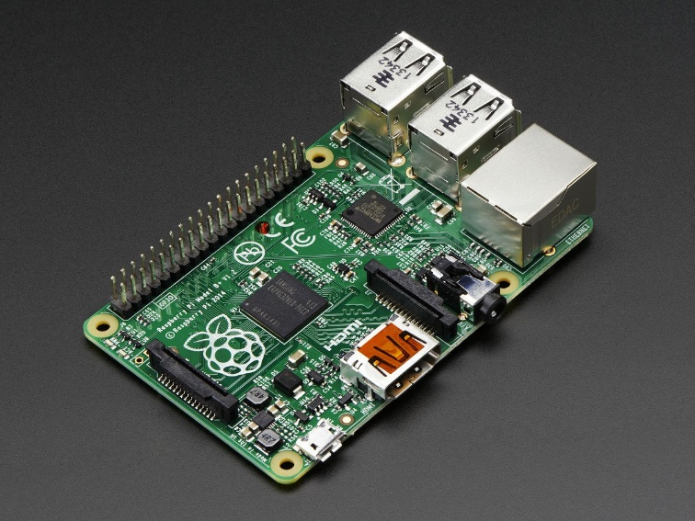
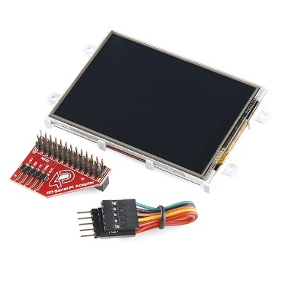

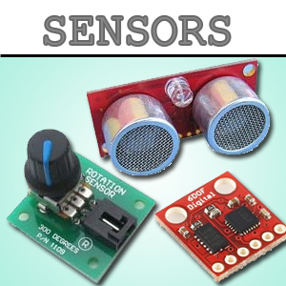
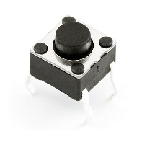
3. SYSTEM OVERVIEW
Fan
RASPBERRY
PC
Particles Sensor
LCD Screen & Buttons
Photocell

