Slide 1
HOTEL BUSINESS DATA ANALYSIS
Investigate Hotel Business
Using Data Visualization
Understanding Booking & Cancellation Behaviour · 2017–2019
Python · Pandas · NumPy · Matplotlib · Seaborn · Jupyter Notebook
01
Notes:
Good [morning/afternoon] everyone. Today I'm walking you through a data analysis project: Investigate Hotel Business Using Data Visualization — a look at what drives guests to book, and more importantly, what drives them to cancel, across two hotel properties from 2017 to 2019.

Slide 2
What We'll Cover
01
Why Booking Behaviour Matters
The business case for this analysis
02
The Dataset & Cleaning Process
119,390 bookings, cleaned to 85,962
03
Three Business Questions, Answered
Hotel type · Stay duration · Lead time
04
Deeper Signals
Customer type, channel, pricing patterns
05
Recommendations
Five data-backed actions for the business
02
Notes:
Here's the roadmap. I'll start with why this matters commercially, then walk through the dataset and how we cleaned it, answer three core business questions, share a few deeper signals we found along the way, and close with concrete recommendations.

Slide 3
Every Cancellation Is Lost Revenue
A cancelled booking isn't just an empty room — it's wasted marketing spend, a missed resale window, and a gap in the forecast a hotel already planned around.
THE CORE QUESTIONS
1
Which hotel type is booked most — and when?
Revenue Management
Set rates and minimum-stay rules by season and lead time
Overbooking Strategy
2
Does length of stay affect cancellation risk?
Calibrate inventory against expected cancellation risk
Marketing Investment
Balance OTA spend against direct-booking incentives
3
Does lead time affect cancellation risk?
Guest Communication
Target reminders and deposits at the riskiest bookings
03
Notes:
Let's start with why this matters. A cancelled booking isn't just an empty room for one night — it's wasted marketing spend to acquire that guest, a missed window to resell the room, and a hole in a forecast the hotel already staffed and priced around. Understanding booking behaviour feeds directly into revenue management, overbooking strategy, marketing spend, and guest communication. And this whole project is anchored around three core questions: which hotel type is booked most and when, does length of stay affect cancellation risk, and does lead time affect cancellation risk.

Slide 4
The Dataset
A real-world hotel booking log spanning two properties and three years.
119,390
29
2017–2019
2
Total Bookings
Features per Booking
Period Covered
Hotel Properties
Columns most relevant to this analysis:
• hotel — City or Resort
• is_canceled — cancellation flag
• lead_time — days before arrival
• stays_in_*_nights — length of stay
• adr — average daily rate
• customer_type & market_segment
04
Notes:
The dataset itself is a real-world hotel booking log: 119,390 bookings, 29 features each, spanning three full years across a City Hotel and a Resort Hotel. The columns that matter most for our questions are things like hotel type, the cancellation flag, lead time, length of stay, average daily rate, and customer and market segment.

Slide 5
Getting the Data Analysis-Ready
Impute
Deduplicate
Standardize
Filter Anomalies
Engineer
Missing children, city, agent, company
➜
Drop exact duplicate rows
➜
'Undefined' meal → 'No Meal'
➜
Invalid ADR & zero-occupancy rows
➜
total_stay = weekend + weekday nights
85,962
clean, analysis-ready bookings remained after removing duplicates,
invalid rates, and zero-guest records — a 28% reduction from the raw file.
05
Notes:
Before any analysis, we had to clean this data. We imputed missing values in columns like children, city, agent and company — in each case, a blank value turned out to mean something specific, like 'booked without an agent,' not just 'unknown.' We dropped duplicate rows, standardized the 'Undefined' meal category into 'No Meal,' and filtered out anomalies — negative or extreme prices, and bookings with zero guests recorded. We also engineered a total_stay feature. After all that, we were left with 85,962 clean, analysis-ready bookings — about a 28 percent reduction from the raw file.

Slide 6
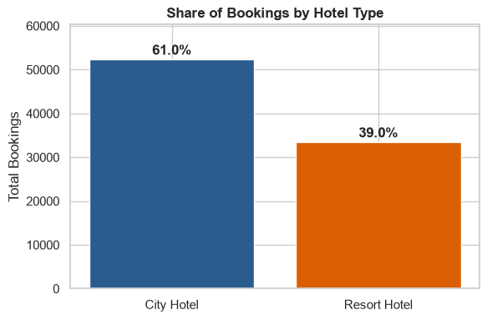
Q1 · Which Hotel Do Guests Book?
The City Hotel dominates demand
61.0% of all bookings go to the City Hotel, versus 39.0% for the Resort Hotel.
For every 2 City Hotel bookings, the Resort Hotel receives roughly 1 — a meaningful, consistent gap across the full three-year window.
Why it matters
Inventory, staffing, and marketing budgets should weight toward the City Hotel — but its higher cancellation rate (next slide) means that volume needs careful risk management.
06
Notes:
Now, question one: which hotel do guests actually book? The City Hotel dominates, with 61 percent of all bookings versus 39 percent for the Resort. That's roughly two City Hotel bookings for every one Resort booking, consistently across the full three years.

Slide 7
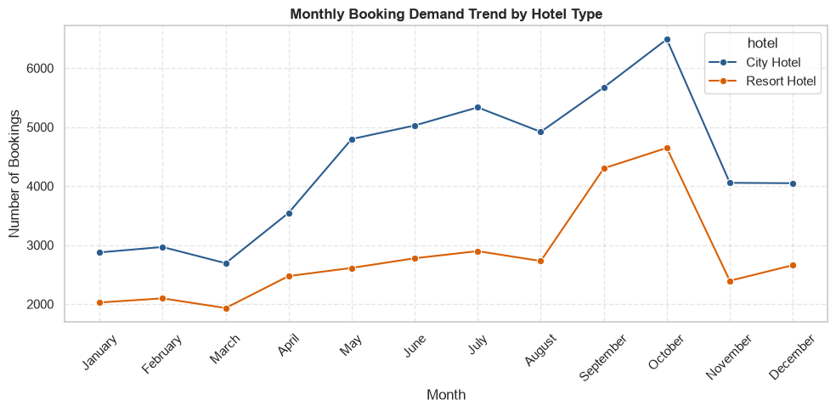
Q1 · When Do They Book?
City Hotel
Sharp climb to an October peak (~6,500), then a steep November drop — a business-travel pattern.
Resort Hotel
Smoother summer build, peaking Sept–Oct (~4,300–4,650) — a classic leisure pattern.
Both properties trough in winter (Jan–Mar) — the natural window for renovation or promotions.
07
Notes:
And when do they book? Both properties trough in winter and build toward an autumn peak, but the shape is different. The City Hotel climbs sharply to an October peak around 6,500 bookings, then drops off a cliff in November — a pattern that looks like business travel and conferences. The Resort Hotel has a smoother, more classic leisure curve, building through summer and peaking a bit later, in September and October.

Slide 8
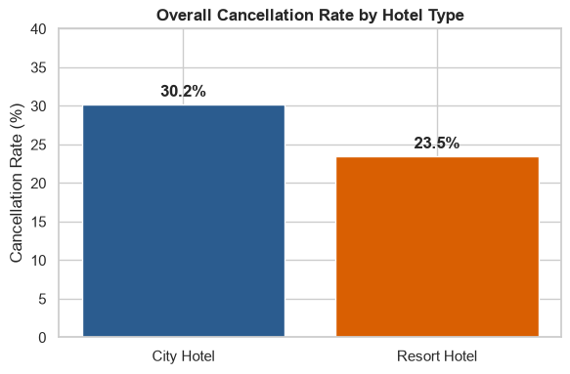
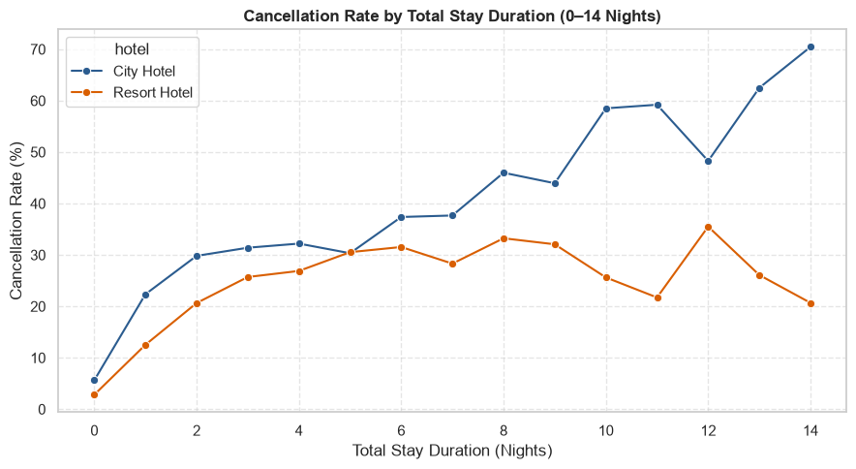
Q2 · Does Stay Length Predict Cancellation?
30.2%
23.5%
City overall
cancellation rate
Resort overall
cancellation rate
Longer stays cancel more — sharply so at the City Hotel, which climbs from ~5% at one night to ~70% at fourteen nights. The Resort Hotel rises too, but plateaus in the 25–35% range.
08
Notes:
Question two: does stay length predict cancellation? Overall, the City Hotel cancels more often than the Resort — 30.2 percent versus 23.5 percent. And when we break that down by length of stay, the pattern is striking. At the City Hotel, cancellation risk climbs almost linearly, from about 5 percent for a one-night stay up to 70 percent for a fourteen-night stay. The Resort Hotel rises too, but far more gently, plateauing somewhere in the 25 to 35 percent range. Longer stays, especially at the City Hotel, behave more like speculative placeholders than firm commitments.

Slide 9
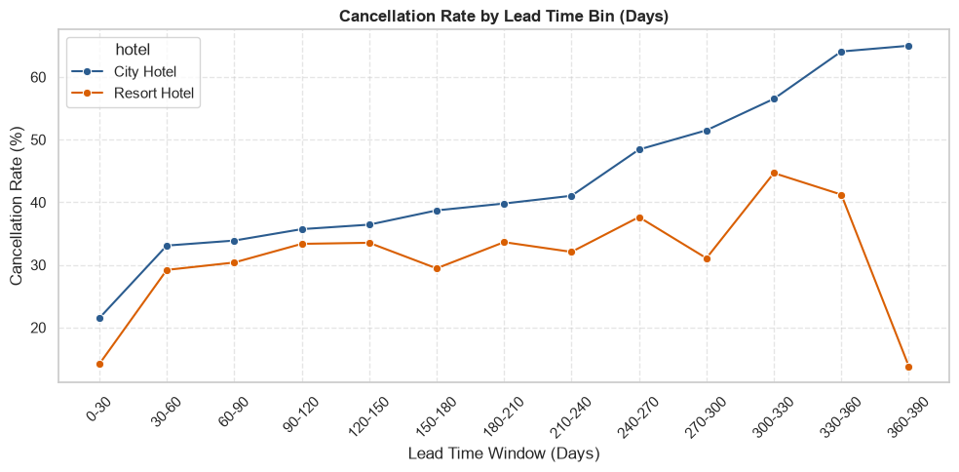
Q3 · Does Booking Early Increase Risk?
21.6% → ~65%
City Hotel cancellation rate, 0–30 days out vs. 360+ days out
The pattern is consistent: bookings made just before arrival rarely cancel — guests already know their plans are firm. The further out a booking sits, the more time there is for plans to change.
Resort Hotel stays comparatively flatter through the middle of the range — its guests commit earlier and more firmly.
09
Notes:
Question three: does lead time — how far in advance a booking is made — affect cancellation? Same story, same direction. Bookings made just before arrival rarely cancel, because the guest's plans are already locked in. But the further out the booking, the higher the risk — and at the City Hotel, bookings made a year or more in advance cancel at close to 65 percent, the single highest-risk segment we found anywhere in this data. The Resort Hotel stays comparatively flatter through the middle of that range.

Slide 10
Deeper Signals Behind the Numbers
3×
Personal/Transient guests cancel at 30.1% — three times the Business rate of 9.8%.
½
Guests who modify their booking cancel at half the rate: 15.7% vs. 30.2%.
75%
of bookings flow through Online & Offline Travel Agencies, not direct channels.
3×
Resort ADR triples from ~€58 in low season to ~€187 at the autumn peak.
10
Notes:
Beyond the three core questions, a few other signals sharpened the picture. Personal or transient guests cancel three times as often as Business guests. Guests who make even one change to their booking — a date, a room type — cancel at about half the rate of guests who never touch it; a modification is a strong signal of continued commitment. Seventy-five percent of all bookings come through Online or Offline Travel Agencies rather than direct channels. And Resort Hotel pricing is highly seasonal, roughly tripling from the low season to the autumn peak.

Slide 11
Key Findings
1
The City Hotel drives the majority of both volume (61%) and cancellations (30.2% vs. 23.5%).
2
Cancellation risk rises steadily with length of stay — steeply at the City Hotel, gently at the Resort.
3
Cancellation risk rises steadily with lead time, peaking near 65% for City bookings made a year out.
4
Personal guests, unmodified bookings, and OTA channels are consistently the highest-risk segments.
11
Notes:
So, pulling it together: the City Hotel drives the majority of both bookings and cancellations. Cancellation risk rises steadily with both stay length and lead time, more steeply at the City Hotel. And across every cut of the data, the same segments keep showing up as higher risk: personal guests, unmodified bookings, and OTA-sourced bookings.

Slide 12
Five Recommendations
1
2
3
Smooth the Season
Price Long Stays
Reach Far-Out Bookers
Spring promotions to lift Resort off-peak demand
Graduated deposits for 5+ night City bookings
Reminder sequence at 90 / 30 / 7 days for 180+ day lead times
4
5
Go Direct
Target by Segment
Incentives to cut 75% OTA dependency
Deposits for Personal guests; retention offers for Business/Contract
★ Highest impact: deposits on far-ahead City Hotel bookings — the single highest-risk segment identified (≈65% cancellation).
12
Notes:
That translates into five recommendations. Smooth the Resort's seasonal swing with spring promotions. Introduce graduated deposits for longer City Hotel stays. Automate a reminder sequence for bookings made far in advance. Invest in direct-booking incentives to reduce OTA dependency. And target retention offers at Business and Contract guests while reserving deposit requirements for the highest-risk Personal segment. If I had to pick just one lever to pull first, it's the deposit policy on far-ahead City Hotel bookings — that's the single highest-risk segment we found, and we already know from the booking-modification data that anything which increases guest commitment roughly halves cancellation risk.

Slide 13
Thank You
Questions & Discussion
Investigate Hotel Business Using Data Visualization · Python · Pandas · Matplotlib · Seaborn
13
Notes:
That's the analysis. Thank you — I'm happy to take any questions.

